Slide 1
MARQUIS TECHNOLOGIES
Drive Route

Slide 2
Delhi/India
Operator Details:
S. No. | Operator |  | Supported Bands | Supported Features by Network
1 | Major | Airtel | LTE FDD B3 & TDD B40/N78 | VoWiFi/VoLTE/4G/2G/5G
2 |  | JIO | LTE FDD B3/B5 & TDD B40/N78/N28 | VoWiFi/VoLTE/4G/5G
3 |  | VI | LTE FDD B1/B3 | VoLTE/4G/2G
4 | Minor | BSNL | LTE FDD B1 | 3G/2G

Slide 3
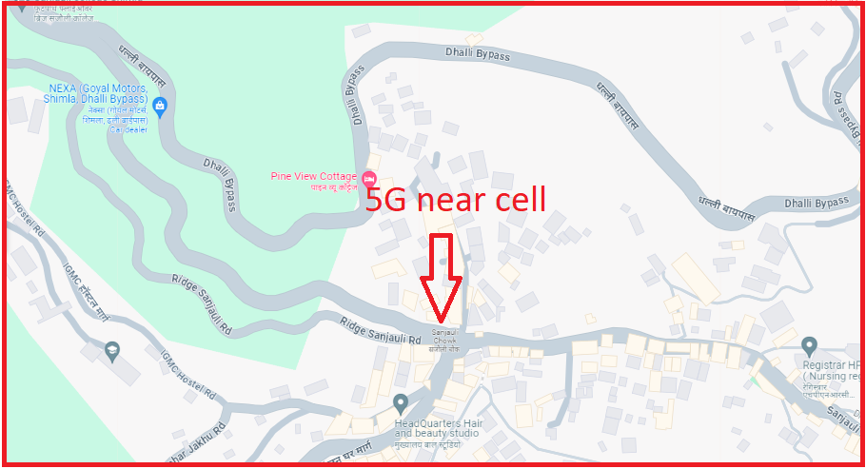
5G Near Cell ,Airtel
Lat/Long - 31.103692, 77.192880
Specification –Stable Airtel 5G NSA network
Good Throughput

Slide 4
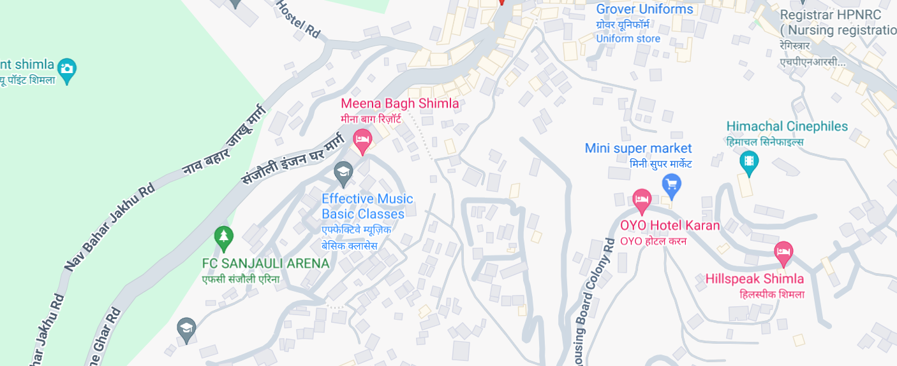
5G Weak Cell ,Airtel
Lat/Long - 31. 31.1009, 77.19042
Specification –Stable Airtel 5G NSA network
Weak Throughput
Airtel 5G NSA weak coverage

Slide 5
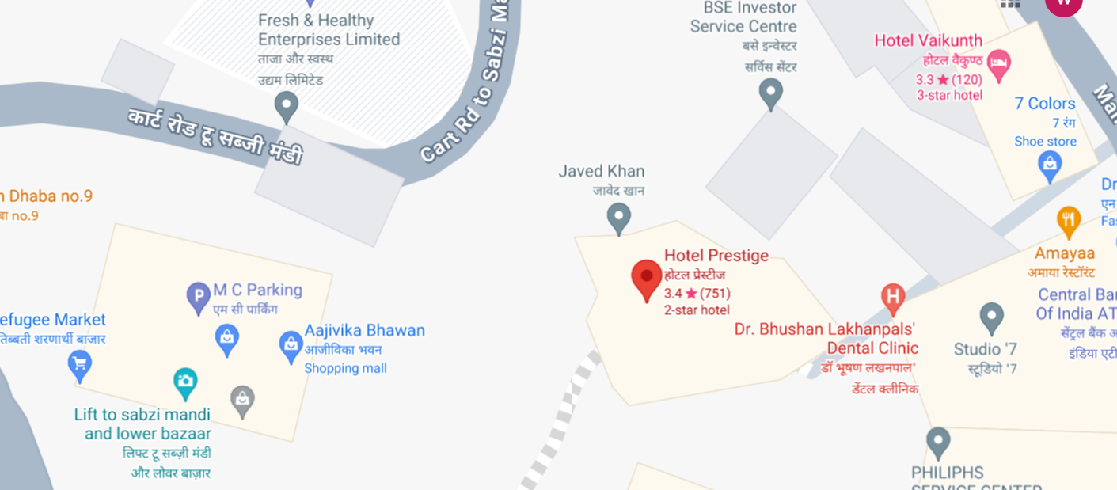
5G Near Cell ,Jio
Lat/Long - 31.102556, 77.176979
Specification –Stable Jio 5G SA network
Good Throughput
Jio 5G near call

Slide 6
5G Weak Cell ,Jio
Lat/Long - 31.102634, 77.176979
Specification –Stable Jio 5G SA network
Weak Throughput
Jio 5g Weak cell

Slide 7
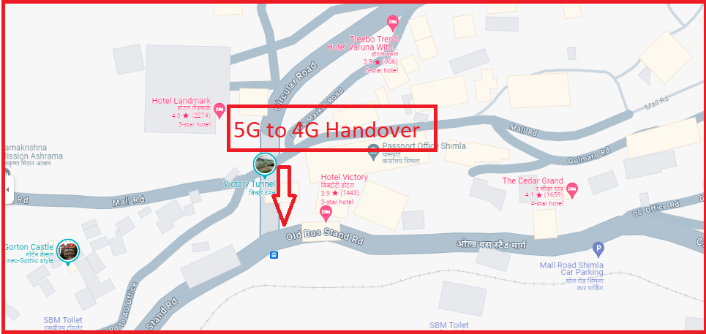
NR to LTE Handover, Airtel
Lat./Long. 31.104809, 77.164041
Location – Old bus stand road, Victory tunnel

Slide 8
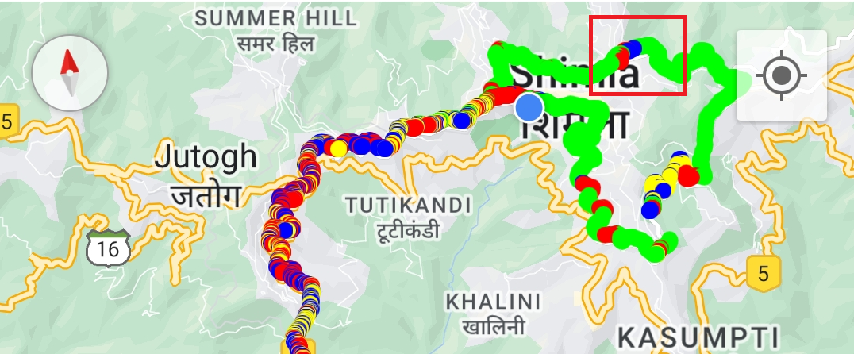
NR to LTE Handover, JIO
Lat. 31.105780 & Long. 77.175257 to Circular Road, lakkar bazzar Specification –Band Handover ,Weak coverage
NR to LTE HO

Slide 9
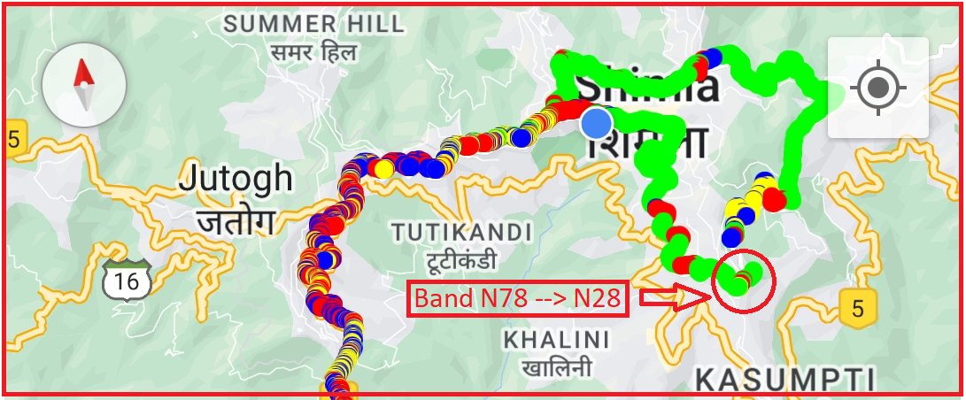
Inter-freq HO on NR ,JIO(n78-n28-n78)
Lat./Long. 31.087921/ 77.1810991 to
Lat./Long. 31.1091494/ 77.1650047 Location- Himachal Pradesh Secretariat, Circular Road

Slide 10
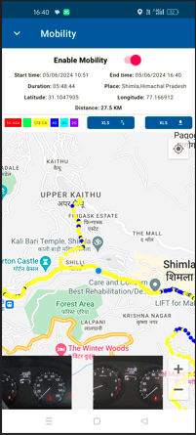
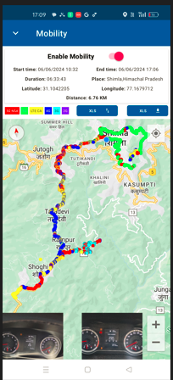
DRIVE ROUTE During VAFT Tool Automation
DAY 1 Day 2

Slide 11
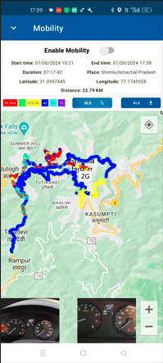
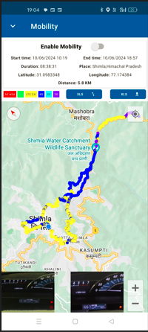
DRIVE ROUTE During VAFT Tool Automation
DAY 3 Day 4

Slide 12
THANK YOU
MARQUIS TECHNOLOGIES
www.marquistech.com

