Slide 1
MARQUIS TECHNOLOGIES
Drive Route

Slide 2
Riyadh/Saudi
Operator Details:
S. No. | Operator |  | Supported Bands | Supported Features by Network
1 | Major | STC | LTE FDD B1/B3/B8 & TDD B40/N78 | VoWiFi/VoLTE/4G/2G/5G
2 |  | ZAIN | LTE FDD B3/B5 & TDD B40/N78/N41 | VoWiFi/VoLTE/4G/5G
3 |  | Mobily | LTE FDD B3/B8 & TDD B41/N78 | VoLTE/4G/3G/2G/5G
4 | Minor | Salam | LTE FDD B1 | VoLTE/4G/3G/2G

Slide 3
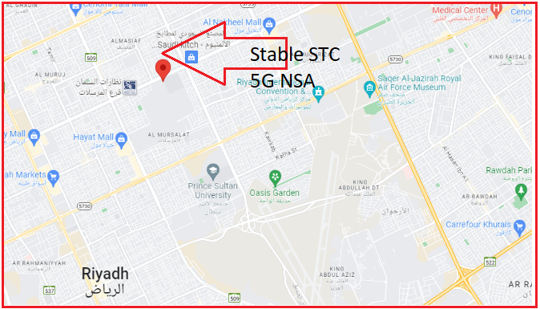
5G Near Cell,STC
Lat/Long -24°45'28.2"N 46°41'21.0"E
Specification –Stable STC 5G NSA network
Good Throughput

Slide 4
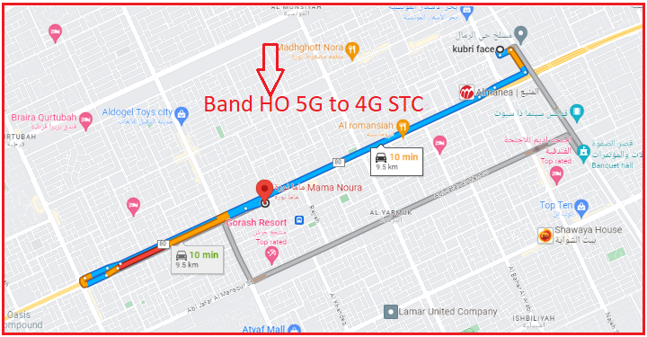
NR to LTE Handover ,STC
Lat. 24.81080650660474, 46.76350776953035 Location –DAMMAM Road Specification –Band Handover ,Weak coverage

Slide 5
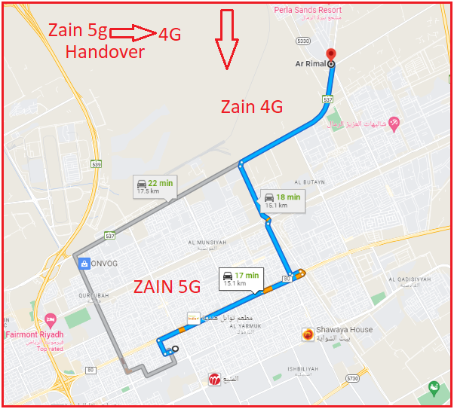
NR to LTE Handover ,ZAIN
24.887353535758475, 46.806360184561704 Location –AR Rimal Riyadh

Slide 6
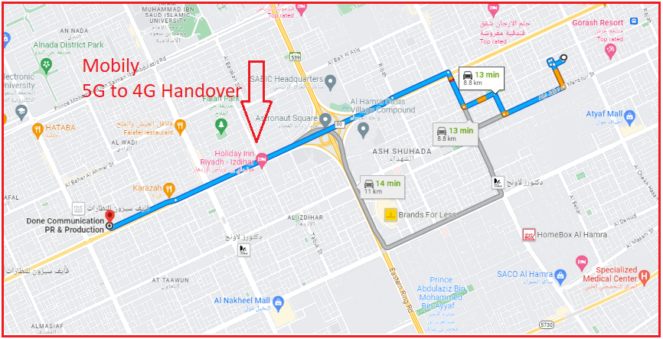
NR To LTE Handover, Mobily
24.78165197265917, 46.6897714608435 Lat. 28.591879 & Long. 77.375831

Slide 7
NR TO LTE TO NR Handover STC
Lat. 24.81080650660474,46.76350776953035 Location – Dammam Road

Slide 8
NR TO LTE TO NR Handover,Zain
24.887353535758475, 46.806360184561704

Slide 9
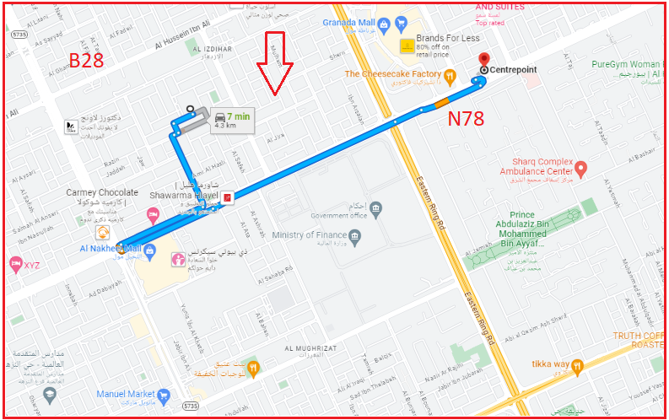
Inter-freq HO on NR ,STC(n78-n28-n78)
24.78022891242638, 46.73655923682119 Location – Near Centre Point Gharnata

Slide 10
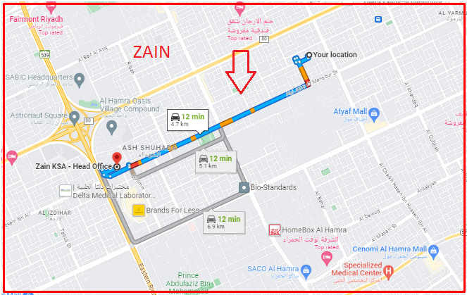
Inter-freq HO on NR ,Zain (n41-n1-n78)
24.787604207323746, 46.728353572165624 Location –Al Shuhada Park Riyadh

Slide 11
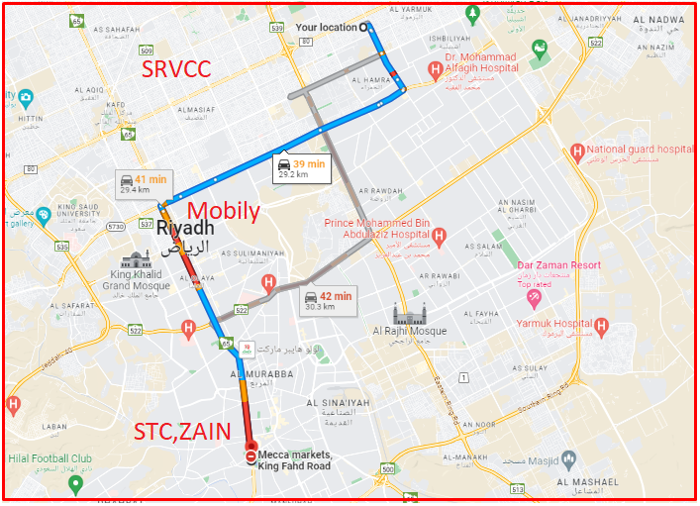
SRVCC(STC,ZAIN,Mobily)
24.627856328930644, 46.70621623517684. Location-Mecca Market Basement Specification –SRVCC,3G,3G Area

Slide 12
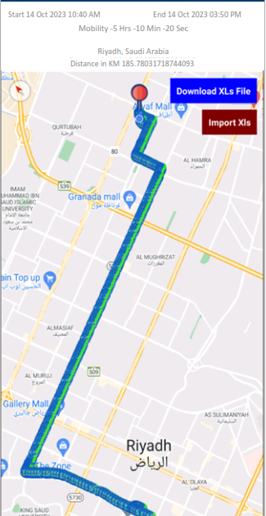
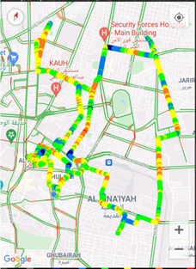
DRIVE ROUTE

Slide 13
THANK YOU
MARQUIS TECHNOLOGIES
www.marquistech.com

