Slide 1
MARQUIS TECHNOLOGIES
ROMANIA Drive Route

Slide 2
Drive Route ORANGE 4G/5G
Near Cell :-Stationary: RSRP: -60dbm to -75dbm
Mixed :-Mobility: RSRP : -75dbm to -95dbm
Cell Edge :-Stationary: RSRP : -95dbm to -115dbm

Slide 3
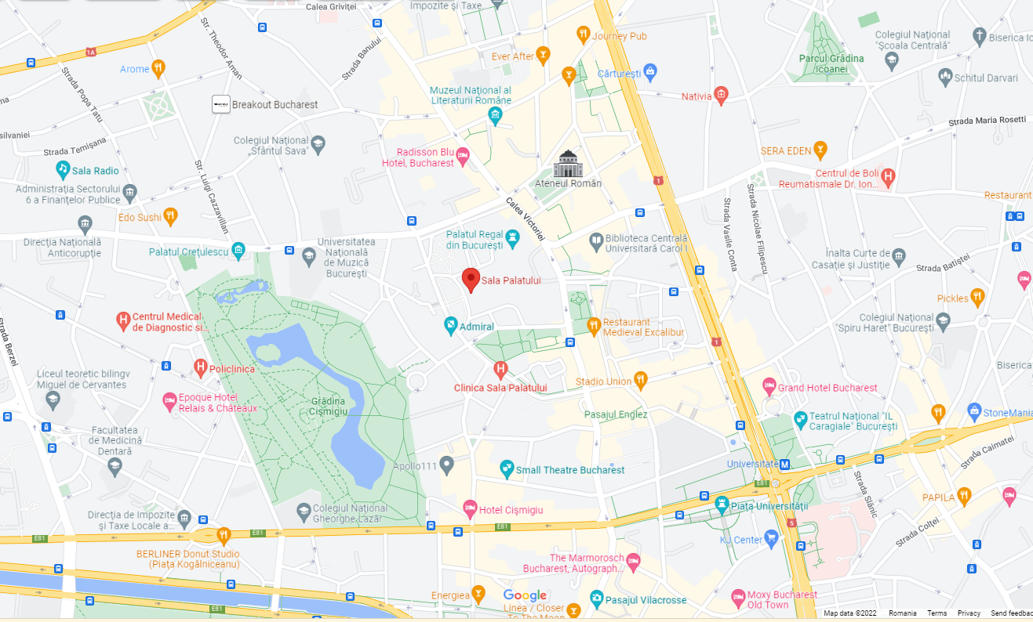
orange Band40(Near Cell):-sala palatului
Operator: orange
Band: 40
Cell ID: 2
E-ARFCN : 39025
RSRP: -60dBm to -75dBm
NC:1

Slide 4
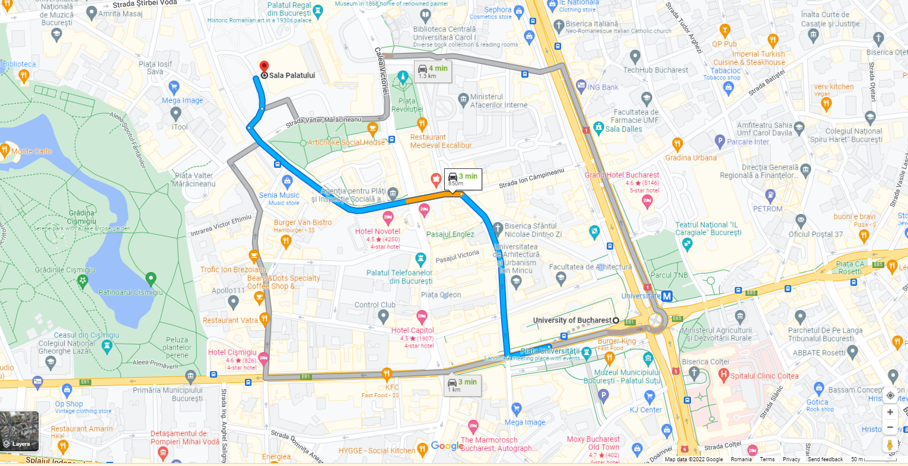
ORANGE Band40(Near Cell):-sala palatului ,universitate
Operator: orange
Band: 40
Cell ID: 2
E-ARFCN : 39025
RSRP: -95dbm to 115dbm
EC:1

Slide 5
orange Band N48(Near Cell):-sala palatului
Operator: orange
Band: N48
Cell ID: 2
E-ARFCN : 639648
RSRP: -60dBm to -75dBm
NC:1

Slide 6
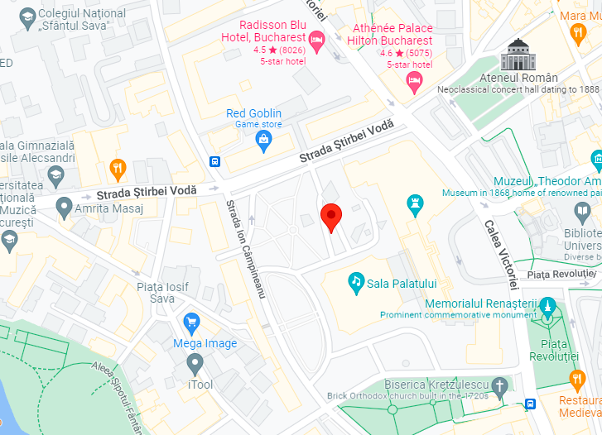
ORANGE N48 (Near Cell):- Sector 1, Bucharest 030167, Romania
Operator: orange
5G Band : N48
E-ARFCN : 634000, 639648
Cell ID: 2

Slide 7
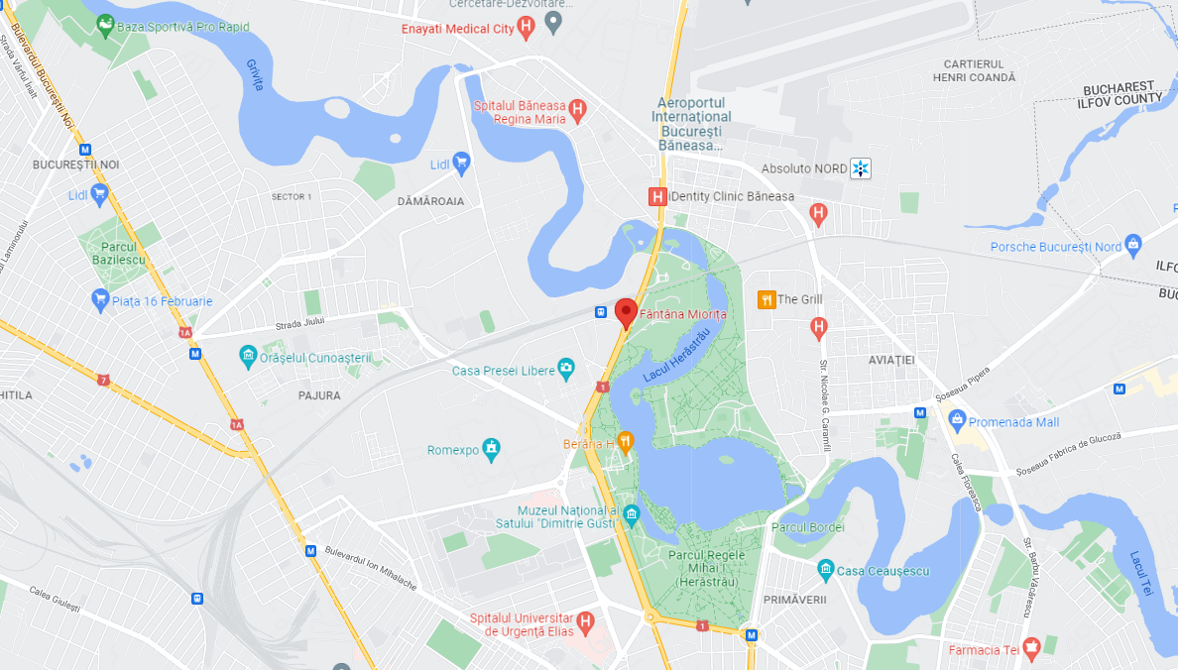
orange(Inter-frequency Band Handover):-fantana monta
Operator: orange
Band Handover: B40-B3-B40
E-ARFCN : 39025-1300-39025

Slide 8
Drive Route VODAFONE
Near Cell :-Stationary: RSRP: -60dbm to -75dbm
Mixed :-Mobility: RSRP : -75dbm to -95dbm
Cell Edge :-Stationary: RSRP : -95dbm to -110dbm

Slide 9
VODAFONE Band-40 (Near Cell)-SALA PALATULUI
Operator: VODAFONE 4G
Band: 40
Cell ID: 24
E-ARFCN : 38750
RSRP: -65dBm to -75dBm
NC:1

Slide 10
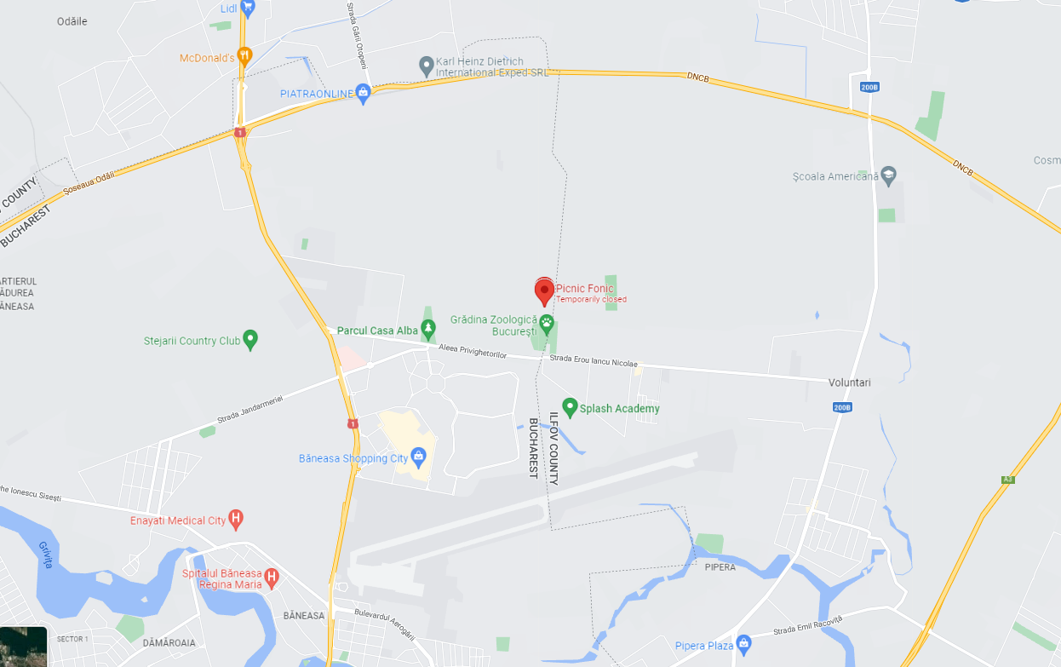
VODAFONE Band-40 (Edge Cell)
Operator: VODAFONE 4G
Band: 40
Cell ID: 50
E-ARFCN : 38750
RSRP: -95dBm to -110dBm
EC:1

Slide 11
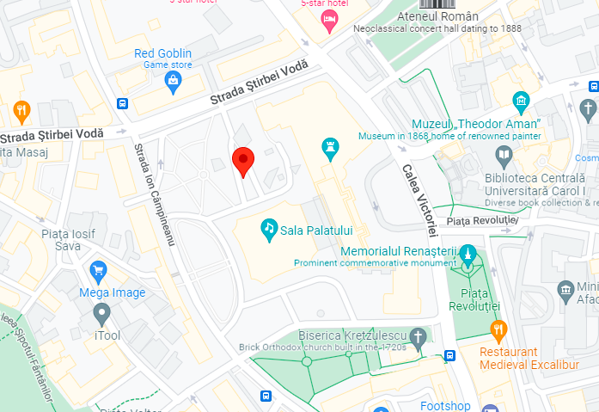
Vodafone N78 (Near Cell):- Sector 1, Bucharest 030167, Romania
Operator:Vodafone5G
5G Band : N78,
E-ARFCN : 634000
Cell ID: 2

Slide 12
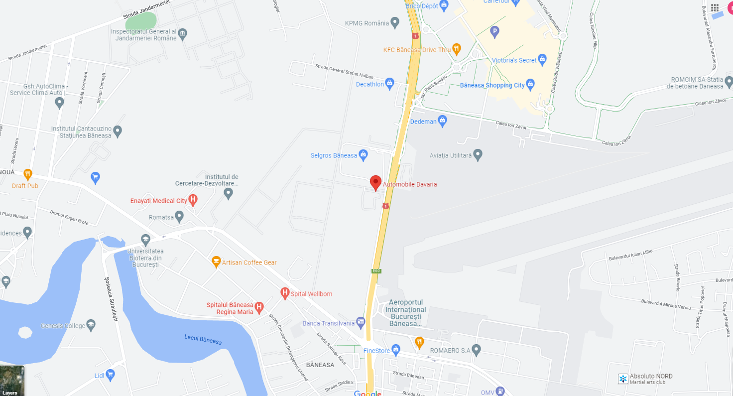
Inter-Frequency Band Reselection B40 to B3 to B5

Slide 13
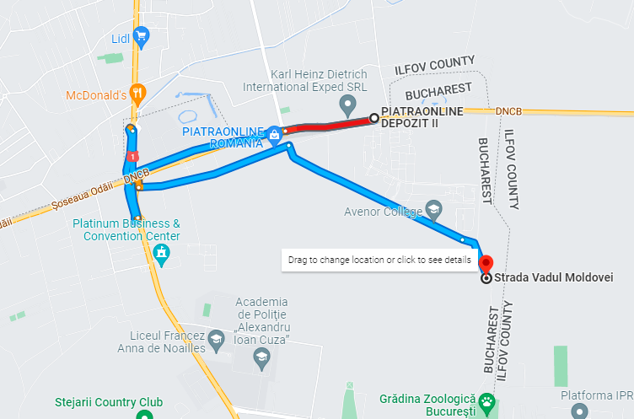
Vodafone (SRVCC):-
Operator: Vodafone
SRVCC
Strada Vadul
EC:3

Slide 14
Orange (SRVCC):-
Operator: Orange
SRVCC
Strada Vadul

Slide 15
THANK YOU
MARQUIS TECHNOLOGIES
www.marquistech.com

