Slide 1
MARQUIS TECHNOLOGIES
Drive Route

Slide 2
Riyadh/Saudi Arabia
Operator Details:
S. No. | Operator |  | Supported Bands | Supported Features by Network
1 | Major | STC | LTE FDD B1/B3/B8 & TDD B40/N78 | VoWiFi/VoLTE/4G/2G/5G
2 |  | ZAIN | LTE FDD B3/B5 & TDD B40/N78/N28 | VoWiFi/VoLTE/4G/2G/5G
3 |  | Mobily | LTE FDD B3/B8 & TDD B41/N78 | VoWiFi/VoLTE/4G/3G/2G/5G
4 | Minor | Salam | LTE FDD B3/B5 & TDD B40/N78/N28 | VoLTE/4G/2G/5G
5 | Minor | Redbull Mobile | LTE FDD B3/B5 & TDD B40/N78/N28 | VoLTE/4G/2G/5G

Slide 3
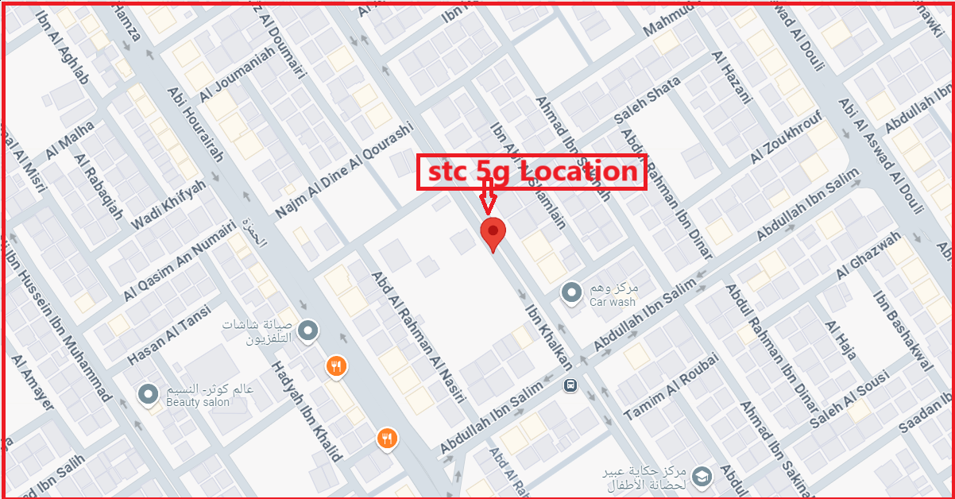
5G Near Cell,STC
Lat/Long -24.7433° N, 46.8353° E
Specification –Stable STC 5G NSA network
Good Throughput

Slide 4
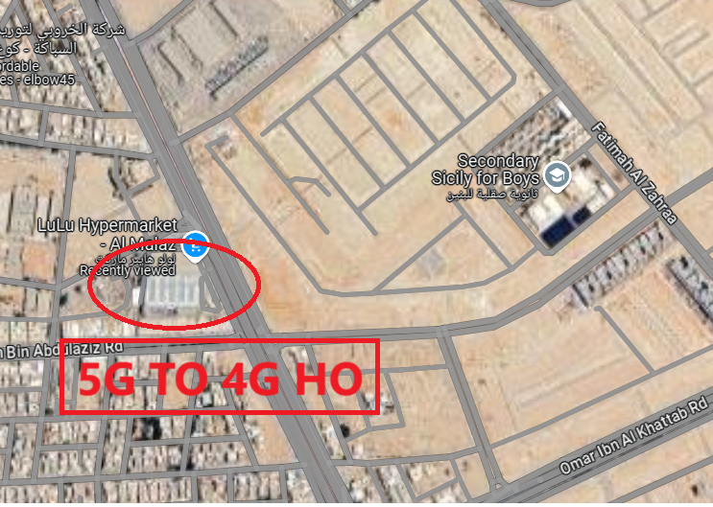
NR to LTE Handover ,STC
Lat. 24.659167, Long 46.751145 to Location –AL Malaz LULU Hyper Market Specification –Band Handover ,Weak coverage

Slide 5
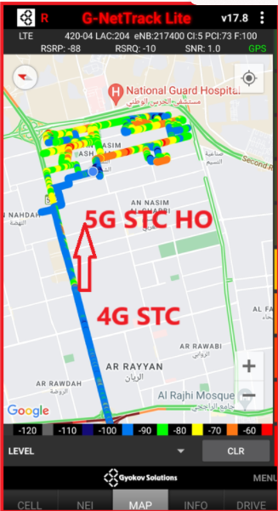
NR to LTE Handover ,STC
Lat. 24.75102 & Long. 46.81011 to
Lat. 24.75238 & Long. 46.82255 Location -Riyadh,

Slide 6
NR To LTE Handover, ZAIN
Lat. 24.659167, Long 46.751145 to Location –AL Malaz LULU Hyper Market Specification –Band Handover ,Weak coverage

Slide 7
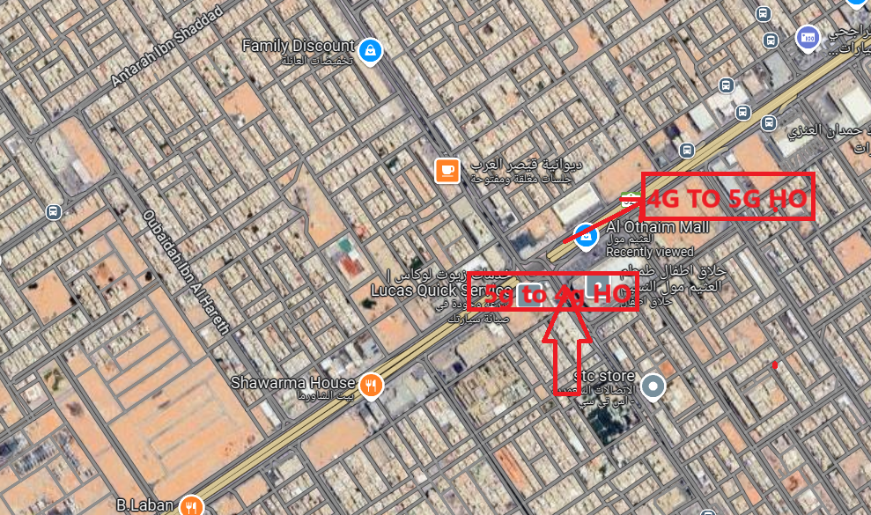
NR TO LTE TO NR Handover,Mobily
Lat. 24.74966, 46.82189 to
Lat. 24.752176, 46.822496

Slide 8
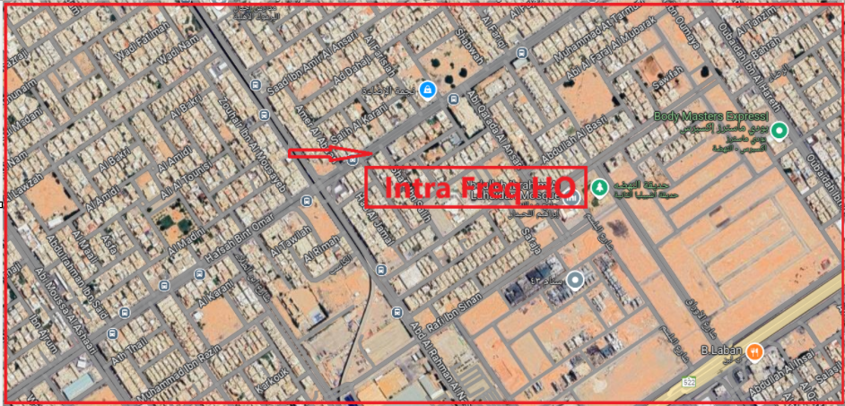
Inter-freq HO on STC (n78-n28)
Lat. Long. 24.749630, 46.80020 to
Lat. Long. 24.75165, 46.80351

Slide 9
Salam HO 5G To 4G
Lat. 24.659167, Long 46.751145 to Location –AL Malaz LULU Hyper Market

Slide 10
Redbull Mobile 5G To 4G HO
Lat. 24.659167, Long 46.751145 to Location –AL Malaz LULU Hyper Market

Slide 11
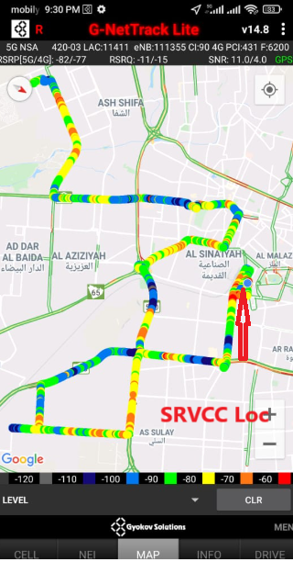
SRVCC(Mobily,ZAIN,Salam & Redbull Mobile)
Lat Long- 24.659167, Long 46.751145 Location-AL Malaz,LuLu Hyper Market,Riyadh Saudi Arabia Specification –SRVCC,

Slide 12
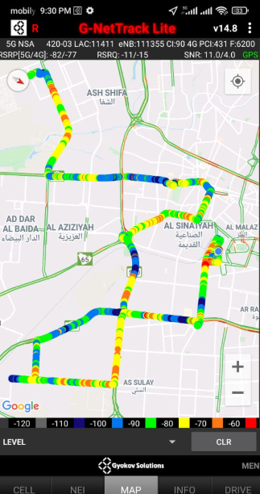
DRIVE ROUTE

Slide 13
THANK YOU
MARQUIS TECHNOLOGIES
www.marquistech.com

