Slide 1
MARQUIS TECHNOLOGIES
Drive Route

Slide 2
(Pune / India)
Country | India
Continent | Asia
City | Pune
Time Zone | +5:30

Slide 3
Operators in Location
MCC | MNC | Operator
405 | 864 | Jio
404 | 90 | Airtel
404 | 22 | VI

Slide 4
Operator 1 - JIO

Slide 6
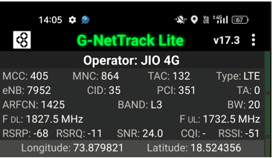
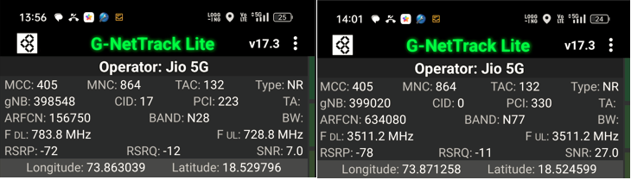
Good Coverage Screenshots
Operator: Jio
Band: B3 | B5 | B40 | N78 | N28

Slide 7
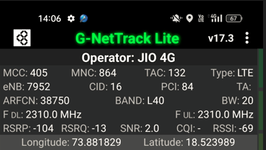
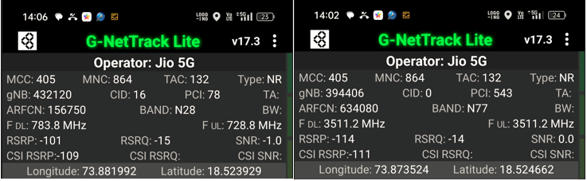
Weak Coverage Screenshots
Operator: Jio
Band: B3 | B5 | B40 | N78 | N28

Slide 8
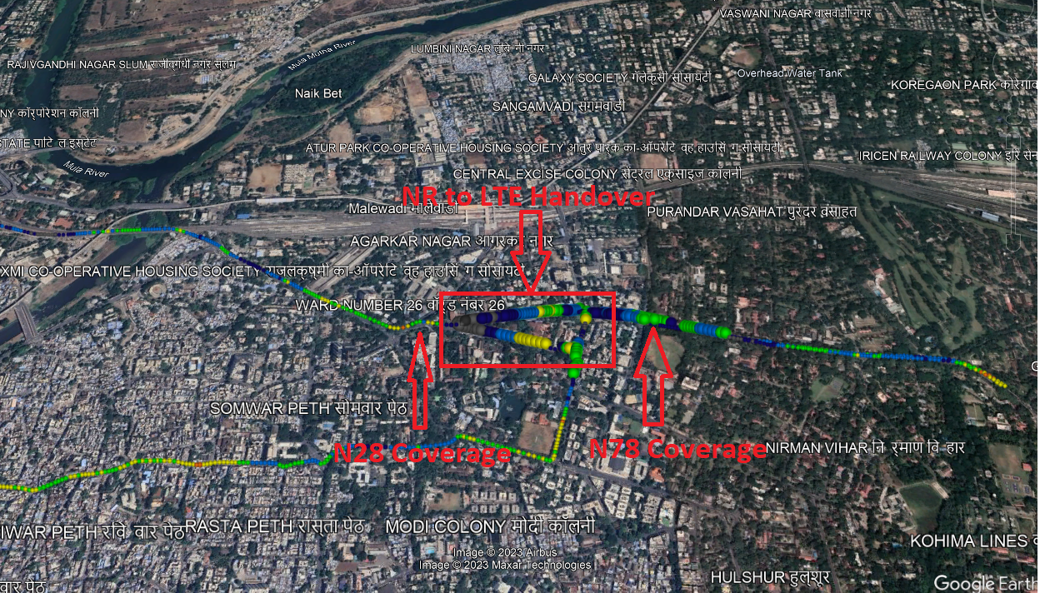
Band Handover – 5G to 4G
Operator: Jio
Band Handover: N78 – B40 – N78

Slide 9
Operator 2 - Airtel

Slide 11
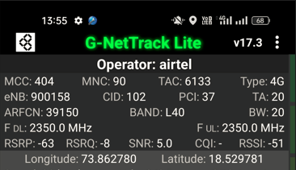
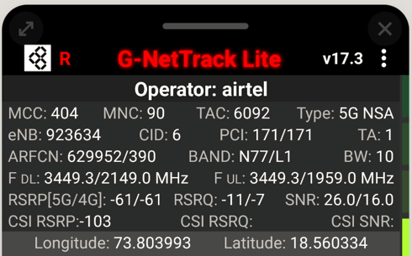
Good Coverage Screenshots
Operator: Airtel
Band : B3 | B8 | B40 | N78

Slide 12
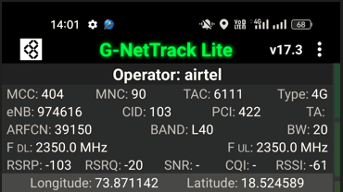
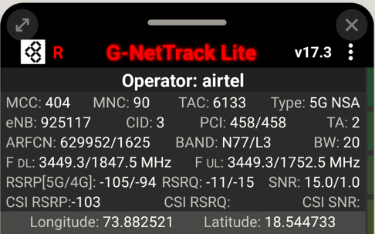
Weak Coverage Screenshots
Operator: Airtel
Band : B3 | B8 | B40 | N78

Slide 13
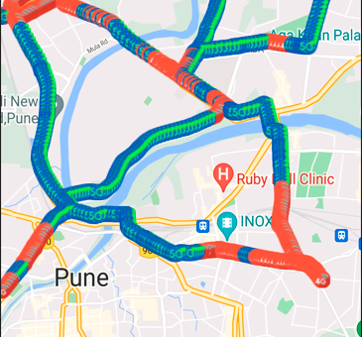
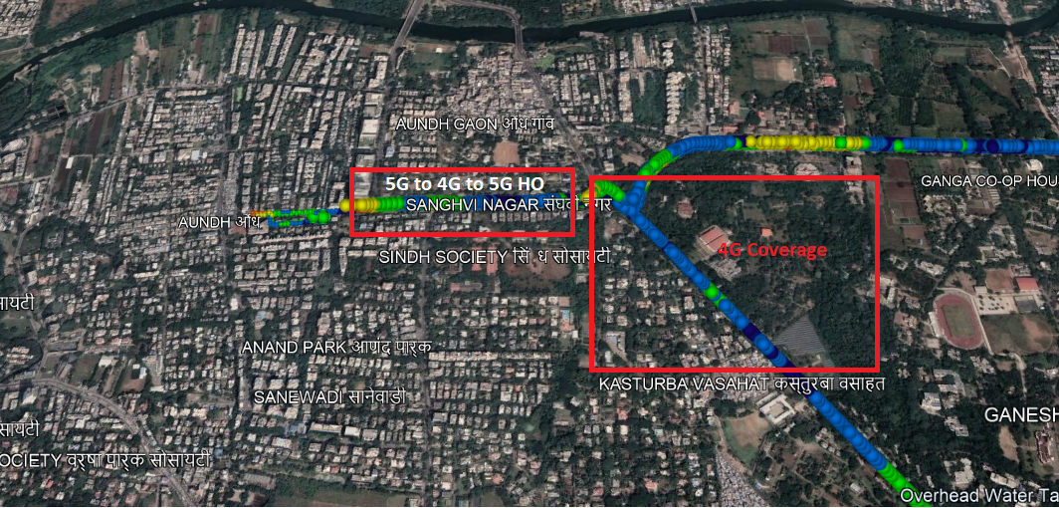
Band Handover – 5G to 4G
Operator: Airtel
HO : NSA to LTE to NSA

Slide 14
Operator 3 - VI

Slide 15
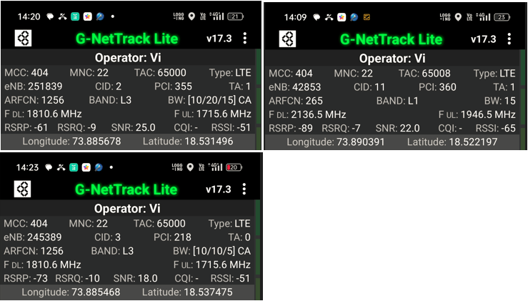
Good Coverage Screenshots
Operator: VI
Band : B1 | B3 | B8 | B40 | B41

Slide 16
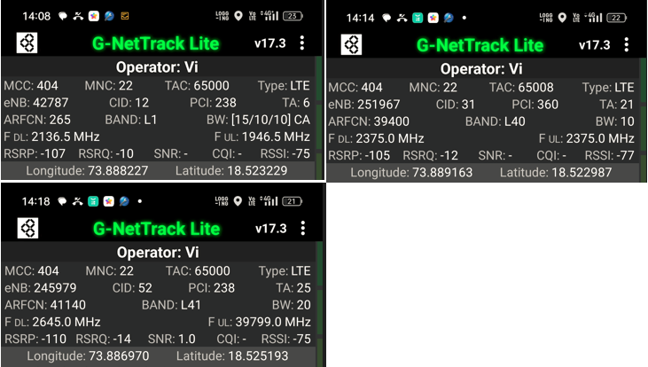
Weak Coverage Screenshots
Operator: VI
Band : B1 | B3 | B8 | B40 | B41

Slide 17
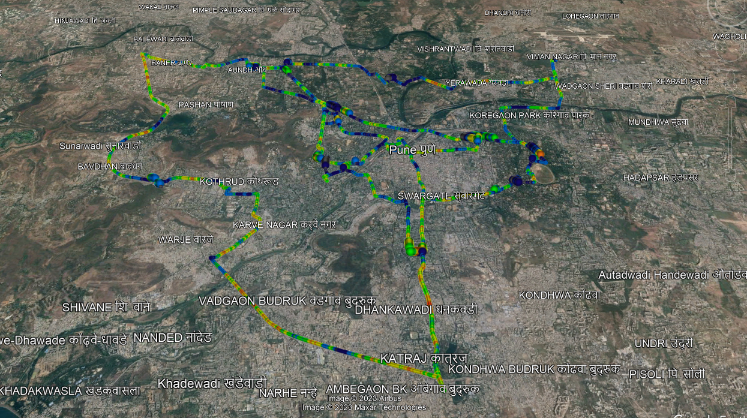
( Drive Route covered during mobility. )

Slide 18
THANK YOU
MARQUIS TECHNOLOGIES
www.marquistech.com

