Slide 1
MARQUIS TECHNOLOGIES
Drive Route

Slide 2
Phnom Penh/Cambodia
Operator Details:
S. No. | Operator |  | Supported Bands | Supported Features by Network
1 | Major | Smart | LTE B1/B3 & B1 | VoLTE/4G/3G/2G
2 |  | Metfone | LTE B3/B5/B7 & B1 | VoLTE/4G/3G/2G
3 |  | Seatel | B5 | VoLTE/4G

Slide 3
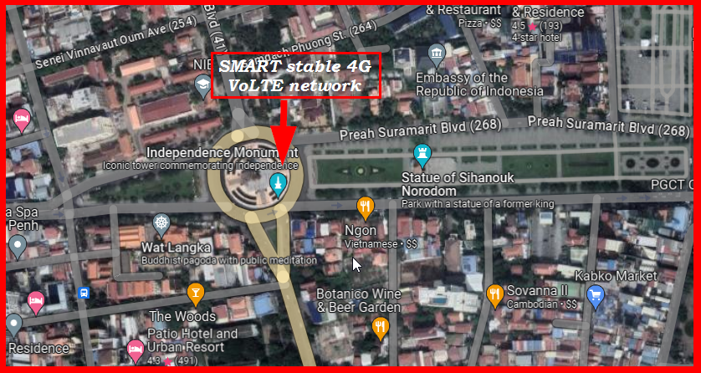
4G VoLTE Near Cell, Smart
Lat/Long -11.5565243841719, 104.92905029377191 Specification –Stable Smart 4G VoLTE network
Good Throughput

Slide 4
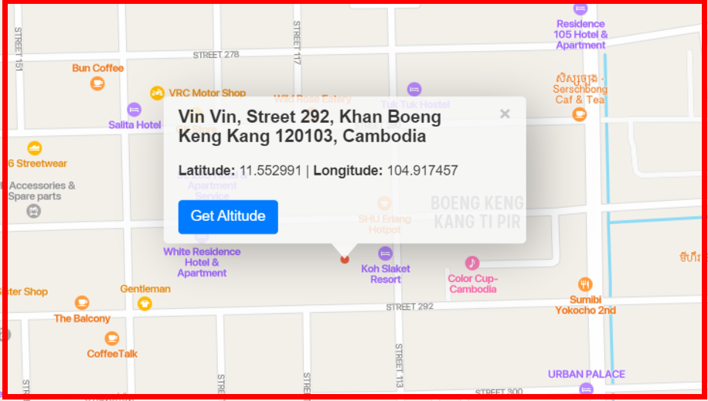
LTE Handover, Smart
Lat. 11.552991 & Long. 104.917457 to Location –Vin Vin, Street 292, Khan Boeng Keng Kang Specification –Band Handover, Weak coverage

Slide 5
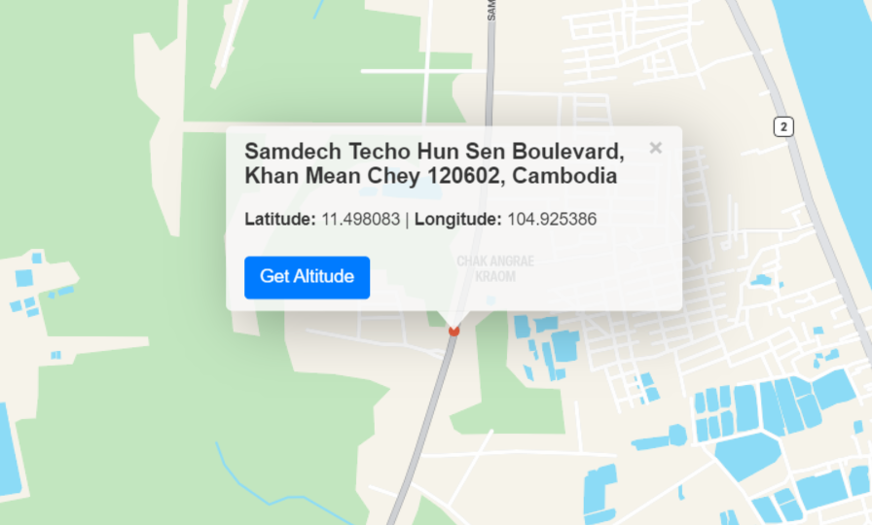
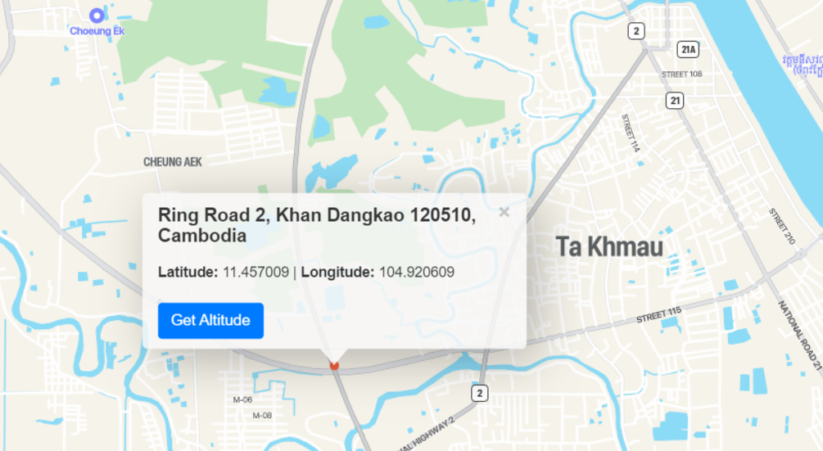
LTE to 3G Handover, Smart
Lat. 11.4980829,104.925386 to Lat. 11.49942015069751,104.93357640786294
Location – Samdech Techno Hun Sen Blv. To Ring Road 2

Slide 6
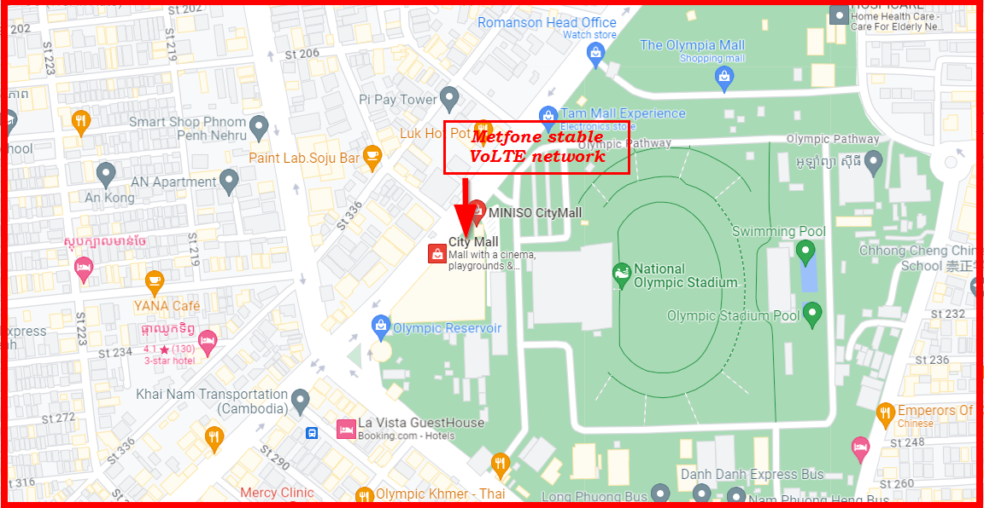
4G VoLTE Near Cell, Metfone
Lat/Long -11.559005564798847, 104.90948863684935 Specification –Stable Mefone 4G VoLTE network
Good Throughput

Slide 7
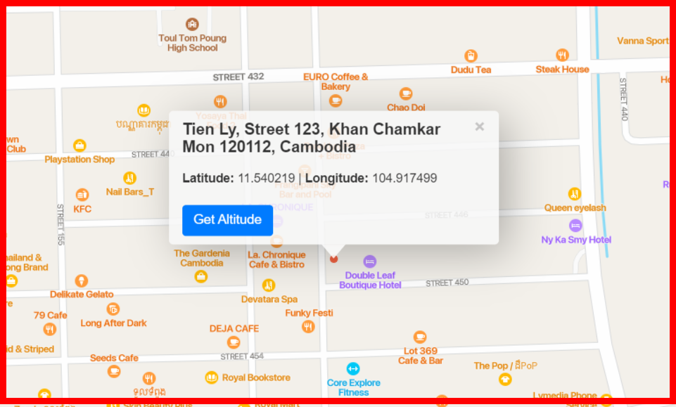
LTE Handover, Metfone
Lat. 11.540219 & Long. 104.917499 to Location – Tien Ly, Street 123, Khan Chamkar Mon Specification –Band Handover, Weak coverage

Slide 8
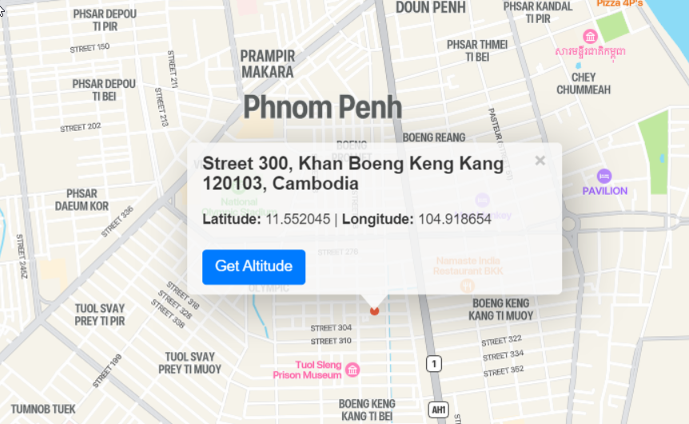
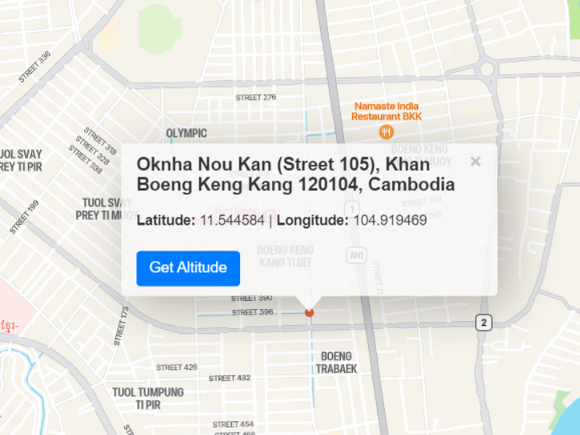
LTE to 3G Handover, Metfone
Lat. 11.5520451,104.9186542 to Lat. 11.544584,104.9194694
Location – Street 300, Khan BKK – Oknha Nou Kan BKK

Slide 9
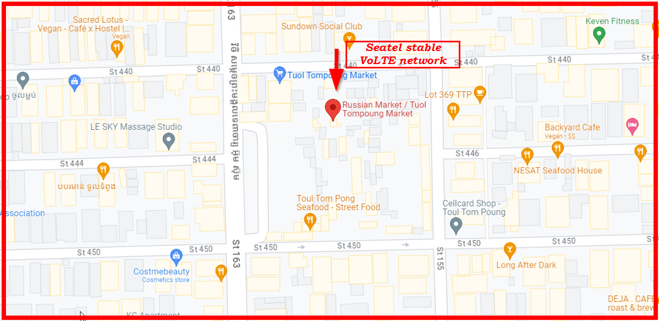
4G VoLTE Near Cell, Seatel
Lat/Long -11.540630798678643, 104.91467800440606 Specification –Stable Seatel 4G VoLTE network
Good Throughput

Slide 10
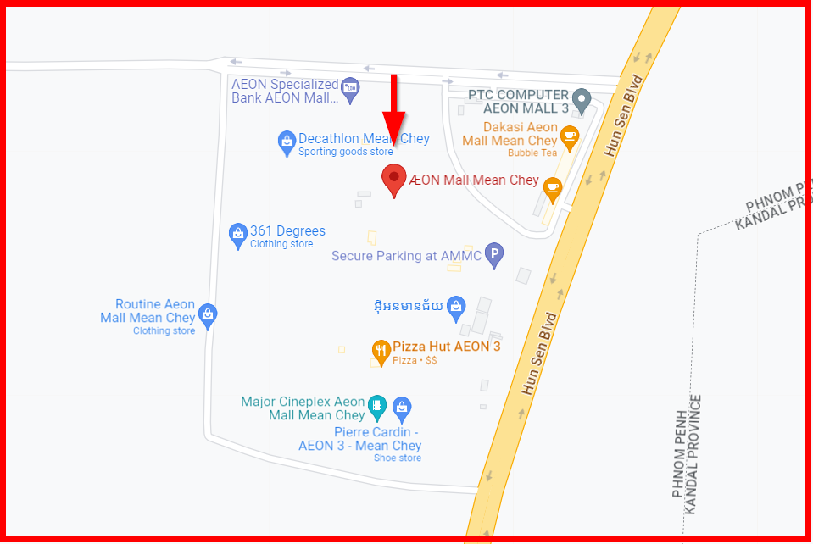
SRVCC (Smart, Metfone)
Lat Long- 11.485341234720583, 104.9183566982003 Location- ÆON Mall Mean Chey, Phnom Penh Specification –SRVCC, IMS Deregister

Slide 11
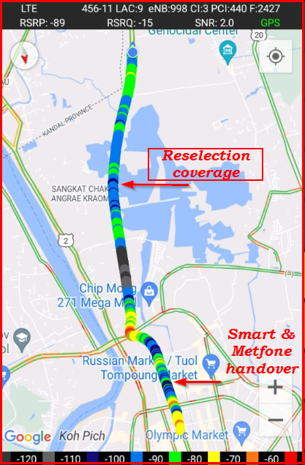
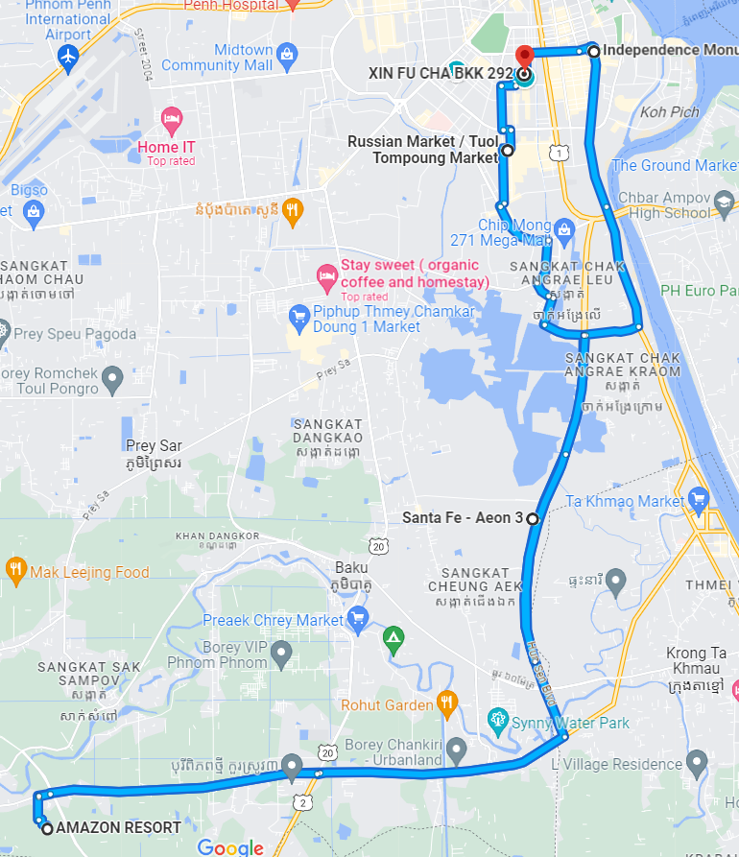
DRIVE ROUTE

Slide 12
THANK YOU
MARQUIS TECHNOLOGIES
www.marquistech.com

