Slide 1
MARQUIS TECHNOLOGIES
Drive Route PATNA

Slide 2
Patna/India
Operator Details:
S. No. | Operator |  | Supported Bands | Supported Features by Network
1 | Major | Airtel | B1/B3/B8/B40/N78 | VoWiFi/VoLTE/4G/2G/5G
2 |  | JIO | B3/B5/B40/N28/N78 | VoWiFi/VoLTE/4G/5G
3 |  | VI | B1/B3/B41 | VoWiFi/VoLTE/4G/2G
4 | Minor | BSNL | UTMS2100/1800 &GSM 1800/900MHZ | 3G/2G

Slide 3
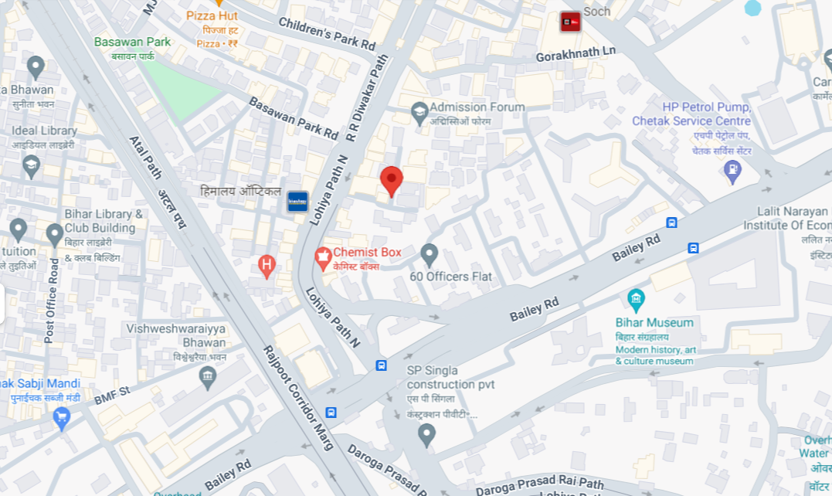
5G Near Cell,Airtel (Patna)
Lat/Long -25°36'33.8"N 85°07'04.7"E
Location-Hotel Crown Place , East Boring Canal Road, Patna
Specification –Stable Airtel 5G NSA network
Good Throughput
Airtel NSA STABLE NETWORK

Slide 4
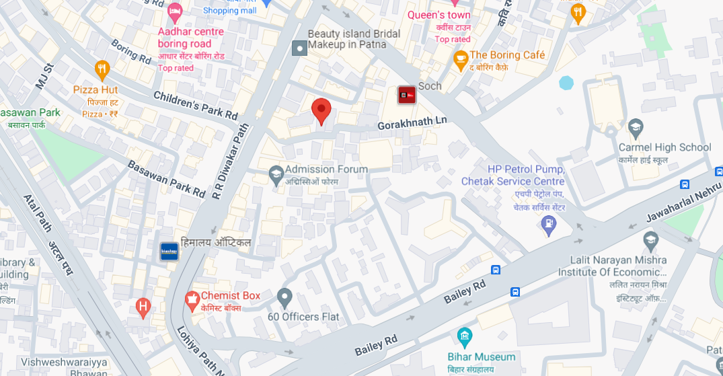
5G Near Cell , Jio (Patna)
Lat/Long. 25°36'38.2"N 85°07'06.4"E Location – Just opposite Children Park road , Boring Road Patna Specification –VONR & 5G STABLE NETWORK
VONR & 5G STABLE NETWORK

Slide 5
VONR to EPSB Handover ,JIO (Patna)
Lat/Long 25°36'38.2"N 85°07'06.4"E to
Lat/Long 25°36'38.9"N 85°07'16.2"E Location – Boring Road , Patna
Specification –VONR Handover
VONR LOCATION
VONR TO EPSB

Slide 6
Vi Near cell, 4G (Patna) Vi Near Cell , 4G (Patna) Lat/Long -25°36'33.8"N 85°07'04.7"E Location-Hotel Crown Place , East Boring Canal Road, Patna Specification –4G Stable Network & Good Throughput
Vi 4G Location

Slide 7
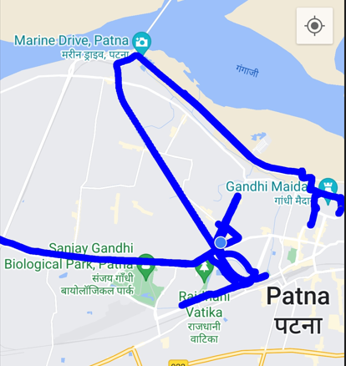
DRIVE ROUTE JIO 5G (Patna) Specification-Call/Throughput/Handover/Cell Reselection/Redirection

Slide 8
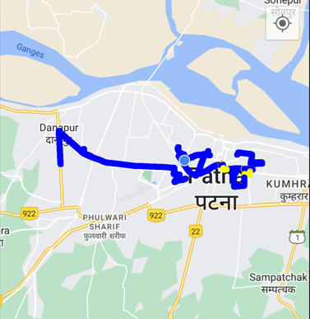
DRIVE ROUTE Airtel 5G (Patna) Specification-Call/Throughput/Handover/Cell Reselection/Redirection

Slide 9
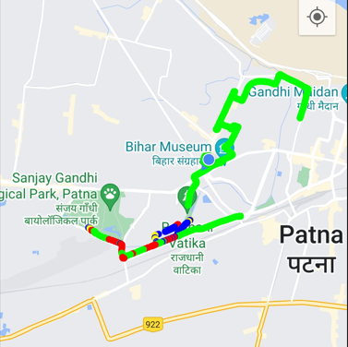
DRIVE ROUTE Vi 4G (Patna) Specification-Call/Throughput/Handover/Cell Reselection/Redirection

Slide 10
THANK YOU
MARQUIS TECHNOLOGIES
www.marquistech.com

