Slide 1
MARQUIS TECHNOLOGIES
Drive Route

Slide 2
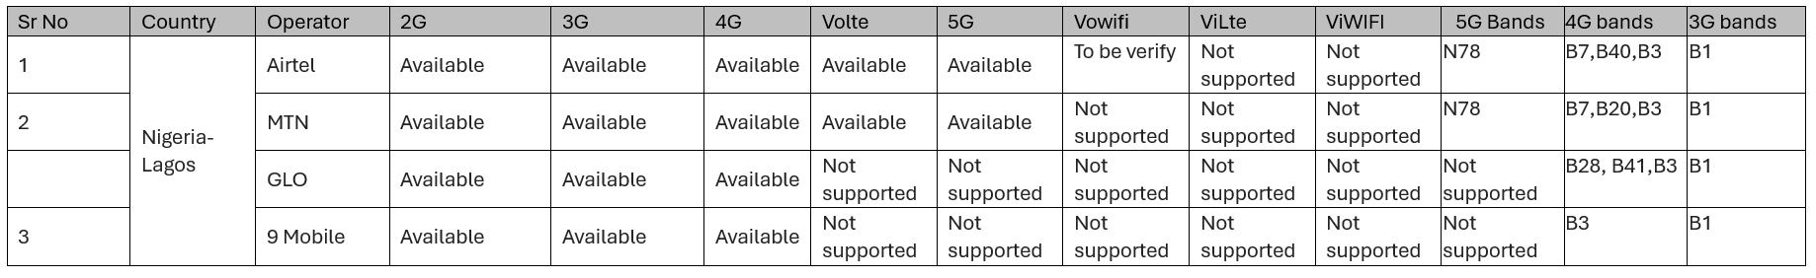
Nigeria
Operator Details:

Slide 3
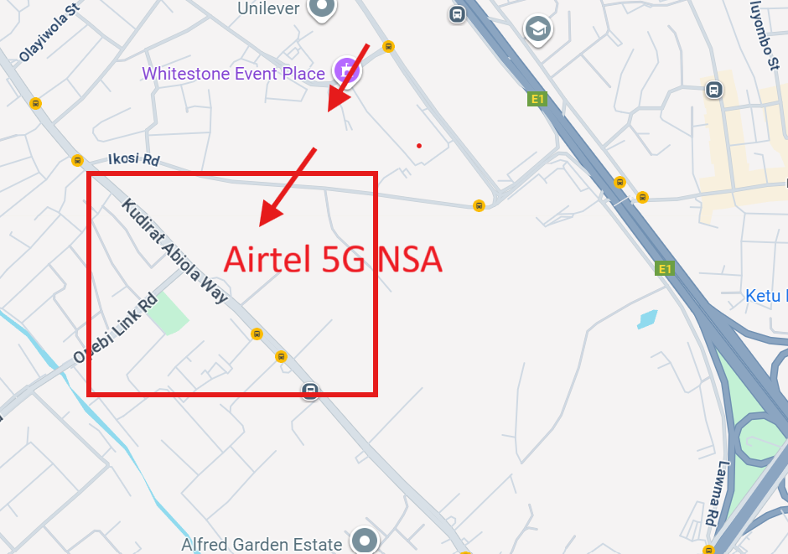
Lat/Long –28.5987,77.3819
Specification –Stable Airtel 5G NSA network
Good Throughput

Slide 4
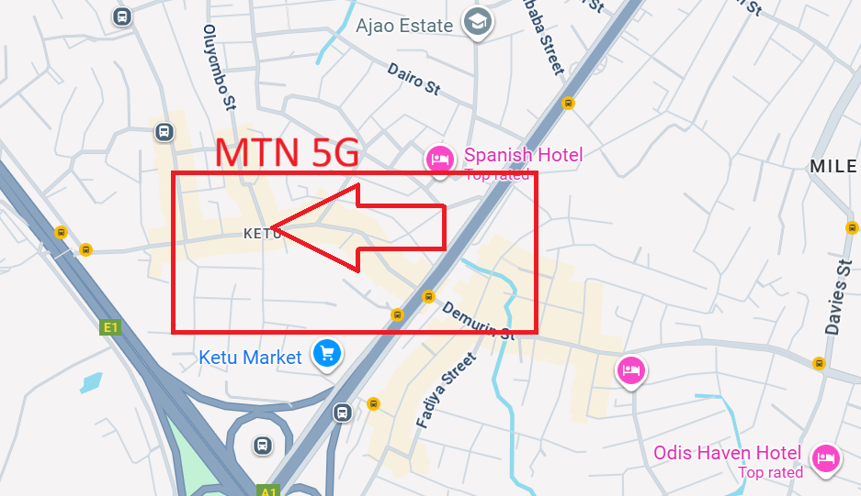
MTN Good Coverage Location
Lat. 28.63291 & Long. 77.35642 to
Good Throughput

Slide 5
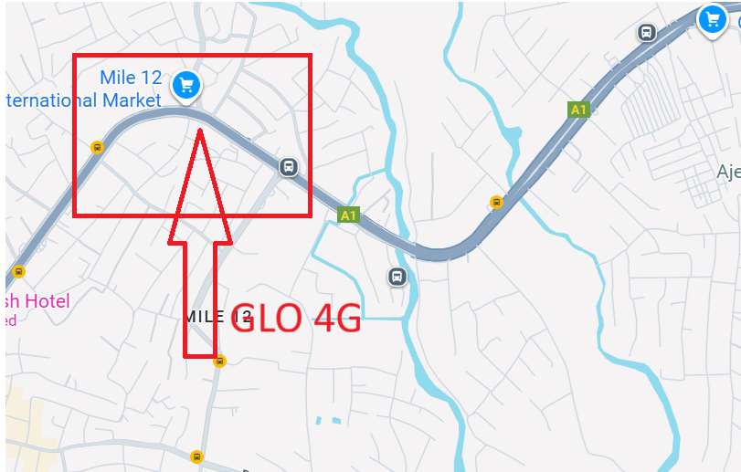
GLO Good Coverage Location
Lat. 28.98291 & Long. 77.60642 to
Good Throughput

Slide 6
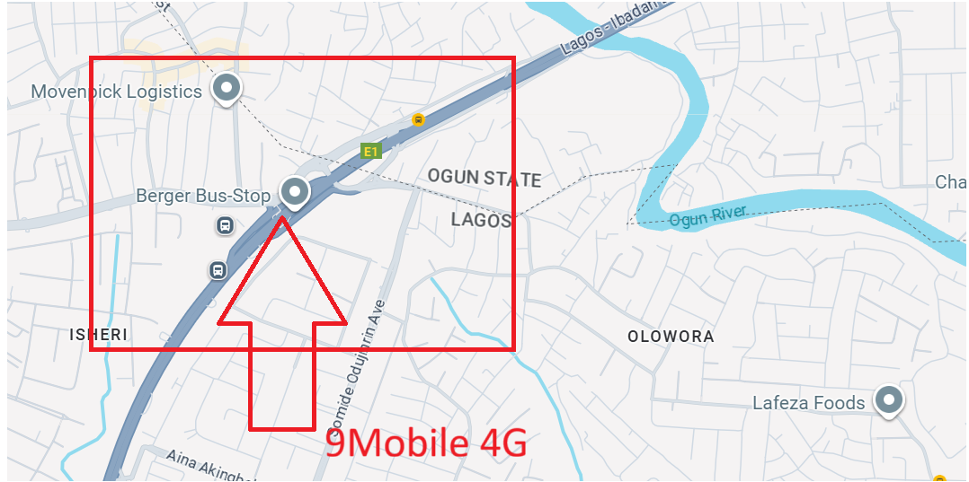
9Mobile Good Coverage Location
Lat. 28.98291 & Long. 77.60642 to
Good Throughput

Slide 7
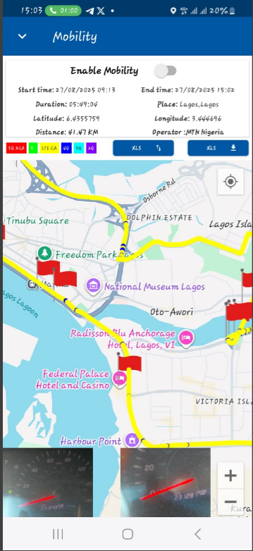
DRIVE ROUTE

Slide 8
THANK YOU
MARQUIS TECHNOLOGIES
www.marquistech.com

