Slide 1
MARQUIS TECHNOLOGIES
Drive Route

Slide 2
Mumbai
Country | INDIA
Continent | Asia
City | Mumbai
Time Zone | GMT+5:30

Slide 3
Operators in Location
MCC | MNC | Operator
405 | 874 | JIO
404 | 93 | Airtel
404 | 20 | VI
JIO
RAT | Band | Comment
5G | N78/N28
4G | B3/B5/B40
3G | NA
2G | NA
Airtel
RAT | Band | Comment
5G | N78
4G | B1/B3/B8/B40
3G | NA
2G | 900/1800
VI
RAT | Band | Comment
5G | NA
4G | B1/B3/B8/B41
3G | NA
2G | 900/1800

Slide 4
Drive Route operator
Near Cell :-Stationary: RSRP: -60dbm to -75dbm
Mixed :-Mobility: RSRP : -75dbm to -95dbm
Cell Edge :-Stationary: RSRP : -95dbm to -115dbm

Slide 5
Operator
JIO/Airtel/VI

Slide 6
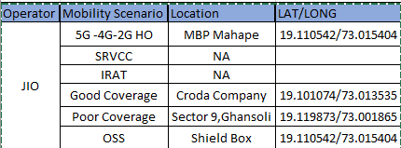
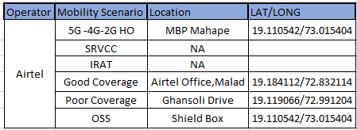
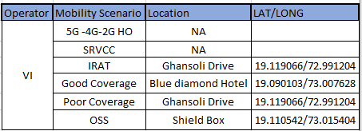

Slide 7
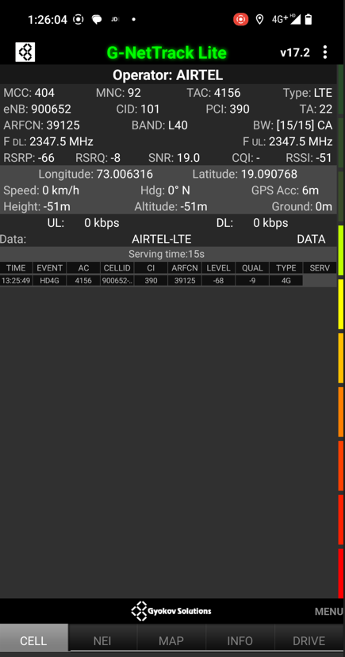
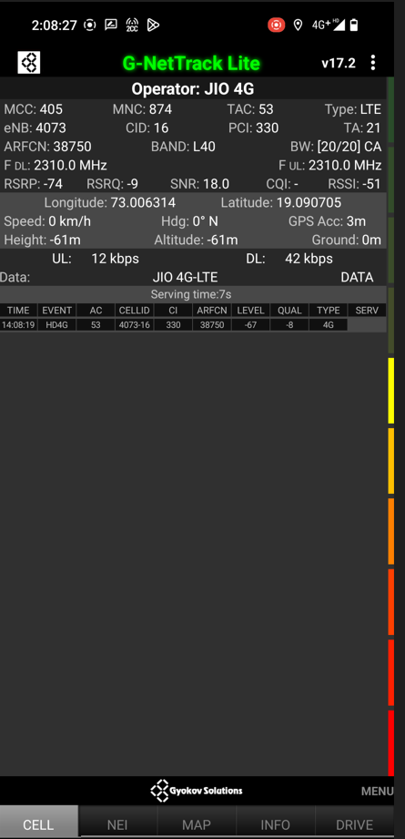
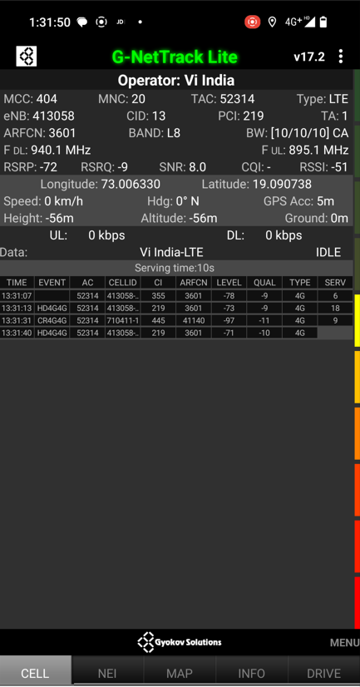
Near Cell screenshots of all band with Network INFO. Which include 5G also.

Slide 8
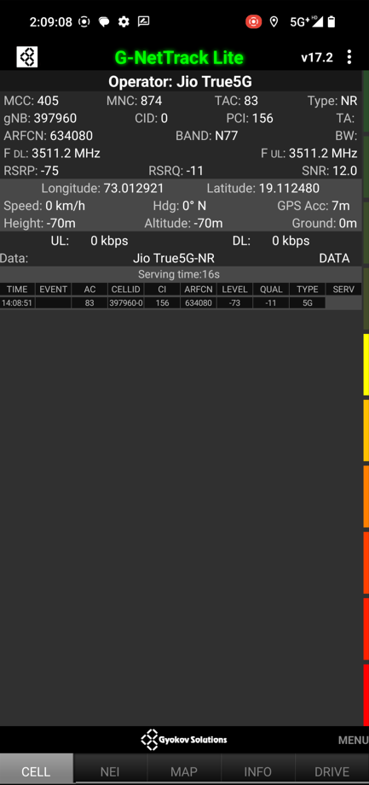
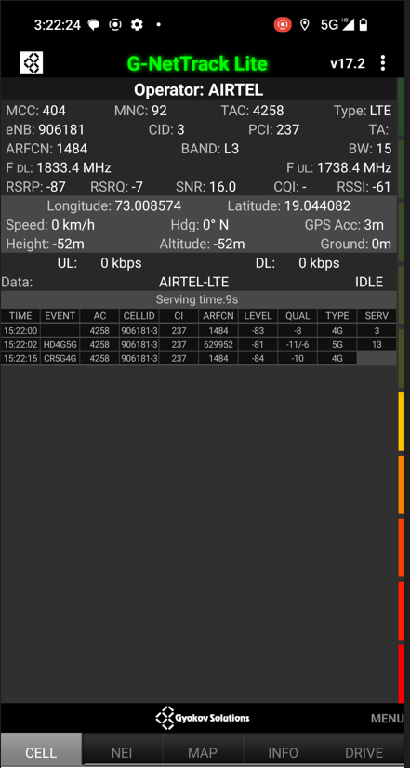
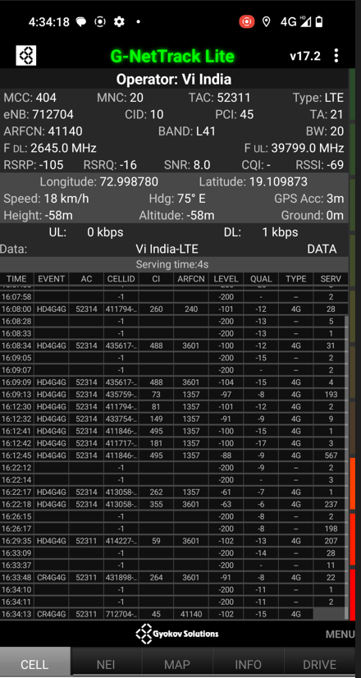
( Mixed Mobility Area) screenshots

Slide 9
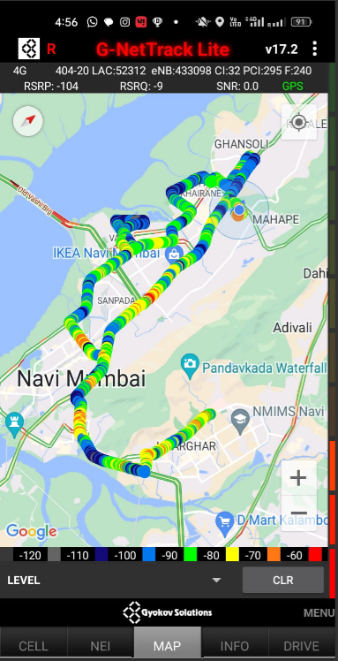
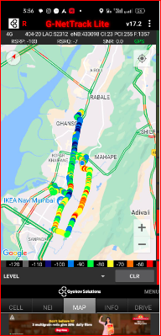
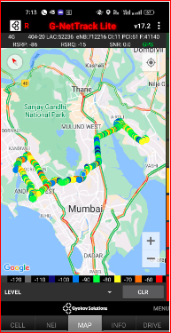
( Drive Route covered during mobility. )

Slide 10
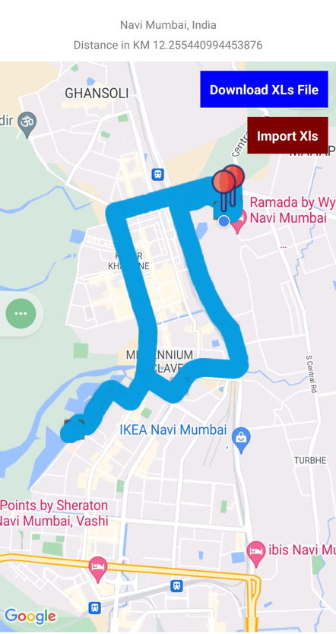
Jio 5G Good Coverage Area
(B3+N78),RSRP=-83db, Vashi Fortis Hospital

Slide 11
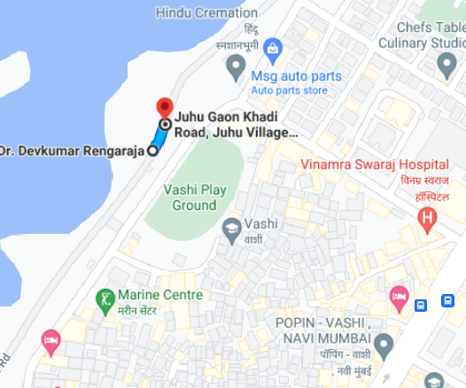
Jio 5G VoNR Coverage Area
(N78),RSRP=-72db, Fortis Hospital Vashi
Lat Long :- 72.999927 19.088210

Slide 12
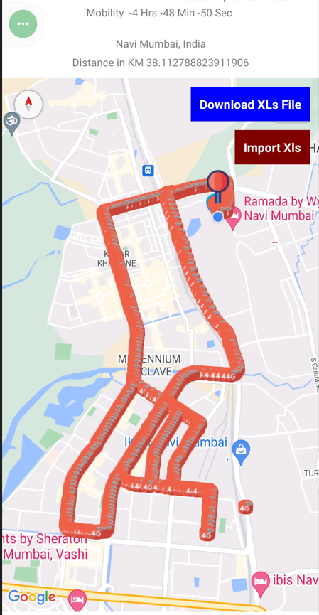
Airtel 5G Good Coverage Area (B8+N78),RSRP=-80db
Blue Dimond Vashi

Slide 13
VI 4G Good Coverage Area (B3/B8/B1)RSRP=-82db
Blue Dimond Vashi

Slide 14
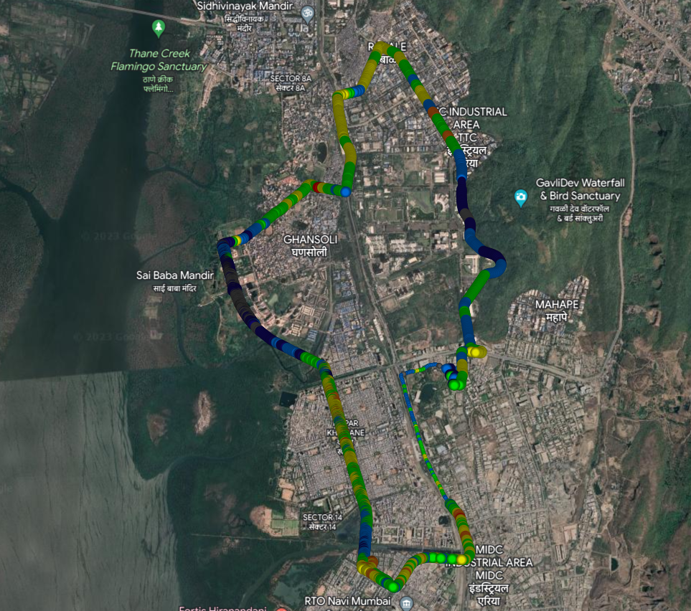
SRVCC 4G to 3G location for VI
Ghansoli Drive(Palm beach)

Slide 15
THANK YOU
MARQUIS TECHNOLOGIES
www.marquistech.com

