Slide 1
MARQUIS TECHNOLOGIES
Drive Route MUMBAI

Slide 2
Drive Route
Near Cell :-Stationary: RSRP: -60dbm to -75dbm
Mixed :-Mobility: RSRP : -75dbm to -95dbm
Cell Edge :-Stationary: RSRP : -95dbm to -115dbm

Slide 3
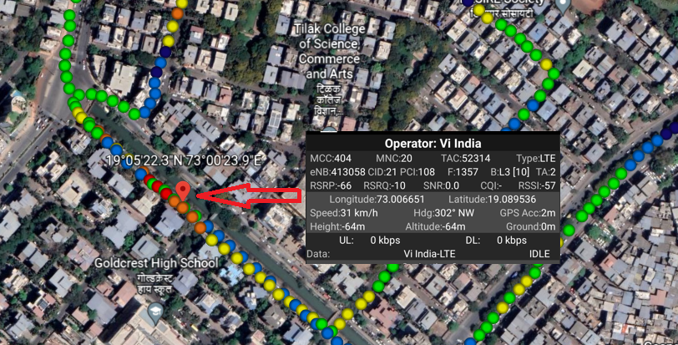
VI 4G VoLTE Good Coverage Area Band3 Route >> MBP >> VASHI >> BLUE DIAMOND >> NEAR TREE HOUSE NURSERY

Slide 4
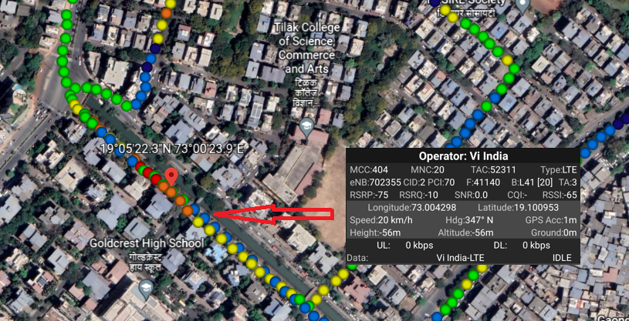
VI 4G VoLTE Good Coverage Area Band41 Route >> MBP >> VASHI >> BLUE DIAMOND >> NEAR TREE HOUSE NURSERY

Slide 5
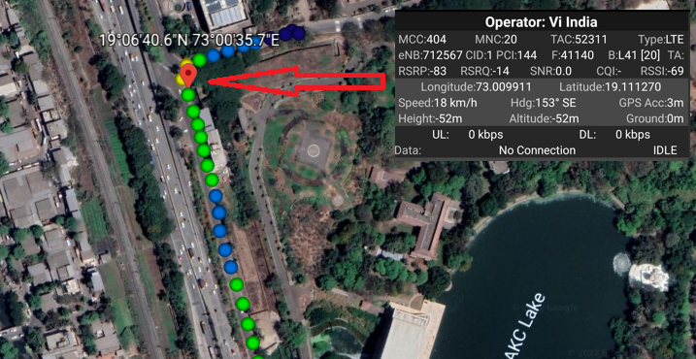
VI 4G VoLTE Mix Coverage Area Route >> MBP >> DATTA MANDIR >> SERVICE ROAD >> GHANSOLI

Slide 6
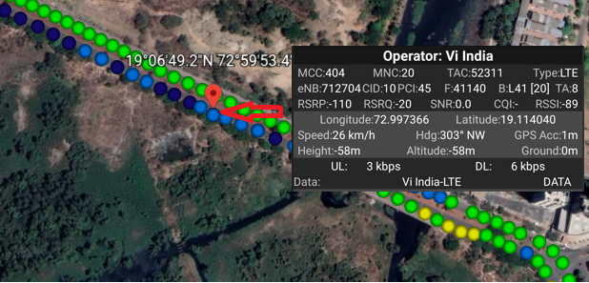
VI 4G VoLTE Weak Coverage Area Band 3 Route >> GHANSOLI SECTOR 4 >> GAGANGIRI MAHARAJ MARG >> CIDCO COMPLEX

Slide 7
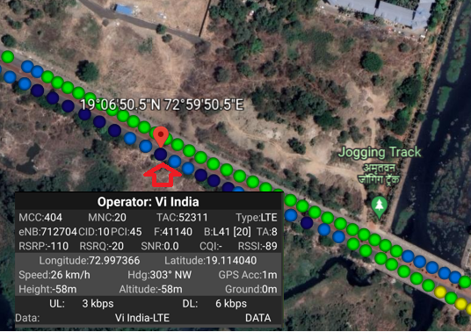
VI 4G VoLTE Weak Coverage Area Band 41 Route >> GHANSOLI SECTOR 4 >> GAGANGIRI MAHARAJ MARG >> CIDCO COMPLEX

Slide 8
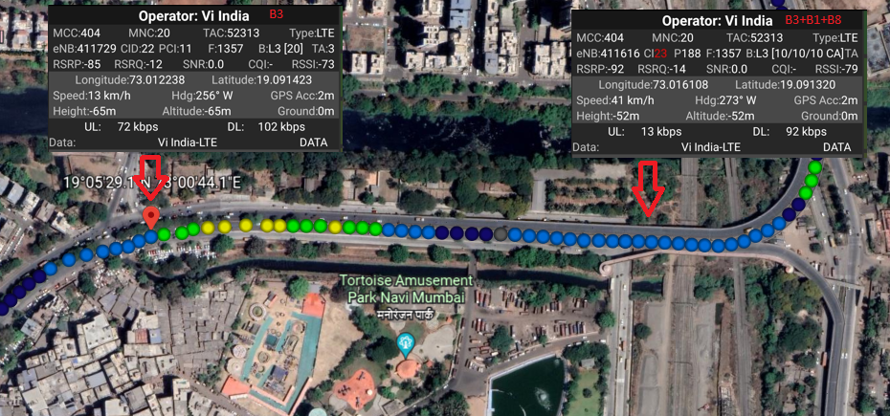
VI 4G VoLTE operator CA to non CA HO (B3+B41_CA to B41_Non CA) Route >> MBP >> RELIANCE HOSPITAL >> TURBHE >> VASHI
EC:2

Slide 9
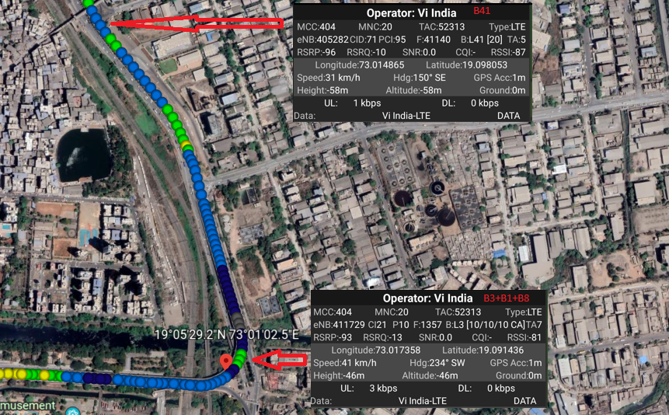
VI 4G VoLTE operator non CA to CA_HO (B41_non CA to B3+B1+B8_CA) Route >> MBP >> RELIANCE HOSPITAL >> TURBHE >> VASHI

Slide 10
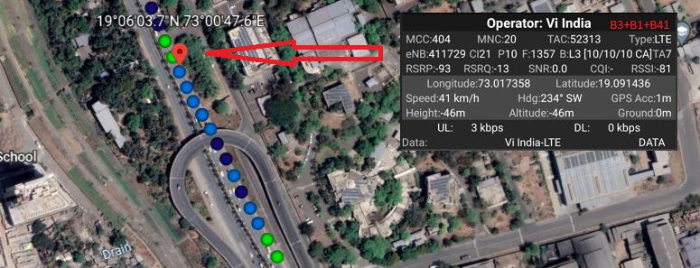
VI 4G Volte operator 3CA (B3+B1+B41) Route >> MBP >> RELIANCE HOSPITAL >> TURBHE

Slide 11
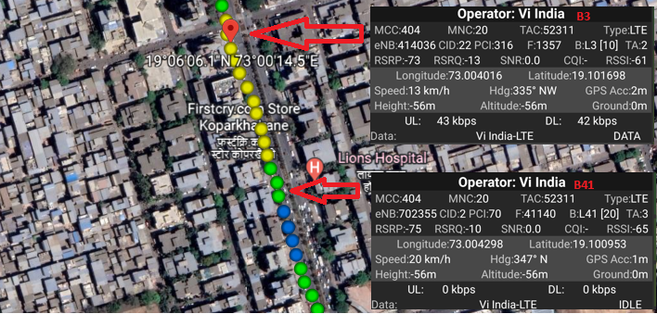
Band HO from B41 to B3 for VI 4G VoLTE operator Route >> VASHI >> SECTOR 15 >> HDFC BANK >> KOPAR KHAIRANE

Slide 12
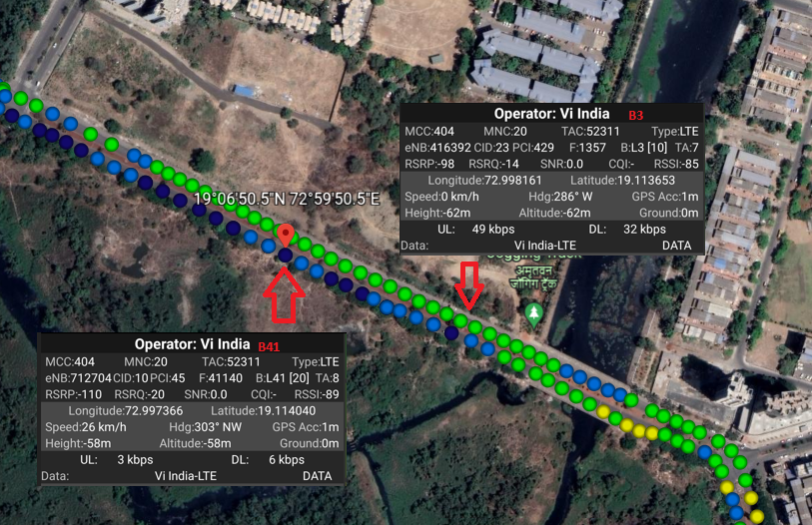
Band HO from B3 to B41 for VI 4G VoLTE operator Route >> GHANSOLI SECTOR 4 >> GAGANGIRI MAHARAJ MARG >> CIDCO COMPLEX

Slide 13
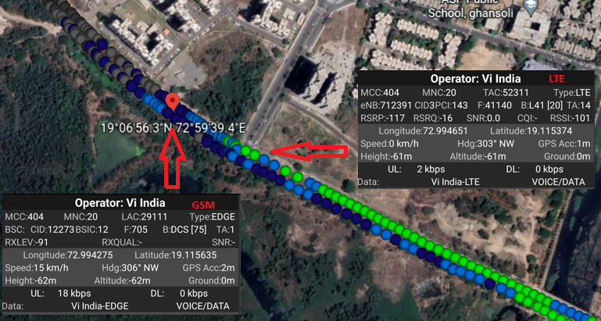
SRVCC VI 4G VoLTE to VI 2G RAT during ongoing MO call Route >> Ghansoli Drive

Slide 14
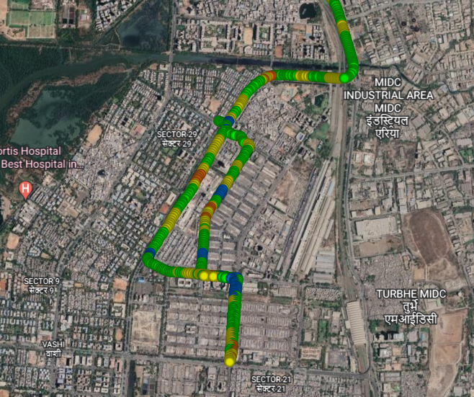
Crowded Area for VI Route >> MBP >> APMC Market

Slide 15
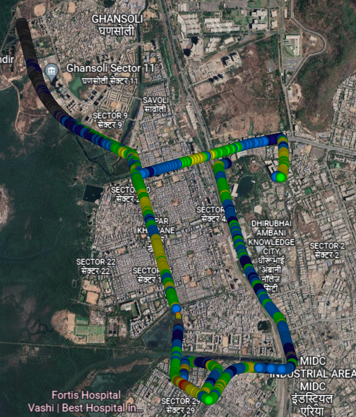
Mix Coverage & Different band Route for long call for VI 4G VoLTE operator ROUTE >> MBP >> GHANSOLI >> GHANSOLI CITY >> TURBHE >> VASHI >> BLUE DIAMOND >> VASHI CITY >> GHANSOLI DRIVE >> MBP

Slide 16
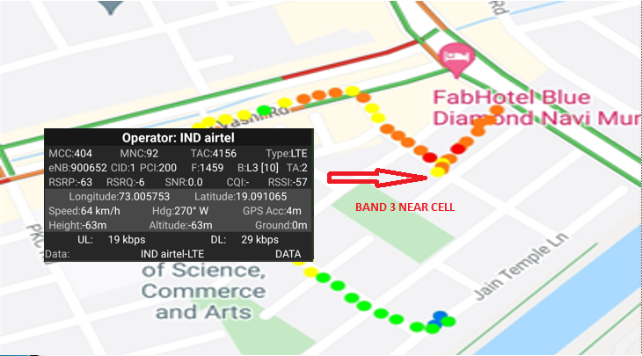
Airtel 4G VoLTE Good Coverage Area Band3 Route >> MBP >> VASHI >> BLUE DIAMOND >> NEAR TREE HOUSE NURSERY

Slide 17
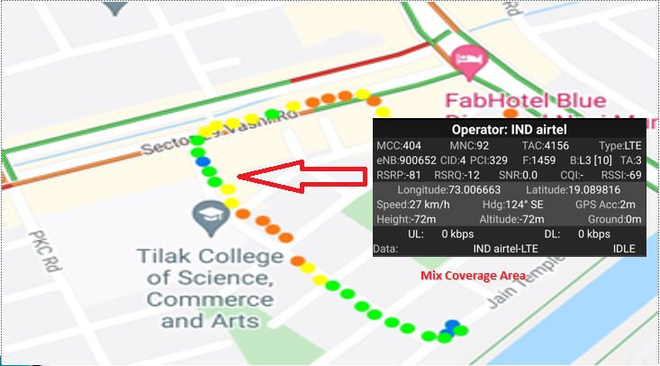
Airtel 4G VoLTE Mix Coverage Area Route >> MBP >> VASHI >> BLUE DIAMOND

Slide 18
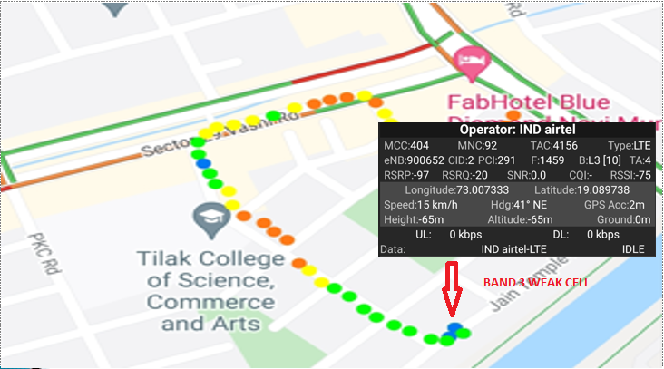
Airtel 4G VoLTE Weak Coverage Area Band3 Route >> MBP >> VASHI >> BLUE DIAMOND >> NEAR PLOT 7-15

Slide 19
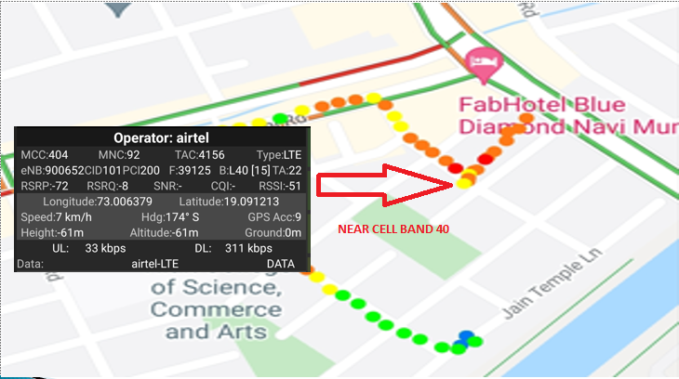
Airtel 4G VoLTE Good Coverage Area Band 40 Route >> MBP >> VASHI >> BLUE DIAMOND >> NEAR TREE HOUSE NURSERY

Slide 20
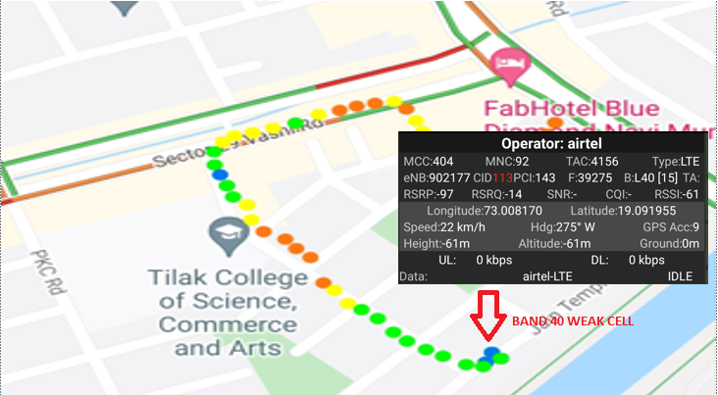
Airtel 4G Volte operator Weak Coverage Area Band 40 Route >> MBP >> VASHI >> BLUE DIAMOND >> NEAR PLOT 7-15

Slide 21
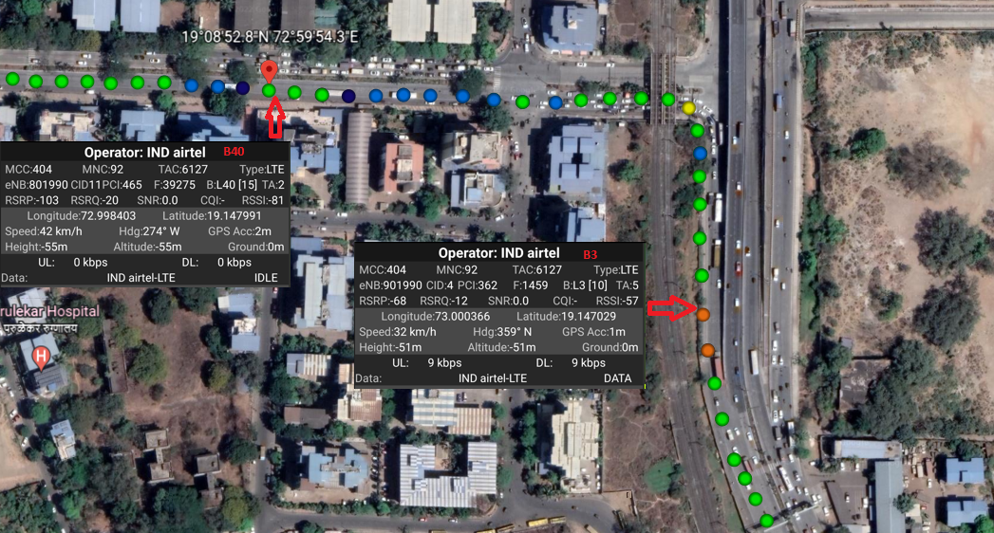
Airtel 4G Volte Operator Band Handover (B3 – B40) Route >> Near St. Xaviers Airoli >> Subway sector 5 Airoli

Slide 22
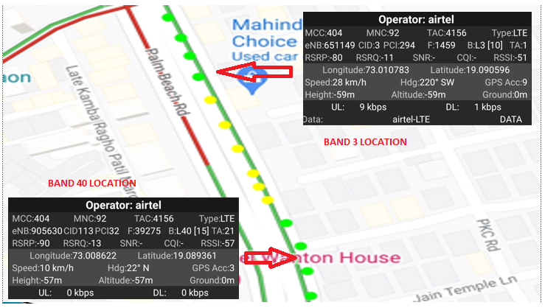
Airtel 4G VoLTE Band Handover B40 to B3 Route >> Turbhe >> Palm Beach Road

Slide 23
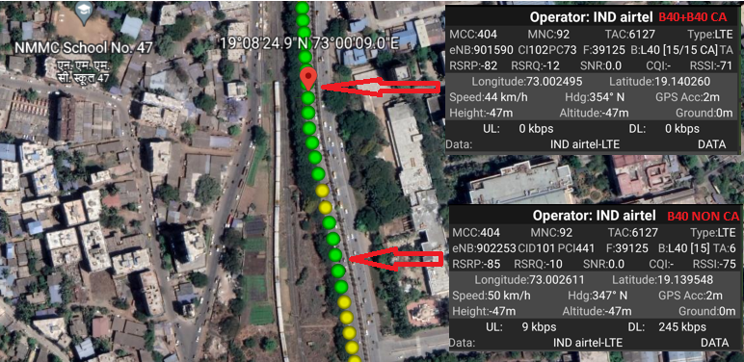
Airtel 4G Volte Operator Non CA B3 to CA (B40 + B40) Handover Route >> Near Radha Krishna temple >> Rabale railway station

Slide 24
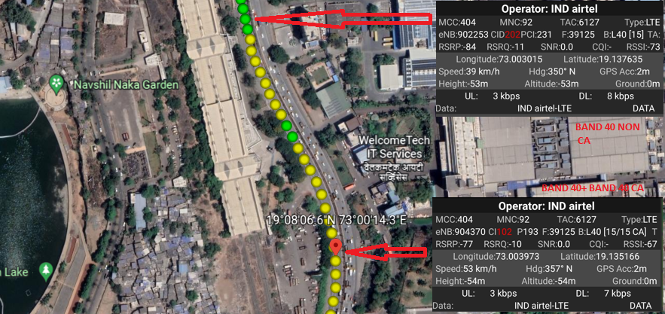
Airtel 4G Volte operator CA (B40+B40) to Non CA B40 Route >> Near SECTOR 26 >> SECTOR 30 GHANSOLI via Thane - Belapur Highway

Slide 25
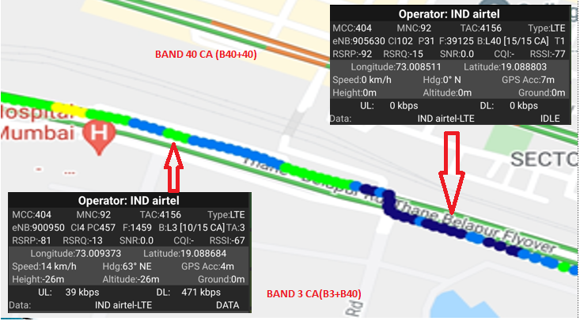
Airtel 4G Volte operator CA to CA Handover(B3+B40) to (B40+B40) Route >> Reliance hospital >> Service road

Slide 26
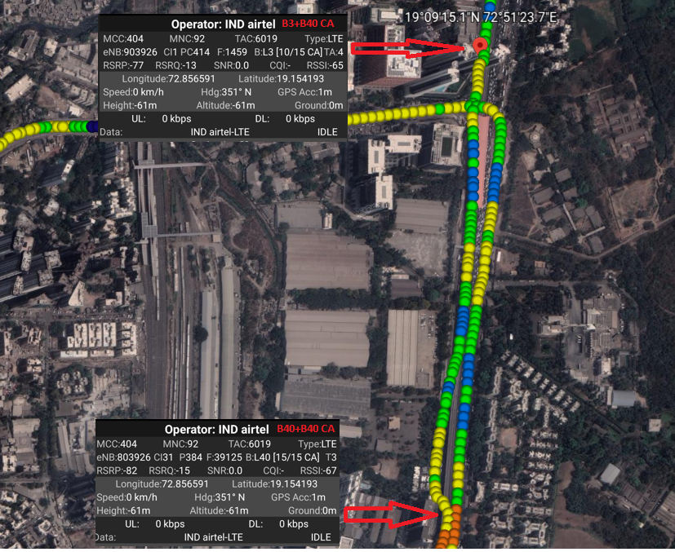
Airtel 4G Volte operator CA to CA Handover(B40+B40) to (B3+B40) Route >> NESCO (GATE 2) Goregaon East >> Lodha Fiorenza (Goregaon East)

Slide 27
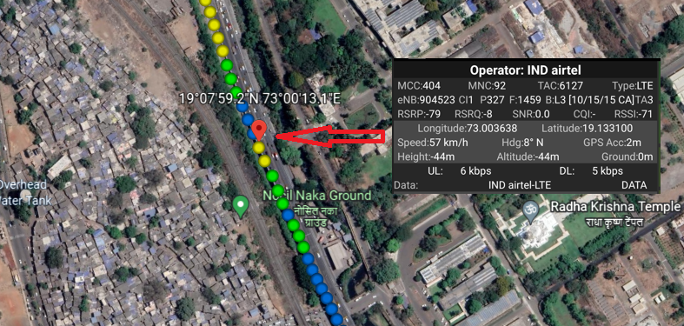
Airtel 4G Volte operator 3CA (B3+B40+B40) Route >> RCP >> Near Nocil naka ground Ghansoli

Slide 28
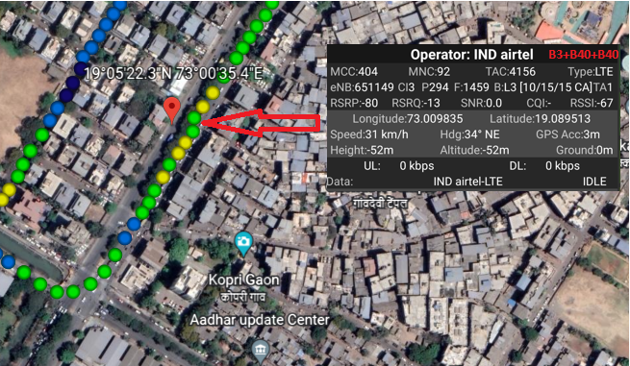
Airtel 4G Volte operator 3CA (B3+B40+B40) Route >> RCP >> TURBHE FLYOVER >> VASHI

Slide 29
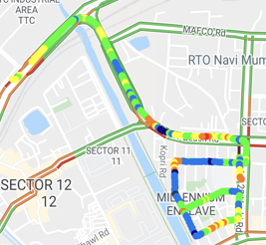
Airtel 4G VOLTE Long Call Drive Route Route >> MBP >> Thane-Belapur Highway >> Turbhe >> Vashi >> Blue Diamond.

Slide 30
Crowded Area for Airtel Route >> MBP >> APMC Market

Slide 31
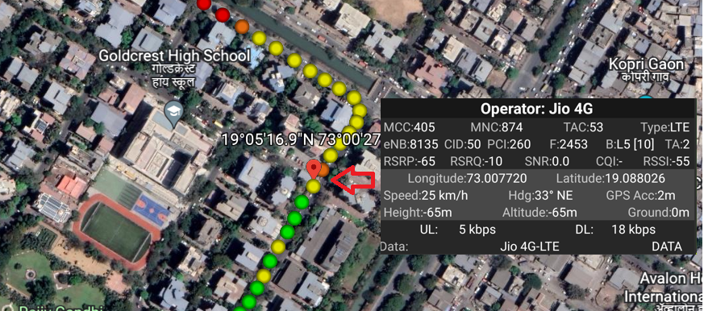
JIO Operator Good coverage Band 5 Route >> Vashi Blue Diamond

Slide 32
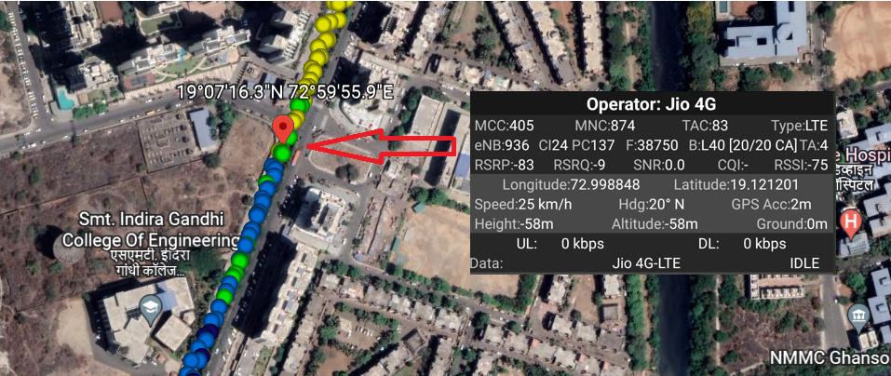
JIO Operator Mix Coverage Route >> Mamura >> Fortis Hospital >> Sector 62 circle

Slide 33
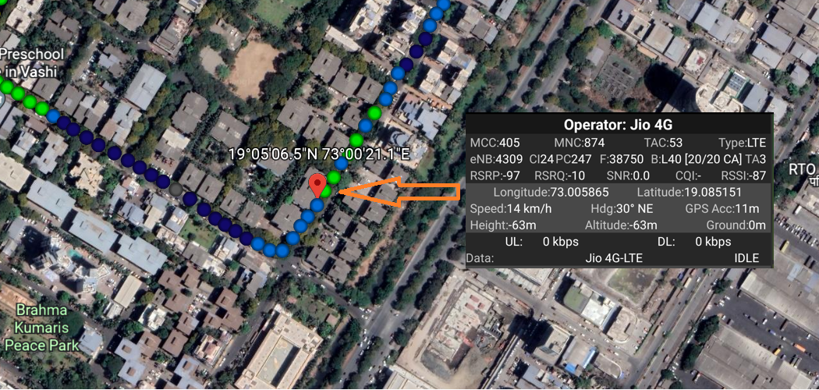
JIO Operator Weak coverage Band 40 Route >> Parmarth Niketan Marg, Juhu Nagar, Sector 29, Vashi

Slide 34
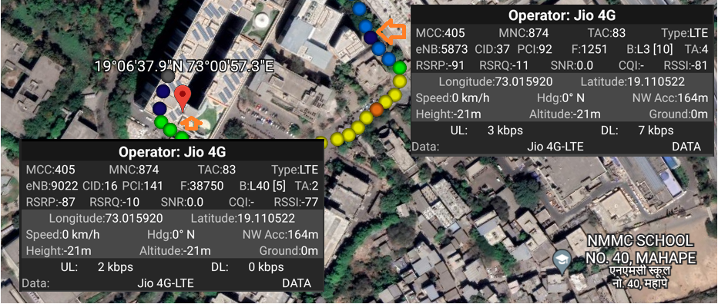
JIO Operator Band Ho from Band 3 to Band 40 Route >> MBP Main Gate >> Rupa Solitaire

Slide 35
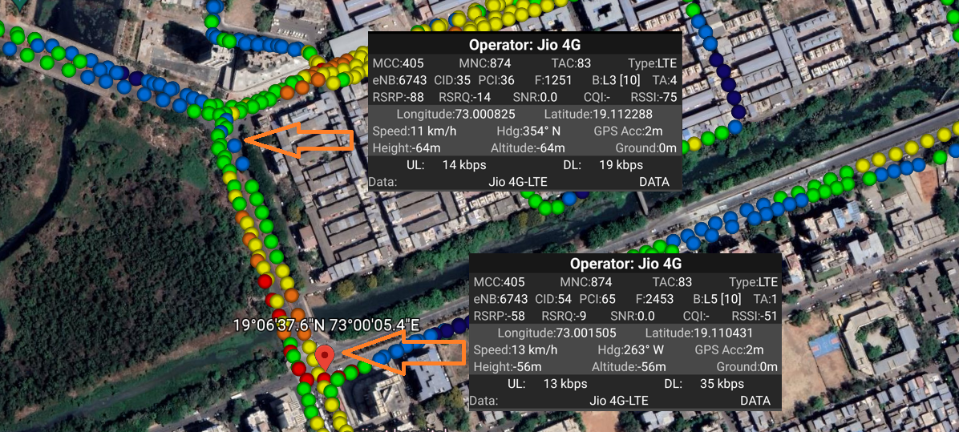
JIO Operator Band HO from Band 3 to band 5 Route >> GHANSOLI SECTOR 4 >> GAGANGIRI MAHARAJ MARG

Slide 36
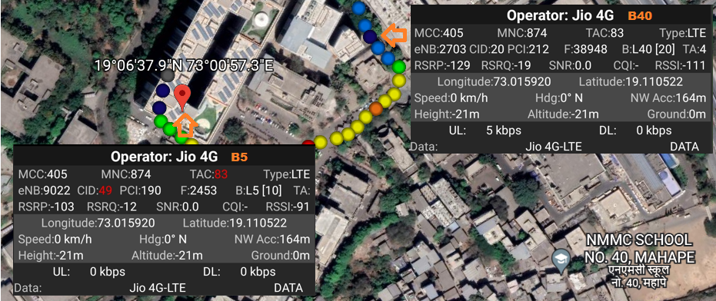
JIO Operator Band HO from Band 5 to Band 40 Route >> Rupa Solitaire >> MBP Main Gate

Slide 37
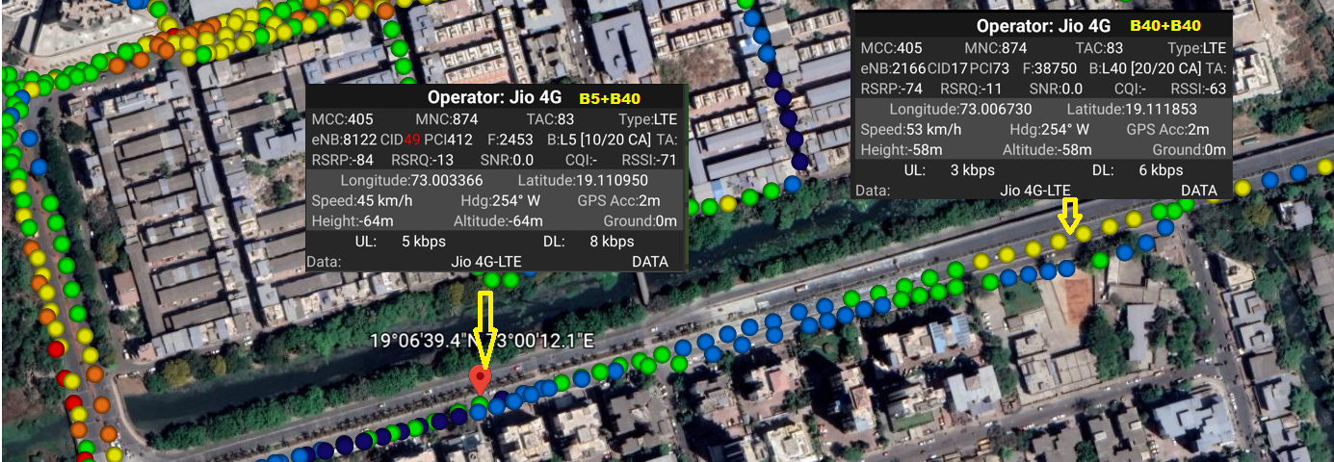
JIO Handover from CA cell to CA cell : 2CA_Band 5 + Band 40 to Band 40 + Band 40 Route >> Ghansoli flyover >> kopar khairane

Slide 38
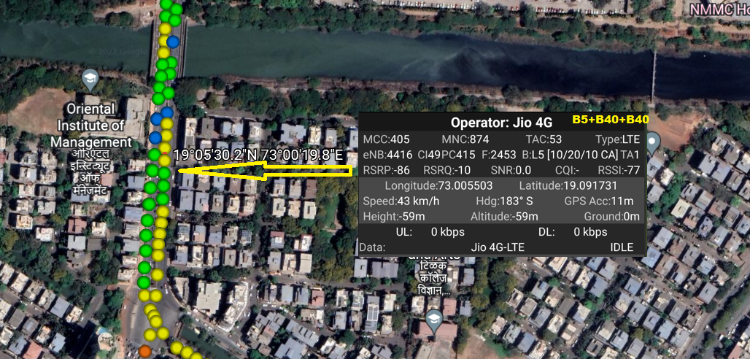
JIO : 3CA_B5+B40+B40 Location >> Near Oriental Institute of management sector 12

Slide 39
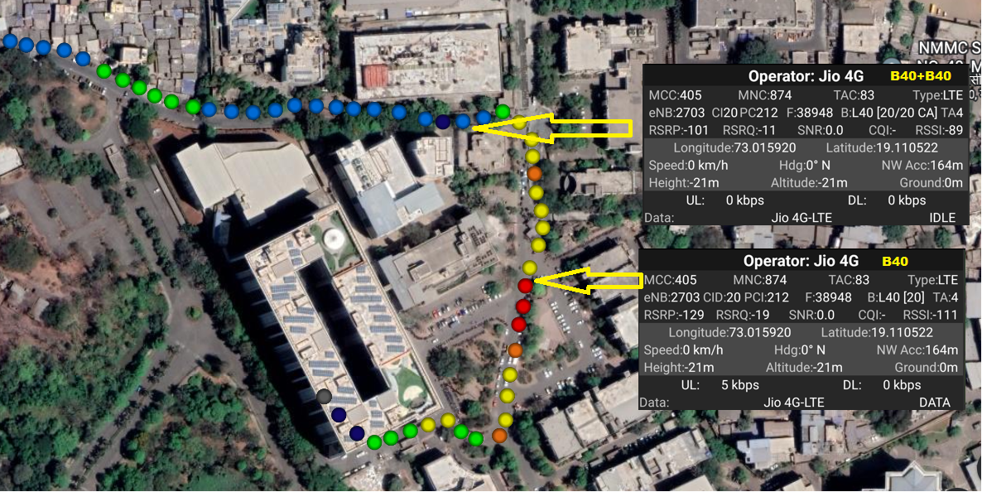
JIO Operator: Non CA cell to CA cell : B (40) to B (40) + B (40) Route >>Near MBP Main Gate

Slide 40
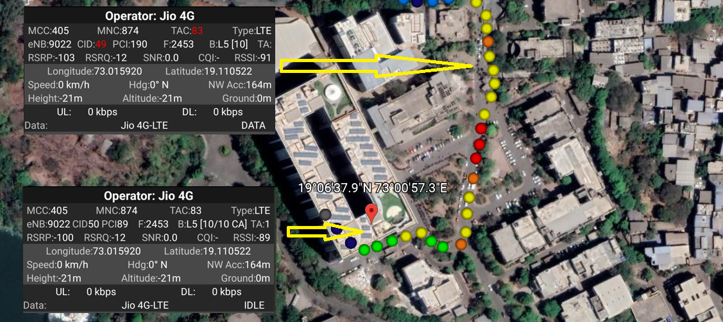
JIO Operator: CA cell to non CA cell : B (5) to B (40) + B (5) Route >> Rupa solitaire to MBP Main Gate

Slide 41
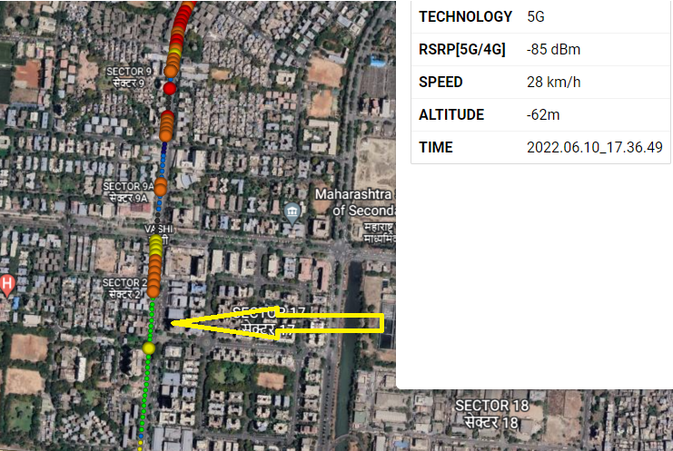
JIO Operator: 5G Route: Backside inorbit Mall (Vashi) BAND: NSA N78 NR NARFCN: 636672

Slide 42
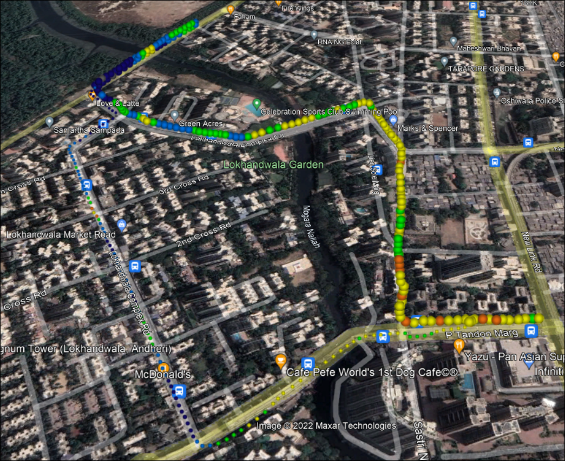
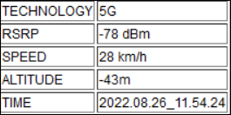
JIO Operator: 5G Route: Exit Gate Infinity Mall (Jogeshwari-W) BAND: SA N78 NR NARFCN: 634080
NR to LTE Handover

Slide 43
JIO Long call Route >> MBP >> Thane-Belapur Highway >> Turbhe >> Vashi >> Blue Diamond

Slide 44
Crowded Area for Jio Route >> MBP >> APMC Market

Slide 45
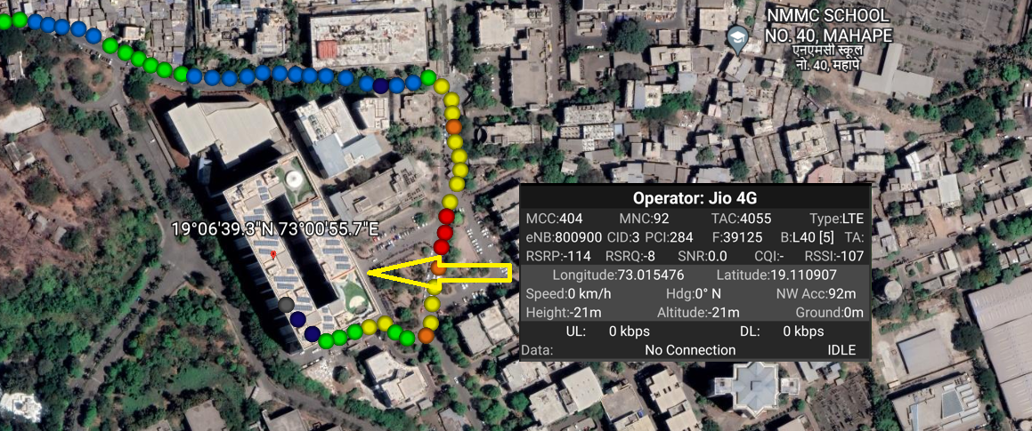
Out Of Service Location for JIO operator Route >> Rupa Solitaire >> B2

Slide 46
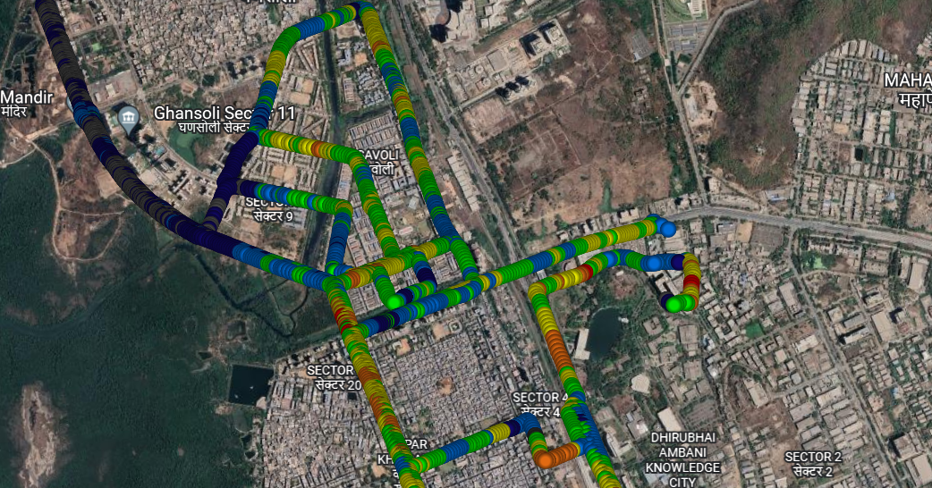
Between High Buildings for JIO/Airtel/Vi Route >> MBP >> Ghansoli City >> Ghansoli drive

