Slide 1
MARQUIS TECHNOLOGIES
Drive Route

Slide 2
Lucknow/India
Operator Details:
S. No. | Operator |  | Supported Bands | Supported Features by Network
1 | Major | Airtel | Band 1 (FDD-2100), Band 8., Band 3 (FDD-1800), Band 40 (TDD-2300), N78 | VoWiFi/VoLTE/4G/2G/5G
2 |  | JIO | Band 3 (FDD-1800),Band 5(FDD-2100) Band 40 (TDD-2300),N78 | VoWiFi/VoLTE/4G/5G
3 |  | VI | Band 3 (FDD-1800), Band 8 (FDD-2900), Band 41(TDD-2500) | VoWiFi/VoLTE/4G/2G

Slide 3
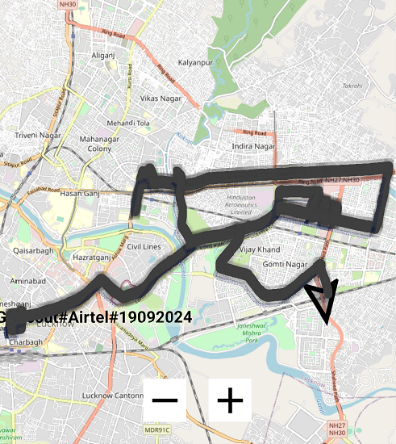
5G NSA Airtel

Slide 4
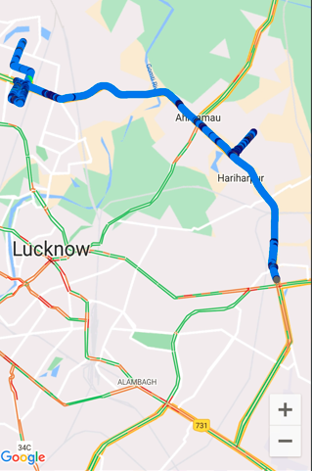
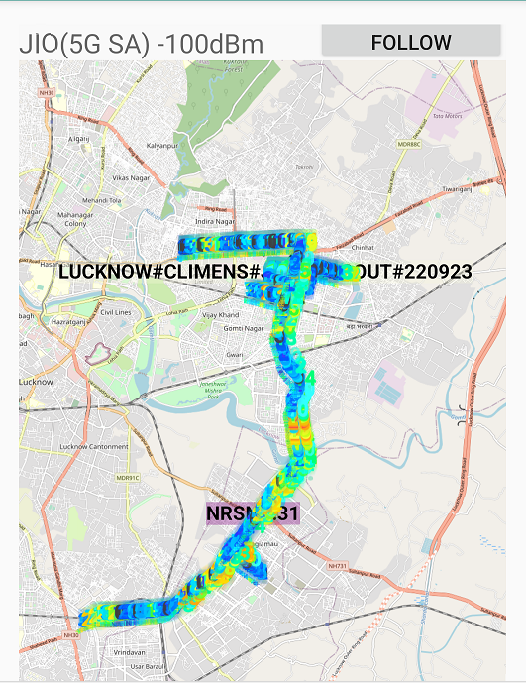
5G SA Rjio
Loc: T/G-6/6 DLF City Centre, Vibhuti Khand, Gomti Nagar, Lucknow, Uttar Pradesh 226010

Slide 5
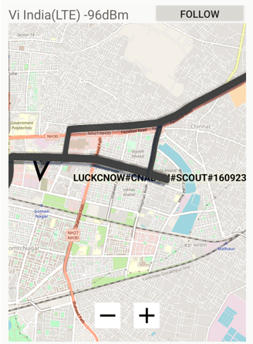
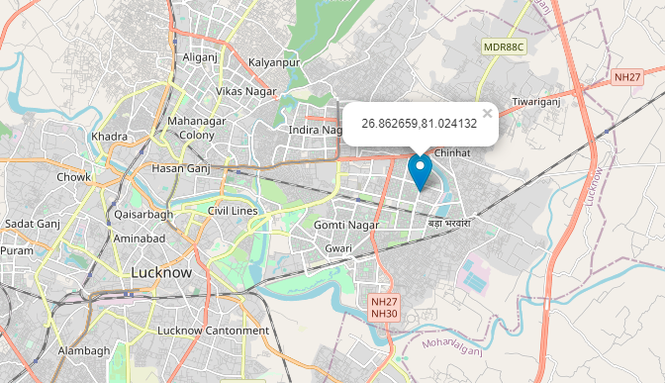
VI LTE Loc: Lat:26.862659 Long.:81.024132

Slide 6
THANK YOU
MARQUIS TECHNOLOGIES
www.marquistech.com

