Slide 1
MARQUIS TECHNOLOGIES
Drive Route

Slide 2
Hubbali/India
Operator Details:
S. No. | Operator |  | Supported Bands | Supported Features by Network
1 | Major | Airtel | Band 1 (FDD-2100) Band 3 (FDD-1800),Band 8(FDD-390) Band 40 (TDD-2300);N78 | 2G/4G/5G/VoLTE/VoWiFi
2 |  | JIO | Band 3 (FDD-1800),Band 5(FDD-2100) Band 40 (TDD-2300);N78 | VoWiFi/VoLTE/4G/5G
3 |  | VI | LTE FDD B3/B8 & TDD B41 | VoWiFi/VoLTE/4G/3G/2G/5G
 |  | VI | Band 3 (FDD-1800), Band 8 (FDD-2900), Band 41(TDD-2500) | 2G/4G/VoLTE
4 | Minor | BSNL | NA | 3G/2G

Slide 3
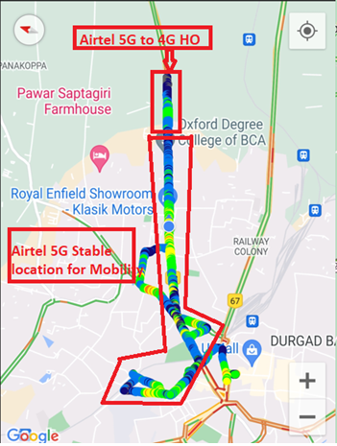
NR to LTE Handover ,Airtel

Slide 4
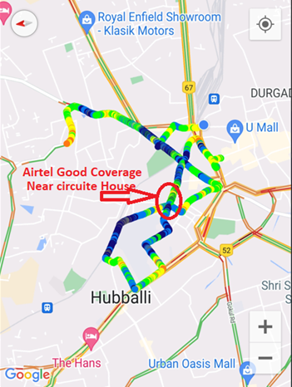
5G Near Cell,Airtel

Slide 5
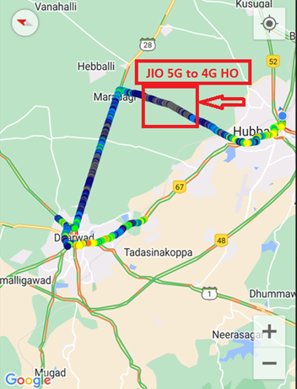
NR (N78) to LTE Handover ,Rjio
Location: 01

Slide 6
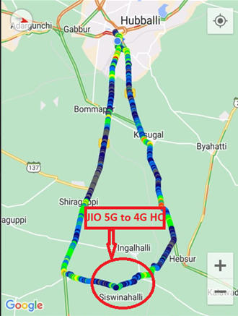
NR (N78) to LTE Handover ,Rjio
Location: 02

Slide 7
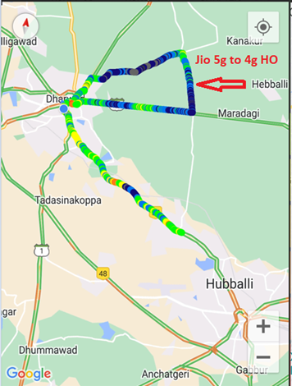
NR (N78) to LTE Handover ,Rjio
Location: 03

Slide 8
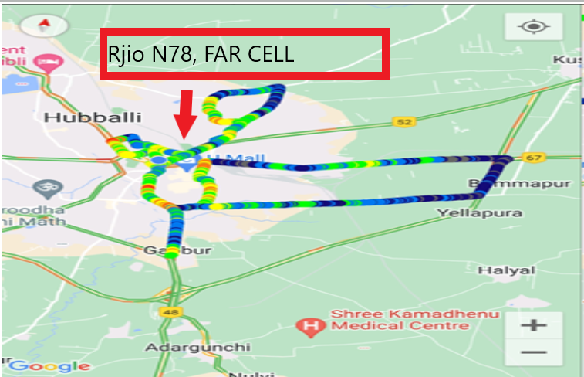
NR (N78) FAR CELL,Rjio
Location: Pinto Rd, Deshpande Nagar, Hubballi, Karnataka 580020

Slide 9
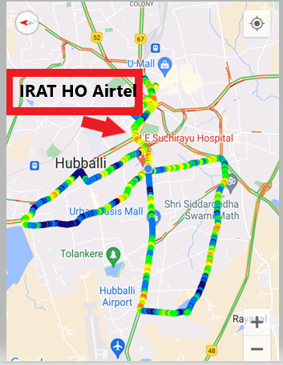
Airtel 2G-4G HO

Slide 10
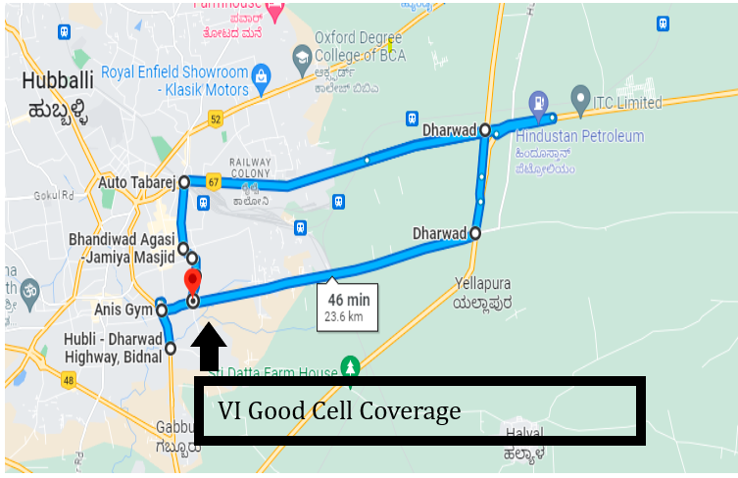
VI Good Cell Area: Anis Gym, Bankapur chowk, PB Rd, near Ashray Hotel, Yallapur Oni, Basavanna Nagar, Hubballi, Karnataka 580020

Slide 11
THANK YOU
MARQUIS TECHNOLOGIES
www.marquistech.com

