Slide 1
MARQUIS TECHNOLOGIES
Drive Route

Slide 2
Delhi/India
Operator Details:
S. No. | Operator |  | Supported Bands | Supported Features by Network
1 | Major | Airtel | LTE FDD B1/B3/B8 & TDD B40 | VoWiFi/VoLTE/4G/2G
2 |  | JIO | LTE FDD B3/B5 & TDD B40 | VoWiFi/VoLTE/4G
3 |  | VI | LTE FDD B3/B8 & TDD B41 | VoWiFi/VoLTE/4G/3G/2G
4 | Minor | BSNL | LTE FDD B1 | VoLTE/4G/3G/2G

Slide 3
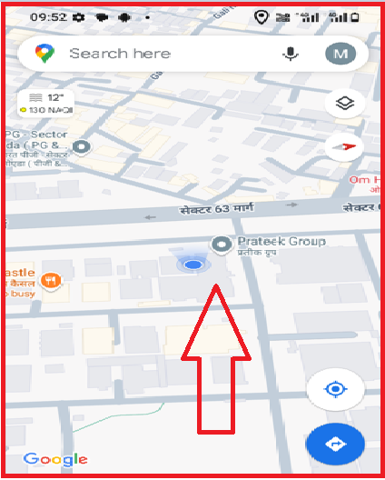
AIRTEL 4G VOLTE
Lat/Long -28.6038° N, 77.3812° E
Specification –Stable Airtel 4G VOLTE network

Slide 4
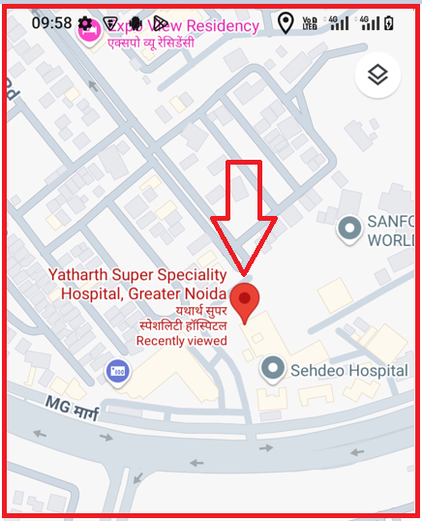
BSNL VOLTE
Lat. 26°28’26 & Long. 80°19'51.9 to
Location – YATHARTH super speciality hospital
Specification –BSNL VOLTE

Slide 5
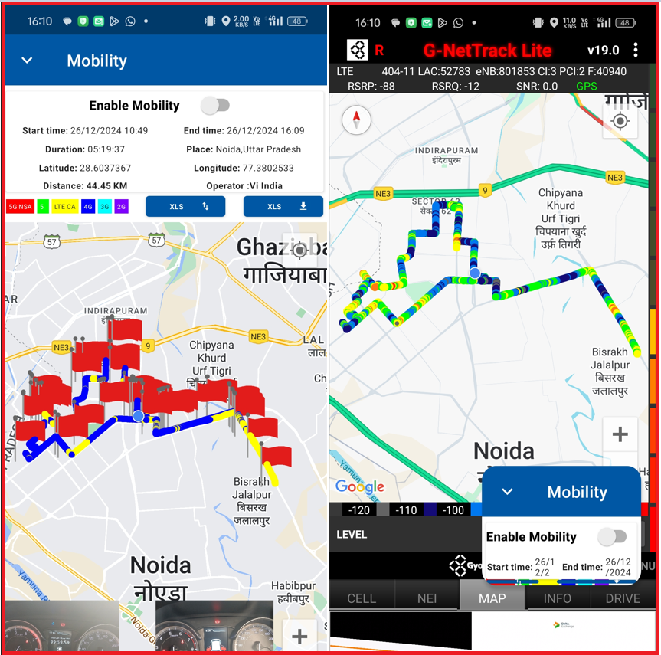
DRIVE ROUTE

Slide 6
THANK YOU
MARQUIS TECHNOLOGIES
www.marquistech.com

