Slide 1
MARQUIS TECHNOLOGIES
Drive Route –Airtel, Idea, VODAFONE & Reliance JIO (FDD/TDD) LTE

Slide 2
Operator Information:
Operator | JIO 4G
MCC | 405
MNC | 8
APN | Jionet
Operator | Airtel 4G
MCC | 405
MNC | 54
APN | Airtelgprs.com
Operator | VI
MCC | 404
MNC | 15
APN | www
Operator | Bsnl
MCC | 404
MNC | 55
APN | Bsnlnet

Slide 3
Operator Information 1
Functionality | Airtel
Website: http://www.airtel.com/ WAP APN: airtelgprs.com
Customer care | 121
MNC | 54
Bands supported | Both FDD and TDD
 | LTE 2300 MHz – TDD(Band 40)
 | LTE 1800, 2100 MHz – FDD(Band 3 & 1)
USSD | To check MDN: *282#
 | Balance check: *123#
 | Data Balance check: *121*2#
VoLTE | Supported
CSFB | Supported (4G to 2G)

Slide 4
Operator Information 2
Functionality | RELIANCE JIO
Website: http://www.jio.com WAP APN: jionet
Customer care | 198
MNC | 8
Bands supported | Both FDD and TDD
 | LTE 2300 MHz –TDD(Band 40)
 | LTE 850 MHz – FDD(Band 5)
 | LTE 1800 MHz –FDD(Band 3)
USSD | NA
 | NA
 | NA
VoLTE | Supported
CSFB | Not Supported

Slide 5
Operator Information 3
Functionality | VI
Website: http://www.vi.com WAP APN: www
Customer care | 121
MNC | 15
Bands supported | Both FDD and TDD
 | LTE 2300 MHz –TDD(Band 41)
 | LTE 850 MHz – FDD(Band 5)
 | LTE 1800 MHz –FDD(Band 3)
USSD | To check MDN*199#
 | Balance check 121
 | Data Balance check: 121
VoLTE | Supported
CSFB | Supported(4g to 2g/3g)

Slide 6
Operator Information 4
Functionality | Bsnl
Website: http://www.bsnl.com WAP APN: www.bsnlnet
Customer care | 121
MNC | 55
Bands supported | Both FDD and TDD not supported
 | UTMS 2100
 | GSM900
USSD | To check MDN*222#
 | Balance check: 123
 | Data Balance check: 123
VoLTE | not Supported
CSFB | not Supported

Slide 7
Drive Route
Near Cell :- Stationary: RSRP : -65dbm to -75dbm
Cell Edge :- Stationary: RSRP : -95dbm to -110dbm
Mixed :- Mobility: RSRP : -65dbm to -110dbm

Slide 8
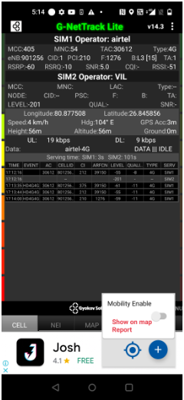
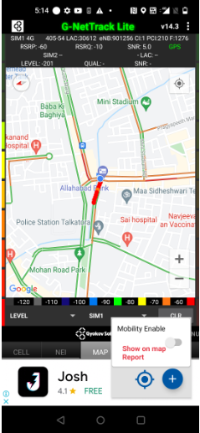
Near Cell (Airtel)
Near cell(NC) | longitude | latitude | RSRP | Cell id | TDD/FDD E-ARFCN
1 | 80.877508 | 26.845856 | 60 | 1 | 1276
  Rajajipuram
RSRP:
-55dbm to 7dbm

Slide 9
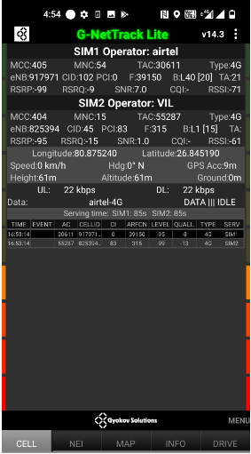
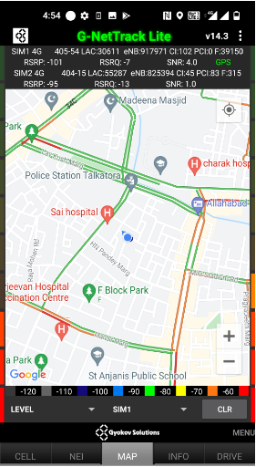
Edge Cell (Airtel)
Near cell(NC) | longitude | latitude | RSRP | Cell id | TDD E-ARFCN
1 | 80.875240 | 26.845190 | 100 | 102 | 39150
Rajajipuram
RSRP:
-95dbm to -110dbm

Slide 10
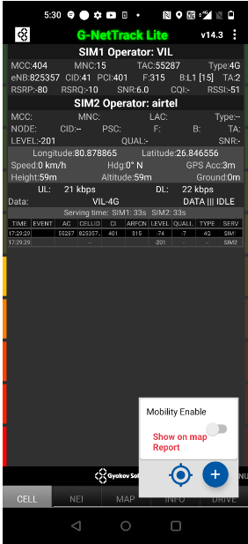
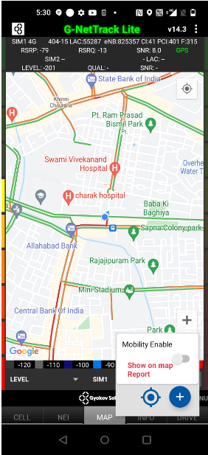
Mixed Mobility:- Lucknow
Rajajipuram
RSRP: -75dbm to -100dbm

Slide 11
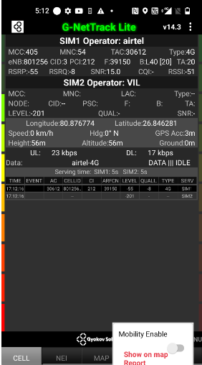
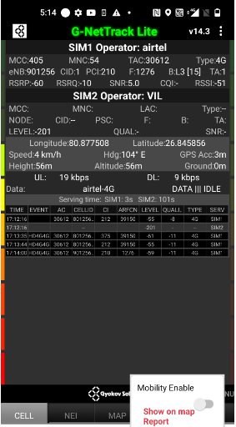
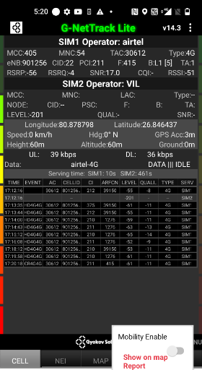
Airtel inter Band HO (TDD-FDD)
Band Hand Over | Longitude | Latitude | RSRP
1 & 3 & 40 | 80.876774 | 26.846281 | -55 to 75 dBM
Rajajipuram Talkatora police station to Meenabakery Chauraha drive root

Slide 12
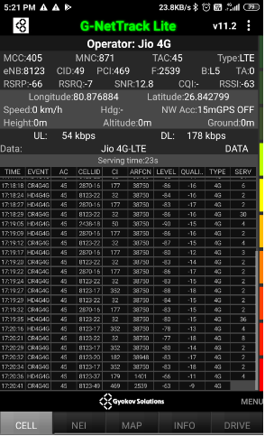
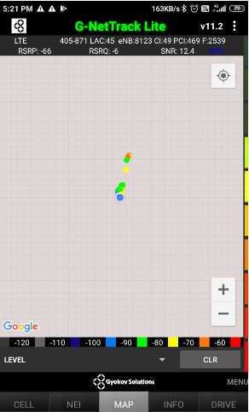
Near Cell (Reliance JIO)
Near cell(NC) | longitude | latitude | RSRP | Cell id | TDD/FDD E-ARFCN
1 | 80.876884 | 26.842779 | 66 | 49 | 2539
Rajajipuram
RSRP:
-65dbm to -75dbm

Slide 13
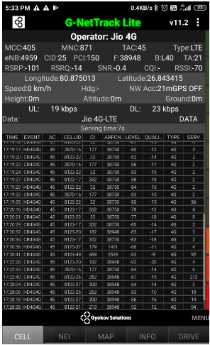
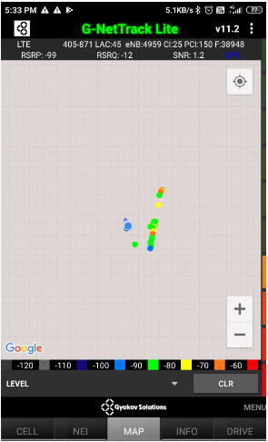
Edge Cell (Reliance JIO)
Edge cell(NC) | longitude | latitude | RSRP | Cell id | TDD E-ARFCN
1 | 80.875013 | 26.843415 | 101 | 25 | 38948
Rajajipuram
RSRP:
-95dbm to -110dbm

Slide 14
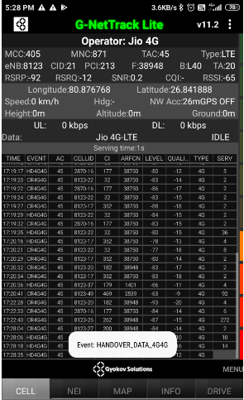
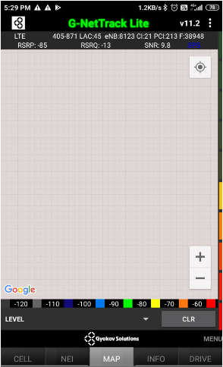
Mixed Mobility:- Lucknow
Rajajipuram F_block
RSRP: -85dbm to -100dbm

Slide 15
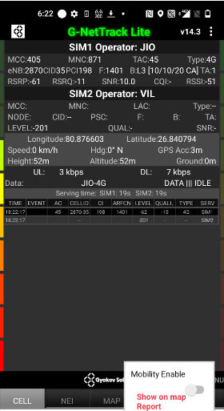
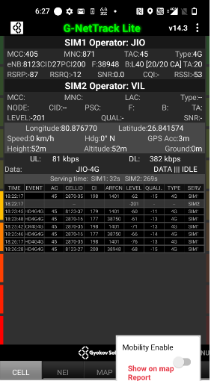
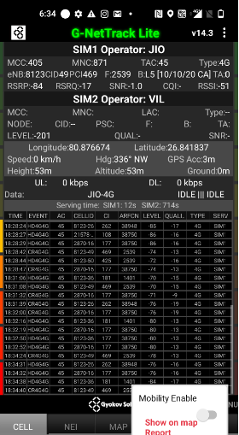
Inter Band Handover (FDD-TDD), JIO 4G
Band Handover | longitude | latitude | RSRP
3 & 5 & 40 | 80.876603 | 26.840794 | -60 to -90
Rajajipuram F_block market to
Talkatota police station

Slide 16
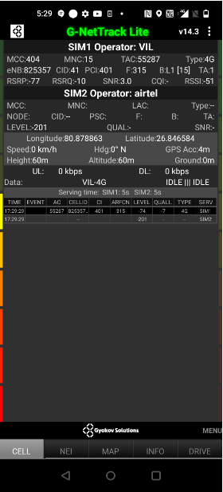
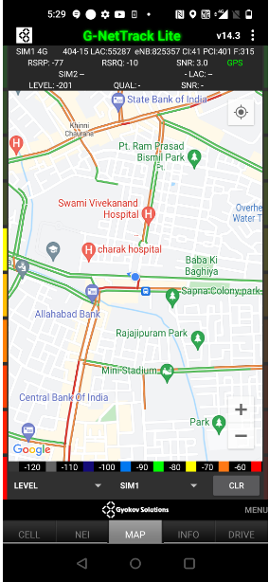
Near Cell VI:
Near cell(NC) | longitude | latitude | RSRP | Cell id | TDD/FDD E-ARFCN
1 | 80.878863 | 26.846584 | 77 | 41 | 315
Rajajipuram
RSRP:
-60dbm to -75dbm

Slide 17
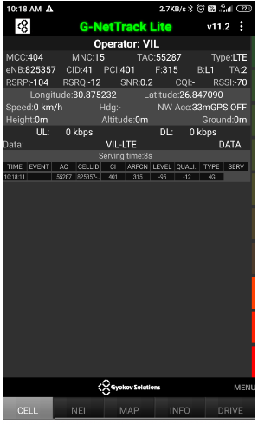
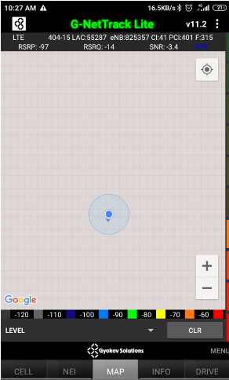
Cell Edge VI:
Edge cell(EC) | longitude | latitude | RSRP | Cell id | TDD/FDD E-ARFCN
1 | 80.875232 | 26.847090 | 98 | 41 | 315
Rajajipuram
RSRP:
-95dbm to -105dbm

Slide 18
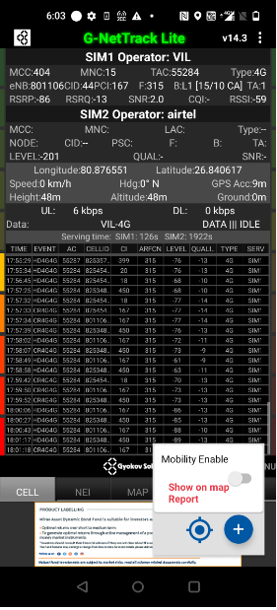
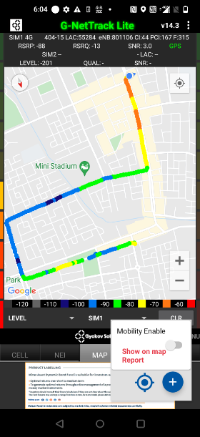
Mixed coverage area Vodafone:
Rajajipuram
RSRP:
-70dbm to -105dbm

Slide 19
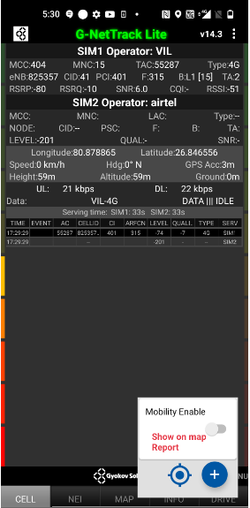
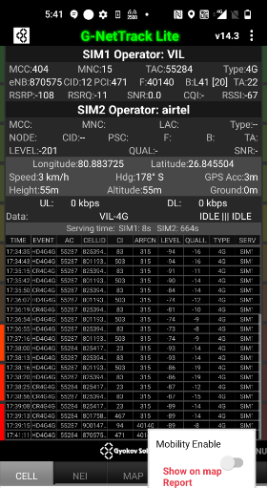
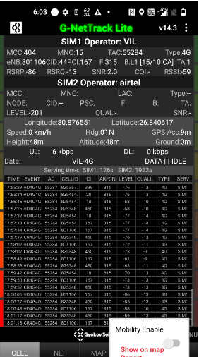
VI Inter Band Handover (TDD/FDD)
Band Hand Over | Longitude | Latitude | RSRP
1 & 3 & 40 | 80.878865 | 26.846556 | -75 to 105 dBM
Rajajipuram to Charbagh
Drive rout for Band HO
RSRP:
-90dbm to -105dbm

Slide 20
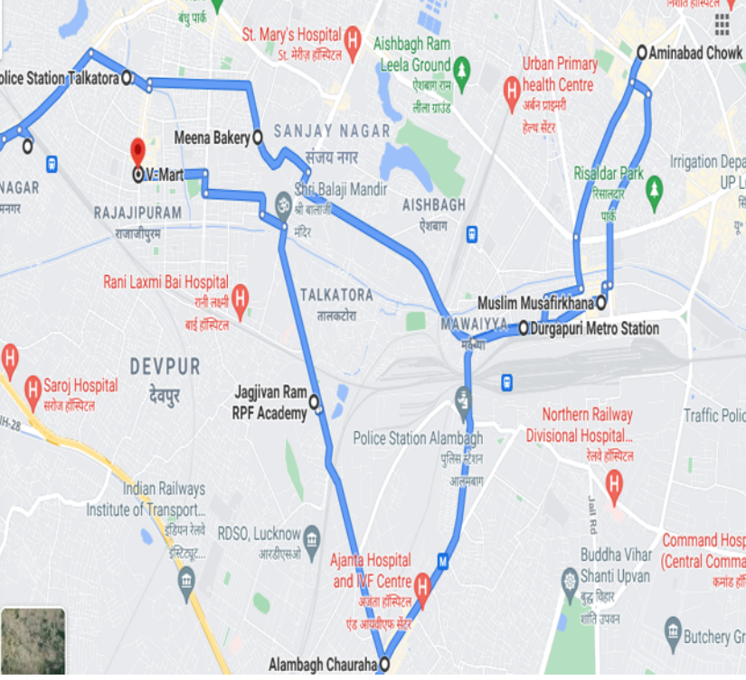
Drive root Tracking map :

Slide 21
THANK YOU
MARQUIS TECHNOLOGIES

