Slide 1
MARQUIS TECHNOLOGIES
Drive Route –Airtel, Idea, VODAFONE & Reliance JIO (FDD/TDD) LTE

Slide 2
Operator Information:
Operator | JIO 4G
MCC | 405
MNC | 862
APN | Jionet
Operator | Airtel 4G
MCC | 404
MNC | 95
APN | Airtelgprs.com
Operator | VI
MCC | 404
MNC | 19
APN | www

Slide 3
Operator Information 1
Functionality | Airtel
Website: http://www.airtel.com/ WAP APN: airtelgprs.com
Customer care | 199
MNC | 40
Bands supported | Both FDD and TDD
 | LTE 2300 MHz – TDD(Band 40)
 | LTE 1800,850 MHz – FDD(Band 3)
USSD | To check MDN: *282#
 | Balance check: *123#
 | Data Balance check: *121*114#
VoLTE | Supported
CSFB | Supported (CSFB to 2G)

Slide 4
Operator Information 2
Functionality | RELIANCE JIO
Website: http://www.jio.com WAP APN: jionet
Customer care | 198
MNC | 862
Bands supported | Both FDD and TDD
 | LTE 2300 MHz –TDD(Band 40)
 | LTE 850 MHz – FDD(Band 5)
 | LTE 1800 MHz –FDD(Band 3)
USSD | NA
 | NA
 | NA
VoLTE | Supported
CSFB | Not Supported

Slide 5
Operator Information 2
Functionality | VI
Website: http://www.jio.com WAP APN: jionet
Customer care | 198
MNC | 862
Bands supported | Both FDD and TDD
 | LTE 2300 MHz –TDD(Band 40,41)
 | LTE 850 MHz – FDD(Band 5)
 | LTE 1800 MHz –FDD(Band 3)
USSD | To check MDN*199#
 | Balance check198
 | Data Balance check: 121
VoLTE | Supported
CSFB | Supported

Slide 6
Drive Route
Near Cell :- Stationary: RSRP : -65dbm to -75dbm
Cell Edge :- Stationary: RSRP : -95dbm to -110dbm
Mixed :- Mobility: RSRP : -65dbm to -110dbm

Slide 7
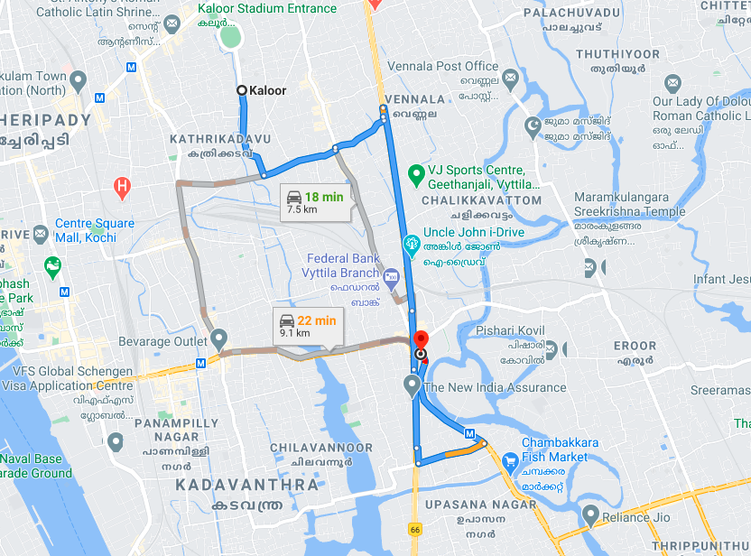
Near Cell (Airtel)
Near cell(NC) | longitude | latitude | RSRP | Cell id | FDD E-ARFCN
1 | 76.31734316 | 9.9748663, | 68 | 61 | 39200
Kaloor Stadium, Vytilla, Cochin , Kerala
RSRP:
-65dbm to 75dbm

Slide 8
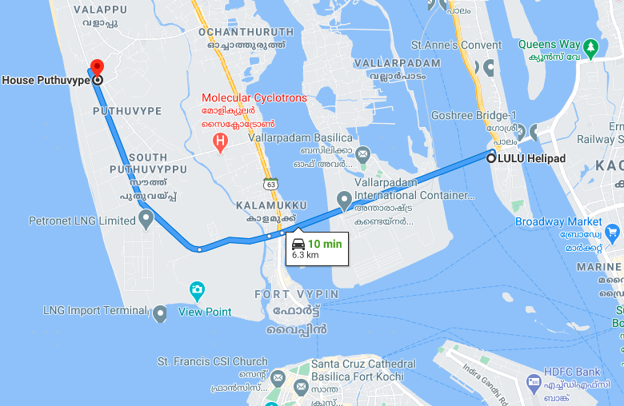
Edge Cell (Airtel)
Edge cell(EC) | longitude | latitude | RSRP | Cell id | TDD E-ARFCN
1 | 76.22501140 | 9.988314082 | 110 | 355 | 39200
Vypin, Cochin , Kerala
RSRP:
-95dbm to -110dbm

Slide 9
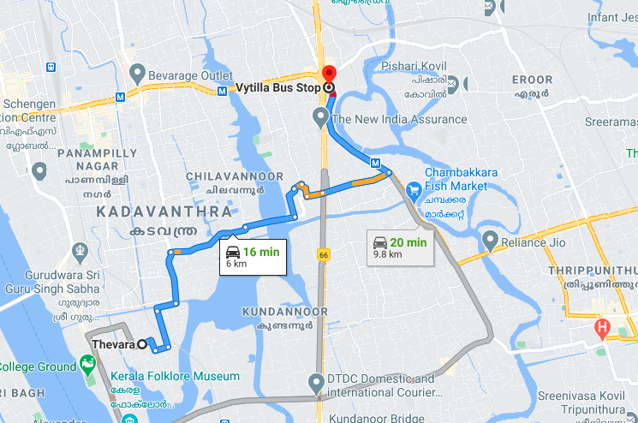
Mixed Mobility:- Vytilla, Cochin, Kerala
Vytila Mobility hub, Cochin ,Kerala
RSRP: -65dbm to -110dbm

Slide 10
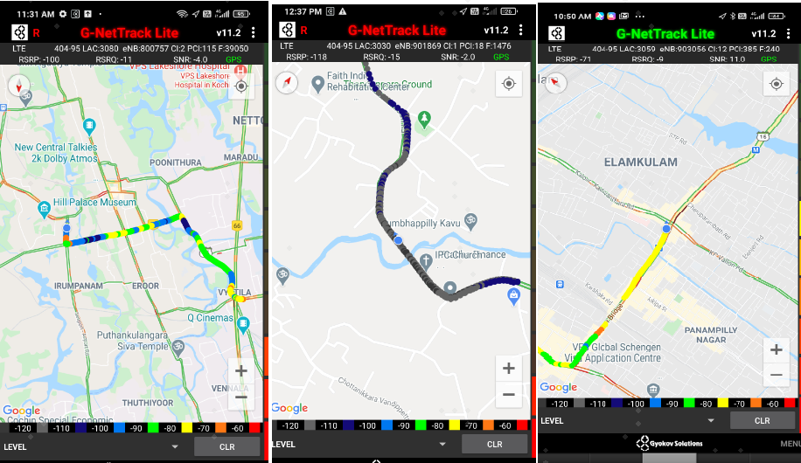
Airtel Band HO
Band Hand Over | longitude | Latitude | RSRP
1 | 80.200582 | 12.998878 | -85 to 105 dBM

Slide 11
Near Cell (Reliance JIO)
Near cell(NC) | longitude | latitude | RSRP | Cell id | TDD E-ARFCN
1 | 76.31734316 | 9.9748663, | 77 | 51 | 38750
Vytilla, Cochin , Kerala
RSRP:
-65dbm to -75dbm

Slide 12
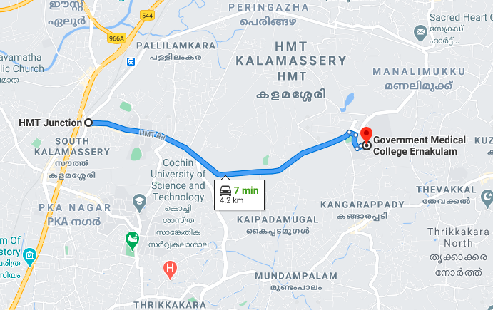
Edge Cell (Reliance JIO)
Edge cell(NC) | longitude | latitude | RSRP | Cell id | TDD E-ARFCN
1 | 76.338418762 | 10.04897520 | 98 | 480 | 38750
Kalamashery, Cochin , Kerala
RSRP:
-95dbm to -110dbm

Slide 13
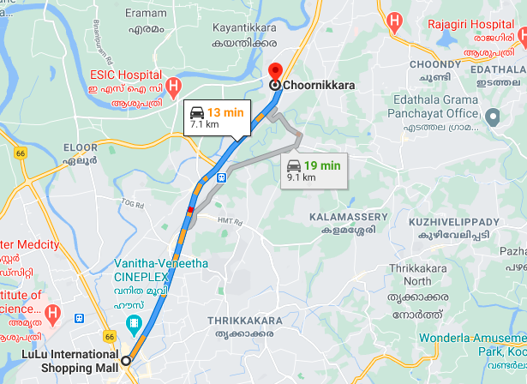
Mixed Mobility:- Kochi Kerala
RSRP: -95dbm to -110dbm

Slide 14
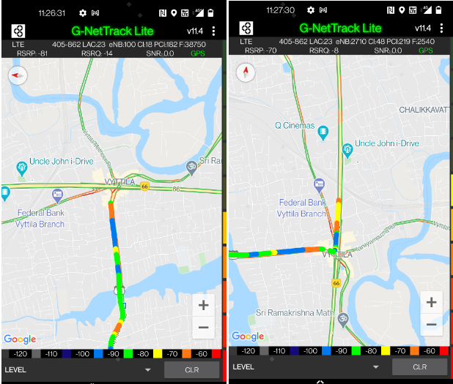
Inter Band Handover (FDD-TDD), JIO 4G
Band Handover | longitude | latitude | RSRP | PCI | TDD E-ARFCN
1 | 76.3190273 | 9.941172194513 | 85 | 213 | 38750

Slide 15
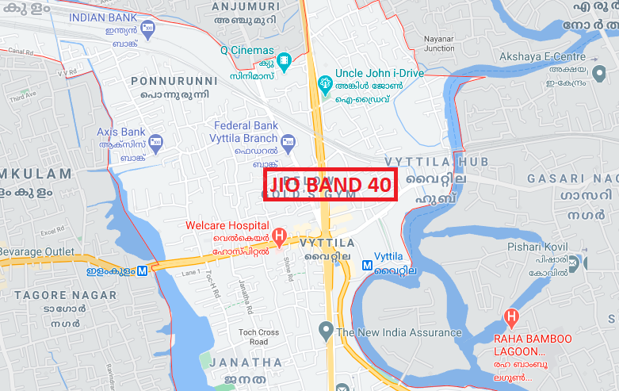
RJIO Band 40 Near Cell:

Slide 16
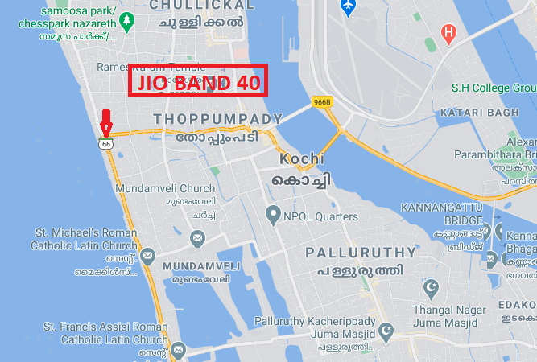
RJIO Band 40 Edge Cell:

Slide 17
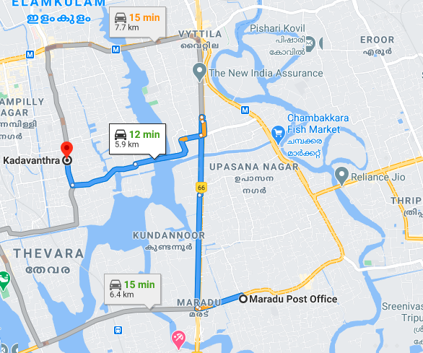
Near Cell VI:
Near cell(NC) | longitude | latitude | RSRP | Cell id | TDD E-ARFCN
1 | 76.33841789 | 10.0489564 | 78 | 346 | 39200
Maradu Cochin , Kerala
RSRP:
-65dbm to -75dbm

Slide 18
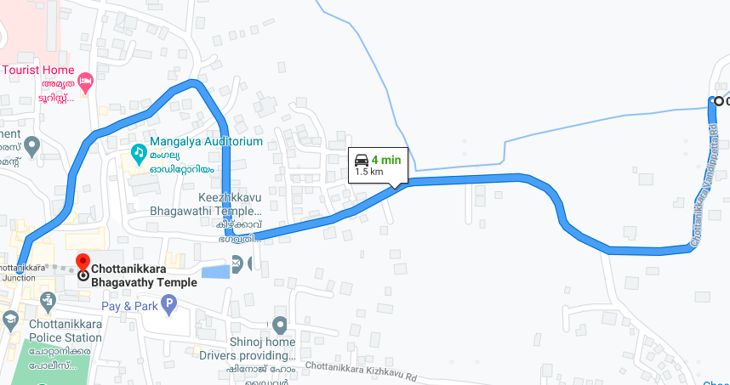
Cell Edge VI:
Edge cell(EC) | longitude | latitude | RSRP | Cell id | TDD E-ARFCN
1 | 76.33843567 | 10.04895432 | 98 | 164 | 39200
Chottanikara Cochin , Kerala
RSRP:
-95dbm to -105dbm

Slide 19
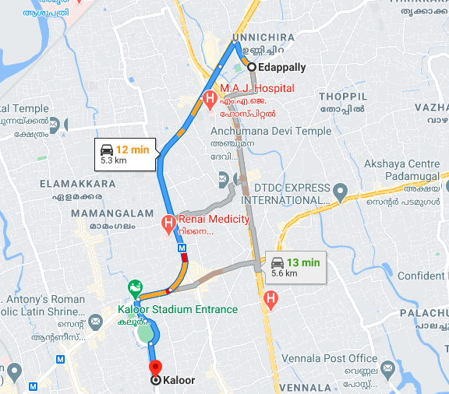
Mixed coverage area Vodafone:

Slide 20
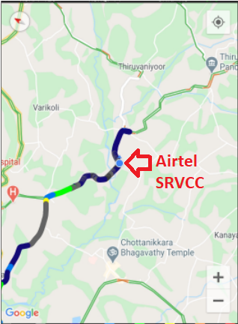
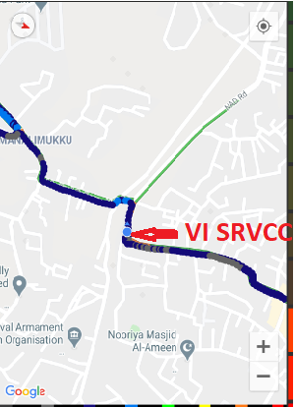
Airtel & VI SRVCC to UTRAN:

Slide 21
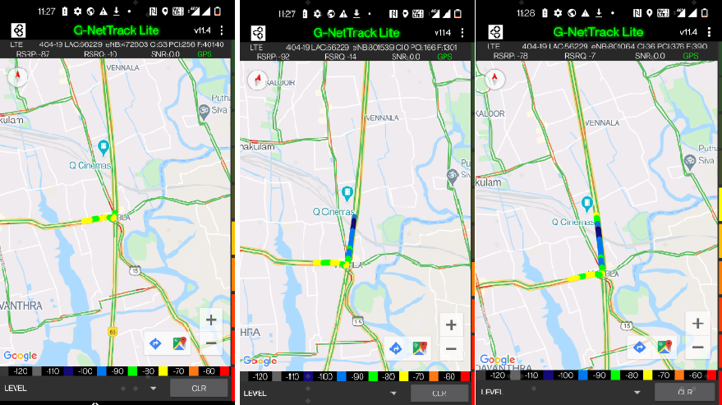
VIBand 3<>5<>40 Handover

Slide 22
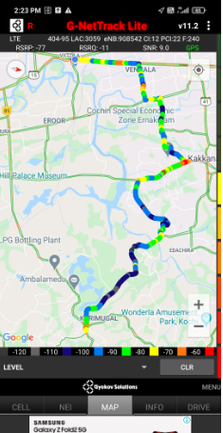
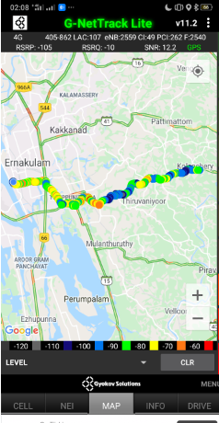
G net Tracker Drive Route

Slide 23
THANK YOU
MARQUIS TECHNOLOGIES

