Slide 1
MARQUIS TECHNOLOGIES
Drive Route

Slide 2
Delhi
Country | INDIA
Continent | Asia
City | Kolkata
Time Zone | GMT+5:30

Slide 3
Operator
JIO/Airtel/VI

Slide 4
Operators in Location
MCC | MNC | Operator
405 | 873 | JIO
404 | 31 | Airtel
404 | 30 | VI

Slide 5
Drive Route operator
Near Cell :-Stationary: RSRP: -60dbm to -75dbm
Mixed :-Mobility: RSRP : -75dbm to -95dbm
Cell Edge :-Stationary: RSRP : -95dbm to -115dbm

Slide 6
Kolkata/India
Operator Details:
S. No. | Operator |  | Supported Bands | Supported Features by Network
1 | Major | Airtel | LTE FDD B1/B3/B8 & TDD B40/N78 | VoWiFi/VoLTE/4G/2G/5G
2 |  | JIO | LTE FDD B3/B5 & TDD B40/N78/N28 | VoWiFi/VoLTE/4G/5G
3 |  | VI | LTE FDD B3/B8 & TDD B41/N78 | VoWiFi/VoLTE/4G/2G

Slide 7
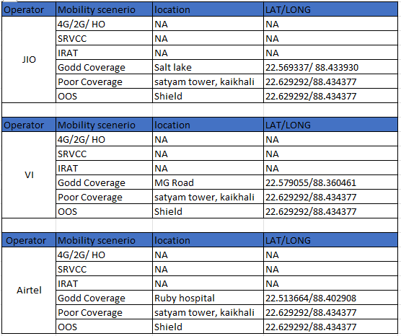

Slide 8
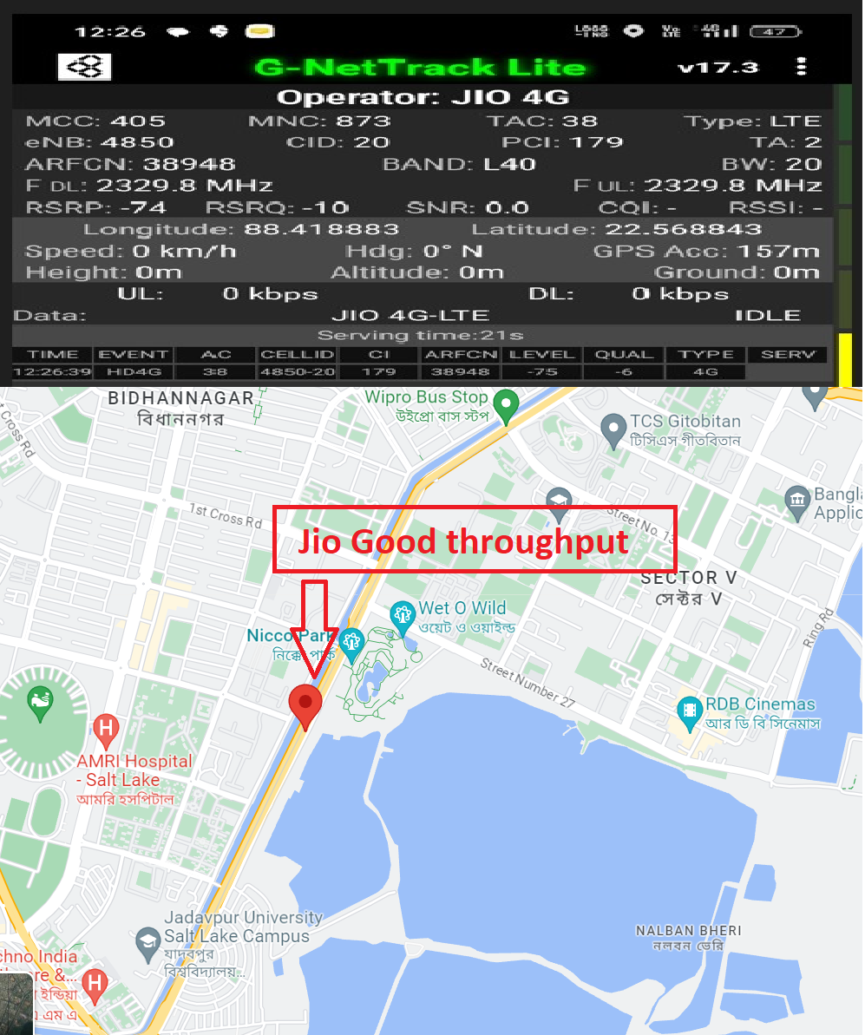
Near Cell Jio.
Lat/Long -22.568843° N, 88.418883° E
Specification –Jio Near cell
Good Throughput

Slide 9
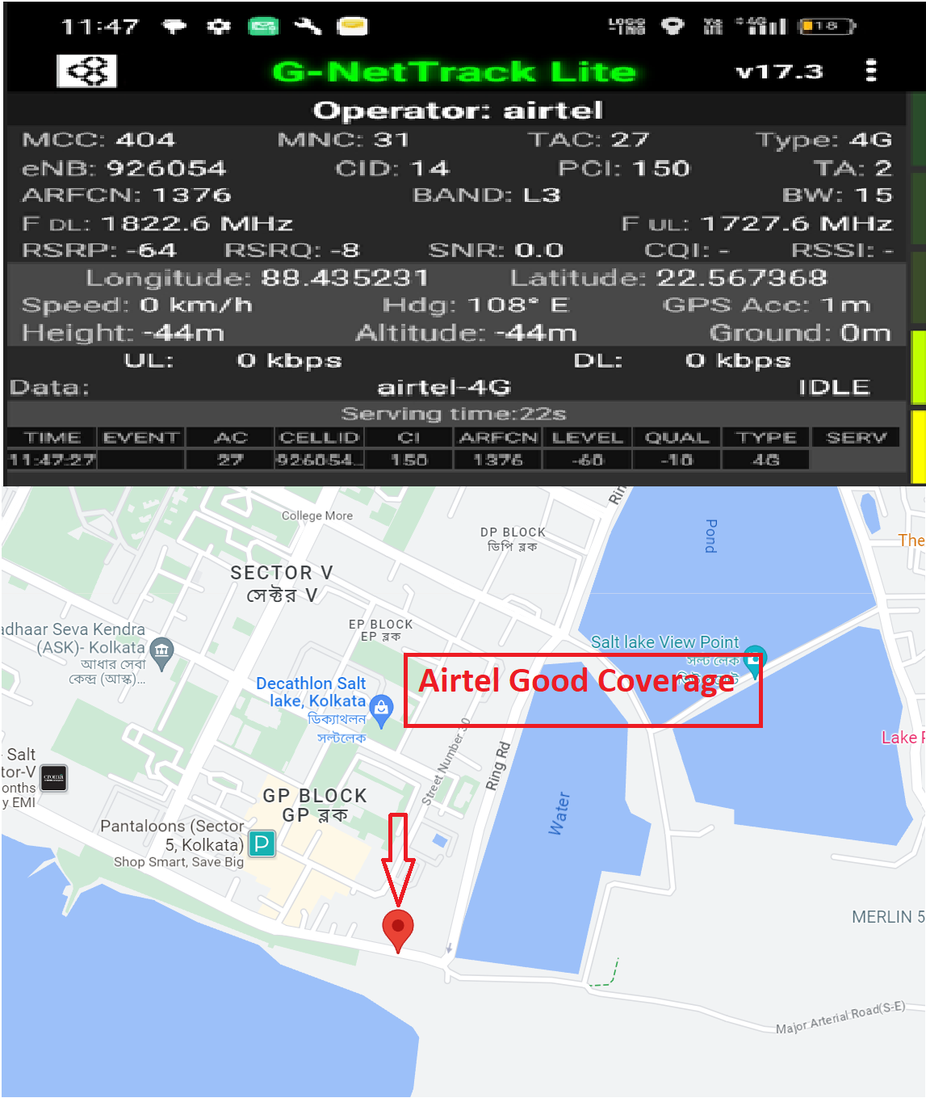
Near Cell Airtel.
Lat/Long -22.567368° N, 88.435231° E
Specification –Airtel Near cell
Good Throughput

Slide 10
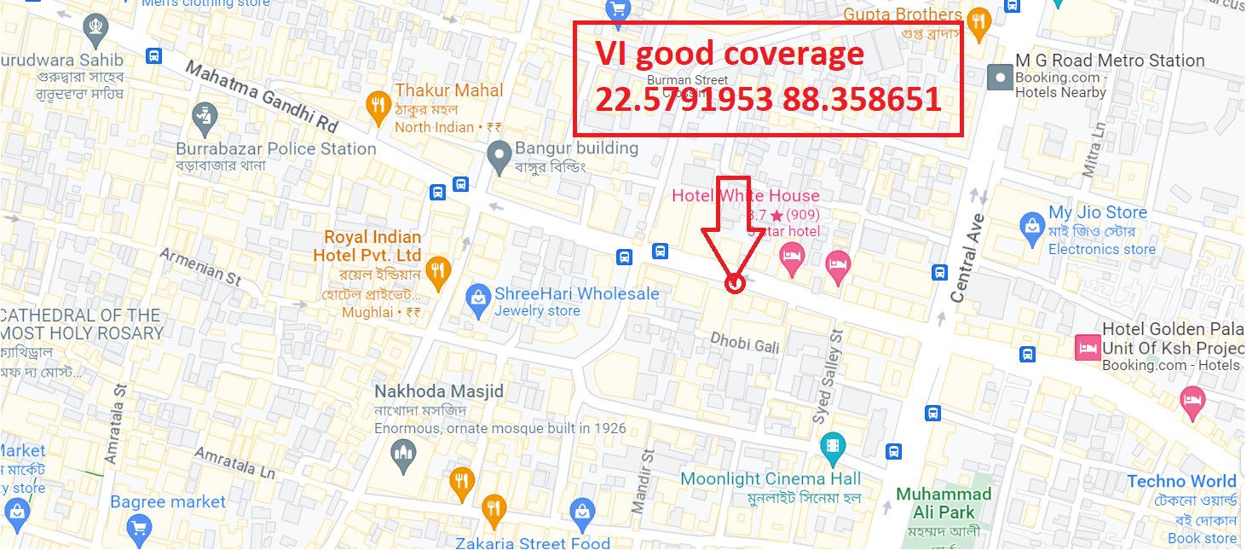
Near Cell VI.
Lat/Long -22.5791953° N, 88.358651° E
Specification –VI Near cell
Good Throughput

Slide 11
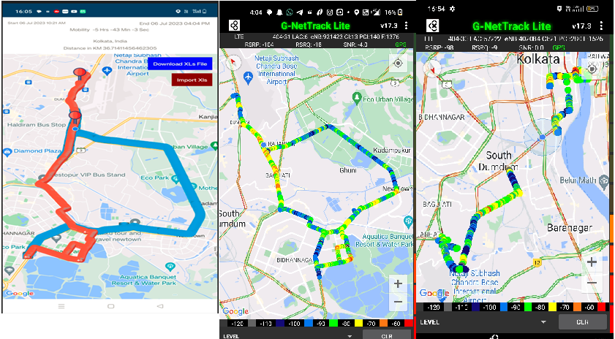
Drive route screen shot

Slide 12
THANK YOU
MARQUIS TECHNOLOGIES
www.marquistech.com

