Slide 1
MARQUIS TECHNOLOGIES
Drive Route

Slide 2
Jamnagar/India
Operator Details:
S. No. | Operator |  | Supported Bands | Supported Features by Network
1 | Major | Airtel | LTE FDD B1/B3/B8 & TDD B40/N78 | VoWiFi/VoLTE/4G/2G/5G
2 |  | JIO | LTE FDD B3/B5 & TDD B40/N78/N28 | VoWiFi/VoLTE/4G/5G
3 |  | VI | LTE FDD B1/B3/B8 & TDD B41 | VoWiFi/VoLTE/4G/2G
4 | Minor | BSNL | LTE FDD B28 | VoLTE/4G/3G/2G

Slide 3
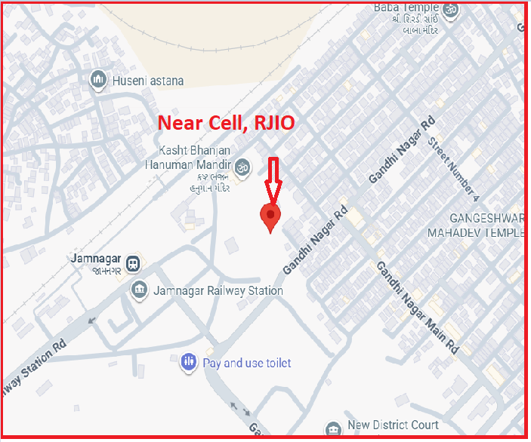
NR 5G Near Cell,RJIO
Lat/Long -22.493351,70.055380
Specification –Stable RJIO 5G SA network
Good Throughput

Slide 4
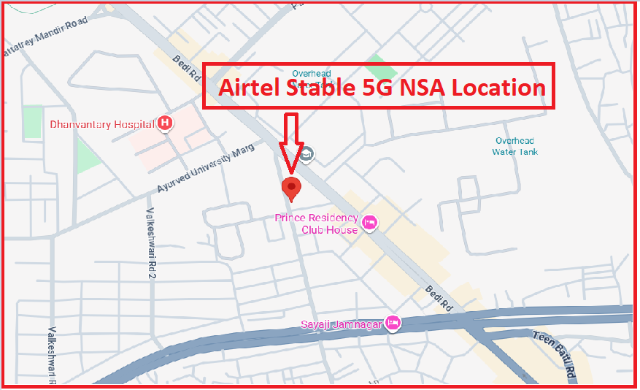
5G Near Cell,Airtel
Lat/Long -22.476125, 70.064795
Specification –Stable Airtel 5G NSA network
Average Throughput

Slide 5
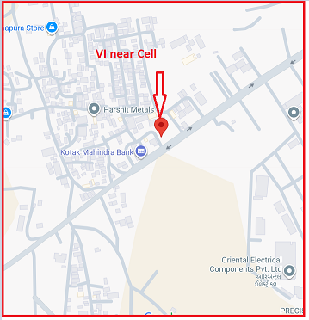
4G Near Cell,Vi
Lat/Long -22.476125, 70.064795
Specification –Stable Vi 4G LTE network
Good Throughput

Slide 6
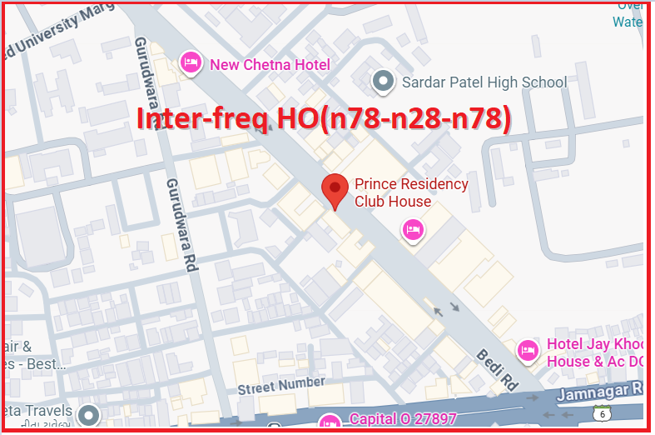
Inter-freq HO on NR ,JIO(n78-n28-n78)
Prince Residency Club House:-Lat. 22.475519 & Long. 70.066459, Reception to Room no. 206,203,207
The Vraj Hotel:- Lat. 22.469423 & Long. 70.041470, Room no:- 203 to 301 Location - Jamnagar,
(Prince Residency Club House, Opp. Amber Talkies Jamnagar and The Vraj Hotal)

Slide 7
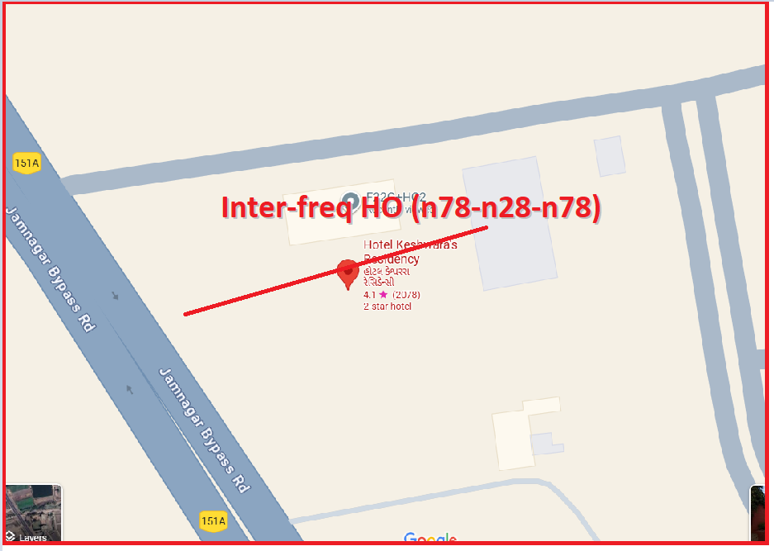
Inter-freq HO on NR ,JIO (n78-n28-n78)
Lat. 22.451490 & Long. 70.025938 to
Lat. 22.451243 & Long. 70.025667 Location – Hotel Keshwara's Residency Jamnagar

Slide 8
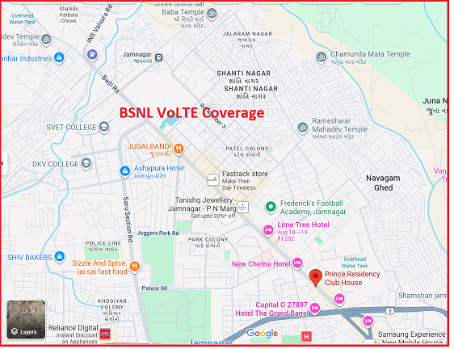
BSNL VOLTE AREA Lat/Long - Lat. 22.475519 & Long. 70.066459 Location –Jamnagar

Slide 9
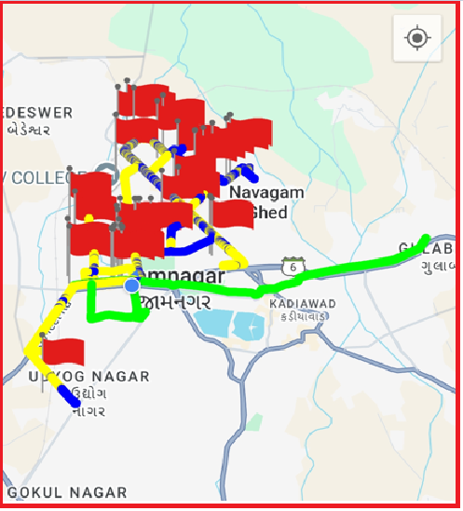
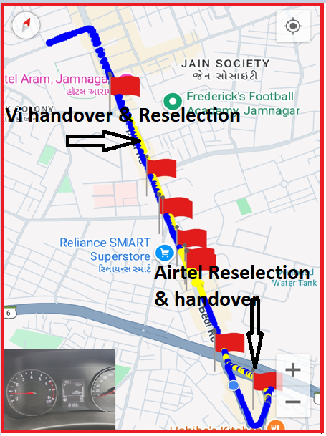
DRIVE ROUTE

Slide 10
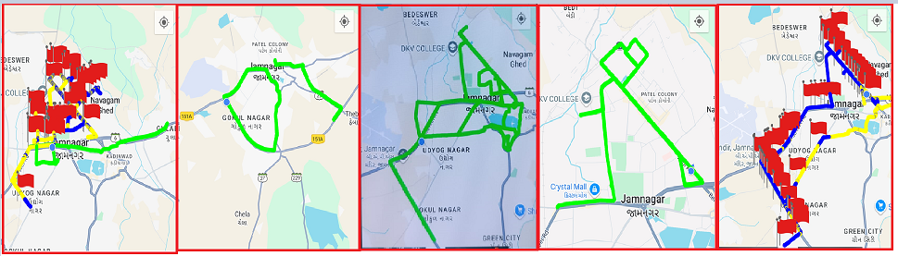
DRIVE ROUTE

Slide 11
THANK YOU
MARQUIS TECHNOLOGIES
www.marquistech.com

