Slide 1
MARQUIS TECHNOLOGIES
SRVCC/CA/Handover Drive Route
Jakarta (Indonesia)

Slide 2
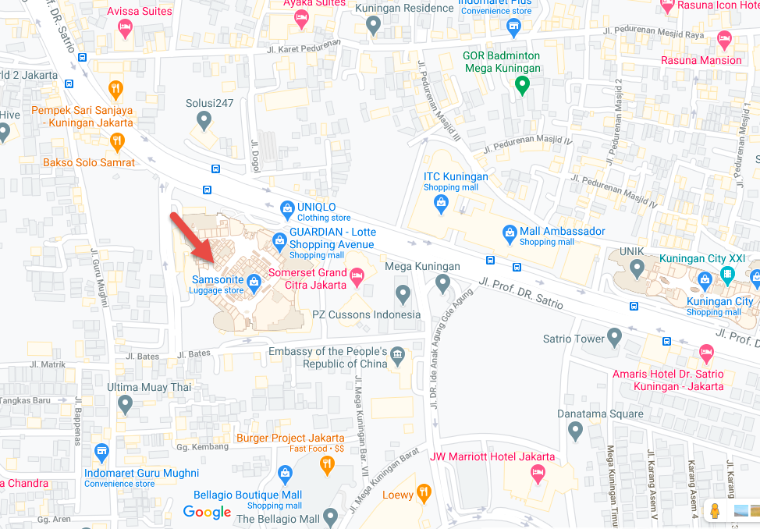
SRVCC location for Telkomsel
Parking Area Lotte Avenue (From Basement 1 to Basement 2)
-6.223886 , 106.822908

Slide 3
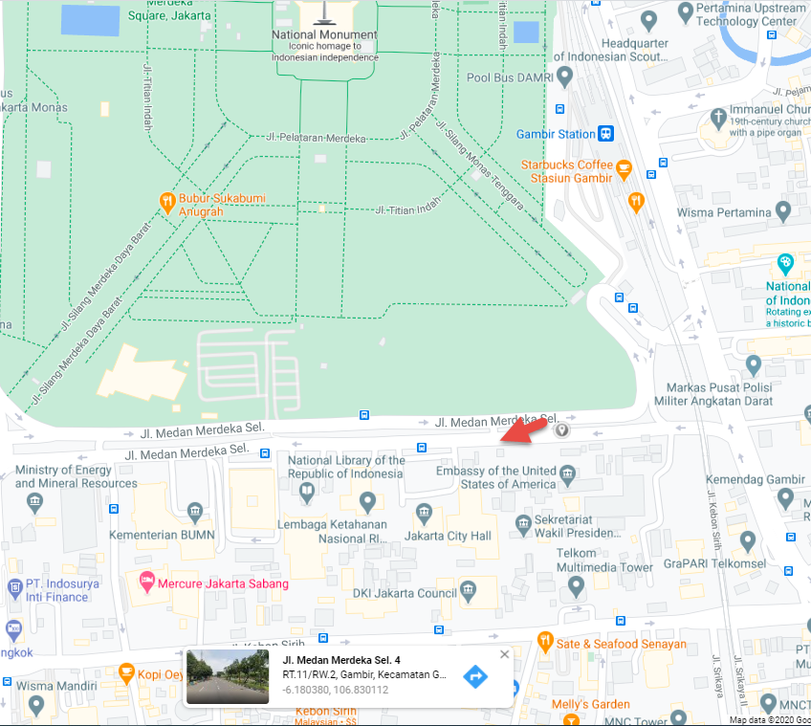
CA location for Telkomsel:
Medan Merdeka Selatan Street (near US Embassy)
(-6.180465, 106.829618)

Slide 4
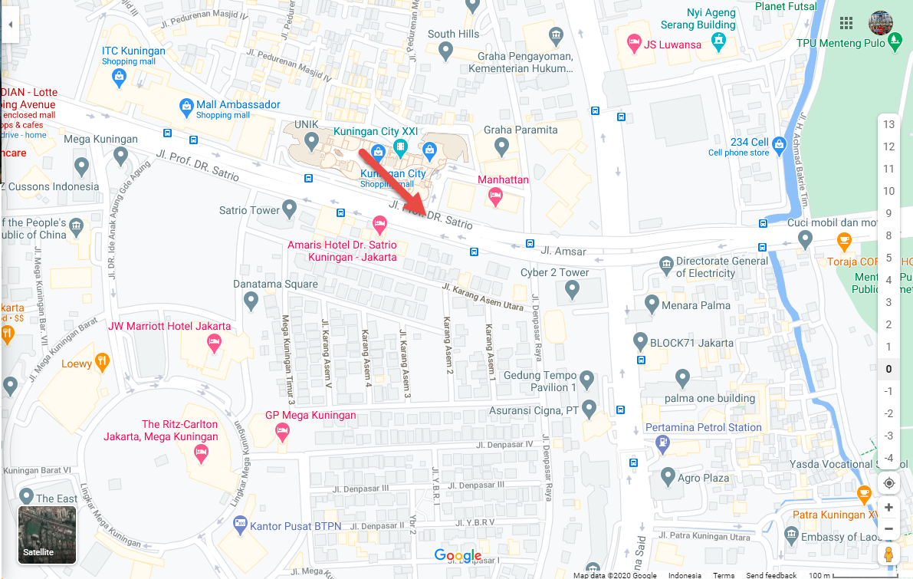
Reselection location for Telkomsel:
DR. Satrio Street
(-6.225284 , 106.830043)

Slide 5
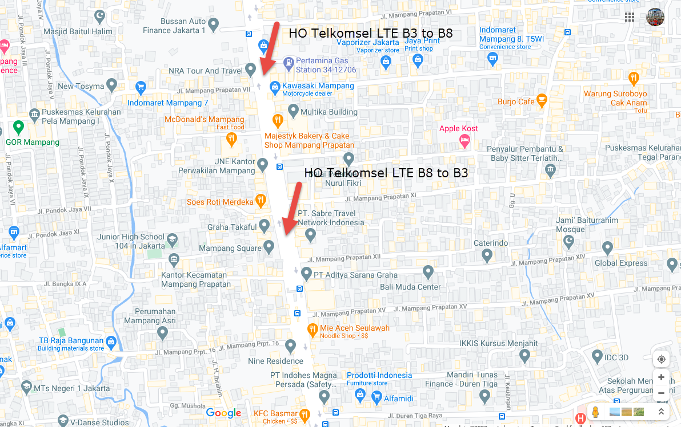
Handover FDD-FDD location for Telkomsel:
From Mampang Prapatan street to Warung Jati Timur
(LTE Band 3 to Band 8 -6.248055 , 106.828059 )
(LTE Band 8 to Band 3 -6.251046 , 106.826778 )

Slide 6
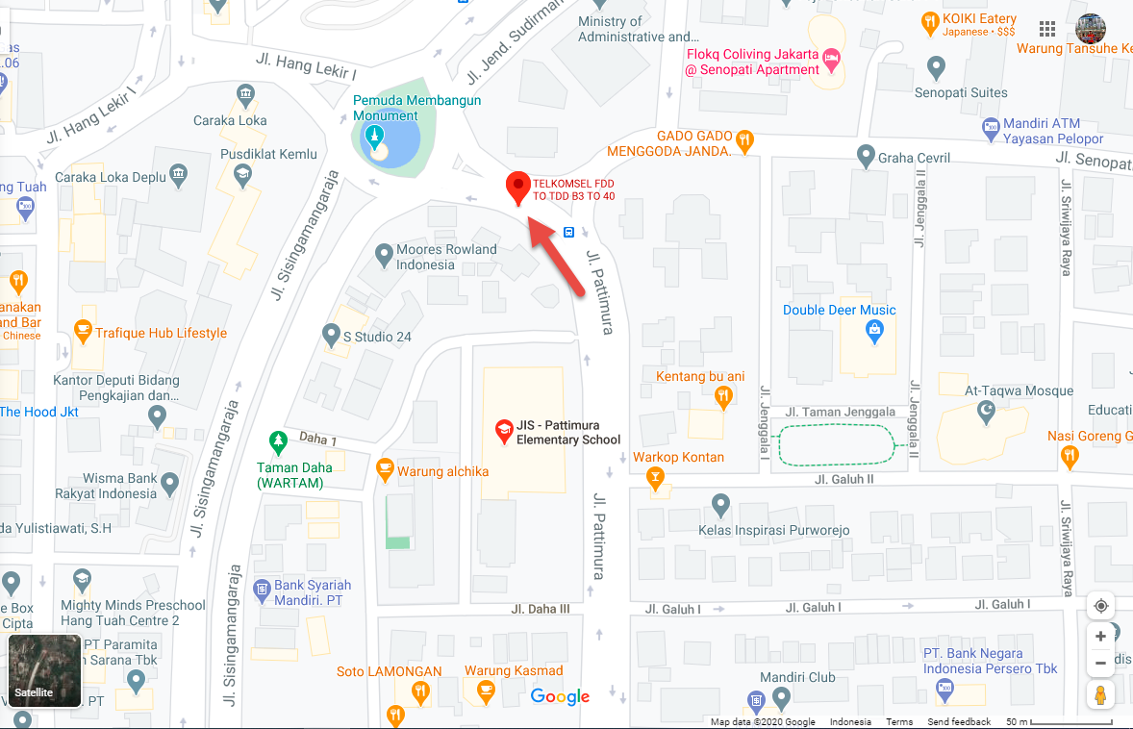
Handover FDD-TDD location for Telkomsel:
From Blok M to Pattimura Street
(LTE Band 3 to Band 40 -6.229623 , 106.800463 )

Slide 7
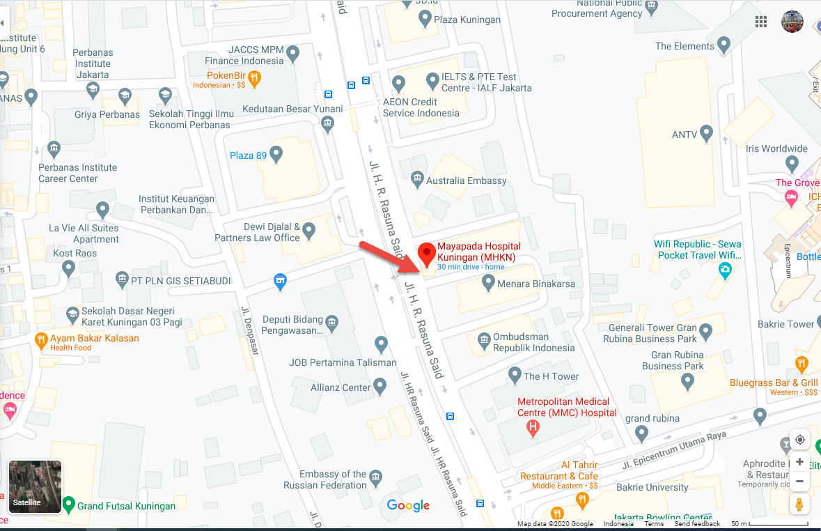
SRVCC location for Indosat Ooredoo
Parking Area Mayapada Hospital (From Lobby to Basement 1)
(-6.218624, 106.831753 )

Slide 8
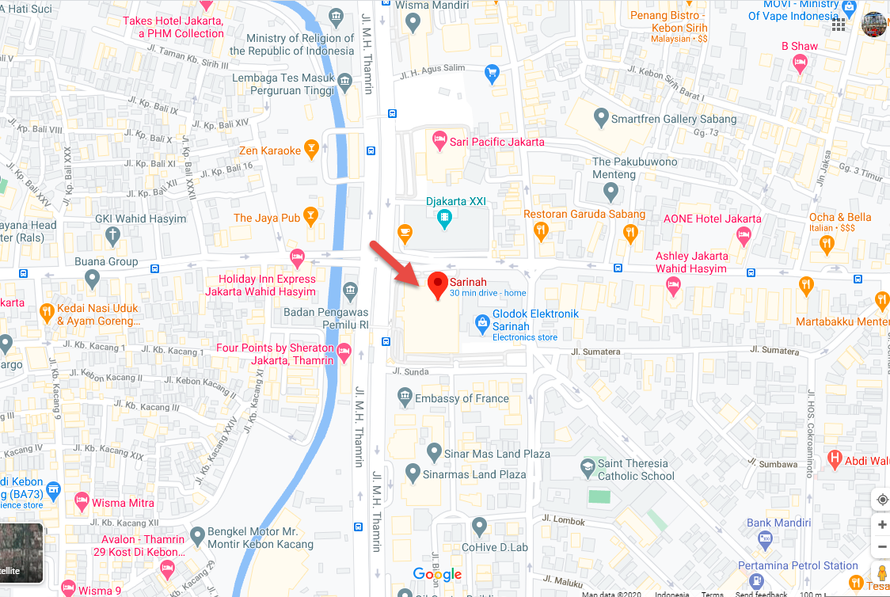
CA location for Indosat Ooredoo
Sarinah Street
(-6.187381 , 106.824362 )

Slide 9
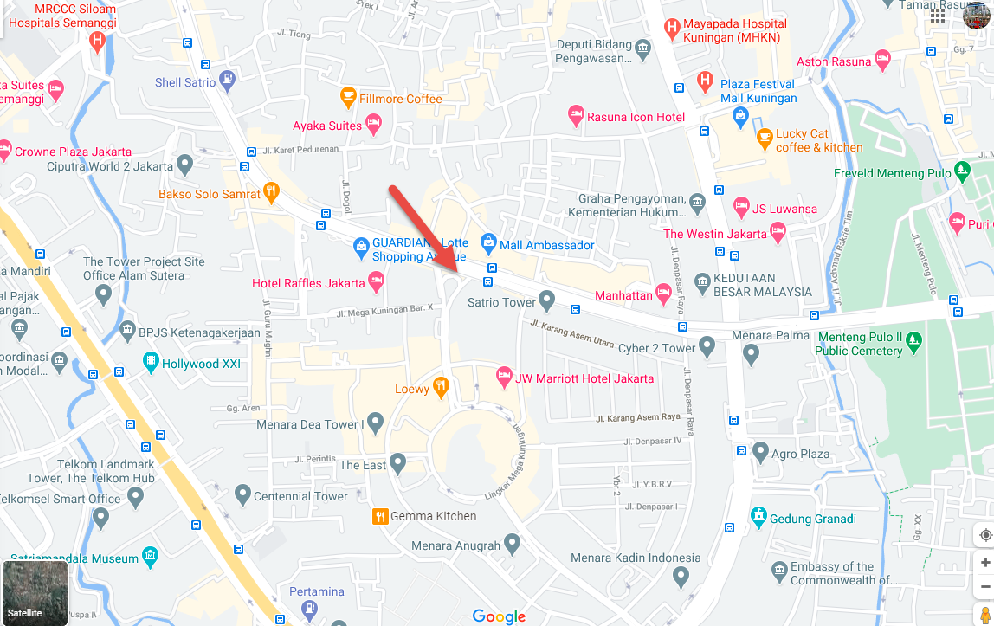
Reselection location for Indosat Ooredoo
DR. Satrio Street
(-6.224415 , 106.826386 )

Slide 10
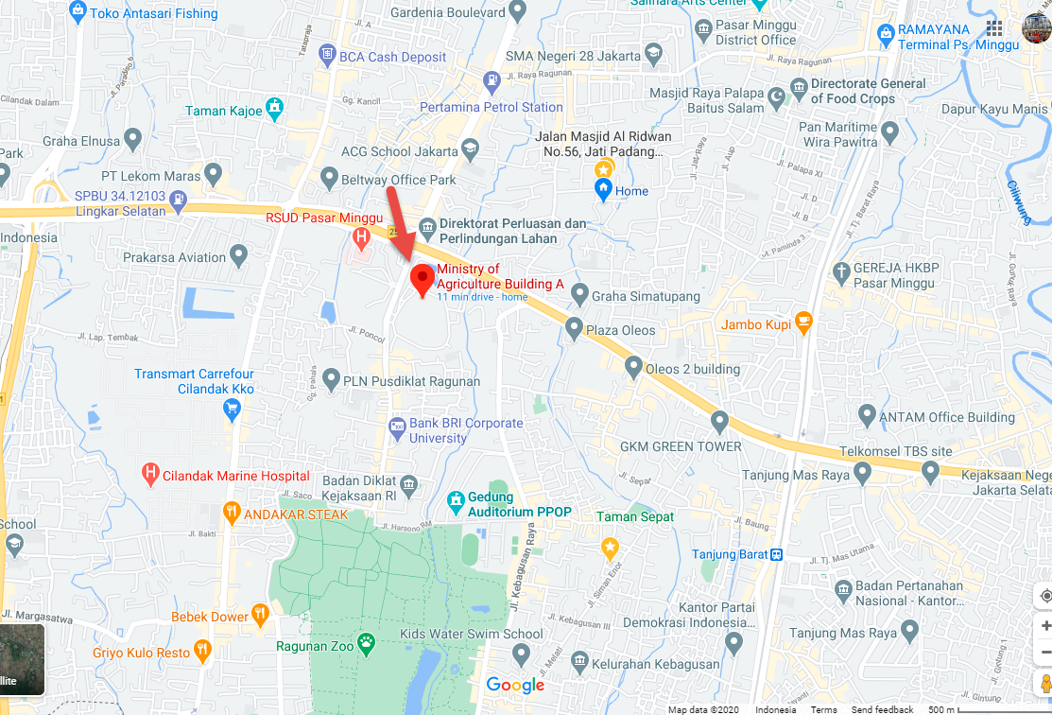
Handover FDD-FDD location for Indosat Ooredoo:
From Warung Jati Timur to Ministry of Agriculture
(LTE Band 3 to Band 1 -6.294520 , 106.822202 )

Slide 11
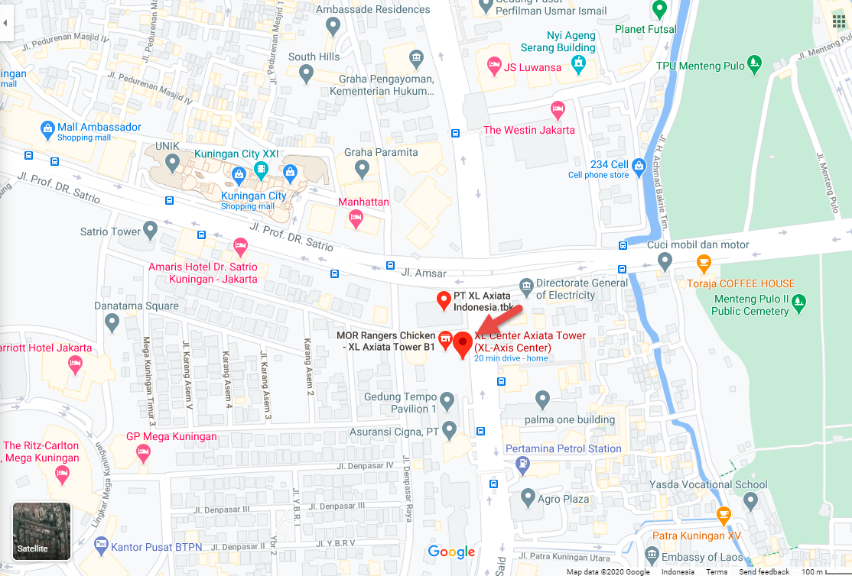
SRVCC location for XL Axiata
XL Axiata Tower Basement 3 (-6.226767, 106.832993 )

Slide 12
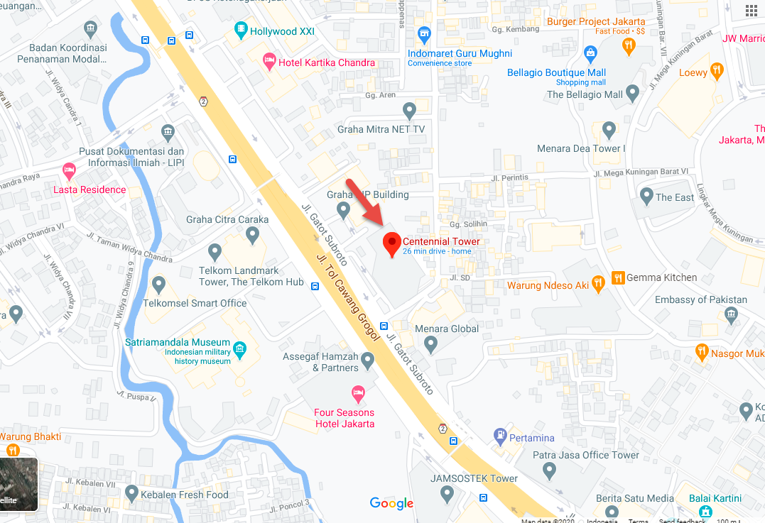
CA location for XL Axiata
Centennial Tower
(-6.229897 , 106.821274 )

Slide 13
Reselection location for XL Axiata
In Front of XL Axiata Tower (-6.226767, 106.832993 )

Slide 14
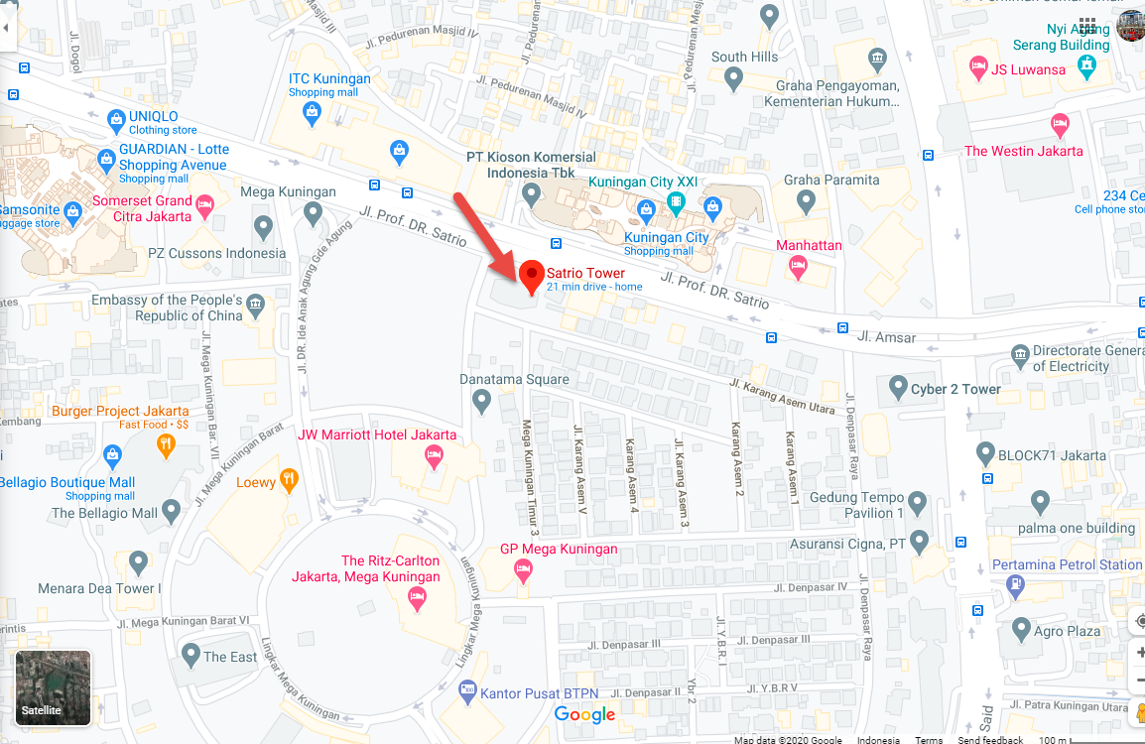
Handover FDD-FDD location for XL Axiata
In Front of Satrio Tower
(LTE Band 3 to Band 1 -6.225109 , 106.828513 )

Slide 15
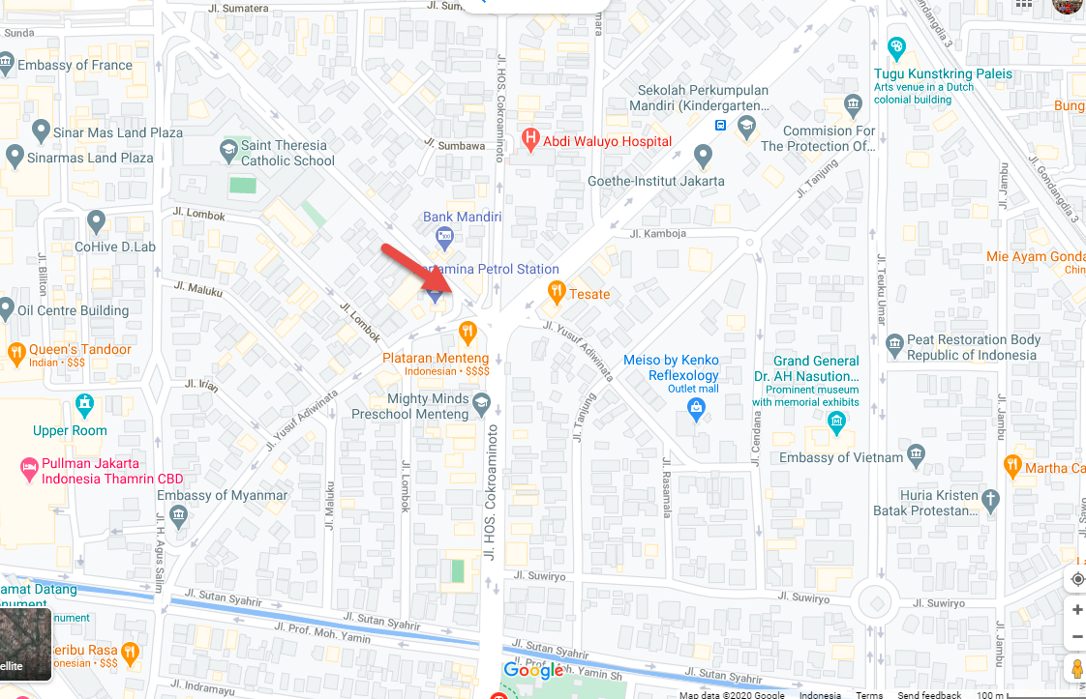
CA location for Smartfren
Near H.O.S Cokroaminoto Street
(-6.191174 , 106.828237 )

Slide 16
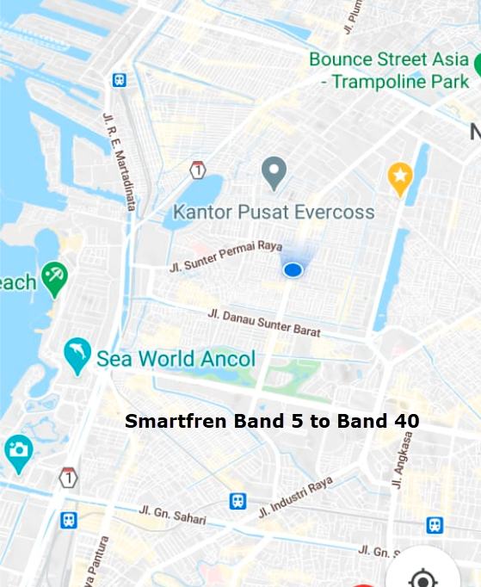
Handover FDD-TDD for Smartfren
Danau Sunter Permai Raya Street
(LTE Band 5 to Band 40 -6.139039 , 106.863110 )

Slide 17
Out of Services location for Telkomsel, Indosat Ooredoo and Smartfren
XL Axiata Tower Basement 4 (-6.226767, 106.832993 )

Slide 18
THANK YOU
MARQUIS TECHNOLOGIES
www.marquistech.com

