Slide 1
MARQUIS TECHNOLOGIES
Drive Route –Airtel, VI & Reliance JIO
jABALPUR

Slide 2
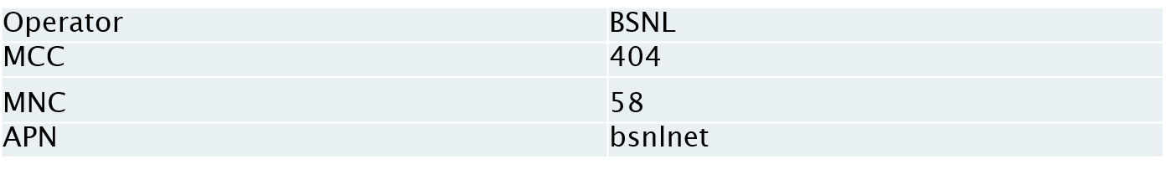
Operator Information:
Operator | JIO 4G
MCC | 405
MNC | 863
APN | Jionet
Operator | Airtel 4G
MCC | 404
MNC | 93
APN | Airtelgprs.com
Operator | VI
MCC | 404
MNC | 78
APN | internet

Slide 3
Operator Information 1
Functionality | Airtel
Website: http://www.airtel.com WAP APN: airtelgprs.com
Customer care | 121
MNC | 93
Bands supported | Both FDD and TDD
 | LTE 2300 MHz – TDD(Band 40)
 | LTE 1800,2100– FDD(Band 3 and 1)
USSD | To check MDN: *282#
 | Balance check: *123#
 | Data Balance check: *121*114#
VoLTE/Vo-Wifi | Supported
CSFB | Supported (CSFB to 2G)

Slide 4
Operator Information 2
Functionality | RELIANCE JIO
Website: http://www.jio.com WAP APN: Jionet
Customer care | 198
MNC | 863
Bands supported | Both FDD and TDD
 | LTE 2300 MHz –TDD(Band 40)
 | LTE 850 MHz – FDD(Band 5)
 | LTE 1800 MHz –FDD(Band 3)
USSD | NA
 | NA
 | NA
VoLTE/Vo-WiFi | Supported
CSFB | Not Supported

Slide 5
Operator Information 3
Functionality | VI
Website: http://www.myvi.in WAP APN: internet
Customer care | 198
MNC | 78
Bands supported | Both FDD and TDD
 | LTE - 2300 MHz –TDD(Band 40)
 | LTE - 2500 MHz –TDD(Band 41)
 | LTE 1800 MHz –FDD(Band 3)
USSD | To check MDN *199#
 | Recharge *199*5#
 | All Balance Check: *199*2*1#
VoLTE/VoWiFi | Supported / Not Support
CSFB | Supported (Switched to 3G)

Slide 6
Drive Route
Near Cell :- Stationary: RSRP : -65dbm to -75dbm
Cell Edge :- Stationary: RSRP : -95dbm to -110dbm
Mixed :- Mobility: RSRP : -65dbm to -110dbm

Slide 7
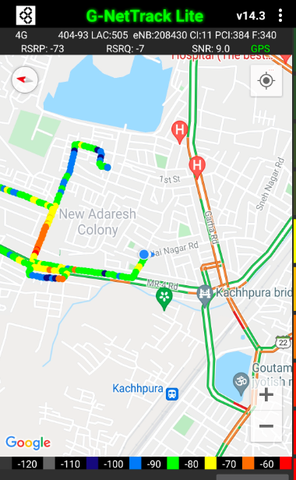
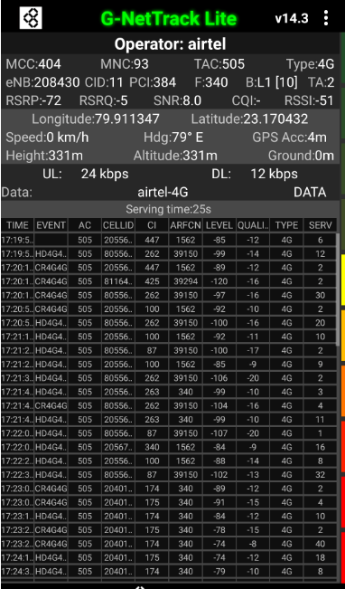
Airtel Network Parameters :Near Cell
Near cell (NC) | longitude | latitude | RSRP | PCI | E-ARFCN
1 | 79.911347 | 23.170432 | -72 | 384 | 340
RSRP: -65dbm to -75dbm

Slide 8
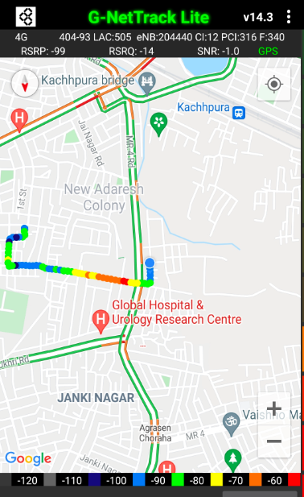
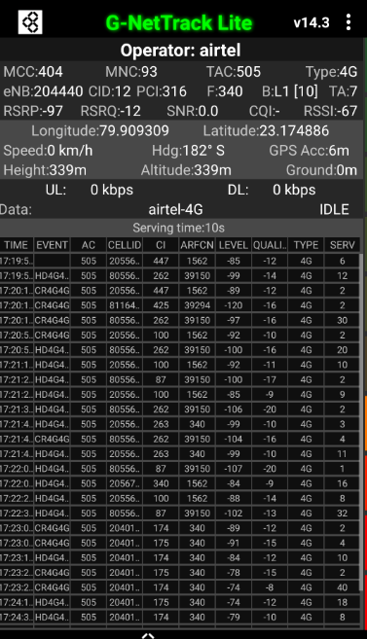
Edge Cell (Airtel):
Edge cell (EC) | longitude | latitude | RSRP | PCI | E-ARFCN
1 | 79.909309 | 23.174886 | -97 | 316 | 340
RSRP: -95dbm to -110dbm

Slide 9
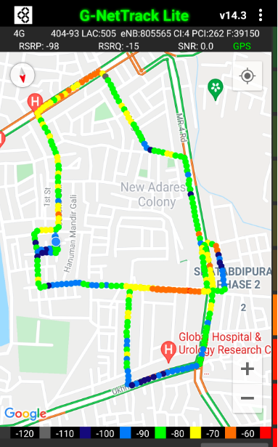
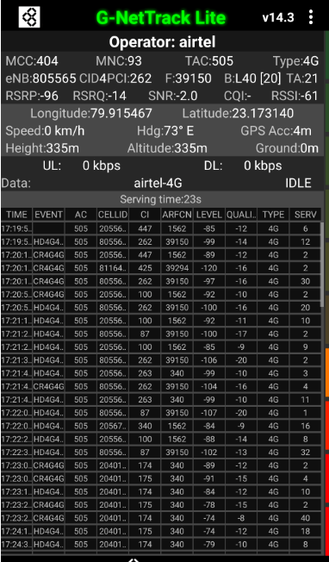
Mixed Mobility Airtel:
RSRP: -65dbm to -110dbm
Yadav nagar colony, Jabalpur M.P.

Slide 10
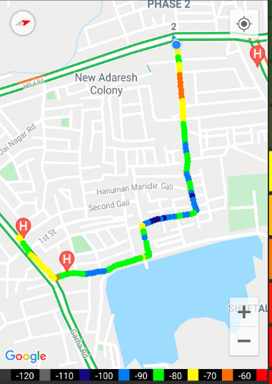
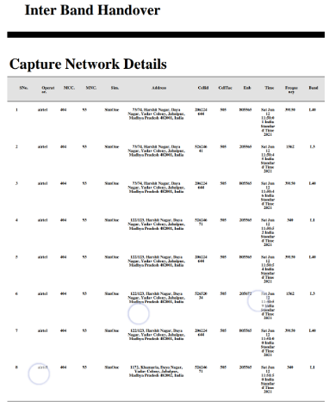
Airtel Inter-Band HO:
Band Hand Over | Longitude | Latitude | RSRP
3 | 79.915443 | 23.168565 | -75 to -105 dBM

Slide 11
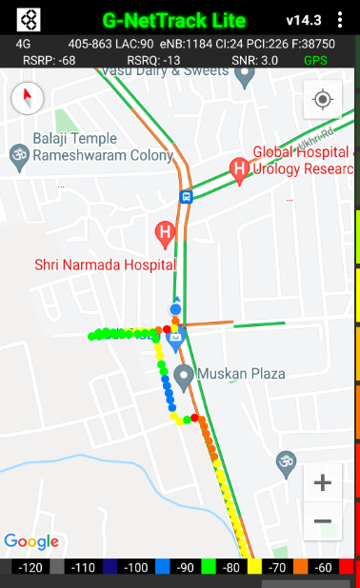
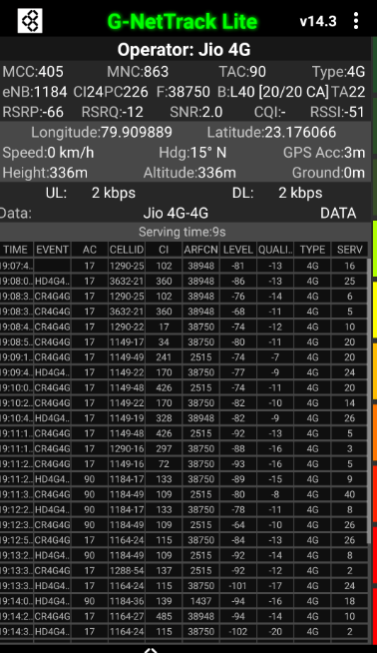
Jio Network Parameters Near Cell:
Near cell (NC) | longitude | latitude | RSRP | PCI | E-ARFCN
1 | 79.909889 | 23.176066 | -66 | 226 | 38750
RSRP: -65dbm to -75dbm

Slide 12
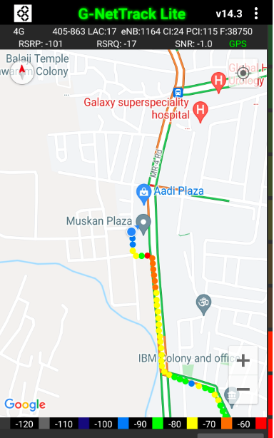
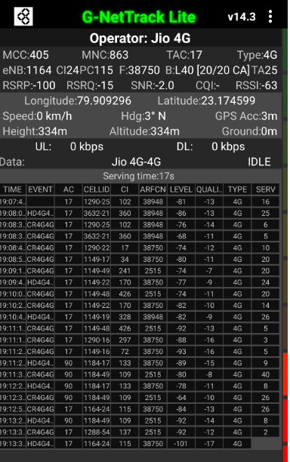
Edge Cell (JIO)
Edge cell (EC) | longitude | latitude | RSRP | PCI | E-ARFCN
1 | 79.909296 | 23.174599 | -100 | 115 | 38750
RSRP: -95dbm to -110dbm

Slide 13
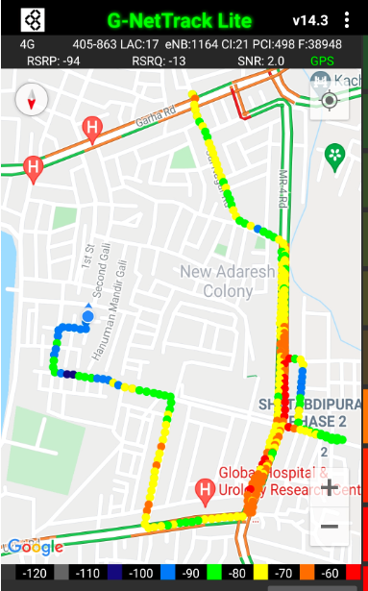
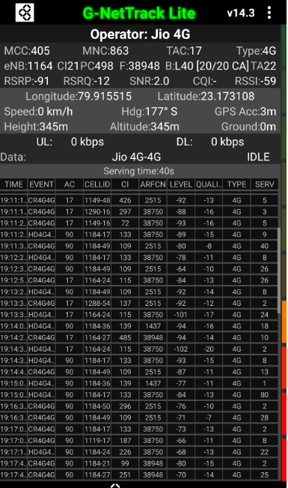
Mixed Mobility Jio:- Jabalpur,M.P
RSRP: -65dbm to -110dbm

Slide 14

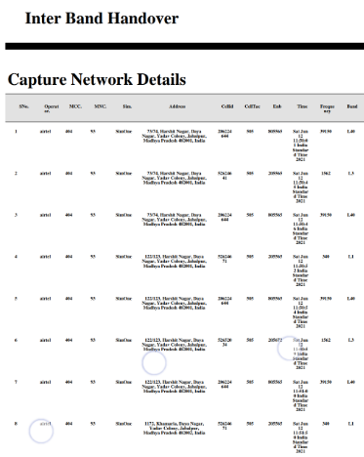
Jio Inter-Band HO:
Band Handover | longitude | latitude | RSRP | PCI | TDD E-ARFCN
3 | 79.909889 | 23.176066 | -94 | 226 | 38750

Slide 15
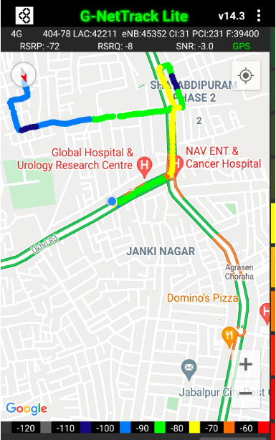
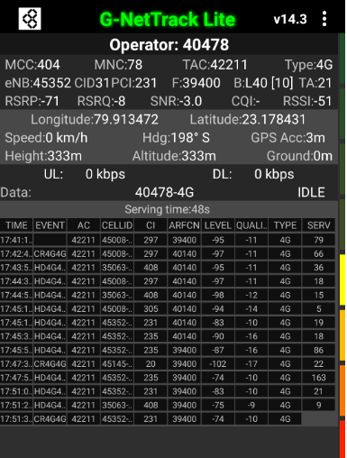
VI Network Parameters Near Cell:
Near cell (NC) | longitude | latitude | RSRP | PCI | E-ARFCN
1 | 79.913472 | 23.178413 | -71 | 231 | 39400
RSRP: -65dbm to -75dbm

Slide 16
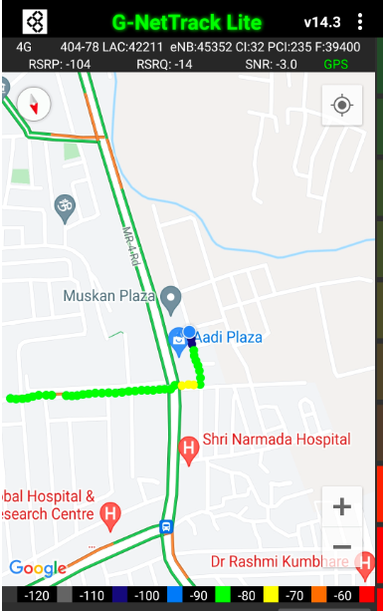
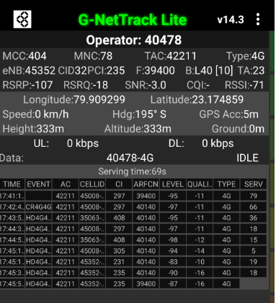
Cell Edge VI:
Edge cell (EC) | longitude | latitude | RSRP | PCI | E-ARFCN
1 | 79.909299 | 23.174859 | -107 | 235 | 39400
RSRP: -95dbm to -105dbm

Slide 17
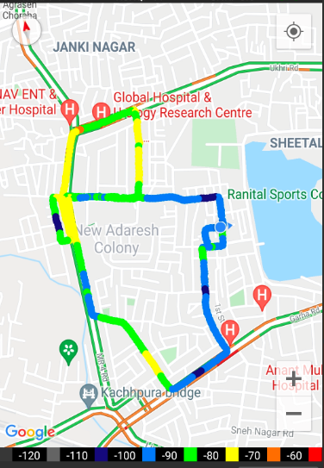
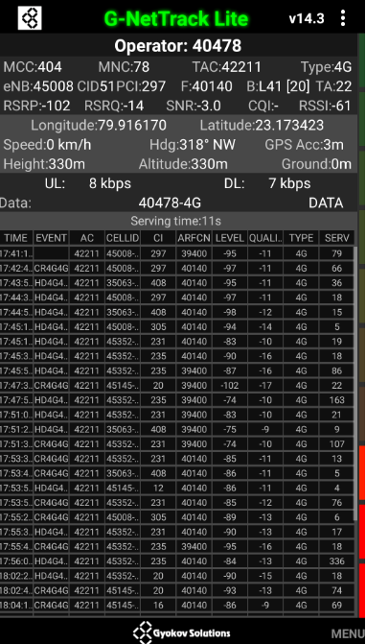
Mixed coverage area VI:
RSRP: -65dbm to -110dbm

Slide 18
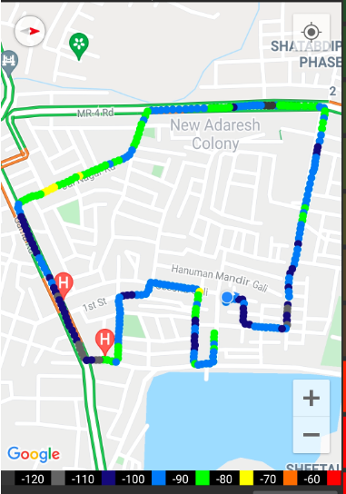
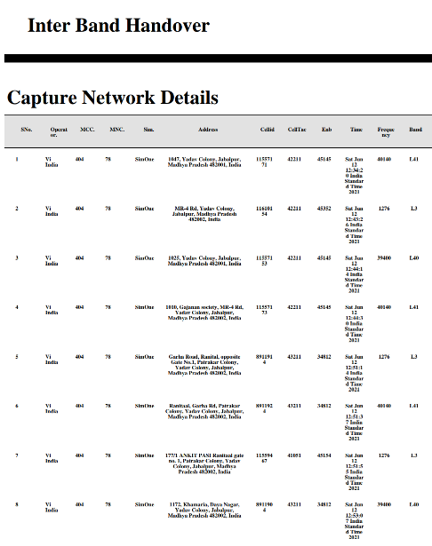
VI Inter-Band HO:
Band Handover | longitude | latitude | RSRP | PCI | TDD E-ARFCN
4 | 79.915461 | 23.173016 | -99 | 297 | 40140

Slide 19
Drive Route :
Mixed coverage area VI
Mixed coverage area JIO
Mixed coverage area AIRTEL

Slide 20
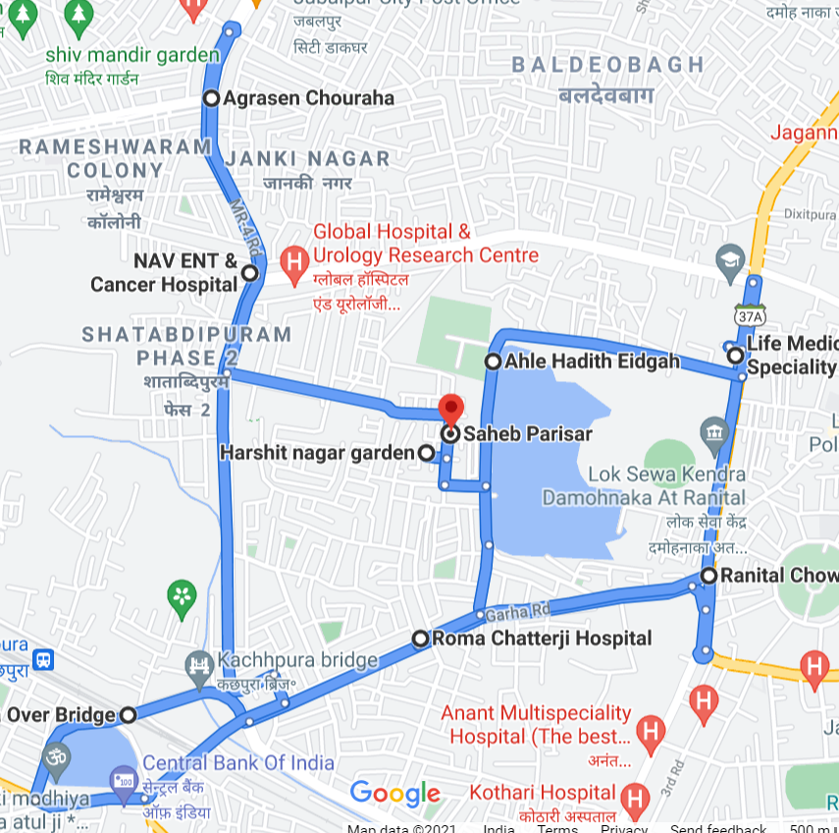
Drive Route :

Slide 21
THANK YOU
MARQUIS TECHNOLOGIES

