Slide 1
MARQUIS TECHNOLOGIES
Drive Route

Slide 2
Helsinki/Finland
Operator Details:
S. No. | Operator |  | Supported Bands | Supported Features by Network
1 | Major | Elisa | N1/N78/N28 | VoWiFi/VoLTE/4G/2G/5G
2 |  | Telia | N1/N78/N28 | VoWiFi/VoLTE/4G/5G

Slide 3
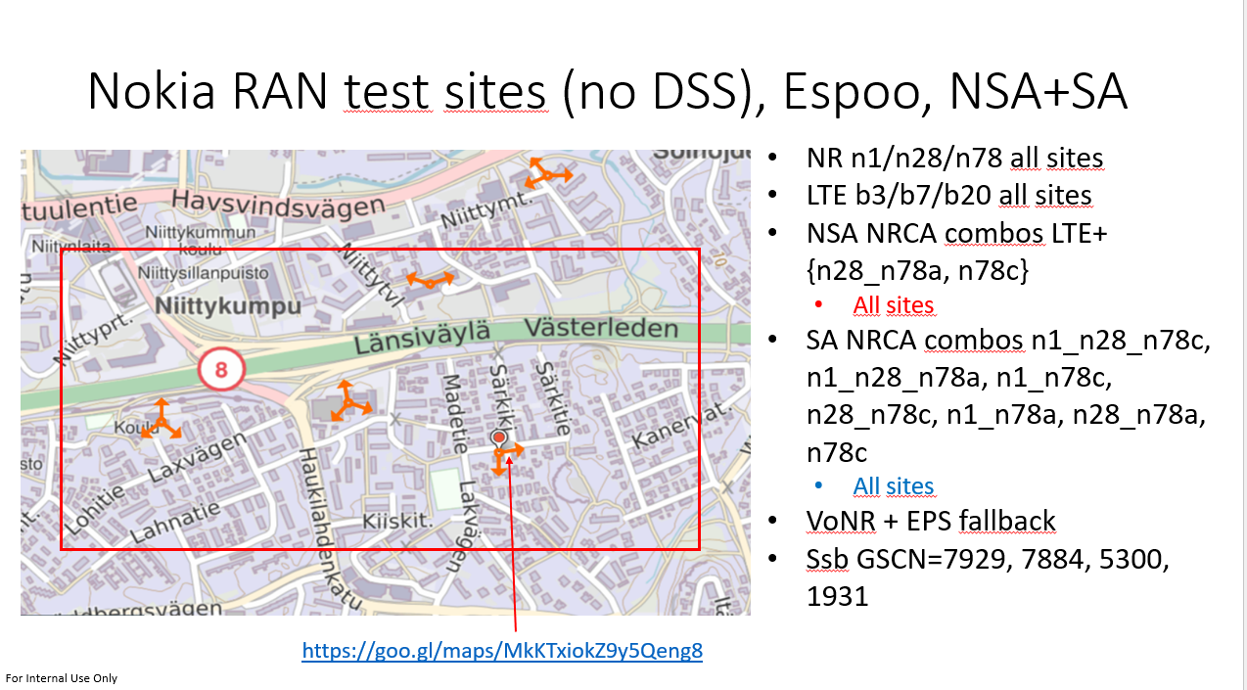
5G Near Cell,Elisa,Nokia Ran Site
https://goo.gl/maps/MkKTxiokZ9y5Qeng8

Slide 4
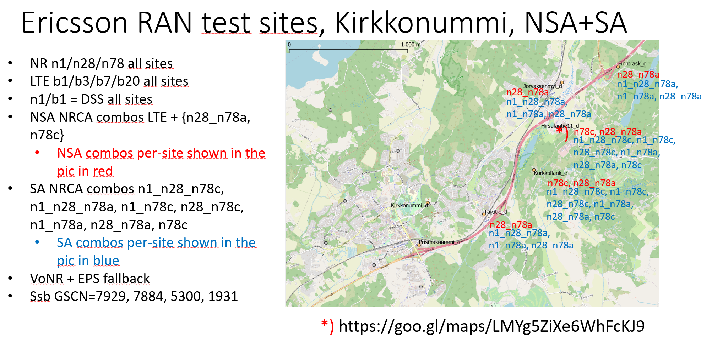
5G Near Cell,Elisa,Ericsson Ran Site
https://goo.gl/maps/LMYg5ZiXe6WhFcKJ9

Slide 5
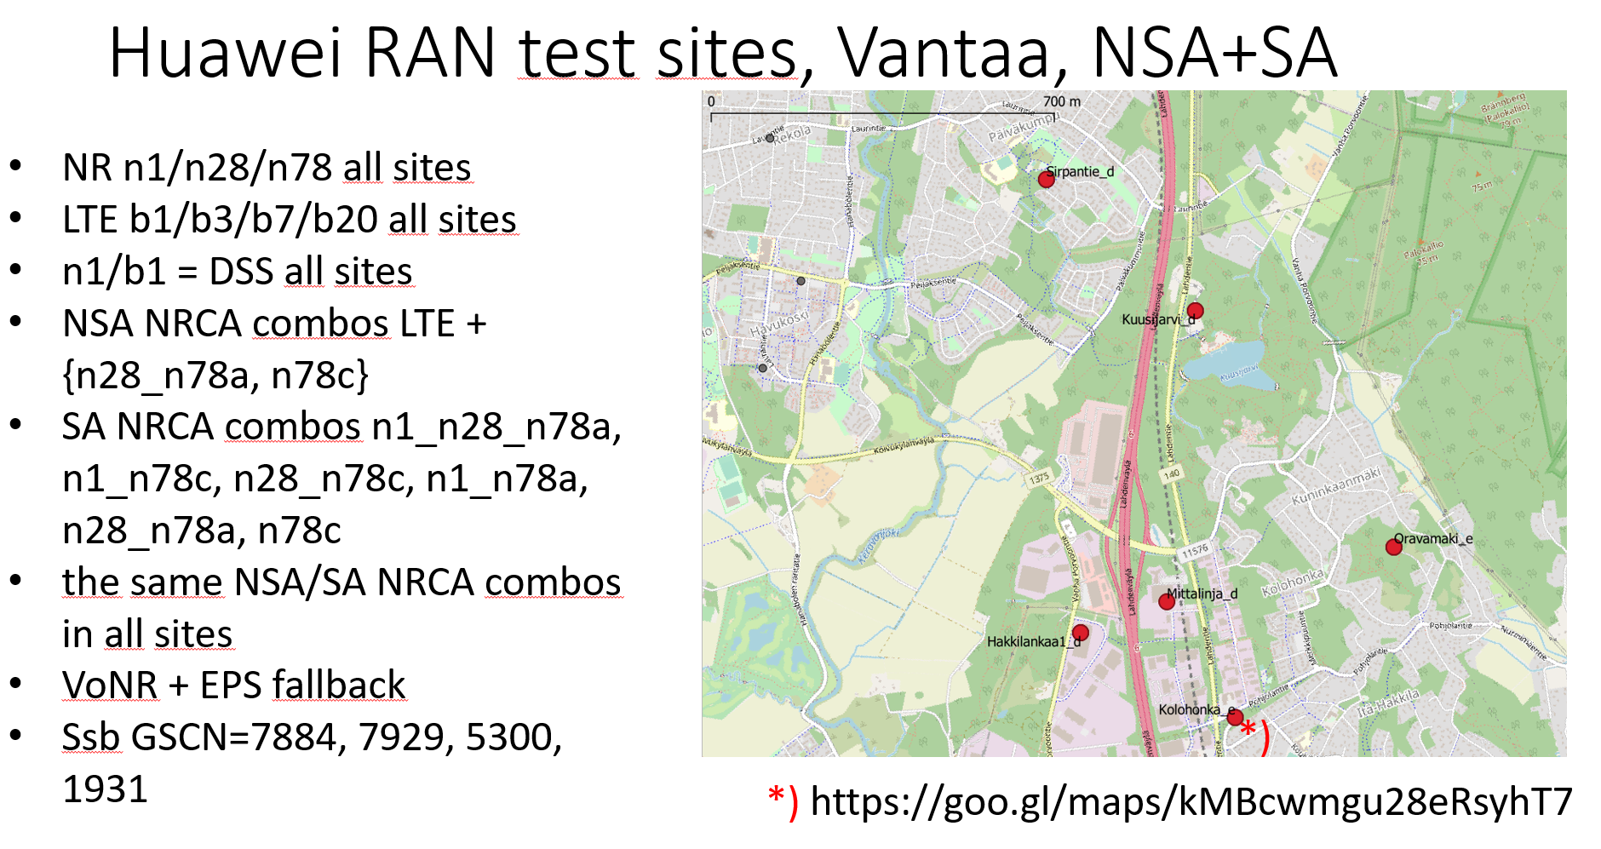
Elisa,Huawei RAN
La

Slide 6
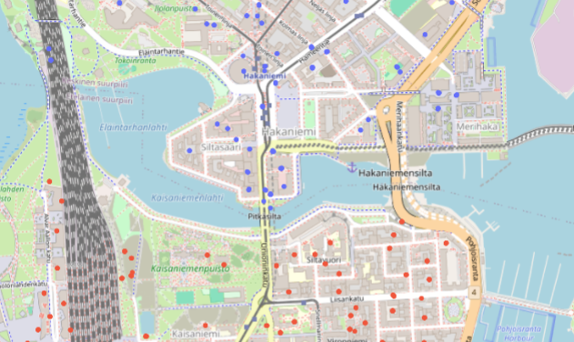
There is lot of Nokia-Huawei borders, in downtown Kaisaniemi – Hakaniemi is probably easy place to drive. Hakaniemi (north) side is Nokia.

Slide 7
THANK YOU
MARQUIS TECHNOLOGIES
www.marquistech.com

