Slide 1
MARQUIS TECHNOLOGIES
Drive Route –Airtel, VI & Reliance JIO (FDD/TDD) LTE

Slide 2
Operator Information:
Operator | JIO 4G
MCC | 405
MNC | 855
APN | Jionet
Operator | Airtel 4G
MCC | 405
MNC | 56
APN | Airtelgprs.com
Operator | VI
MCC | 405
MNC | 751
APN | www

Slide 3
Operator Information 1
Functionality | Airtel
Website: http://www.airtel.com/ WAP APN: airtelgprs.com
Customer care | 199
MNC | 56
Bands supported | Both FDD and TDD
 | LTE 2300 MHz – TDD(Band 40)
 | LTE 2100 ,1800,850 MHz – FDD(Band 1, Band 3, Band 5)
USSD | To check MDN: *282#
 | Balance check: *123#
 | Data Balance check: *121*114#
VoLTE | Supported
CSFB | Supported (CSFB to 2G)

Slide 4
Operator Information 2
Functionality | RELIANCE JIO
Website: http://www.jio.com WAP APN: jionet
Customer care | 198
MNC | 855
Bands supported | Both FDD and TDD
 | LTE 2300 MHz –TDD(Band 40)
 | LTE 850 MHz – FDD(Band 5)
 | LTE 1800 MHz –FDD(Band 3)
USSD | NA
 | NA
 | NA
VoLTE | Supported
CSFB | Not Supported

Slide 5
Operator Information 3
Functionality | VI
Website: https://www.myvi.in/ WAP APN: www
Customer care | 198
MNC | 751
Bands supported | Both FDD and TDD
 | LTE 2500 MHz –TDD(Band 41)
 | LTE 2100 MHz – FDD(Band 1)
 | LTE 1800 MHz –FDD(Band 3)
USSD | To check MDN*199#
 | Balance check *199#
 | Data Balance check: *199#
VoLTE | Supported
CSFB | Supported (3G/2G)

Slide 6
Drive Route
Near Cell :- Stationary: RSRP : -65dbm to -75dbm
Cell Edge :- Stationary: RSRP : -95dbm to -110dbm
Mixed :- Mobility: RSRP : -65dbm to -110dbm

Slide 7
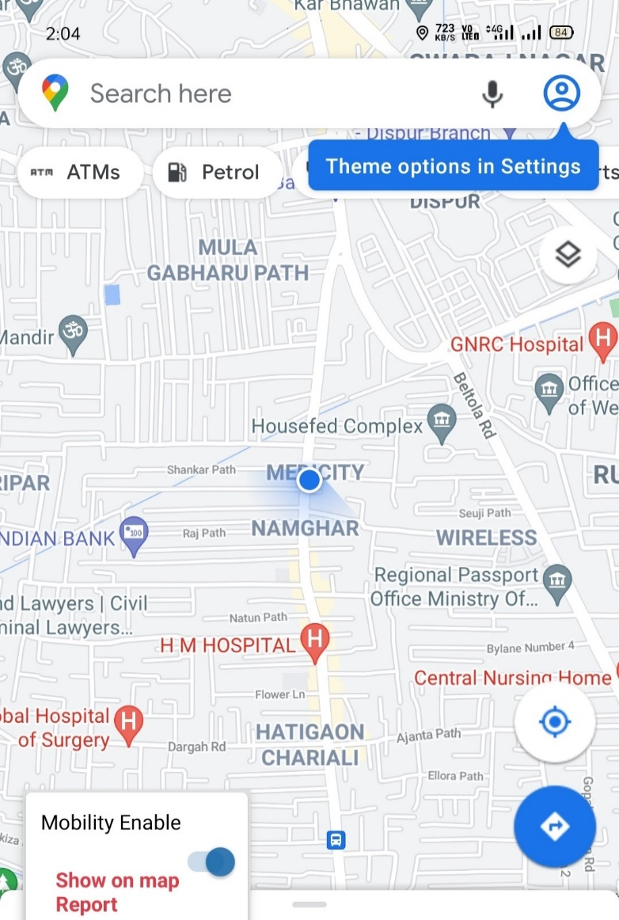
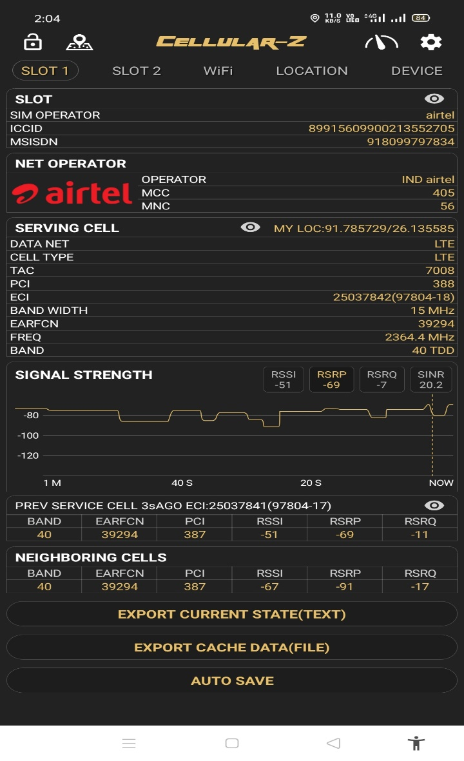
Near Cell (Airtel)
Near cell(NC) | longitude | latitude | RSRP | Cell id | FDD E-ARFCN
1 | 91.785729 | 26.135585 | 69 | 388 | 39294
Townhouse 195 Grand Majesty near Medicity,
Hatigaon Guwahati
RSRP:
-65dbm to 75dbm

Slide 8
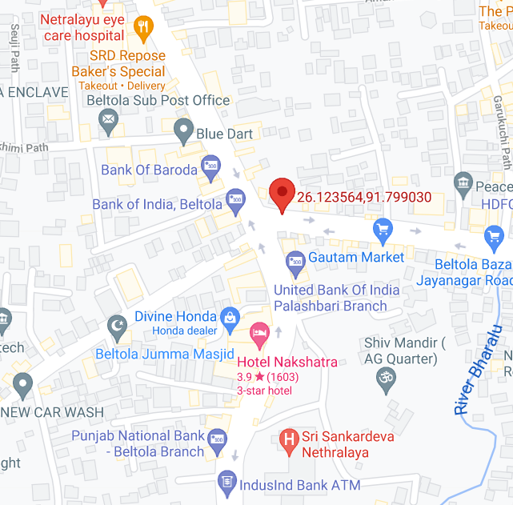
Edge Cell (Airtel)
Edge cell(EC) | longitude | latitude | RSRP | Cell id | TDD E-ARFCN
1 | 91.799030 | 26.12356442 | 108 | 433 | 39150
Beltola Tiniali, Guwahati
RSRP:
-95dbm to -110dbm

Slide 9
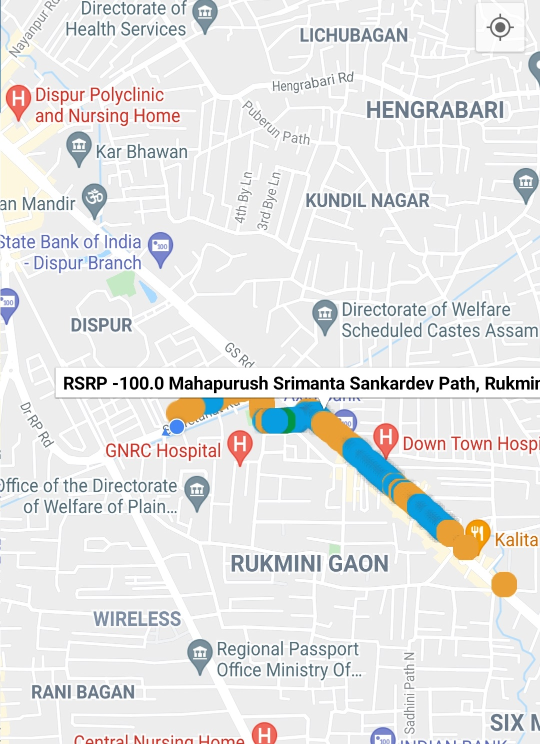
Mixed Mobility:- Rukminigaon, GS Road, Guwahati
Rukminigaon, Guwahati, Assam
RSRP: -65dbm to -110dbm

Slide 10
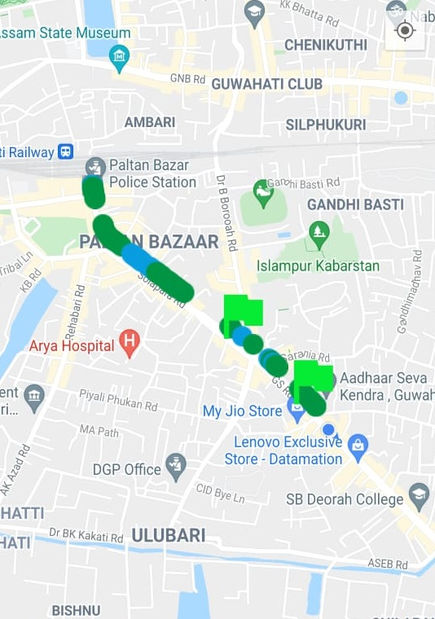
Airtel Band HO
Band Hand Over | longitude | Latitude | RSRP
1 | 91.75708576 | 26.17530824 | -74 to -97 dbm

Slide 11
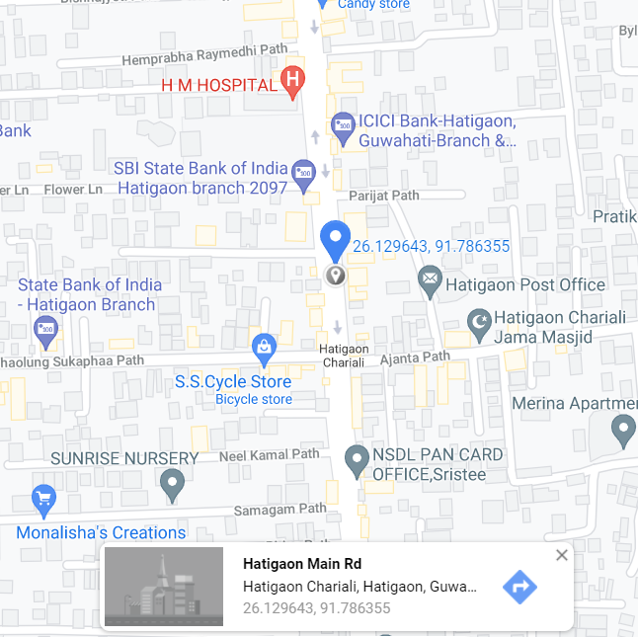
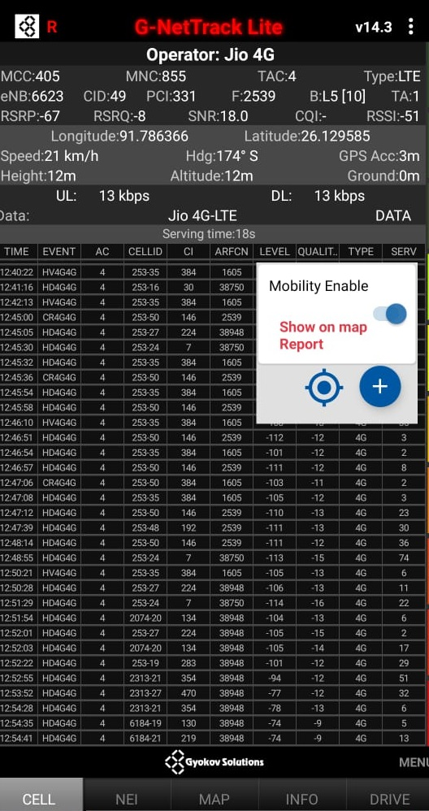
Near Cell (Reliance JIO)
Near cell(NC) | longitude | latitude | RSRP | Cell id | TDD E-ARFCN
1 | 91.786366 | 26.129585 | 67 | 331 | 2539
Near Hatigaon Chariali, Hatigaon
RSRP:
-65dbm to -75dbm

Slide 12
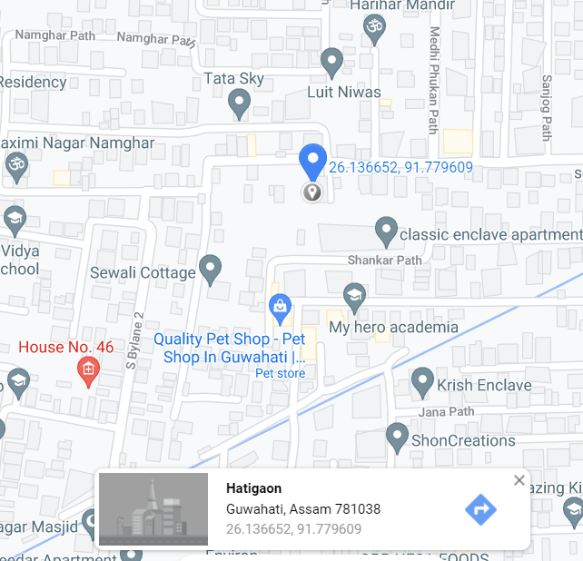
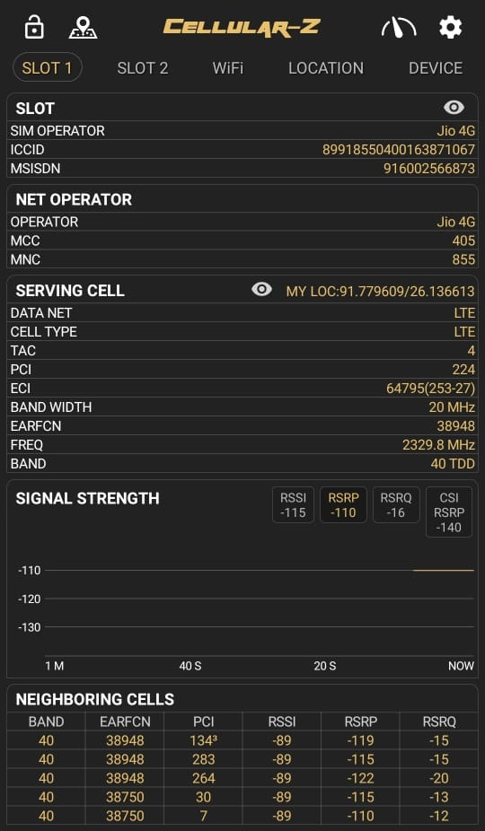
Edge Cell (Reliance JIO)
Edge cell(NC) | longitude | latitude | RSRP | Cell id | TDD E-ARFCN
1 | 91.779609 | 26.136613 | 110 | 224 | 38948
Hatigaon, Ghy
RSRP:
-95dbm to -110dbm

Slide 13
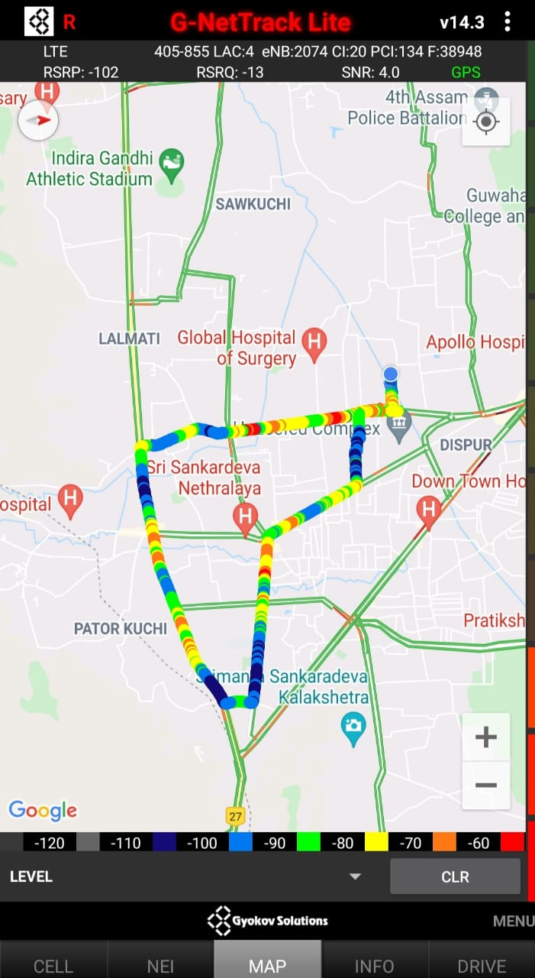
Mixed Mobility:- Guwahati, Assam
RSRP: -65dbm to -110dbm

Slide 14
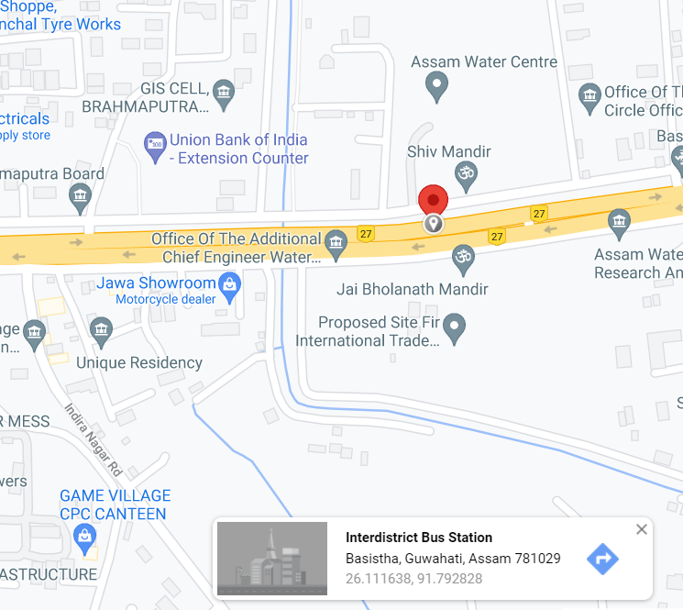
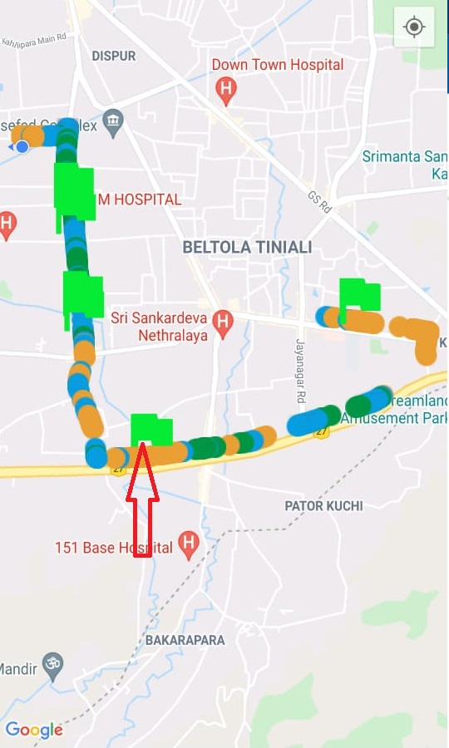
Inter Band Handover (FDD-TDD), JIO 4G
Band Handover | longitude | latitude | RSRP | PCI | FDD E-ARFCN
1 | 91.7928173 | 26.11163774 | 100 | 379 | 375588

Slide 15
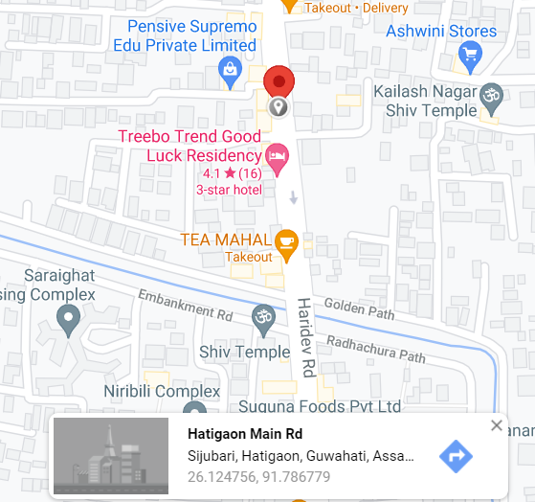
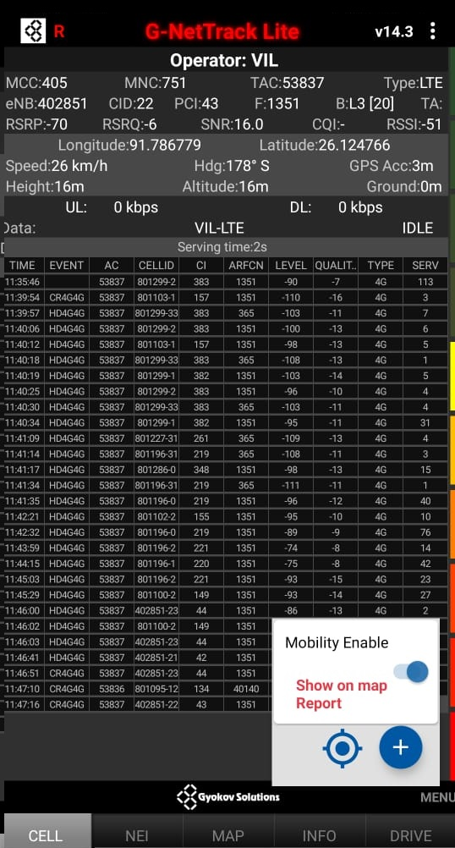
Near Cell VI:
Near cell(NC) | longitude | latitude | RSRP | Cell id | FDD E-ARFCN
1 | 91.786779 | 26.124766 | 70 | 22 | 1351
Sijubari, Hatigaon, GHY

Slide 16
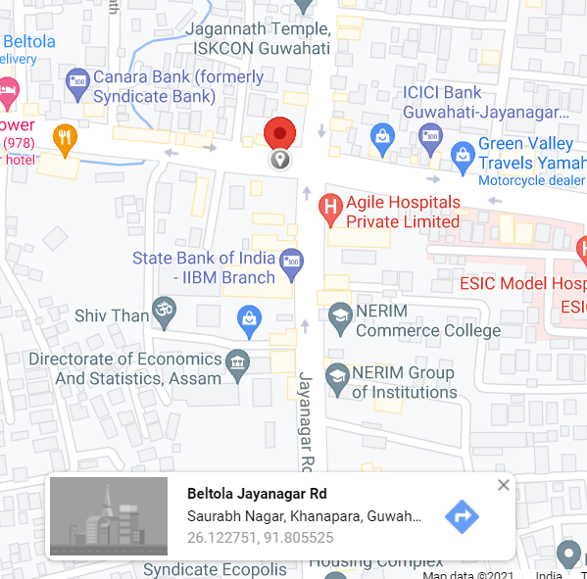
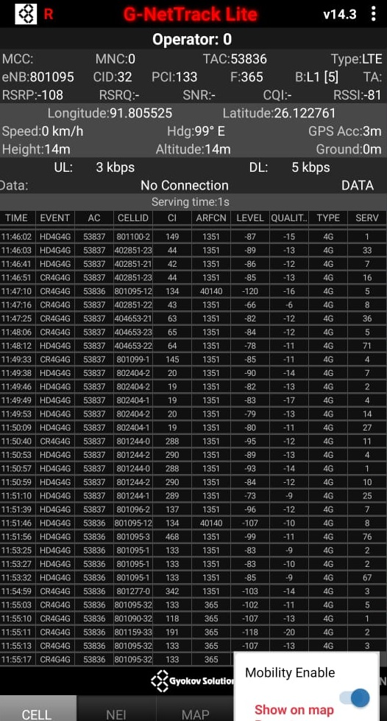
Cell Edge VI:
Edge cell(EC) | longitude | latitude | RSRP | Cell id | FDD E-ARFCN
1 | 91.805525 | 26.122761 | 108 | 32 | 365
RSRP: 108, Beltola Jayanagr road, Ghy

Slide 17
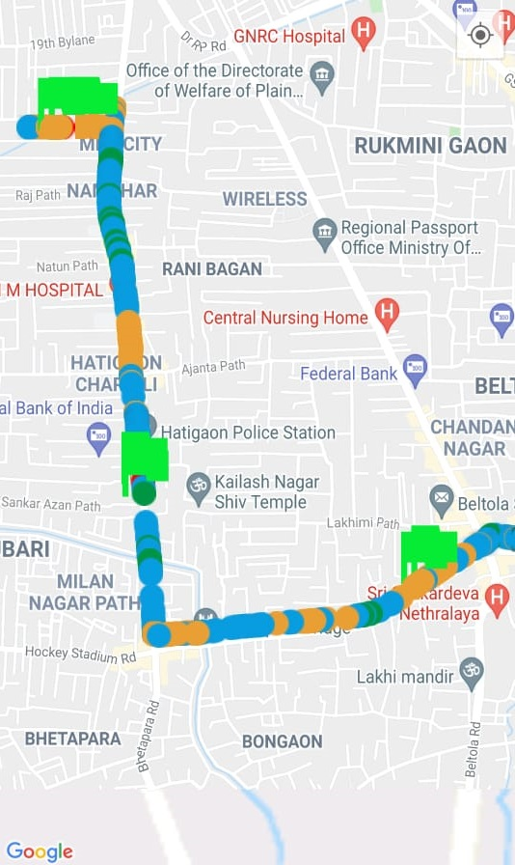
Mixed coverage area Vodafone:
RSRP: -65dbm to -110dbm

Slide 18
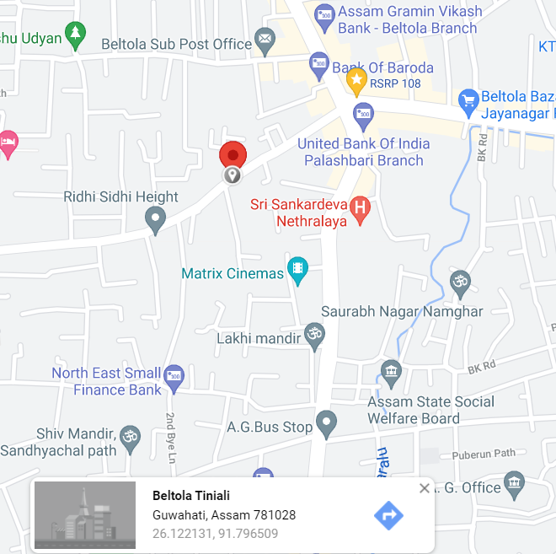
Inter Band Handover (FDD-TDD), VI

Slide 19
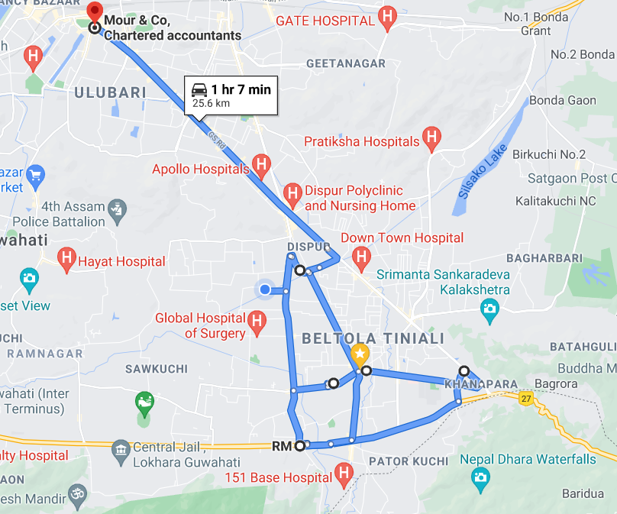
Drive Route

Slide 20
THANK YOU
MARQUIS TECHNOLOGIES

