Slide 1
MARQUIS TECHNOLOGIES
Drive Route

Slide 2
Ranchi/India
Operator Details:
S. No. | Operator |  | Supported Bands | Supported Features by Network
1 | Major | Airtel | LTE FDD B1/B3/B8 & TDD B40/N78 | VoWiFi/VoLTE/4G/2G/5G
2 |  | JIO | LTE FDD B3/B5 & TDD B40/N78 | VoWiFi/VoLTE/4G/5G
3 |  | VI | LTE FDD B3/B1 | VoWiFi/VoLTE/4G/3G/2G

Slide 3
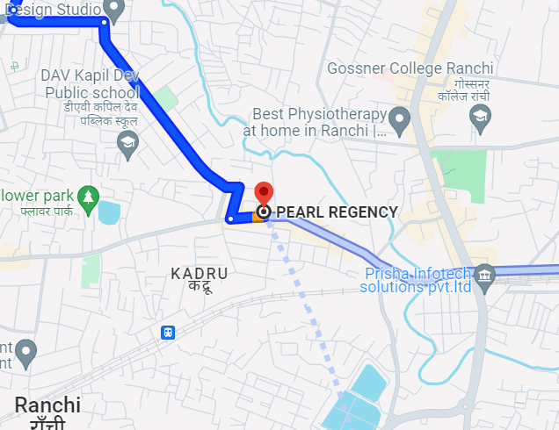
5G Near Cell , Airtel
Lat/Long -23.351318297144203, 85.31730724399854
Specification –Stable Airtel 5G NSA network Good Throughput

Slide 4
NR to LTE Handover ,Airtel
Lat. 23.351318297144203, 85.31730724399854
Location –Near Pearl Residency Hotel Ranchi. Specification –Band Handover ,Weak coverage

Slide 5
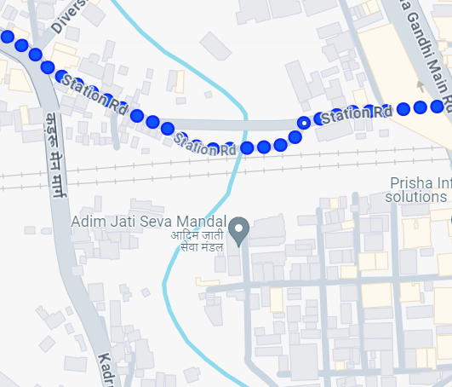
5G Near Cell , JIO Lat/Long -23.348934517333436, 85.32398465260393 Specification –Stable JIO 5G SA network Good Throughput
JIO Good 5G

Slide 6
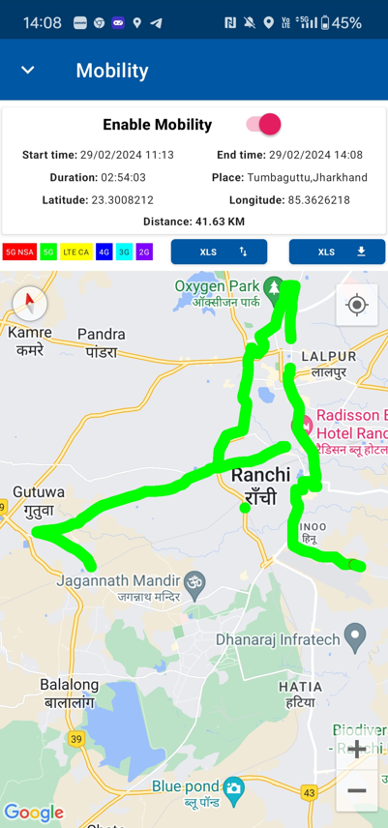
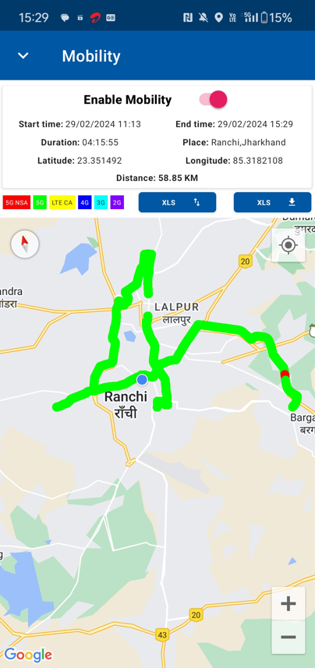
DRIVE ROUTE- Mobility Day -01

Slide 7
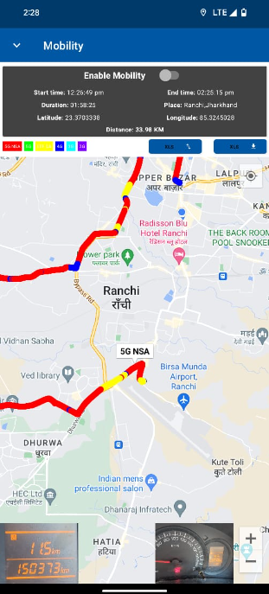
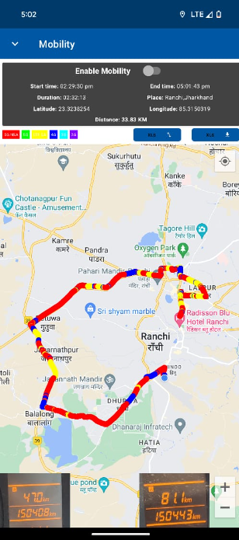
Drive Route- Mobility Day- 02

Slide 8
THANK YOU
MARQUIS TECHNOLOGIES
www.marquistech.com

