Slide 1
MARQUIS TECHNOLOGIES
Drive Route

Slide 2
(Location Name)
Country | India
Continent | Asia
City | Lucknow
Time Zone | GMT+5:30

Slide 3
Operators in Location
MCC | MNC | Operator
405 | 871 | JIO
404 | 15 | VI
405 | 54 | Airtel

Slide 4
Drive Route operator
Near Cell :-Stationary: RSRP: -60dbm to -75dbm
Mixed :-Mobility: RSRP : -75dbm to -95dbm
Cell Edge :-Stationary: RSRP : -95dbm to -115dbm

Slide 5
Operator - JIO
operator Network Info-JIO
RAT | Band | Comment
5G | NA
4G | Band 3,5& Band 40
3G | NA
2G | NA

Slide 6


Slide 7
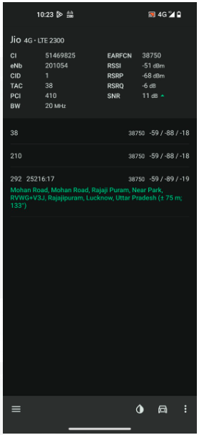
Near Cell screenshots of all band with Network INFO.
Operator: JIO
Band: 40
Cell ID: 1
E-ARFCN : 38750
RSRP: -60dBm to -75dBm

Slide 8
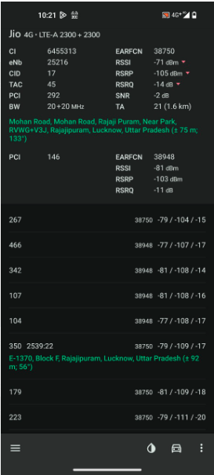
Edge Cell screenshots of all band with Network INFO.
Operator: JIO
Band: 40
Cell ID: 17
E-ARFCN : 38750
RSRP: -95dbm to 115dbm

Slide 9
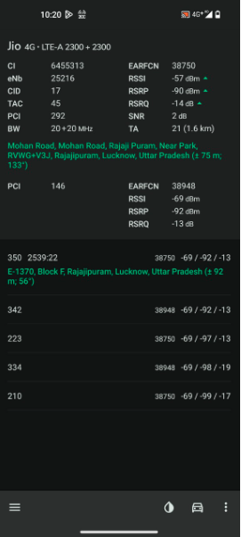
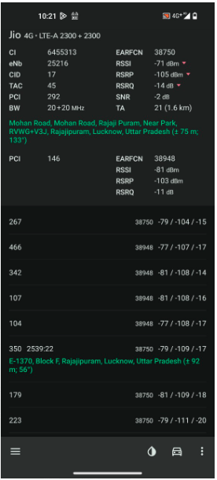
( Mixed Mobility Area) screenshots

Slide 10
Operator - Airtel
operator Network Info-AIRTEL
RAT | Band | Comment
5G | NA
4G | Band 3, Band 40 & Band 1
3G | NA
2G | EDGE900

Slide 11
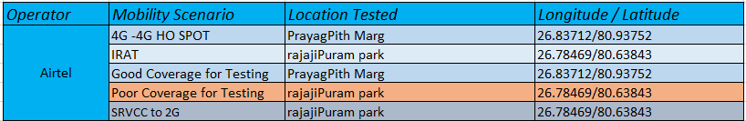

Slide 12
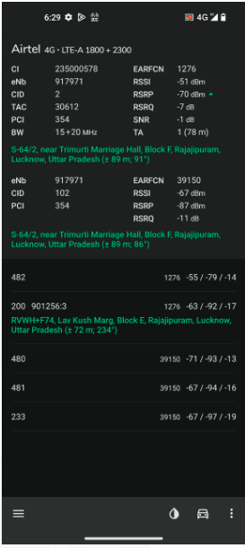
Near Cell screenshots of all band with Network INFO.
Operator: AIRTEL
Band: 40
Cell ID: 1
E-ARFCN : 38750
RSRP: -60dBm to -75dBm

Slide 13
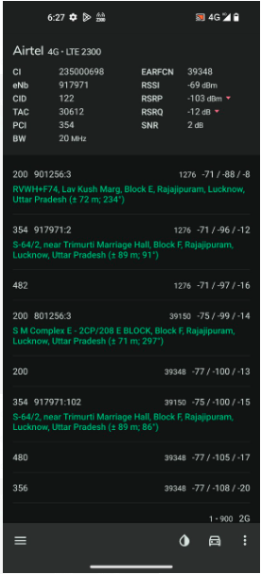
Edge Cell screenshots of all band with Network INFO.
Operator: AIRTEL
Band: 40
Cell ID: 122
E-ARFCN : 39348
RSRP: -95dbm to 115dbm

Slide 14
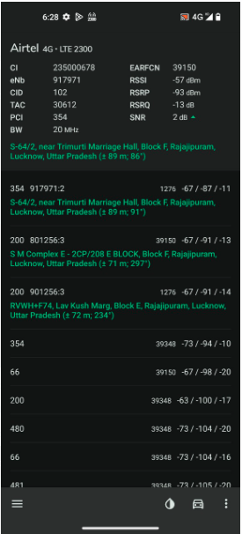
( Mixed Mobility Area) screenshots

Slide 15
Operator - VI
operator Network Info-VI
RAT | Band | Comment
5G | NA
4G | Band 3,Band 41 & Band 8,Band 1
3G | NA
2G | EDGE900

Slide 16
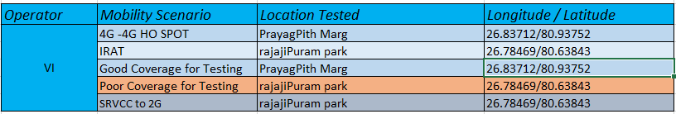

Slide 17
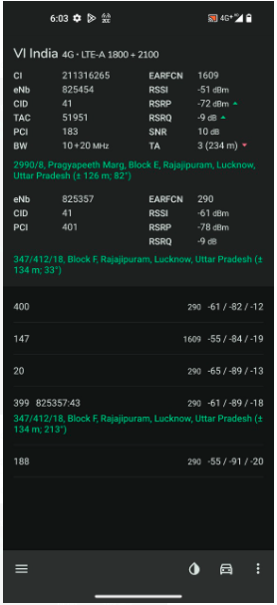
Near Cell screenshots of all band with Network INFO.
Operator: VI
Band: 3
Cell ID: 41
E-ARFCN : 1609
RSRP: -60dBm to -75dBm

Slide 18
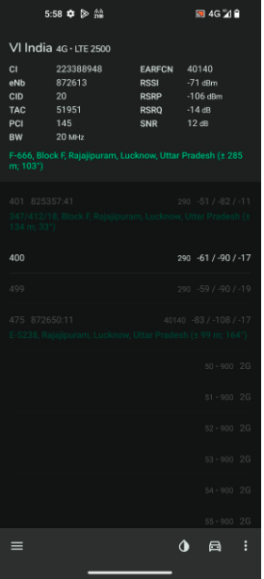
Edge Cell screenshots of all band with Network INFO. Which includes 5G also
Operator: VI
Band: 41
Cell ID: 20
E-ARFCN : 40140
RSRP: -95dbm to 115dbm

Slide 19
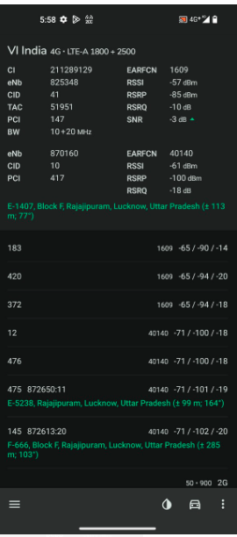
( Mixed Mobility Area) screenshots

Slide 20
THANK YOU
MARQUIS TECHNOLOGIES
www.marquistech.com

