Slide 1
MARQUIS TECHNOLOGIES
Drive Route

Slide 2
Delhi/India
Operator Details:
S. No. | Operator |  | Supported Bands | Supported Features by Network
1 | Major | EIR | LTE FDD B1/B3/B20 & TDD B1/N48/N28/N3 | 2G/3G/4G/5G NSA
2 |  | H3G | LTE FDD B1/B3 & B1/N78 | 2G/4G/5G NSA
3 |  | VDF | LTE FDD B3/B1/B7 & B3/N78 | 4G/5G NSA
4 | Minor | SKY | LTE FDD B1/B7 & B1/N78 | 2G/4G/5G NSA

Slide 3
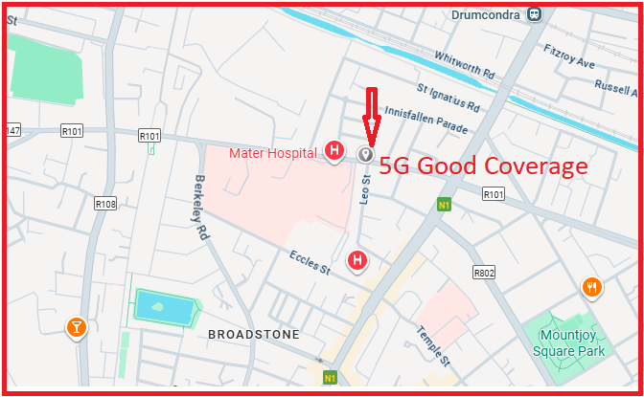
5G Near Cell ,H3G
Lat/Long -53.360300, -6.264252
Specification –Stable H3G 5G NSA network
Good Throughput

Slide 4
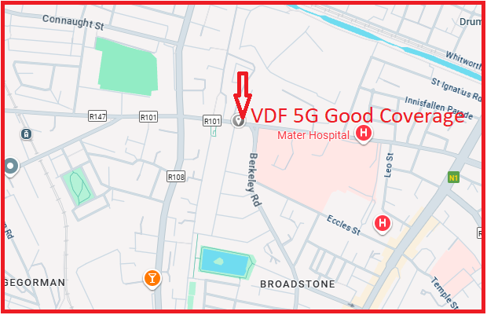
5G Near Cell ,VDF
Lat/Long -53.360681, -6.270310
Specification –Stable VDF 5G NSA network
Good Throughput

Slide 5
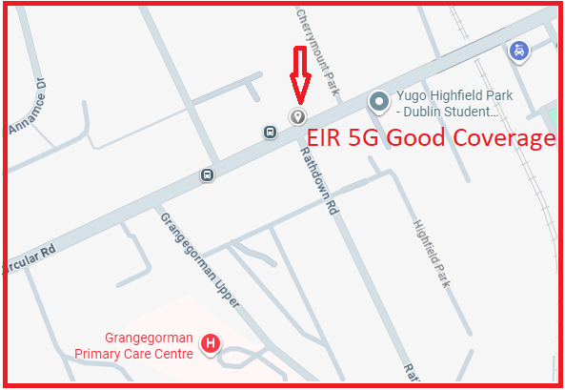
5G Near Cell , EIR
Lat/Long -53.359302, -6.280603
Specification –Stable EIR 5G NSA network
Good Throughput

Slide 6
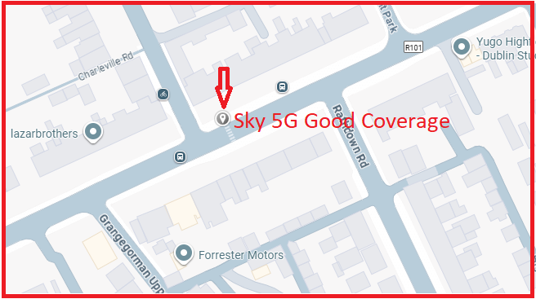
5G Near Cell , SKY
Lat Long- 53.359043, -6.281411
Specification –Stable Sky 5G NSA network
Good Throughput

Slide 7
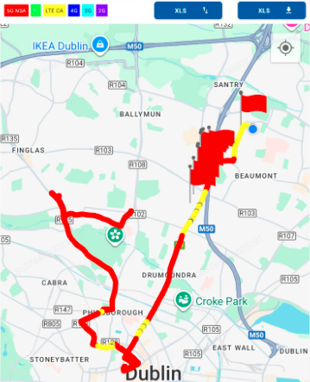
DRIVE ROUTE

Slide 8
THANK YOU
MARQUIS TECHNOLOGIES
www.marquistech.com

