Slide 1
MARQUIS TECHNOLOGIES
Drive Route

Slide 2
Drive Route 5G
Near Cell :-Stationary: RSRP: -60dbm to -75dbm
Mixed :-Mobility: RSRP : -75dbm to -95dbm
Cell Edge :-Stationary: RSRP : -95dbm to -115dbm

Slide 3
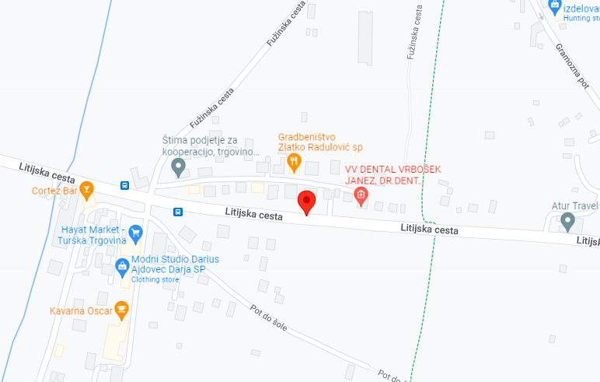
Mobitel N7(5G):-Litijska cesta 152
Operator: Mobitel
Band: N7
Cell ID: 3
E-ARFCN : 2620
RSRP: -75dBm to -90Bm
NC:1

Slide 4
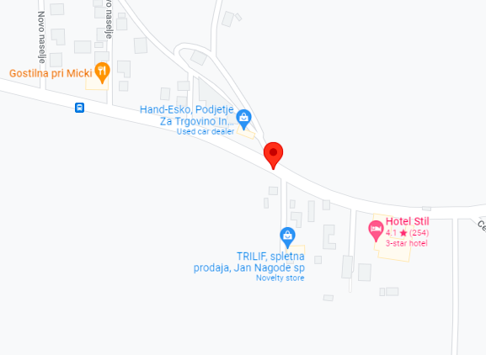
Teleach N48(5G):-Novo naselje, 1261 Ljubljana - Dobrunje
Operator: Telemach
Band: N48
Cell ID: 4
E-ARFCN : 3700
RSRP: -95dbm to 115dbm
EC:1

Slide 5
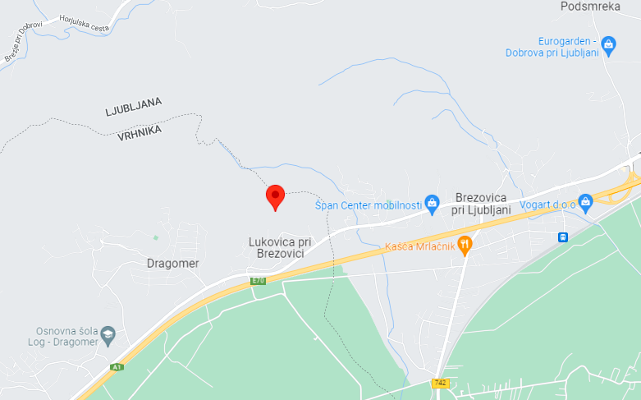
Teleach (SRVCC):- 1351 Lukovica pri Brezovici, Slovenia
Operator: Telemach
SRVCC location
EC:1

Slide 6
Mobitel (SRVCC):-1351 Lukovica pri Brezovici, Slovenia
Operator: Mobitel
SRVCC location

Slide 7
THANK YOU
MARQUIS TECHNOLOGIES
www.marquistech.com

