Slide 1
MARQUIS TECHNOLOGIES
Drive Route

Slide 2
Drive Route 5G
Near Cell :-Stationary: RSRP: -60dbm to -75dbm
Mixed :-Mobility: RSRP : -75dbm to -95dbm
Cell Edge :-Stationary: RSRP : -95dbm to -115dbm

Slide 3
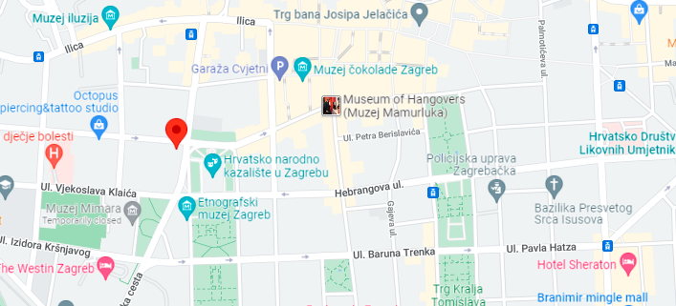
HT Band N77(5G Near cell):-Trg Republike Hrvatske 12, 10000, Zagreb, Croatia
Operator: HT
Band: N77
Cell ID: 6
E-ARFCN : 39025
RSRP: -60dBm to -75dBm
NC:1

Slide 4
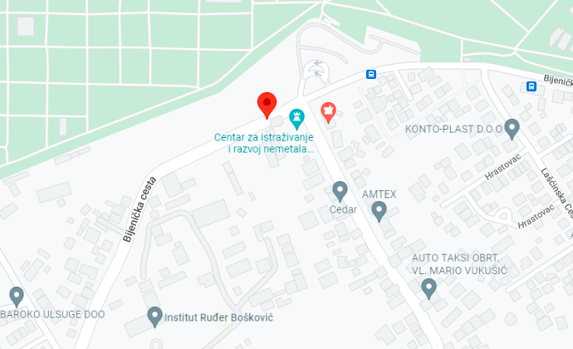
HT Band N77(5G Edge cell):- 10000, Zagreb, Croatia
Operator: HT
Band: N77
Cell ID: 6
E-ARFCN : 39025
RSRP: -90dBm to -105dBm
NC:1

Slide 5
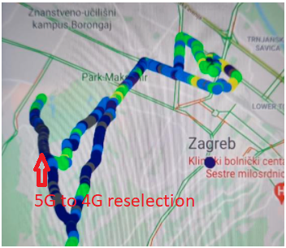
HT (5G to 4G Reselection):-Trg Republike Hrvatske 12, 10000, Zagreb, Croatia
Operator: HT
5G to 4G reselection
NC:1

Slide 6
THANK YOU
MARQUIS TECHNOLOGIES
www.marquistech.com

