Slide 1
MARQUIS TECHNOLOGIES
Drive Route

Slide 2
(Location Name)
Country | INDIA
Continent | AISA
City | HYDERABAD
Time Zone | Time zone in Kothaguda, Telangana (GMT+5:30)

Slide 3
Operators in Location
MCC | MNC | Operator
405 | 845 | JIO
404 | 49 | AIRTEL
404 | 13 | VI
JIO
RAT | Band | Comment
5G | N28,N78
4G | 3,5,40
3G | NA
2G | NA
AIRTEL
RAT | Band | Comment
5G | N78
4G | 3,8,40
3G | NA
2G | GSM 900/1800
VI
RAT | Band | Comment
5G | NA
4G | 1,3,41
3G | NA
2G | GSM 900MHz

Slide 4
Drive Route operator
Near Cell :-Stationary: RSRP: -60dbm to -85dbm
Mixed :-Mobility: RSRP : -95dbm to -105dbm
Cell Edge :-Stationary: RSRP : -105dbm to -115dbm

Slide 5
JIO

Slide 6
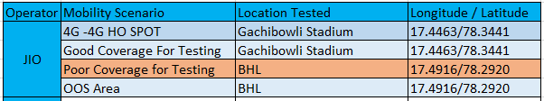

Slide 7
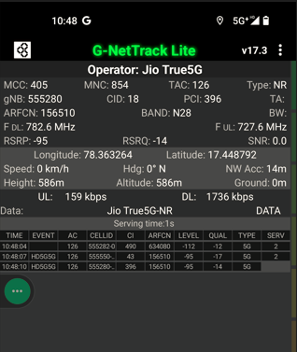
Medium NR Cell screenshots of all band with Network INFO. Which includes 5G also
Operator: JIO
Band: N28
Cell ID: 28
E-ARFCN : 156510
RSRP: -95dbm to -105dbm

Slide 8
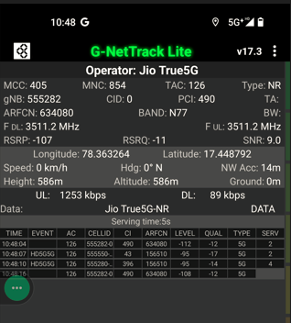
Edge NR Cell screenshots of all band with Network INFO. Which include 5G also.
Operator: JIO
Band: 40
Cell ID: 2
E-ARFCN : 39025
RSRP: -105dBm to -115dBm

Slide 9
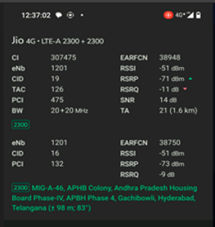
Near LTE Cell screenshots of all band with Network INFO. Which include 4G also.
Operator: JIO
Band: 40
Cell ID: 475
E-ARFCN : 38948
RSRP: -60dBm to -85dBm

Slide 10
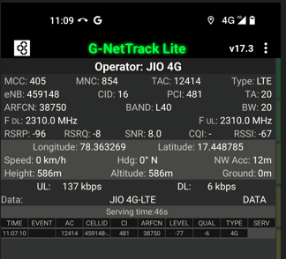
Medimum LTE Cell screenshots of all band with Network INFO. Which include 4G also.
Operator: JIO
Band: 40
Cell ID: 16
E-ARFCN : 38750
RSRP: -95dBm to -105dBm

Slide 11
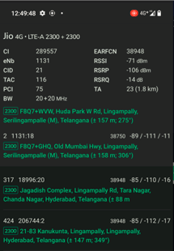
Edge LTE Cell screenshots of all band with Network INFO. Which include 4G also.
Operator: JIO
Band: 40
Cell ID: 75
E-ARFCN : 38948
RSRP: -105dBm to -115dBm

Slide 12
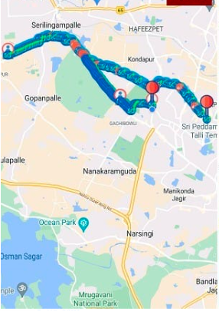
( Mixed Mobility Area) screenshots

Slide 13
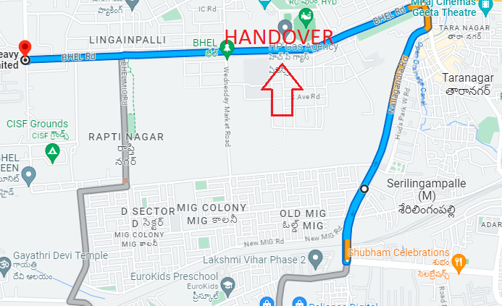
Band Handover – It will includes all 5G to 4G to 5G.
Operator: JIO
Band Handover: B40-N77-B40
E-ARFCN : 38750-634080-38750

Slide 14
AIRTEL

Slide 15
Operator | Mobility Scenario | Location Tested | Longitude / Latitude
AIRTEL | 5G-4G -4G HO SPOT | IKEA Mindspace road | 17.4394/78.3753
 | IRAT | BHEL | 17.4916/78.2920
 | Good Coverage for Testing | Gachibowli Stadium | 17.4463/78.3441
 | Poor Coverage for Testing | BHEL | 17.4916/78.2920
 | OOS Area | BHEL | 17.4916/78.2920

Slide 16
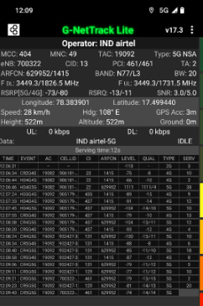
Near NR Cell screenshots of all band with Network INFO. Which include 5G also.
Operator: Airtel
Band: 77
Cell ID:461
E-ARFCN : 629952
RSRP: -60dBm to -85dBm

Slide 17
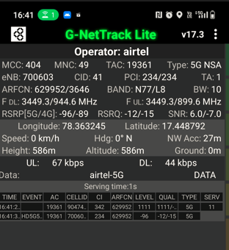
Medium NR Cell screenshots of all band with Network INFO. Which includes 5G also
Operator: Airtel
Band: N77
Cell ID: 234
E-ARFCN : 629952
RSRP: -95dbm to -105dbm

Slide 18
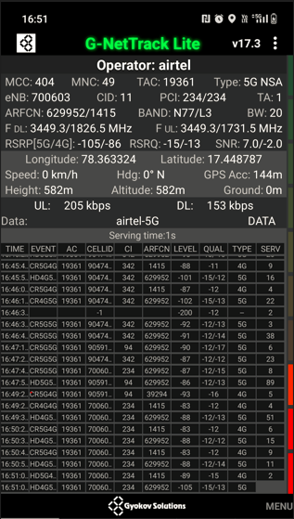
Edge NR Cell screenshots of all band with Network INFO. Which include 5G also.
Operator: AIRTEL
Band: N77
Cell ID: 234
E-ARFCN : 629952
RSRP: -105dBm to -115dBm

Slide 19
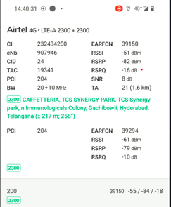
Near LTE Cell screenshots of all band with Network INFO. Which include 4G also.
Operator: AIRTEL
Band: 20+10
Cell ID: 24
E-ARFCN : 39150
RSRP: -60dBm to -75dBm

Slide 20
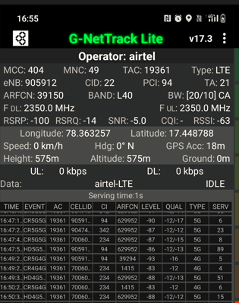
Medimum LTE Cell screenshots of all band with Network INFO. Which include 4G also.
Operator: AIRTEL
Band: 40
Cell ID: 94
E-ARFCN : 39150
RSRP: -95dBm to -105dBm

Slide 21
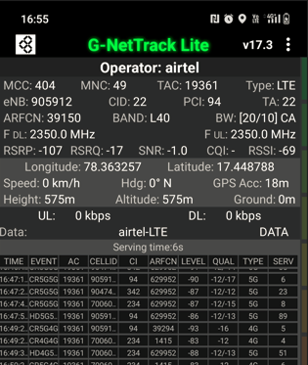
Edge LTE Cell screenshots of all band with Network INFO. Which include 4G also.
Operator: JIO
Band: 40
Cell ID: 94
E-ARFCN : 39150
RSRP: -105dBm to -115dBm

Slide 22
( Mixed Mobility Area) screenshots

Slide 23
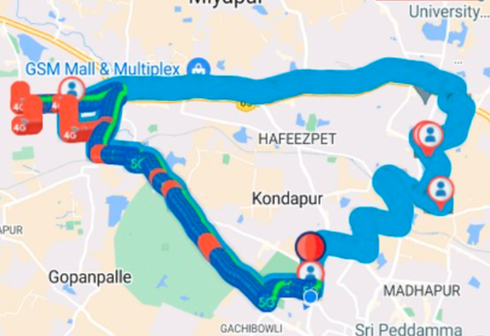
Band Handover – It will includes all 5G to 4G , 4G to 5G.
Operator: Airtel
Band Handover: B40-B3-B40
E-ARFCN : 39025-1300-39025

Slide 24
Operator VI

Slide 25
Operator | Mobility Scenario | Location Tested | Longitude / Latitude
VI | 5G-4G -4G HO SPOT | IKEA Mindspace road | 17.4394/78.3753
 | IRAT | BHEL | 17.4916/78.2920
 | Good Coverage for Testing | Gachibowli Stadium | 17.4463/78.3441
 | Poor Coverage for Testing | BHEL | 17.4916/78.2920
 | OOS Area | BHEL | 17.4916/78.2920
 | SRVCC to 2G | BHEL | 17.4916/78.2920

Slide 26
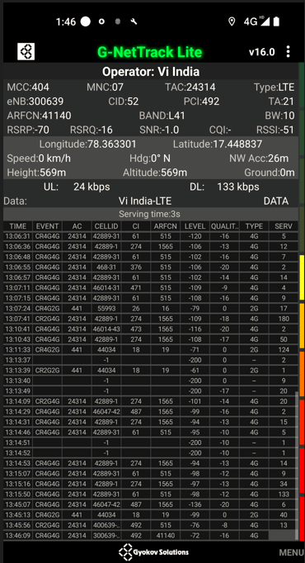
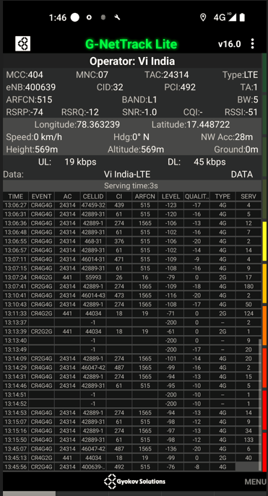
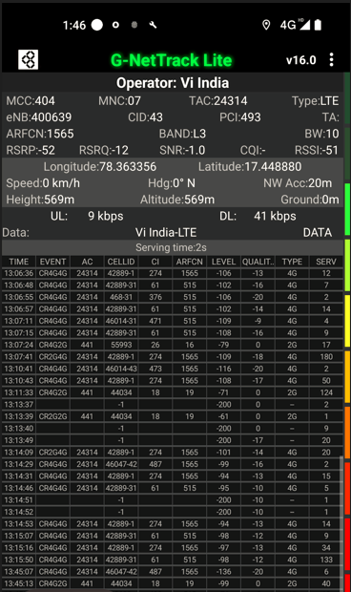
Near Cell screenshots of all band with Network INFO.
Operator: VI
Band: 41
Cell ID: 492
E-ARFCN : 41140
RSRP: -60dBm to -75dBm

Slide 27
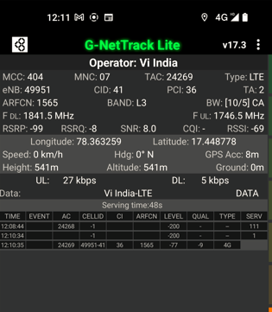
Medium Cell screenshots of all band with Network INFO.
Operator: VI
Band: 3
Cell ID: 36
E-ARFCN : 1565
RSRP: -95dBm to -105dBm

Slide 28
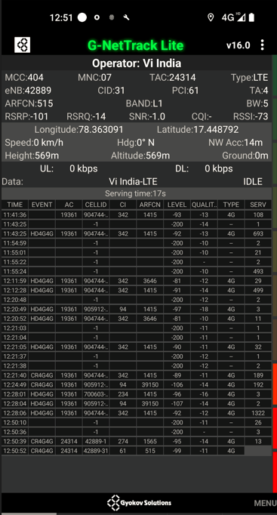
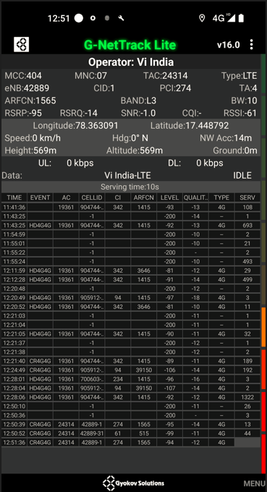
Edge Cell screenshots of all band with Network INFO.
Operator: VI
Band: L1
Cell ID: 61
E-ARFCN : 515
RSRP: -95dbm to 115dbm

Slide 29
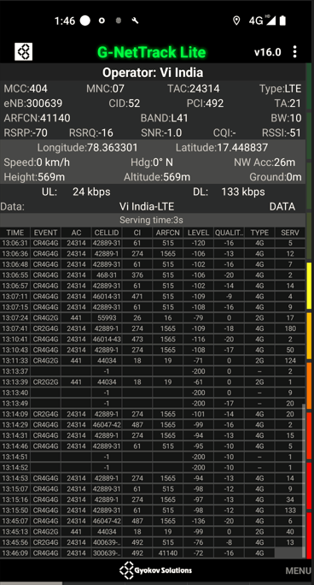
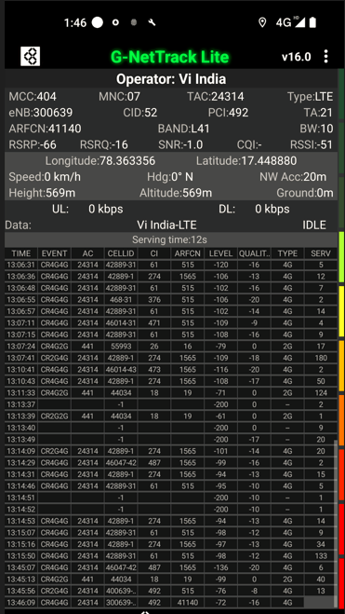
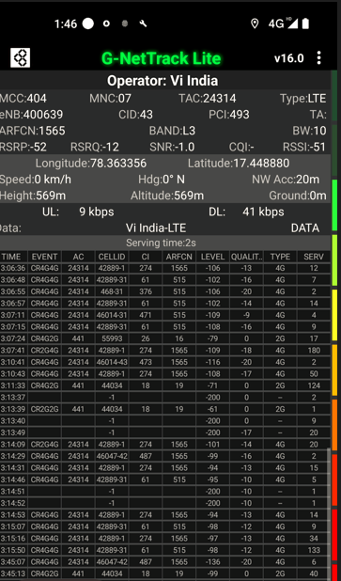
( Mixed Mobility Area) screenshots

Slide 30
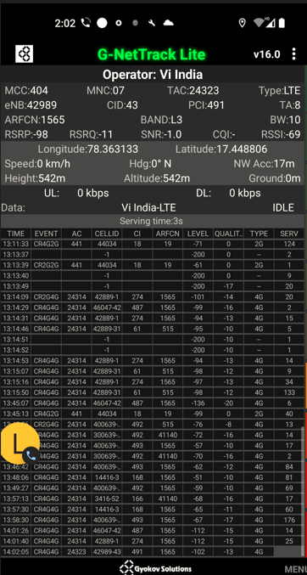
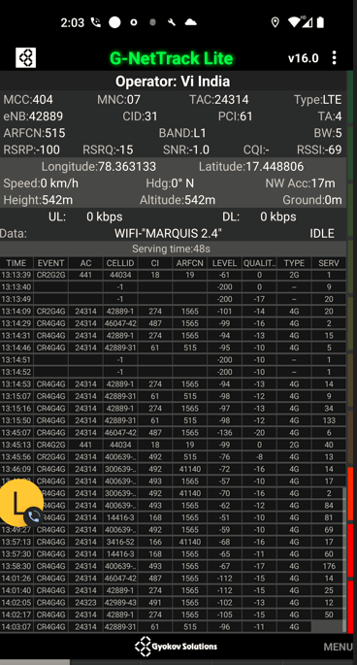
Band Handover – It will includes all 4G to 4G.
Operator: VI
Band Handover: B1-B3
E-ARFCN : 1565-515

Slide 31
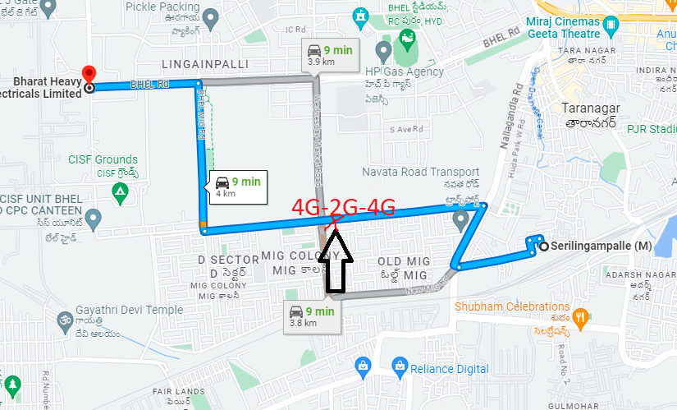
Band Handover – It will includes all 4G to 2G to 4G.
Operator: VI
Band Handover: 4G-2G-4G

Slide 32
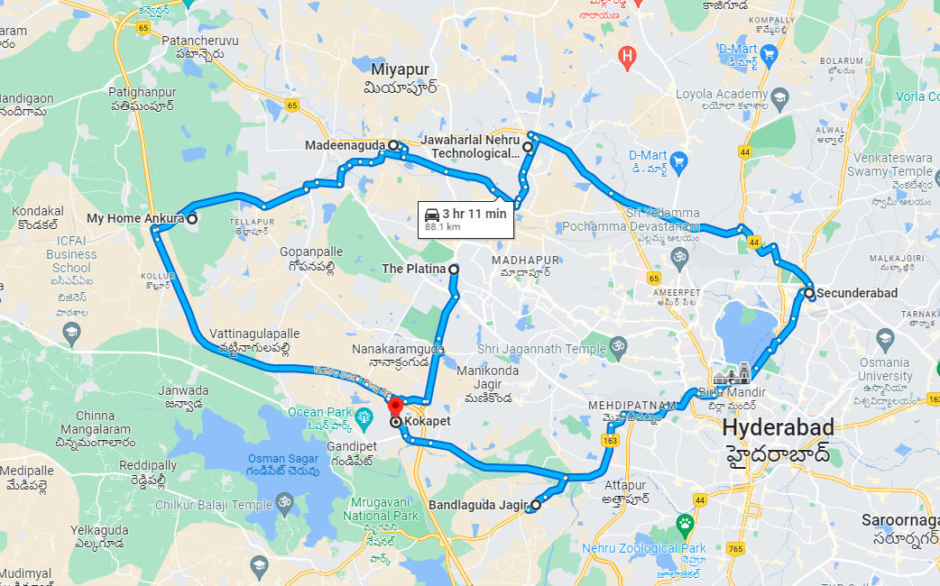
( Drive Route covered during mobility. )

Slide 33
THANK YOU
MARQUIS TECHNOLOGIES
www.marquistech.com

