Slide 1
MARQUIS TECHNOLOGIES
Drive Route

Slide 2
Dubai/UAE
Operator Details:
S. No. | Operator |  | Supported Bands | Supported Features by Network
1 | Major | DU | LTE FDD B1/B3/B20 & TDD N78 | VoWiFi/VoLTE/4G/2G/5G
2 |  | Etisalat | LTE FDD B3/B5 & TDD N78 | VoWiFi/VoLTE/4G/2G/5G

Slide 3
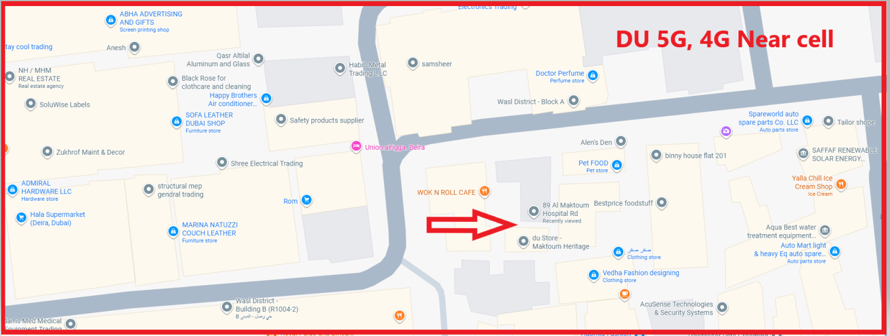
DU 5G, 4G Near Cell
Lat/Long 25.270244 55.313131
Specification –Stable DU network
Good Throughput

Slide 4
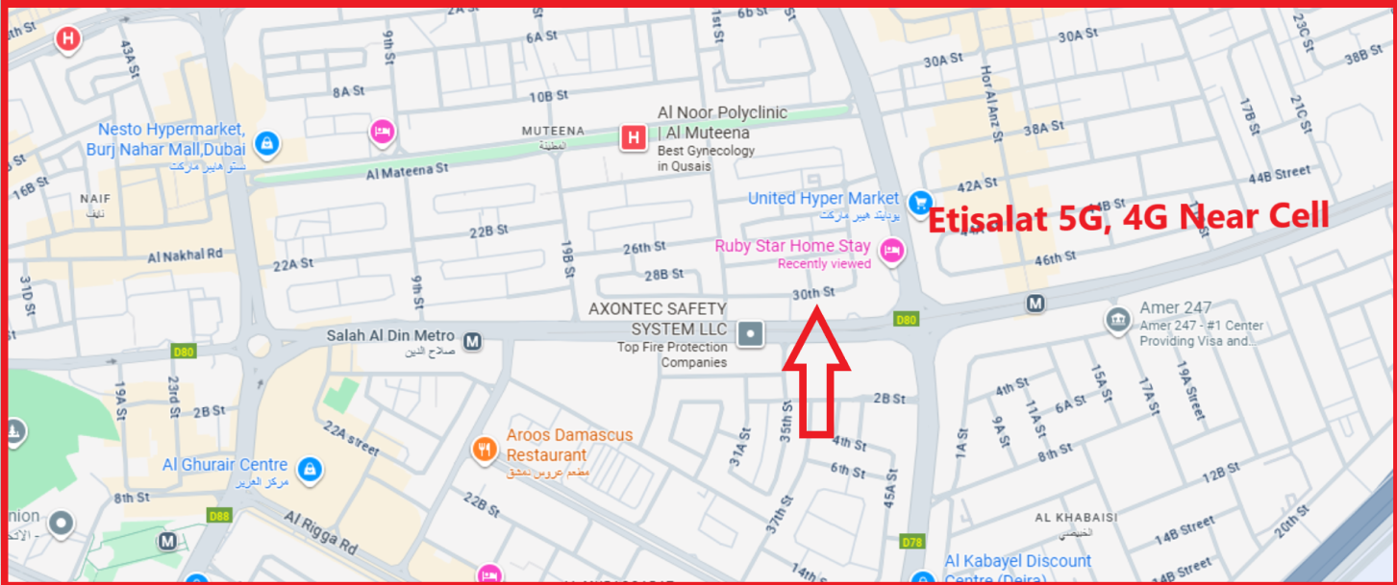
Etisalat 4G,5G Near Cell
Lat/Long 25.276637 55.334982
Specification –Stable Etisalat network
Good Throughput

Slide 5
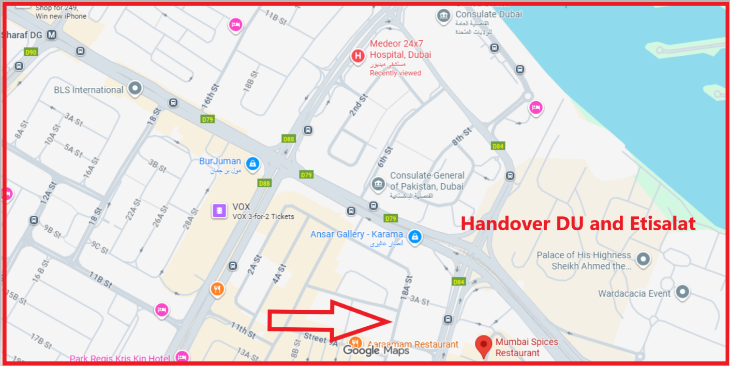
Handover (DU and Etisalat)
Lat Long- 25.266040, Long 55.324434
Location-18 A Street,Dubai, UAE
Specification - Handover

Slide 6
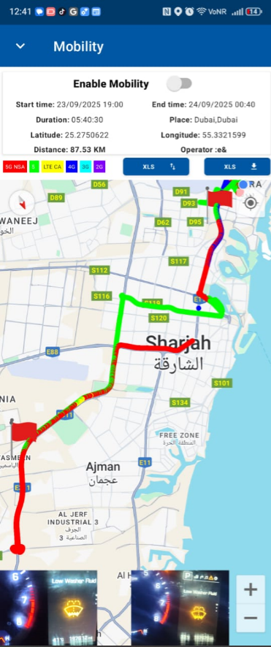
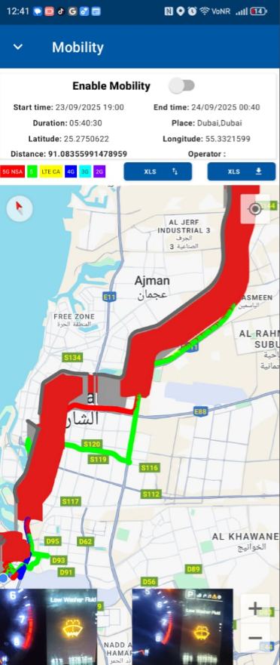
DRIVE ROUTE

Slide 7
THANK YOU
MARQUIS TECHNOLOGIES
www.marquistech.com

