Slide 1
MARQUIS TECHNOLOGIES
Drive Route

Slide 2
Delhi/India
Operator Details:
S. No. | Operator |  | Supported Bands | Supported Features by Network
1 | Major | Etisalat | LTE B1/B3/B8/B20 NR N78 & N41 | 2G, 3G, 4G, VoLTE, VoWIFI, 5G NSA
2 |  | DU | LTE B1/B3/B20/B41 NR N78 & N41 | 2G, 3G, 4G, VoLTE, 5G NSA

Slide 3
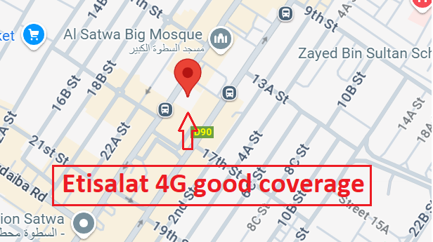
4G Near Cell, Etisalat
Lat/Long - 25°13'53.0"N 55°16'34.9"E
Specification –Stable Etisalat 4G LTE network Good Throughput

Slide 4
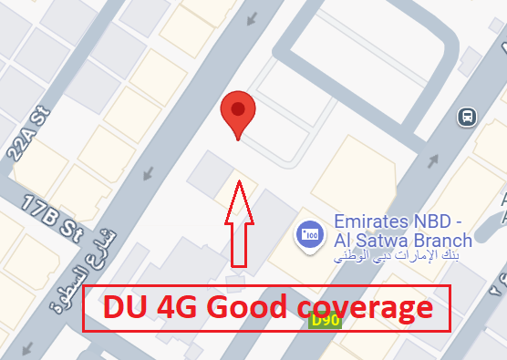
4G Near Cell, DU
Lat/Long - 25°13'52.8"N 55°16'34.8"E
Specification –Stable DU 4G LTE network Good Throughput

Slide 5
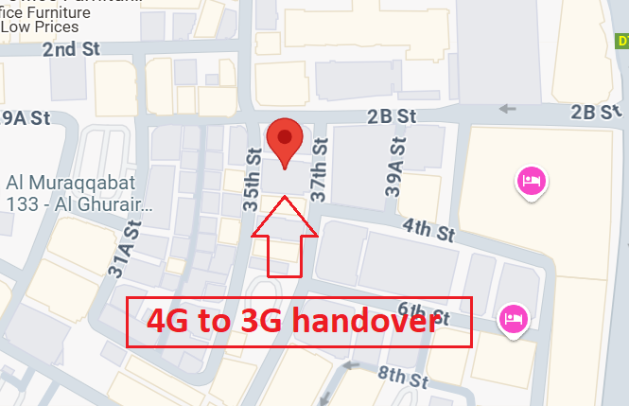
LTE to 3G Handover, Etisalat
Lat/Long :- 25.268781809760668, 55.32780003154675
Location :- 4 37th St - Deira - Dubai - United Arab Emirates (Basement)

Slide 6
LTE to 3G Handover, DU
Lat/Long :- 25.268781809760668, 55.32780003154675
Location :- 4 37th St - Deira - Dubai - United Arab Emirates (Basement)

Slide 7
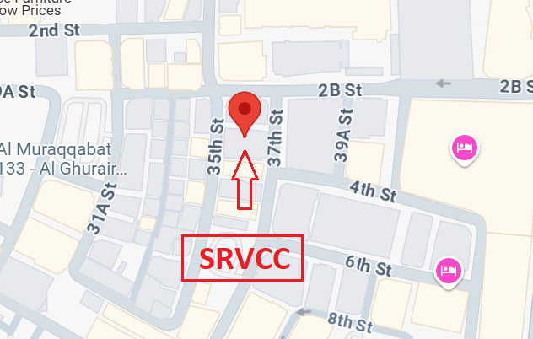
SRVCC(Etisalat, DU)
Lat Long- 25.268869129979667, 55.32782148921928.
Location- 4 37th St - Deira - Dubai - United Arab Emirates (Lift)
Specification – SRVCC

Slide 8
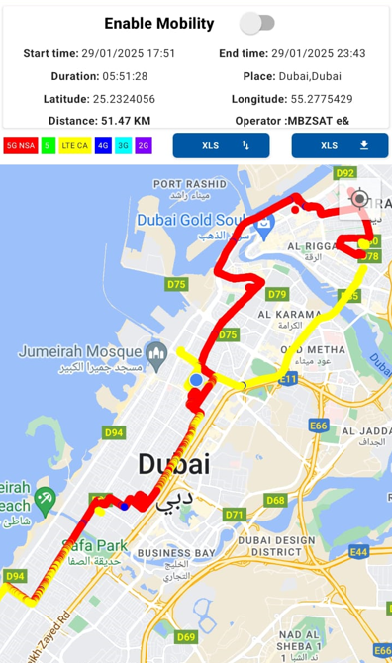
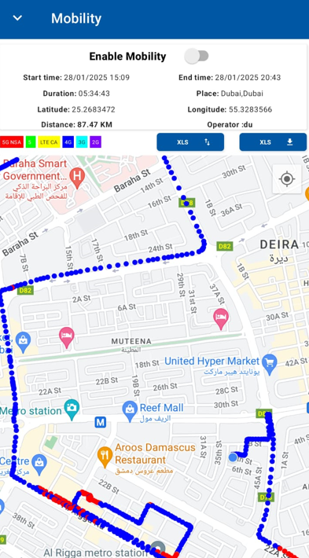
DRIVE ROUTE

Slide 9
THANK YOU
MARQUIS TECHNOLOGIES
www.marquistech.com

