Slide 1
MARQUIS TECHNOLOGIES
Drive Route

Slide 2
Delhi/India
Operator Details:
S. No. | Operator |  | Supported Bands | Supported Features by Network
1 | Major | Airtel | LTE FDD B1/B3/B8 & TDD B40/N78 | VoWiFi/VoLTE/4G/2G/5G
2 |  | JIO | LTE FDD B3/B5 & TDD B40/N78/N28 | VoWiFi/VoLTE/4G/5G
3 |  | VI | LTE FDD B3/B8 & TDD B41/N78 | VoWiFi/VoLTE/4G/3G/2G/5G
4 | Minor | BSNL | LTE FDD B1 | VoLTE/4G/3G/2G

Slide 3
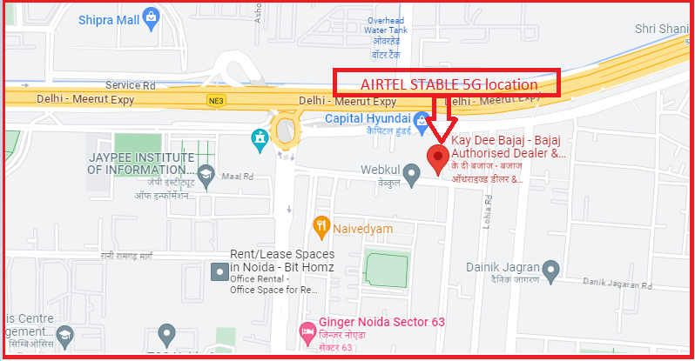
AIRTEL 5G Near Cell
Lat/Long -28.6210° N, 77.3812° E
Specification –Stable Airtel 5G NSA network

Slide 4
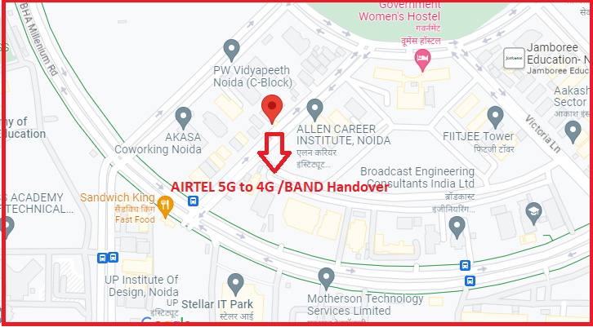
NR to LTE Handover Airtel
Lat. 28.591503 & Long. 77.375496 to
Location –D PARK Sector 62
Specification –Band Handover

Slide 5
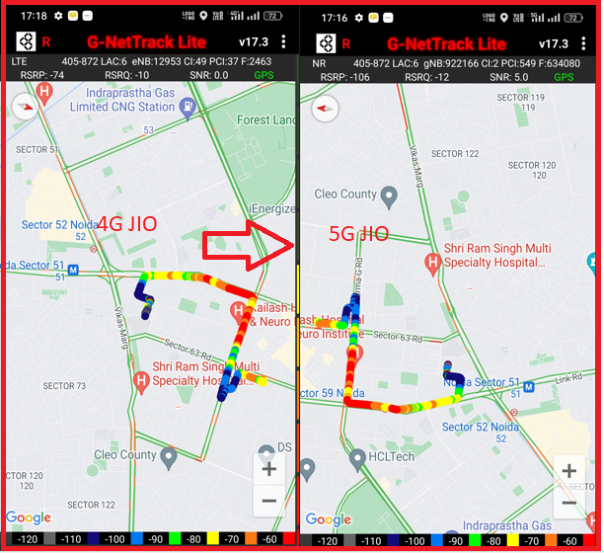
NR to LTE Handover JIO
Lat. 28.591503 & Long. 77.375496 to
Lat. 28.591879 & Long. 77.375831
Location -Noida, Sector 71
(Jagrati Apartment, Pocket A3)

Slide 6
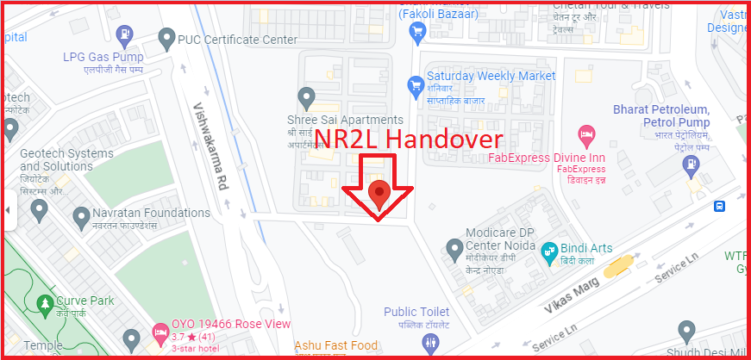
NR To LTE Handover JIO
Lat. 28.591503 & Long. 77.375496 to
Lat. 28.591879 & Long. 77.375831

Slide 7
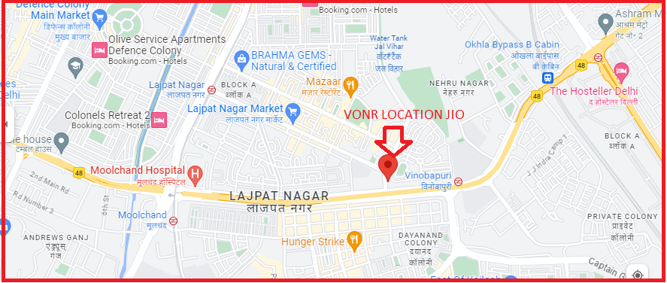
VoNR call on NR to LTE route
Lat. 28.5659° N, Long 77.2505° E
Location - Vinoba Puri Metro Station, Delhi
Specification -100% VONR call success rate

Slide 8
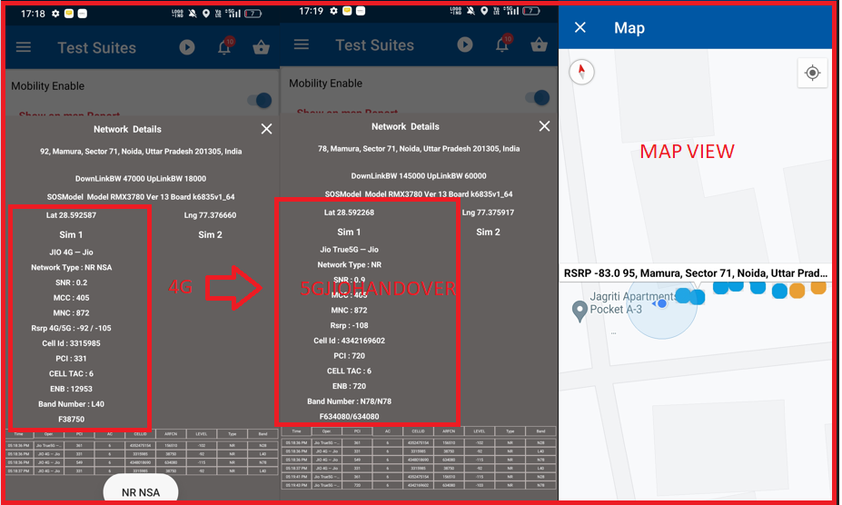
NR TO LTE TO NR Handover
Lat. 28.591587 & Long. 77.376660 to
Lat. 28.592268 & Long. 77.375917
Location - Noida, Sector 71
(Jagrati Apartment, Pocket A3)

Slide 9
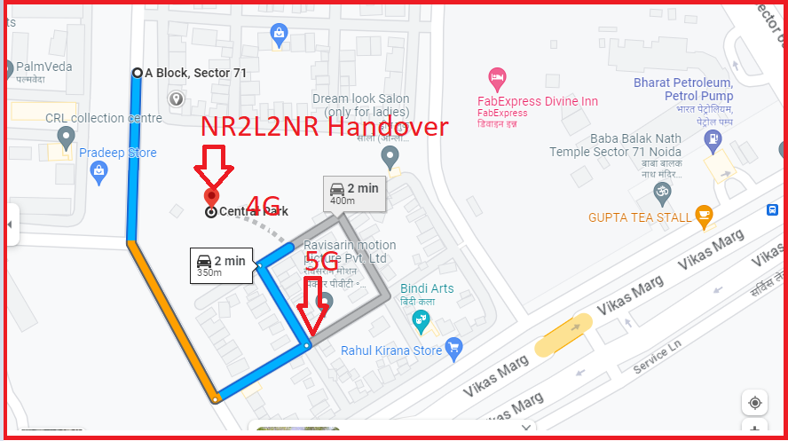
NR TO LTE TO NR Handover
Lat. 28.591587 & Long. 77.376660 to
Lat. 28.592268 & Long. 77.375917

Slide 10
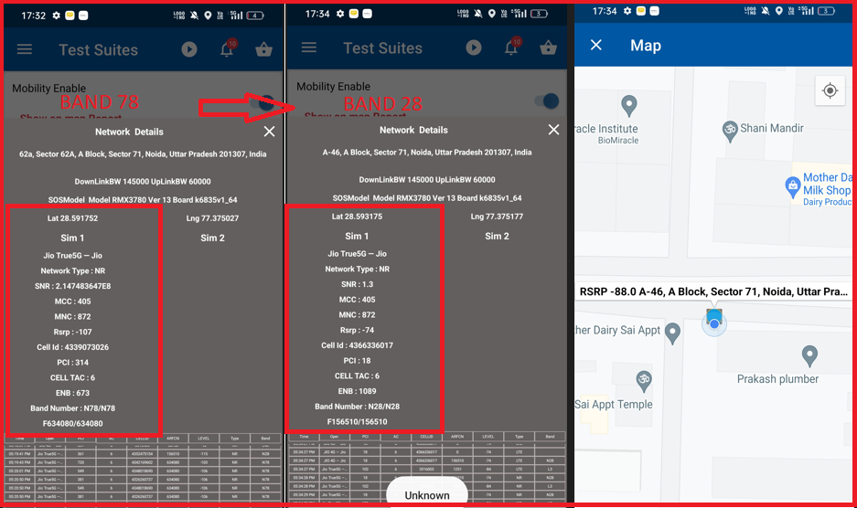
Inter-freq HO on NR (n78-n28-n78)
Lat. 28.591752 & Long. 77.375027 to
Lat. 28.593175 & Long. 77.375177
Location - Noida, Sector 71
(Jagrati Apartment, Pocket A3)

Slide 11
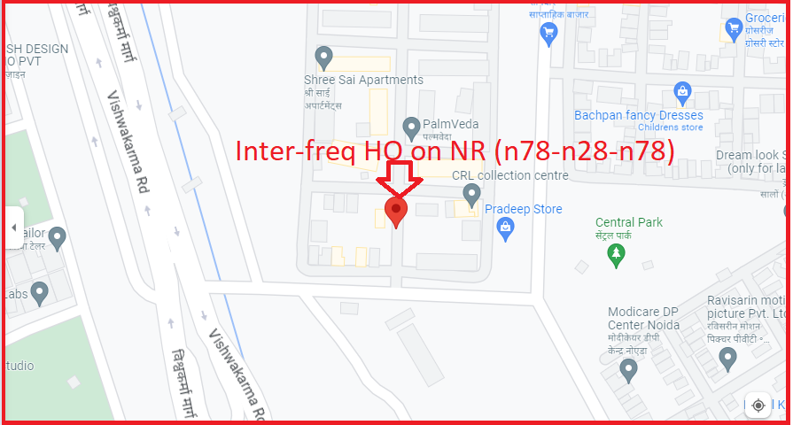
Inter-freq HO on NR (n78-n28-n78)
Lat. 28.591752 & Long. 77.375027 to
Lat. 28.593175 & Long. 77.375177
Location –Shri Sai Apartment DELHI

Slide 12
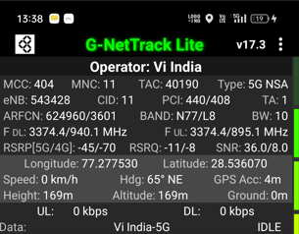
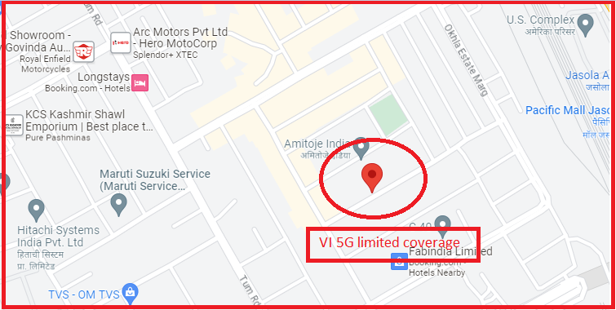
VI 5G
Lat long - 28.536070° N, 77.277530° E
Location –Okla Delhi India
Specification –VI 5G limited coverage

Slide 13
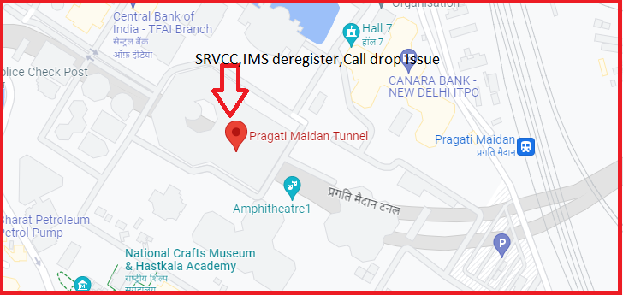
SRVCC and Call drop
Lat Long- 28.6159804/ 77.2443823995.
Location-Pargati Maidain Tunnel
Specification –SRVCC,IMS Deregister,Call drop Issue

Slide 14
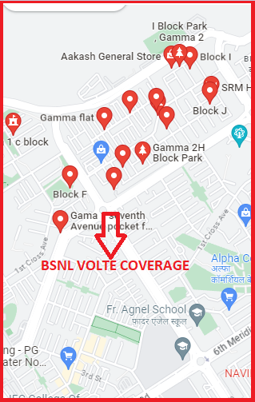
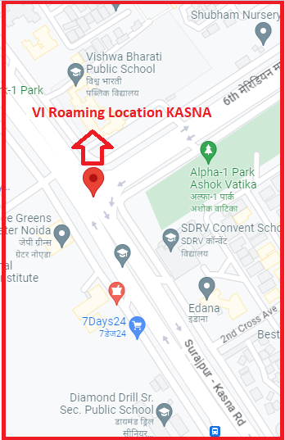
BSNL VOLTE AREA
Lat/Long - 28.5127° N, 77.4842° E
Location –SURAJPUR GREATER NOIDA
VI ROAMING
Lat/Long- 28.474388, 77.503990
Location –Kherli Neher G.Noida

Slide 15
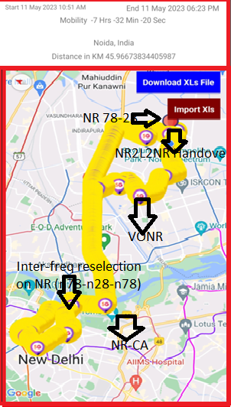
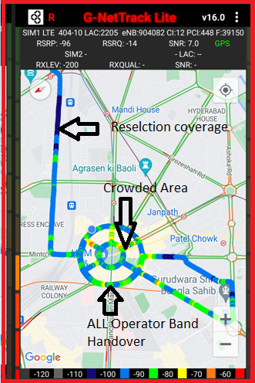
DRIVE ROUTE

Slide 16
THANK YOU
MARQUIS TECHNOLOGIES
www.marquistech.com

