Slide 1
MARQUIS TECHNOLOGIES
Drive Route

Slide 2
Dehradun/India
Operator Details:
S. No. | Operator |  | Supported Bands | Supported Features by Network
1 | Major | Airtel | LTE FDD B5 & TDD B40/N78 | VoWiFi/VoLTE/4G/2G/5G NSA
2 |  | JIO | LTE FDD B3/B5& TDD B40/N78/N28 | VoWiFi/VoLTE/4G/5G SA
3 |  | VI | LTE FDD B3,B8 TDD-B40 | VoWiFi/VoLTE/4G/2G
4 | Minor | BSNL | UTMS2100/1800 ,GSM 1800/900MHZ & LTE-2100MHz | 3G/2G/4G

Slide 3
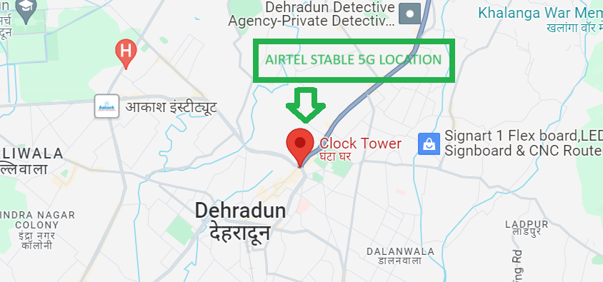
5G Near Cell,Airtel
Lat/Long -30.3278452,78.047343
Specification –Stable Airtel 5G NSA network
Good Throughput

Slide 4
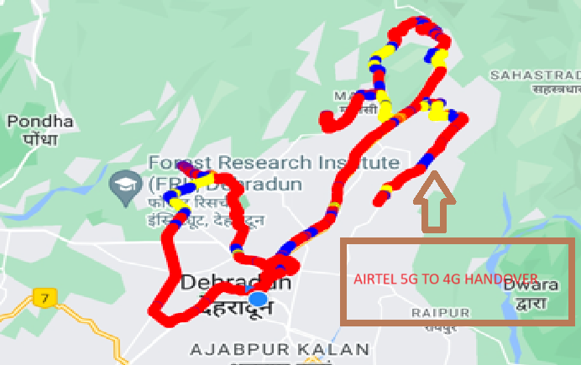
NR to LTE Handover ,Airtel
Lat. 30.342522, 78.016255 Location –Near Forest Research Institute ,Chakratta Road Specification –Band Handover ,Weak coverage

Slide 5
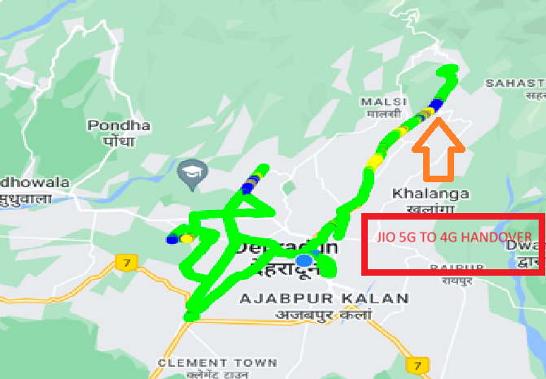
NR to LTE Handover ,JIO
Lat/Long 30.368942,78.0942517to
Lat/Long 30.3700158,78.0817204 Location – Dehradun to Mussoorie Diversion Road

Slide 6
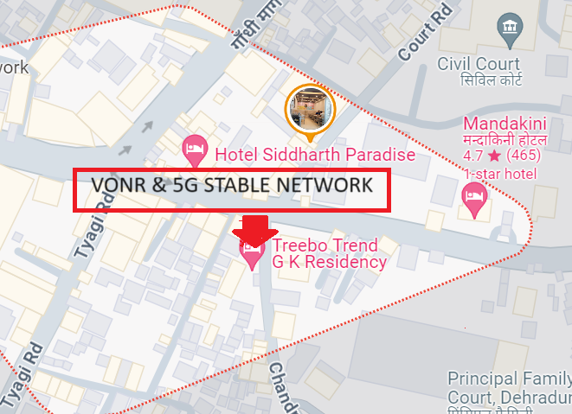
5G Near Cell JIO ,Dehradun
Lat/Long. 30.3153536,78.0355921 Location – Near Prince Chowk ,Dehradun Specification –VONR & 5G STABLE NETWORK

Slide 7
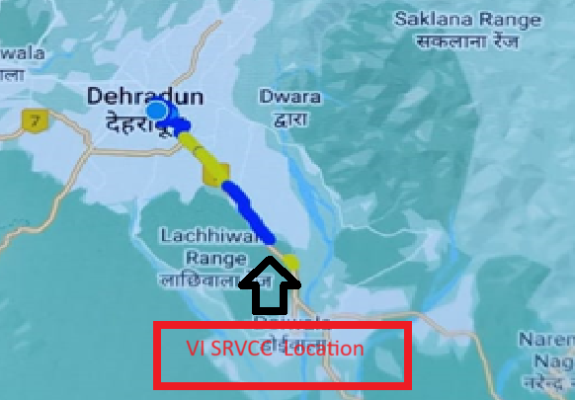
SRVCC for VI operator
Lat/Long 30.368942,78.0942517to
Lat/Long 30.216554, 78.122021 Location – Dehradun to Haridwar Road

Slide 8
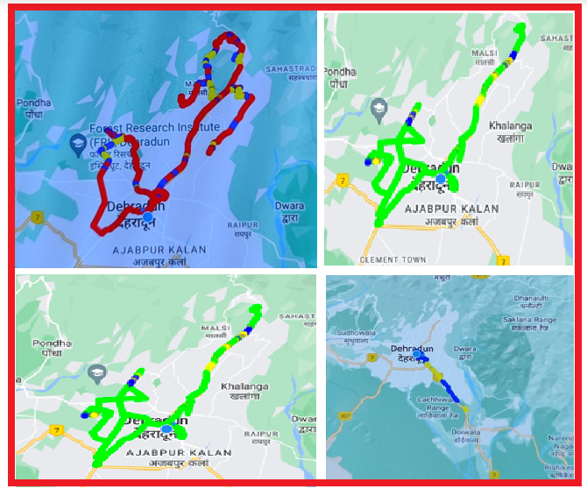
DRIVE ROUTE

Slide 9
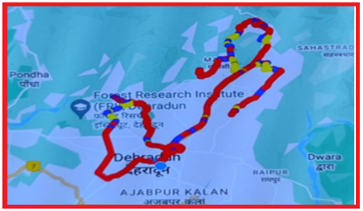
DRIVE ROUTE JIO 5G (Dehradun) Specification-Call/Handover/Cell Reselection/Redirection

Slide 10
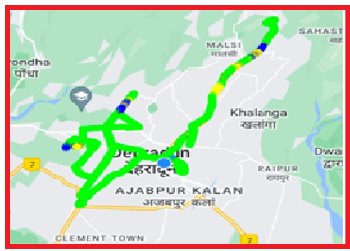
DRIVE ROUTE Airtel 5G (Dehradun) Specification-Call/Handover/Cell Reselection/Redirection

Slide 11
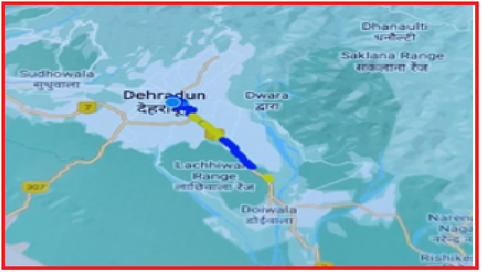
DRIVE ROUTE Vi 4G (Dehradun) Specification-Call/Handover/Cell Reselection/Redirection

Slide 12
THANK YOU
MARQUIS TECHNOLOGIES
www.marquistech.com

