Slide 1
MARQUIS TECHNOLOGIES
5G Drive Route – Copenhagen(Denmark)

Slide 2
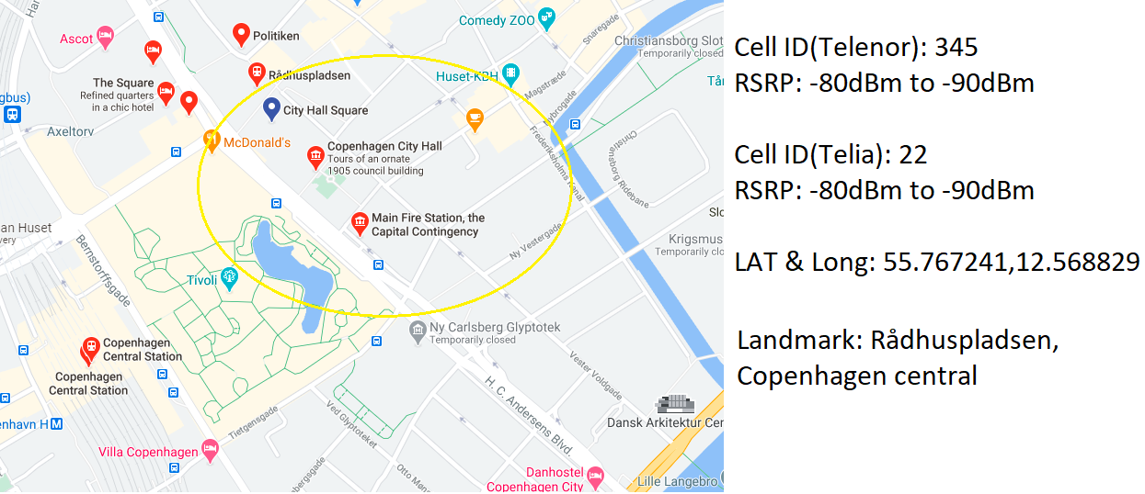
Telenor & Telia 5G Band 78

Slide 3
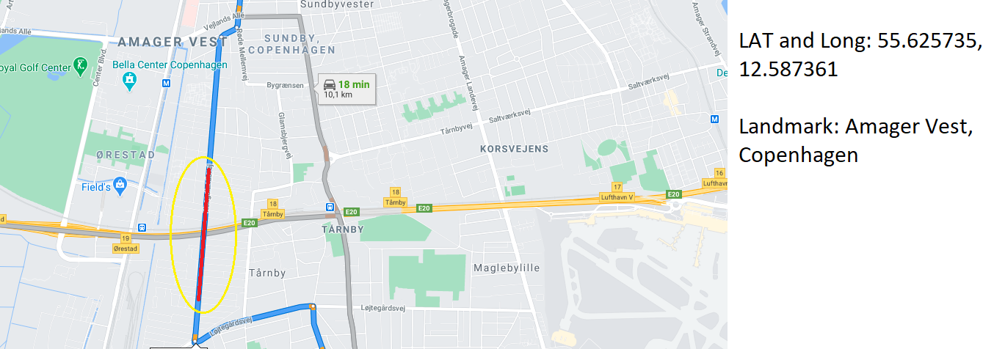
Yousee 5G Band 78 to Band 28 Handover

Slide 4
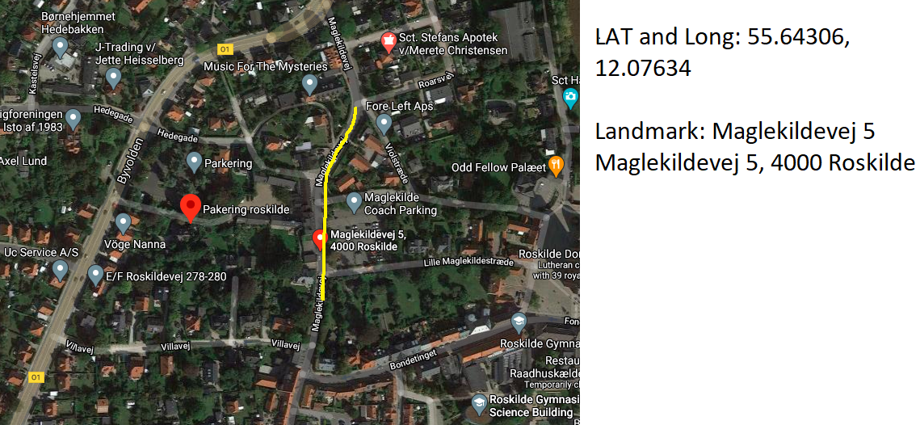
Tre(3) 5G Band 3 location:

Slide 5
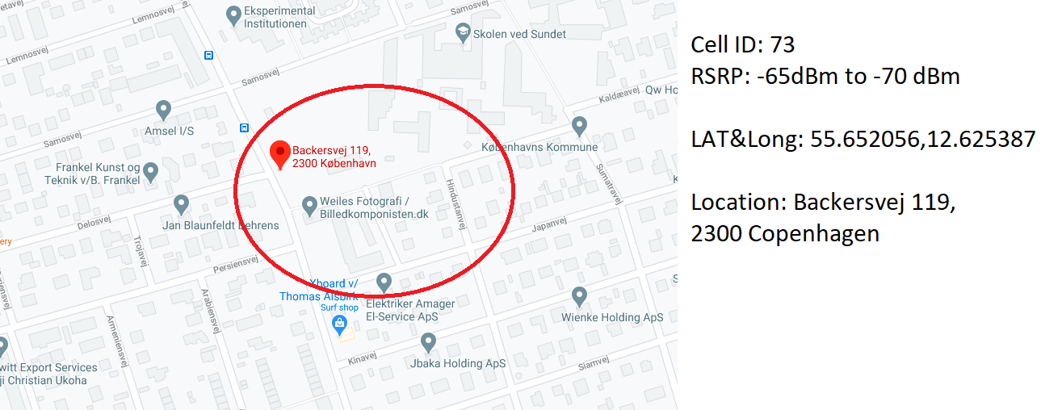
Tre(3) 5G Band 1

Slide 6
THANK YOU
MARQUIS TECHNOLOGIES
www.marquistech.com

