Slide 1
MARQUIS TECHNOLOGIES
Drive Route

Slide 2
CHENNAI
Country | INDIA
Continent | TAMIL NADU
City | CHENNAI
Time Zone | ---

Slide 3
Operators in Location
MCC | MNC | Operator
404 | 40 | AIRTEL
405 | 862 | JIO
404 | 84 | VI
operator Network Info(Airtel)
RAT | Band | Comment
5G | N78
4G | Band 1 (FDD-2100) Band 3 (FDD-1800),Band 8(FDD-390) Band 40 (TDD-2300)
3G | -
2G | GSM900, 1800
operator Network Info(JIO)
RAT | Band | Comment
5G | N78 ,N28
4G | LTE 2300 MHz –TDD(Band 40), LTE 850 MHz – FDD(Band 5) , LTE 1800 MHz –FDD(Band 3)
3G | -
2G | -
operator Network Info(VI)
RAT | Band | Comment
5G | -
4G | LTE 2100 MHz – FDD(Band 1), LTE 1800 MHz –FDD(Band 3)
3G | -
2G | GSM900, 1800

Slide 4
Drive Route operator
Near Cell :-Stationary: RSRP: -60dbm to -75dbm
Mixed :-Mobility: RSRP : -75dbm to -95dbm
Cell Edge :-Stationary: RSRP : -95dbm to -115dbm
(VONR Location & SRVCC not available in Chennai location)

Slide 5
AIRTEL

Slide 6
OPERATOR | Mobility Scenario | Location tested | Longitude/Latitude
Airtel | IRAT | kamakshi Hospital Road | 80.2362,12.9416
 | Good Coverage For Testing | West Saidapet | 80.213367,13.024770
 | Poor Coverage For Testing | Tansi Nagar,Velachery | 80.2180,12.9815

Slide 7
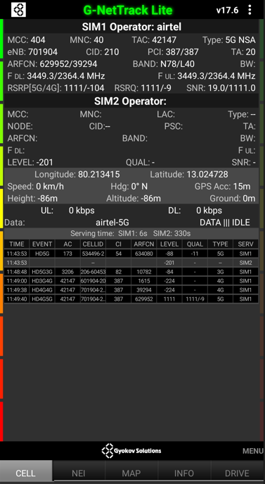
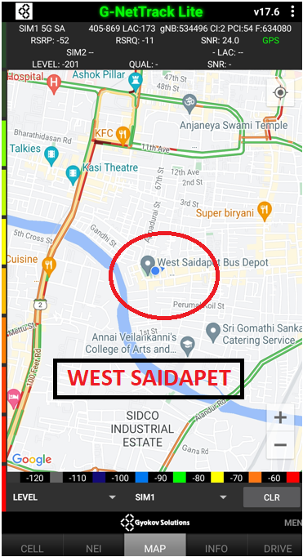
Edge Cell screenshots of all band with Network INFO. Which includes 5G
Operator: Airtel
Band: N78/L40
Location : Gandhi street,west saidapet
Cell ID: 2(387/387)
E-ARFCN : 629952
RSRP: -95dbm to 115dbm
Lat :13.024380, Long : 80.213350

Slide 8
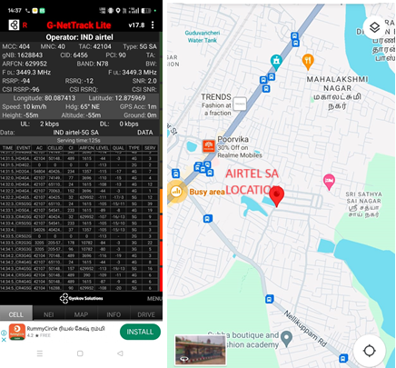
Airtel SA Location
Operator: Airtel
Band: N78
Location : Guvanchery
Cell ID: 90
E-ARFCN : 629952
RSRP: -75dbm to 95dbm
Lat :12.875969, Long : 80.087413

Slide 9
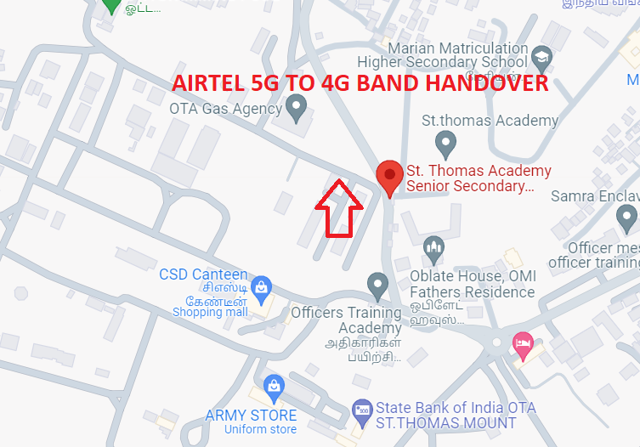
NR to LTE Handover Airtel
Lat. 13.001815 & Long. 80.189989
Location – St.Thomas academy senior secondary CBSE school
Specification –Band Handover
Operator: Airtel
Band Handover: B78 – B40 and B40-B3-B40
E-ARFCN : 629952-39150-629952 and 39150-1800-39150

Slide 10
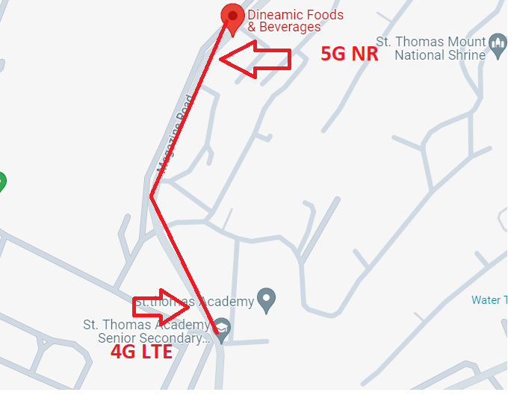

NR TO LTE TO NR Handover
Lat. 13.005401 & Long.80.190104 to
Lat. 13.001944 & Long. 80.189973
Location: 3/94 Magazine road,ramapuram,st.thomas mount.

Slide 11
JIO

Slide 12
OPERATOR | Mobility Scenario | Location tested | Longitude/Latitude
JIO | 5G to 4G HO Spot | Marina Road | 80.2824, 13.0500
 |  | St thomas Mount Road | 80.1923,13.0051
 | IRAT | kamakshi Hospital Road | 80.2362,12.9416
 | Good Coverage For Testing | West Saidapet | 80.213367,13.024770
 | Poor Coverage For Testing | Tansi Nagar,Velachery | 80.2180,12.9815

Slide 13
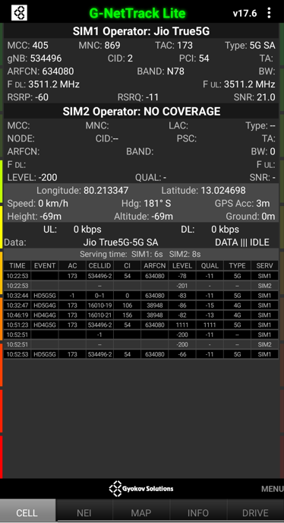
Near Cell screenshots of all band with Network INFO. Which include 5G also.
Operator: JIO
Band: N78
Cell ID: 54
Location : Gandhi street,West saidapet
E-ARFCN : 630480
RSRP: -60dBm to -75dBm
Lat :13.024380, Long : 80.213350

Slide 14
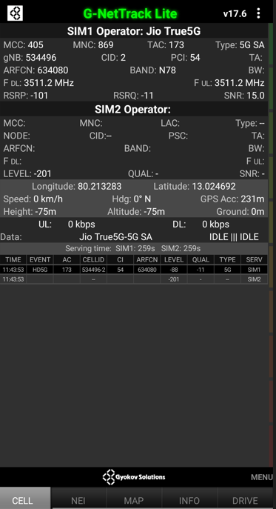
Edge Cell screenshots of all band with Network INFO. Which includes 5G also
Operator: JIO
Band: N78
Cell ID: 54
Location: Gandhi street,West Saidapet.
E-ARFCN : 634080
RSRP: -95dbm to 115dbm
Lat :13.024380, Long : 80.213350

Slide 15
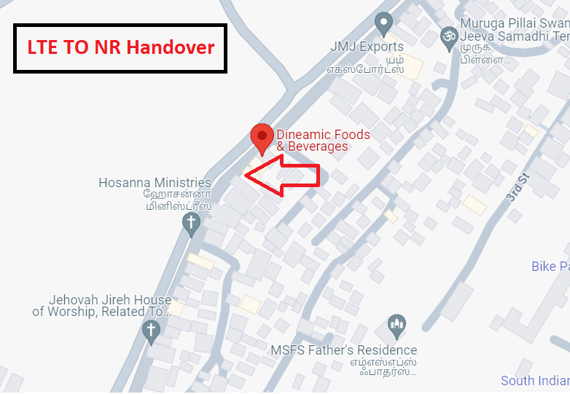
LTE to NR Handover JIO
Lat. 13.001815 & Long. 80.189989 to
Lat. 13.005659 & Long.80.190124
Location : 3/94 magazine road, ramapuram,st.thomas mount

Slide 16
VoNR
VoNR Location not available in Chennai location

Slide 17
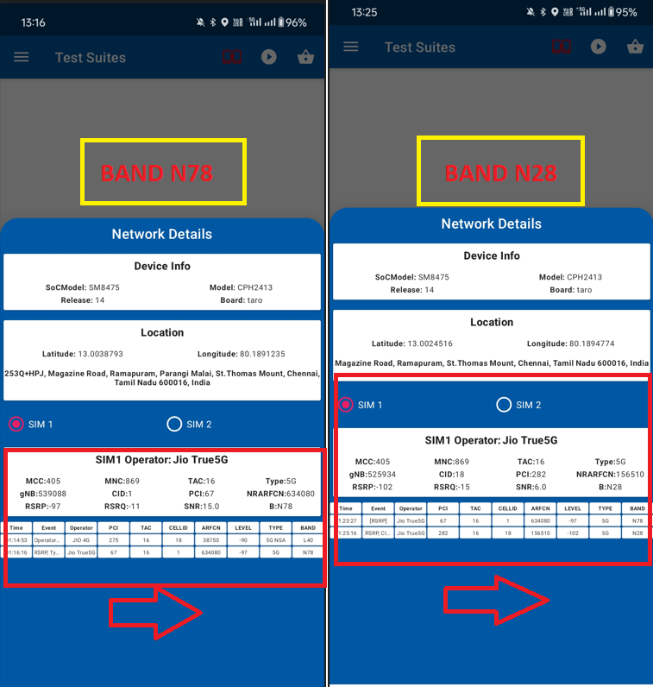
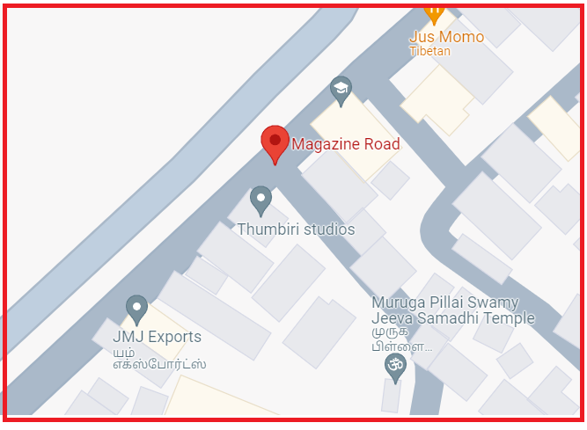
Inter-freq HO on NR (n78-n28-n78)
Lat.13.0038793, Long: 80.1891235 (N78
Lat: 13.0024516, Long: 80.1894774
Location: 253Q+HPJ,Mgazine road,Ramapuram,parangi malai,st.thomas mount,chennai

Slide 18
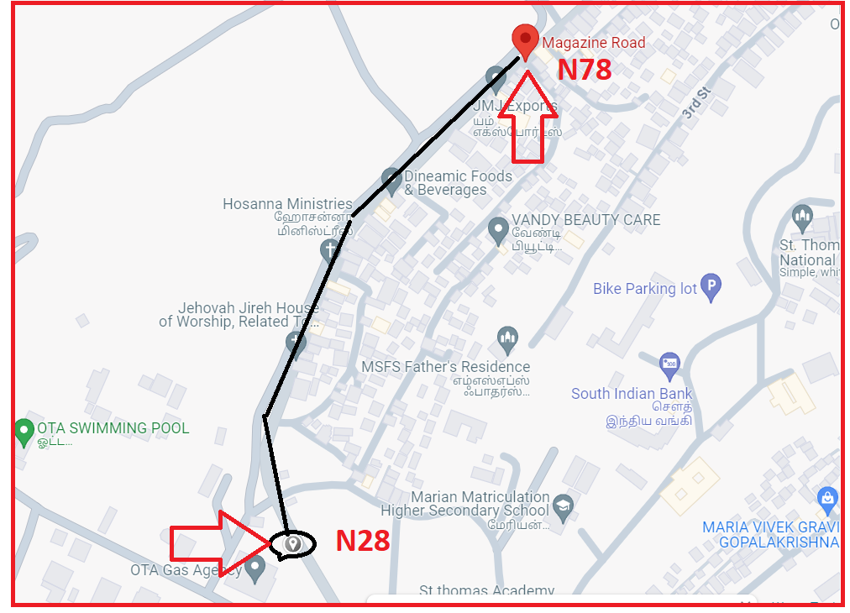
Inter-freq HO on NR (n78-n28-n78)
Lat.13.0038793, Long: 80.1891235 (N78)
Lat: 13.0024516, Long: 80.1894774 (N28)
Location: 253Q+HPJ,Mgazine road,ramapuram,parangi malai,st.thomas mount,Chennai.

Slide 19
VI 5G
VI 5G Not available in Chennai location

Slide 20
SRVCC
SRVCC Location not available in Chennai location

Slide 21
BSNL VOLTE AREA
BSNL Volte area Location not available in Chennai location
VI ROAMING
VI Roaming Location not available in Chennai location

Slide 22
THANK YOU
MARQUIS TECHNOLOGIES
www.marquistech.com

