Slide 1
MARQUIS TECHNOLOGIES
Drive Route

Slide 2
Delhi/India
Operator Details:
S. No. | Operator |  | Supported Bands | Supported Features by Network
1 |  | Airtel | LTE FDD L3/L8 & TDD L40/5G-N78 | VoWiFi/VoLTE/4G/2G/5G
2 |  | JIO | LTE FDD L1/L3/L5/ & TDD L40/5G-N78/N28 | VoWiFi/VoLTE/4G/5G
3 |  | VI | LTE FDD L1/L3/ & TDD L41 | VoWiFi/VoLTE/4G/3G/2G

Slide 3
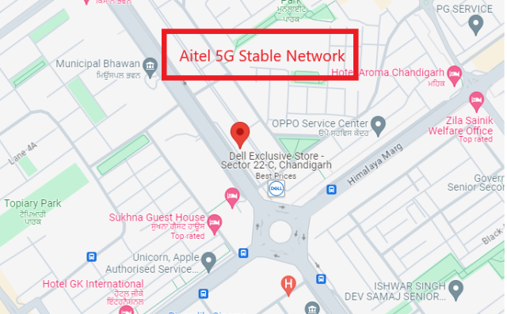
5G Near Cell, Airtel
Lat/Long -30.7284126° N, 76.7672529° E
Specification –Stable Airtel 5G NSA network
Good Throughput

Slide 4
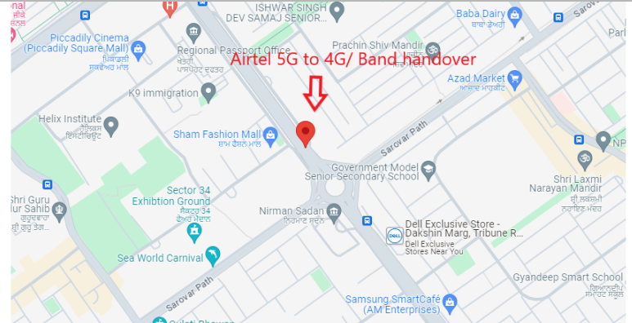
5G to 4G Handover ,Airtel
Lat. 30.7214744 & Long. 76.7725953 to Location – City center Sector 34B Specification –Band Handover ,Weak coverage

Slide 5
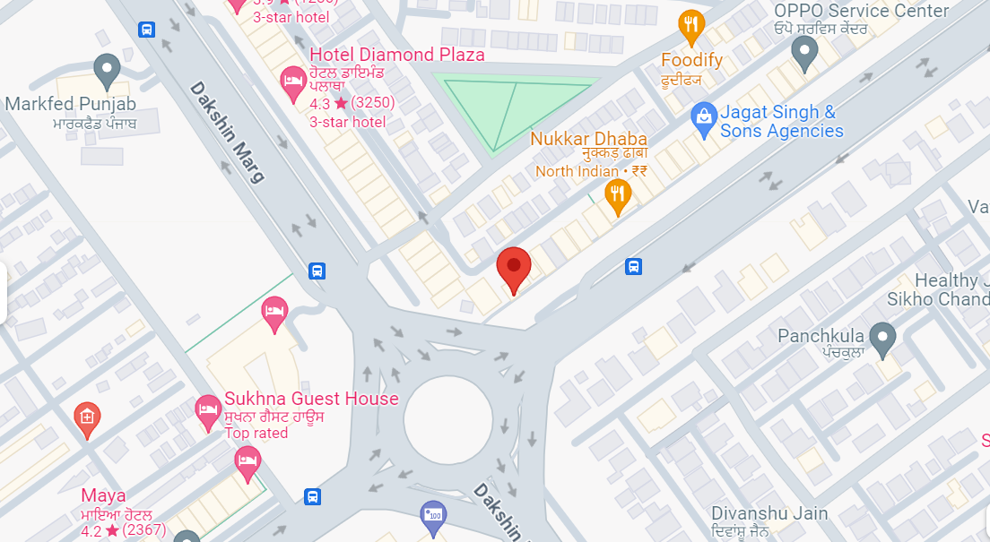
5G to 4G Handover, Jio
Lat/Long : 30.727179° N, 76.768945° E
Specification –5G to 4G Handover, Jio
5G to 4G Handover

Slide 6
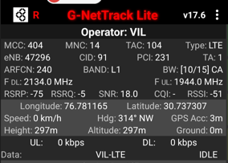
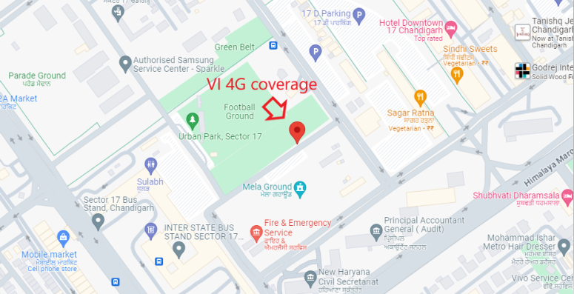
VI 4G
Lat long – 30.737307° N, 76.781165° E Location – Sector 17, Chandigarh, India Specification –VI 4G

Slide 7
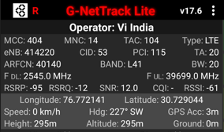
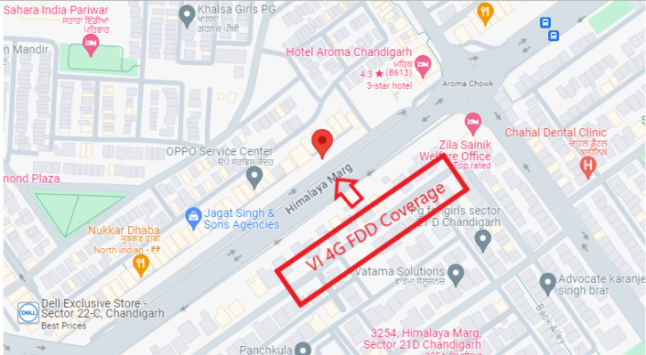
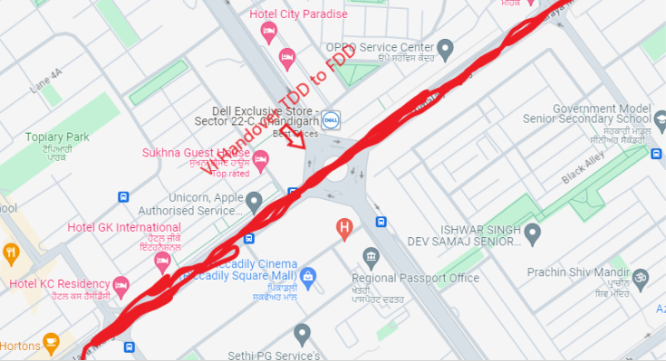
VI 4G FDD COVERAGE
Lat Long- 30.729044/ 76.772141 Location- near Aroma Taxi Stand, Sector 22C, Sector 22,
Vi Handover :- Himalaya Marg, Near sector 22C

Slide 8
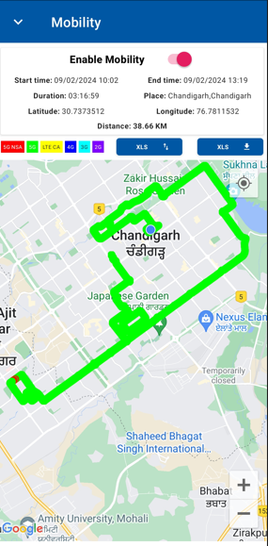
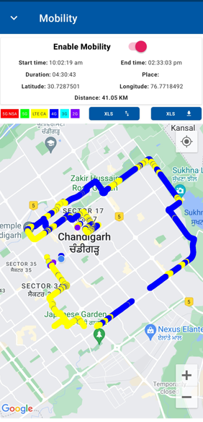
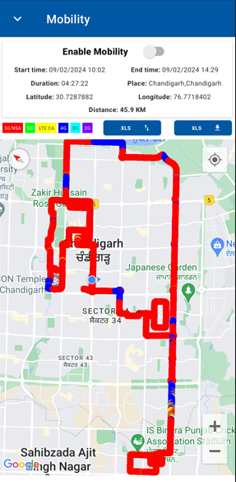
DRIVE ROUTE: Chandigarh

Slide 9
THANK YOU
MARQUIS TECHNOLOGIES
www.marquistech.com

