Slide 1
MARQUIS TECHNOLOGIES
Drive Route –Airtel, Idea, VODAFONE & Reliance JIO (FDD/TDD) LTE

Slide 2
Operator Information:
Operator | JIO 4G
MCC | 405
MNC | 866
APN | Jionet
Operator | Airtel 4G
MCC | 405
MNC | 53
APN | Airtelgprs.com
Operator | VI
MCC | 405
MNC | 753
APN | www
Operator | BSNL
MCC | 404
MNC | 76
APN | bsnlmms

Slide 3
Operator Information 1
Functionality | Airtel
Website: http://www.airtel.com/ WAP APN: airtelgprs.com
Customer care | 199
MNC | 53
Bands supported | Both FDD and TDD
 | LTE 2300 MHz – TDD(Band 40)
 | LTE 1800 – FDD(Band 3)
USSD | To check MDN: *282#
 | Balance check: *123#
 | Data Balance check: *121*114#
VoLTE | Supported
CSFB | Supported (CSFB to 2G)

Slide 4
Operator Information 2
Functionality | RELIANCE JIO
Website: http://www.jio.com WAP APN: jionet
Customer care | 198
MNC | 866
Bands supported | Both FDD and TDD
 | LTE 2300 MHz –TDD(Band 40)
 | LTE 850 MHz – FDD(Band 5)
 | LTE 1800 MHz –FDD(Band 3)
USSD | NA
 | NA
 | NA
VoLTE | Supported
CSFB | Not Supported

Slide 5
Operator Information 3
Functionality | VI
Website: http://www.myvi.in WAP APN: www
Customer care | 198
MNC | 753
Bands supported | Both FDD and TDD
 | LTE 1800 MHz –FDD(Band 3)
USSD | To check MDN*199#
 | Balance check*121#
 | Data Balance check:*121#
VoLTE | Supported
CSFB | Supported (Switched to 3G)

Slide 6
Drive Route
Near Cell :- Stationary: RSRP : -65dbm to -75dbm
Cell Edge :- Stationary: RSRP : -95dbm to -110dbm
Mixed :- Mobility: RSRP : -65dbm to -110dbm

Slide 7
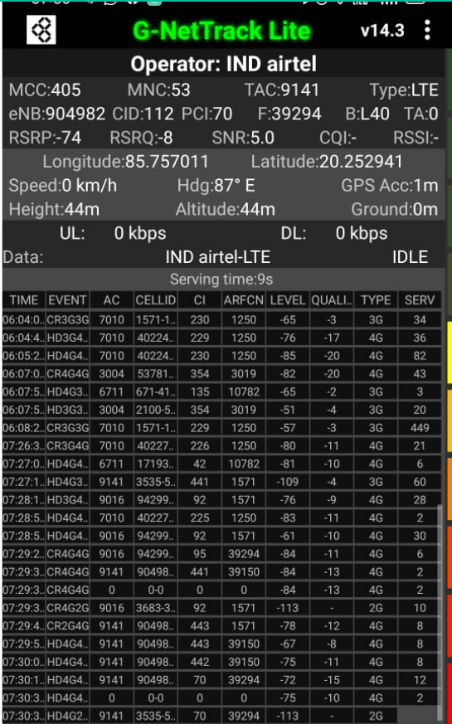
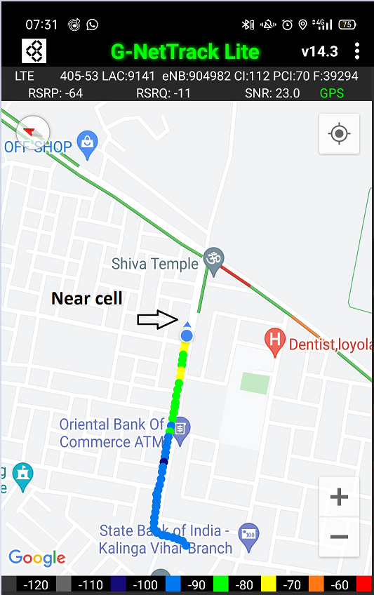
Near Cell (Airtel)
Near cell(NC) | longitude | latitude | RSRP | PCI | FDD E-ARFCN
1 | 85.757011 | 20.252941 | 74 | 70 | 39294
Kalinga Vihar
Kalinga Vihar LIG, Kalinganagar, Bhubaneswar, Odisha 752054
RSRP:
-65dbm to 75dbm

Slide 8
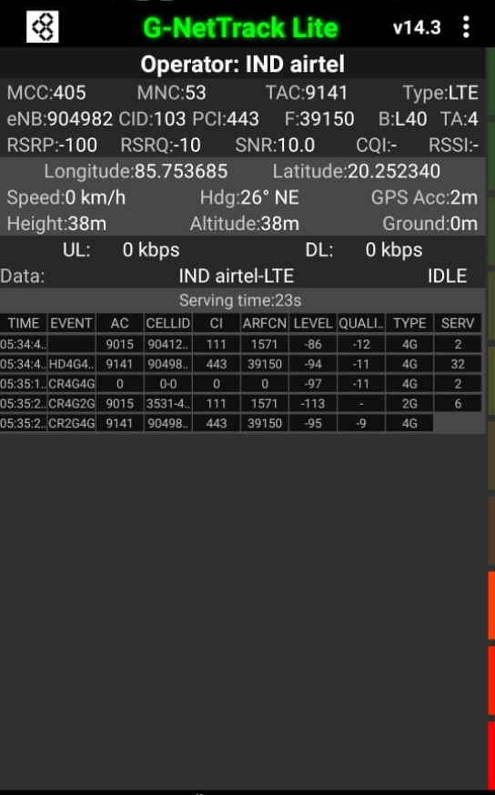
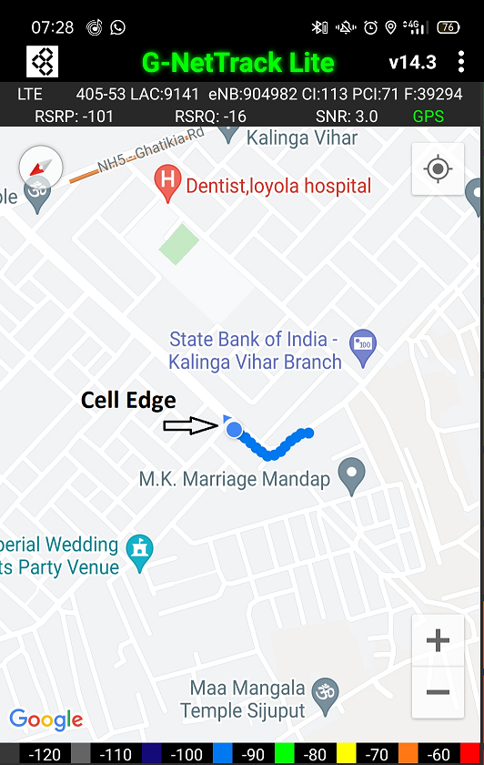
Edge Cell (Airtel)
Edge cell(EC) | longitude | latitude | RSRP | PCI | TDD E-ARFCN
1 | 85.753685 | 20.252340 | 100 | 443 | 39150
Kalinga Vihar
Kalinga Vihar LIG, Kalinganagar, Bhubaneswar, Odisha 752054
RSRP:
-95dbm to -110dbm

Slide 9
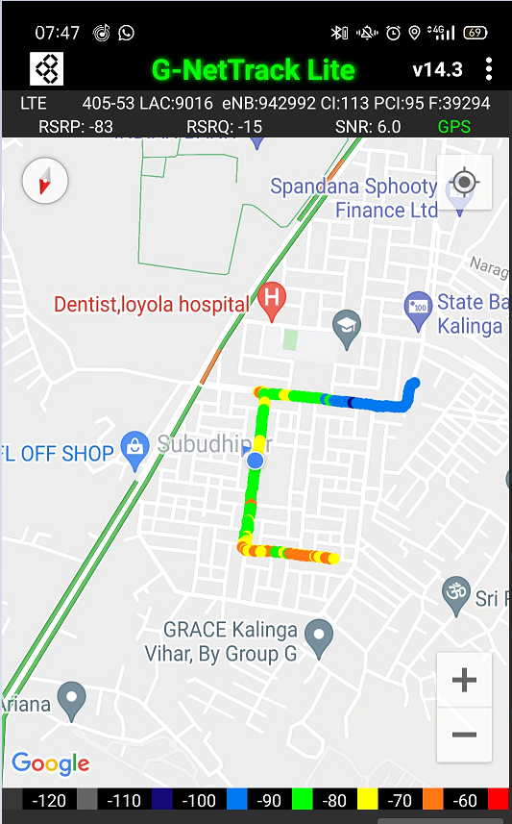
Mixed Mobility(Airtel)
Kalinga Vihar LIG, Kalinganagar, Bhubaneswar, Odisha 752054
RSRP: -65dbm to -110dbm

Slide 10
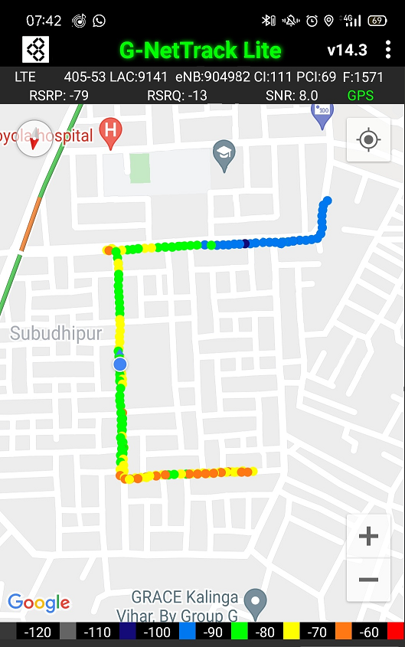
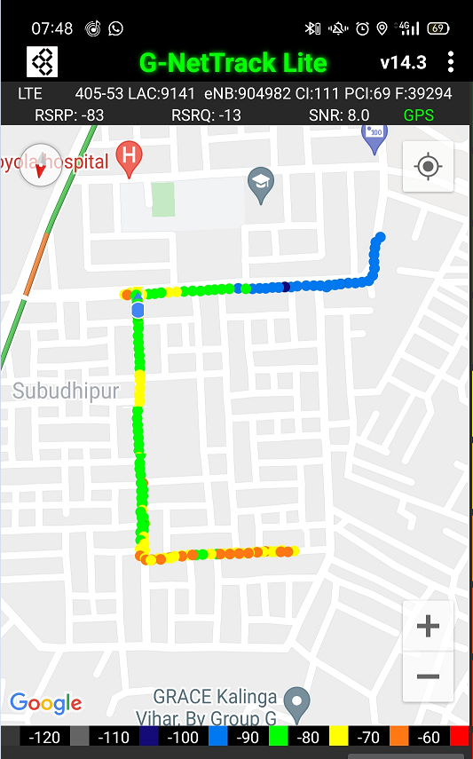
Airtel Band HO
Band Hand Over | Longitude | Latitude | RSRP
1 | 85.75308 | 20.2515 | -85 to 105 dBM
Band 40_3
Band 3_40

Slide 11
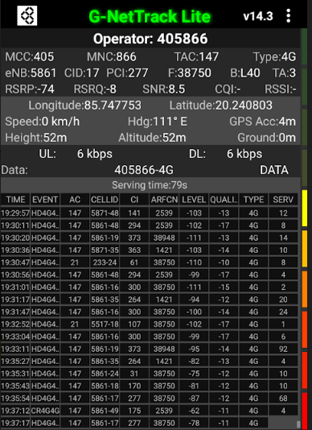
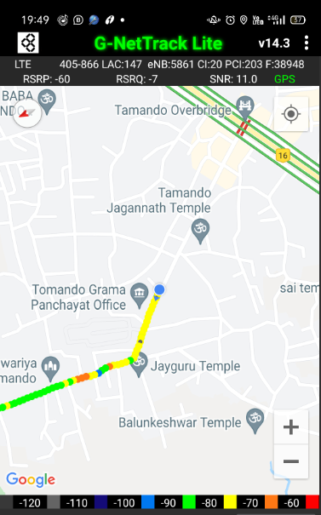
Near Cell (Reliance JIO)
Near cell(NC) | longitude | latitude | RSRP | PCI | TDD E-ARFCN
1 | 85.747753 | 20.240803 | 74 | 277 | 38750
Naragoda
Bhubaneswar, Odisha 752054
RSRP:
-65dbm to -75dbm

Slide 12
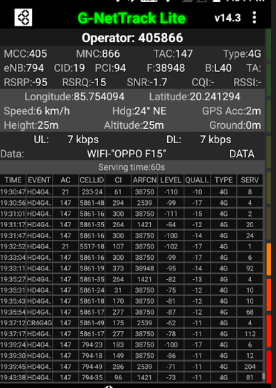
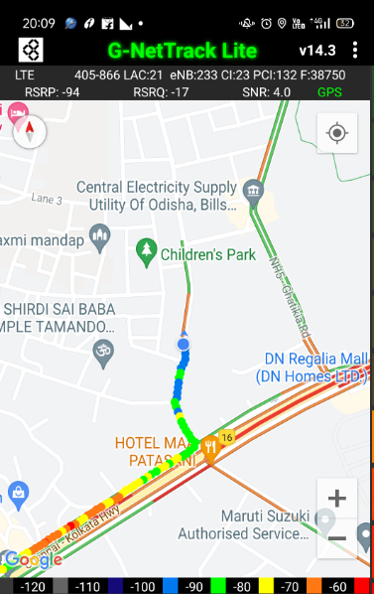
Edge Cell (Reliance JIO)
Edge cell(NC) | longitude | latitude | RSRP | PCI | TDD E-ARFCN
1 | 85.754094 | 20.241294 | 95 | 94 | 38948
Kalinga Vihar
Kalinga Vihar LIG, Kalinganagar, Bhubaneswar, Odisha 752054
RSRP:
-95dbm to -110dbm

Slide 13
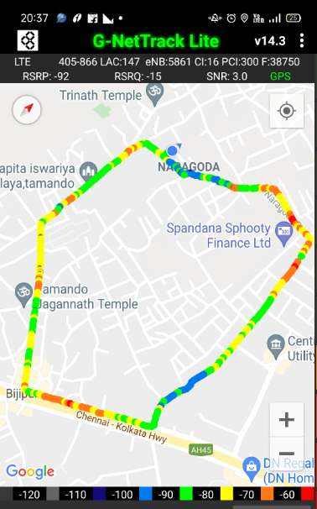
Mixed Mobility (Reliance JIO)
RSRP: -95dbm to -110dbm

Slide 14
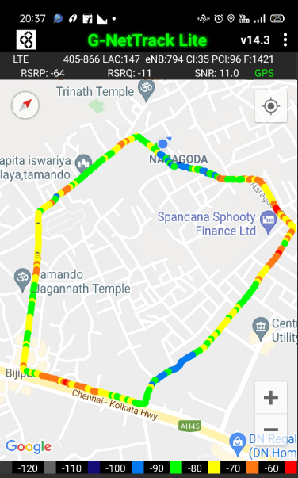
Reliance JIO Band HO
Band Handover | longitude | latitude | RSRP | PCI | TDD E-ARFCN
1 | 85.7496 | 20.2385 | 92 | 300 | 38750

Slide 15
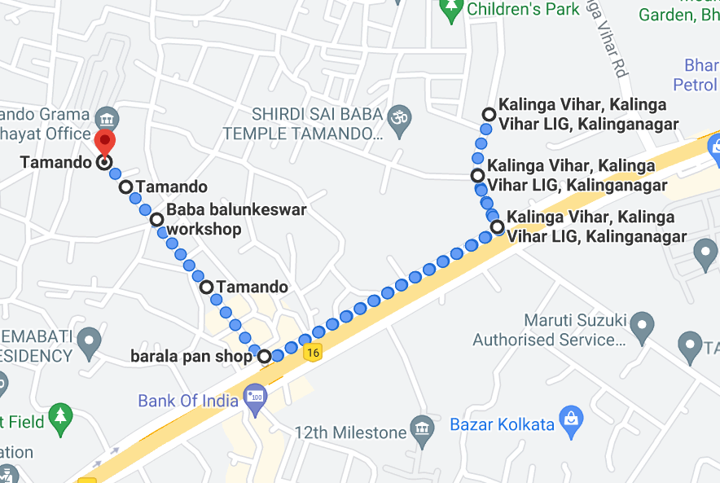
RJIO Band 40 Near Cell:
Near cell

Slide 16
RJIO Band 40 Edge Cell:
Cell Edge

Slide 17
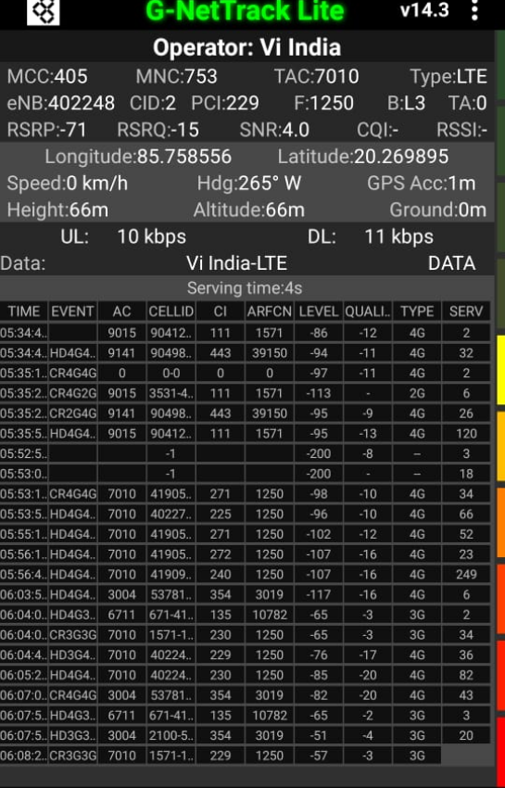
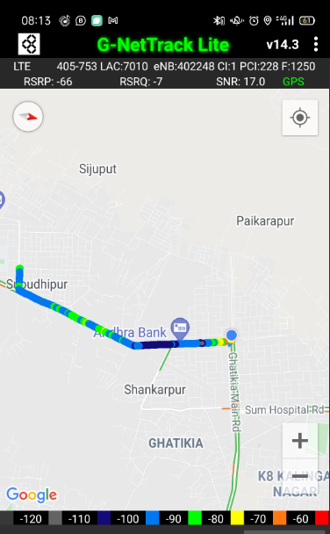
Near Cell (VIL)
Near cell(NC) | longitude | latitude | RSRP | PCI | TDD E-ARFCN
1 | 85.758556 | 20.269859 | 71 | 229 | 1250
Ghatikia Main Rd
Ghatikia, Bhubaneswar, Odisha 751003
RSRP:
-65dbm to -75dbm

Slide 18
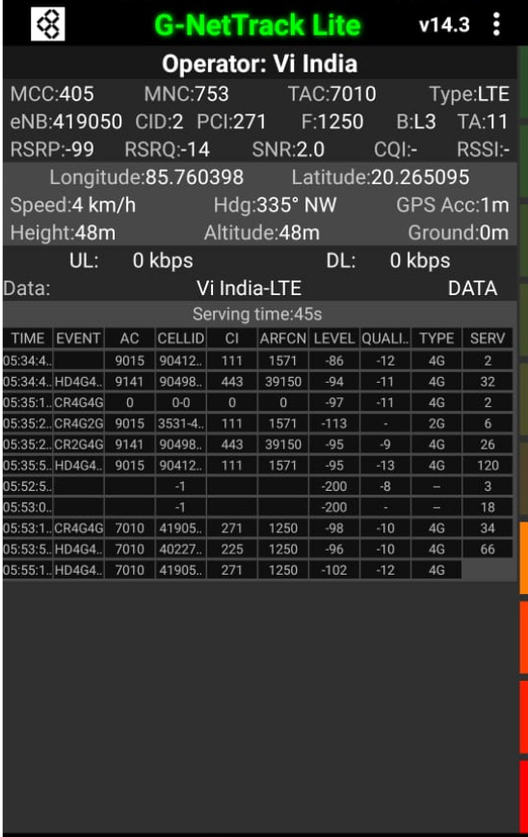
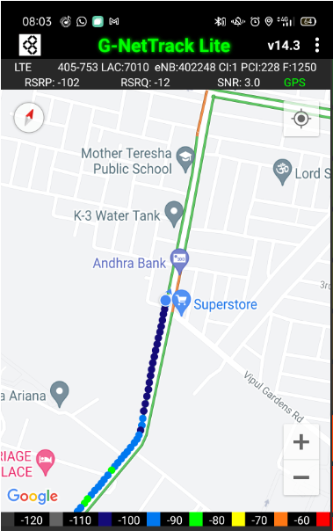
Cell Edge (VI)
Edge cell(EC) | longitude | latitude | RSRP | PCI | TDD E-ARFCN
1 | 85.760398 | 20.265095 | 99 | 271 | 1250
Kalinganagar
Bhubaneswar, Odisha 751003
RSRP:
-95dbm to -105dbm

Slide 19
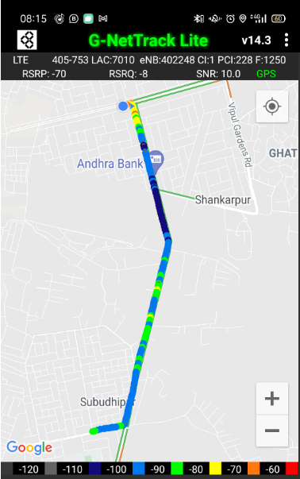
Mixed Mobility (VIL)

Slide 20
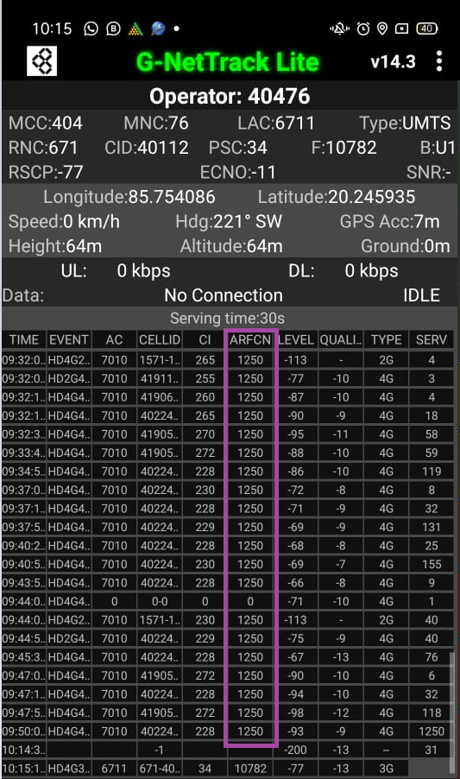
VIL Band HO
* In my location only band 3 available for operator VIL

Slide 21
G net Tracker Drive Route
Airtel
VIL
JIO

Slide 22
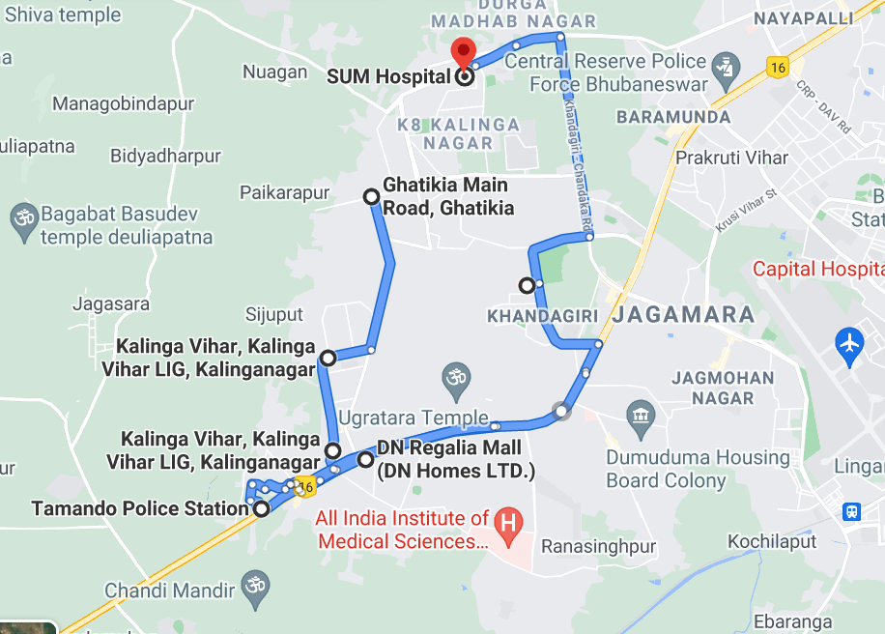
Google Driver Route

Slide 23
THANK YOU
MARQUIS TECHNOLOGIES

