Slide 1
MARQUIS TECHNOLOGIES
Drive Route Bhubaneswar

Slide 2
Bhubaneshwar/India
Operator Details:
S. No. | Operator |  | Supported Bands | Supported Features by Network
1 | Major | Airtel | LTE FDD B3/B8 & TDD B40/N78 | VoWiFi/VoLTE/4G/2G/5G
2 |  | JIO | LTE FDD B3/B5/B8& TDD B40/N78/N28 | VoWiFi/VoLTE/4G/5G
3 |  | VI | LTE FDD B3 | VoWiFi/VoLTE/4G/2G
4 | Minor | BSNL | UTMS2100/1800 &GSM 1800/900MHZ | 3G/2G

Slide 3
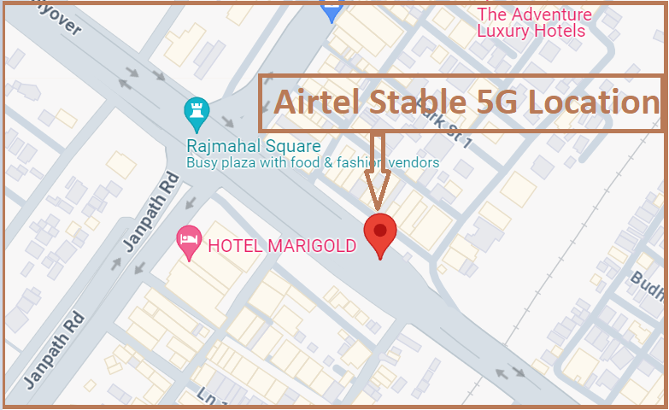
5G Near Cell,Airtel (Bhubaneshwar)
Lat/Long -20°15'38.8"N 85°50'17.1"E
Location-Rajmahal Flyover near The Shivalik hotel Ashok Nagar
Specification –Stable Airtel 5G NSA network
Good Throughput

Slide 4
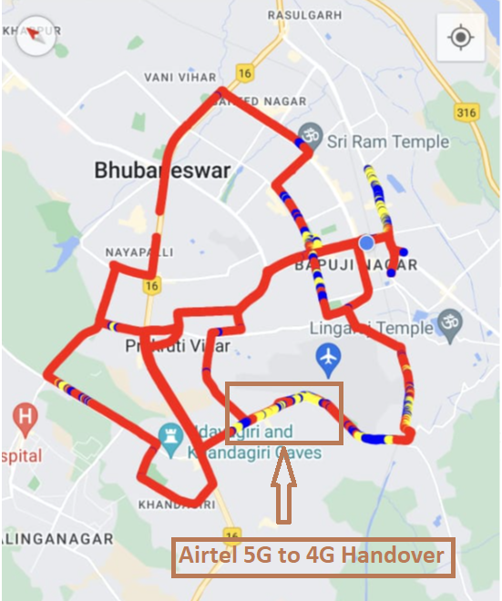
NR to LTE Handover ,Airtel (Bhubaneshwar)
Lat. 20.253972, 85.803454to Location –Kala Bhoomi Odisha Crafts Museum/Near Jagamara Specification –Band Handover ,Weak coverage

Slide 5
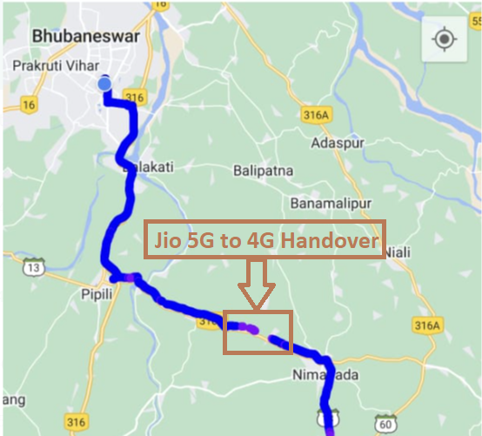
NR to LTE Handover ,JIO (Bhubaneshwar)
Lat/Long 20.083104, 85.949672 to
Lat/Long 20.089347, 85.926234 Location – Pipli Konark Road (Dhanua,Bhuan Bridge)
Specification –Band Handover ,Weak coverage

Slide 6
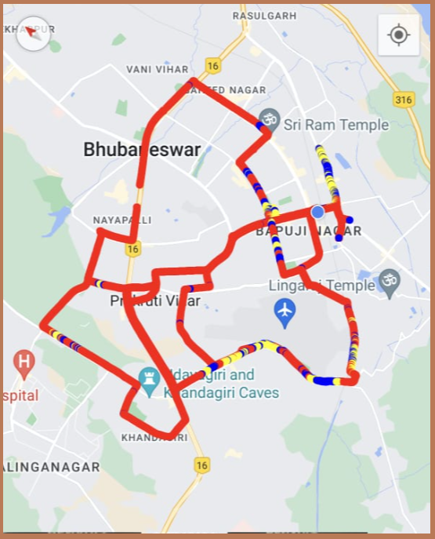
DRIVE ROUTE Airtel 5G (Bhubaneshwar) Specification-Call/Throughput/Handover/Cell Reselection/Redirection

Slide 7
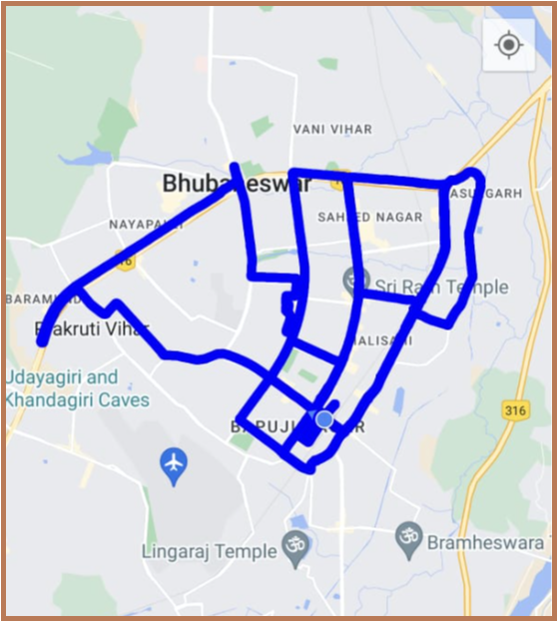
DRIVE ROUTE JIO 5G (Bhubaneshwar) Specification-Call/Throughput/Handover/Cell Reselection/Redirection

Slide 8
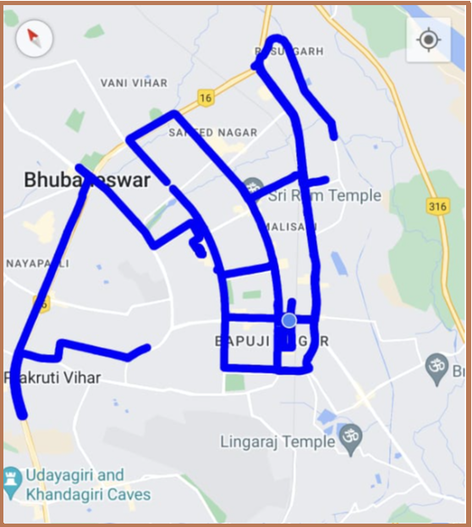
DRIVE ROUTE VI 4G (Bhubaneshwar) Specification-Call/Throughput/Handover/Cell Reselection/Redirection

Slide 9
THANK YOU
MARQUIS TECHNOLOGIES
www.marquistech.com

