Slide 1
MARQUIS TECHNOLOGIES
Drive Route BANGALORE

Slide 2
Drive Route
Near Cell :-Stationary: RSRP: -60dbm to -75dbm
Mixed :-Mobility: RSRP : -75dbm to -95dbm
Cell Edge :-Stationary: RSRP : -95dbm to -115dbm

Slide 3
Services Supported by Vi VoLTE Operator
Operator | Supported Feature By Network | Supported Bands | Infra | MCC | MNC
Vi | VoLTE/4G/2G | B1, B3 & B8 | Nokia & Huawei | 404 | 86
Operator | Feature/Services | Supports(Yes/No)
Vi | Reselection | Yes
 | Redirection | Yes
 | MMS | Yes
 | Volte | Yes
 | CSFB | Yes(2G)
 | PS Handover | Yes

Slide 4
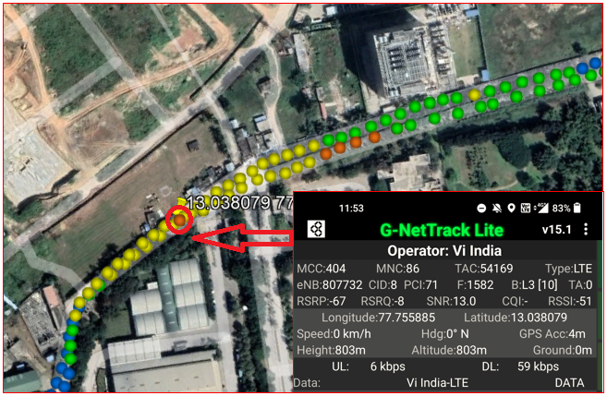
Vi operator Good Coverage Area Band3
Route >> Safal market

Slide 5
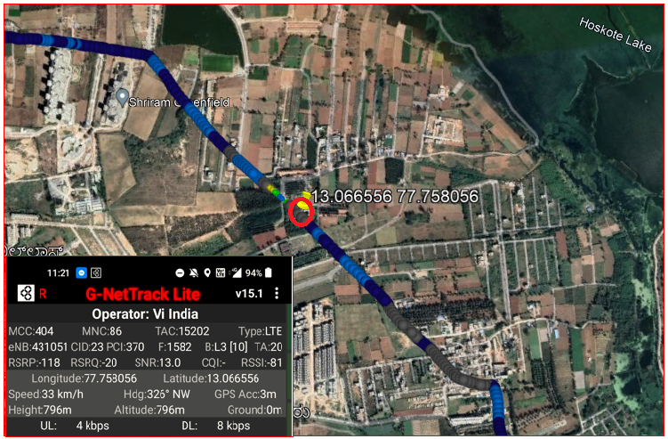
Vi operator Weak Coverage Area Band 3
Route >> huskur road>>raghuvanahall-hoskote rd>>3m farm-mani’s mythri manasa_biowise
_

Slide 6
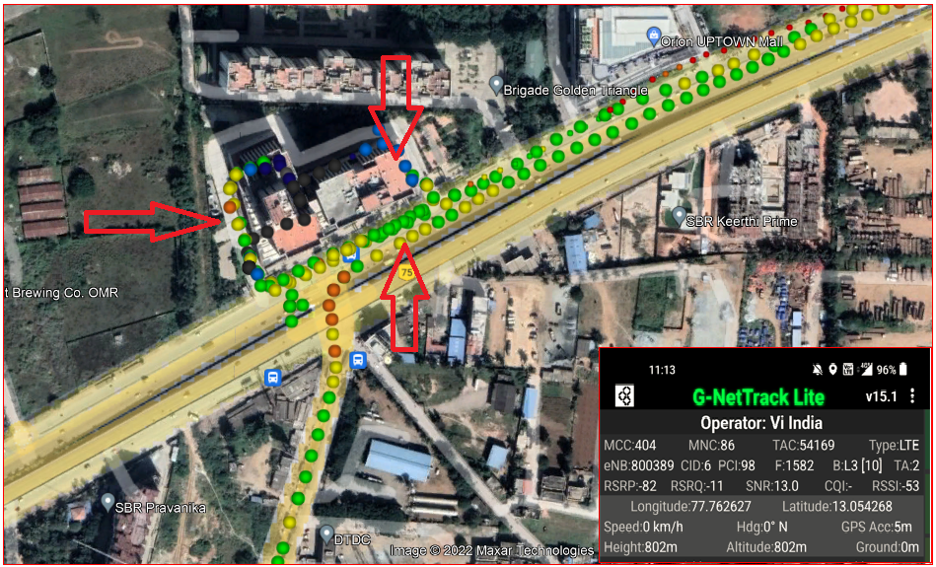
Vi operator Mix Coverage Area
Route >> kattamanallur>>brigade signature tower

Slide 7
Crowded area for Vi operator route>>kattamanallur>>brigade signature tower>>orion uptown mall

Slide 8
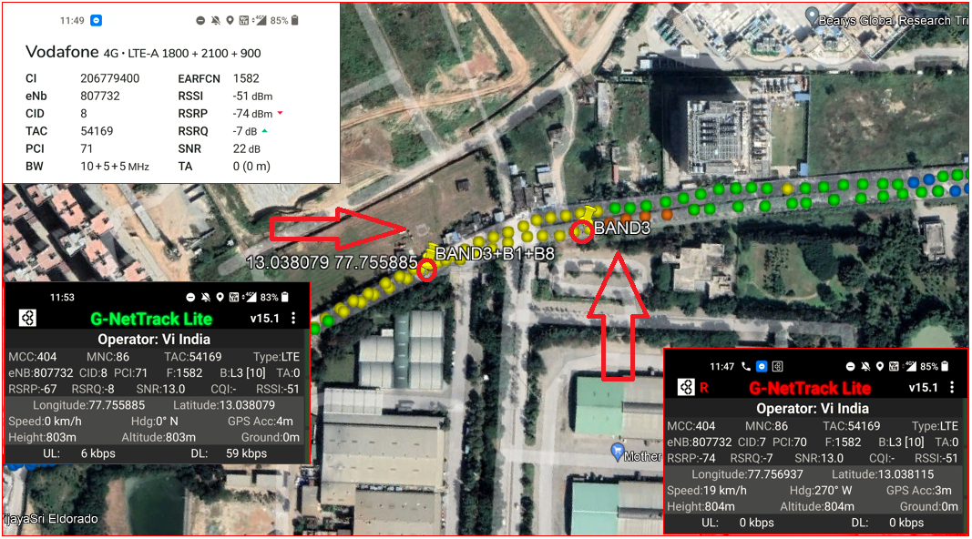
Vi operator non CA to CA_HO(B3_non CA to B3+B1+B8_CA)
Route>>whitle fileld road>>Safal market>>mother dairy>>Bandapura road

Slide 9
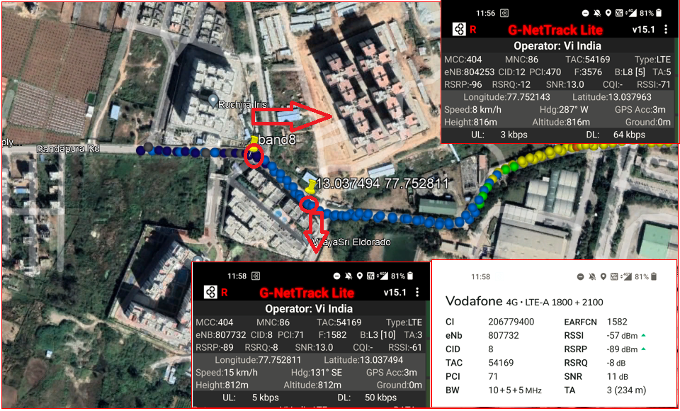
Vi operator non CA to CA HO (B8_to B3+B1_CA)
Route>>bandapura road >> mother dairy>>Safal market

Slide 10
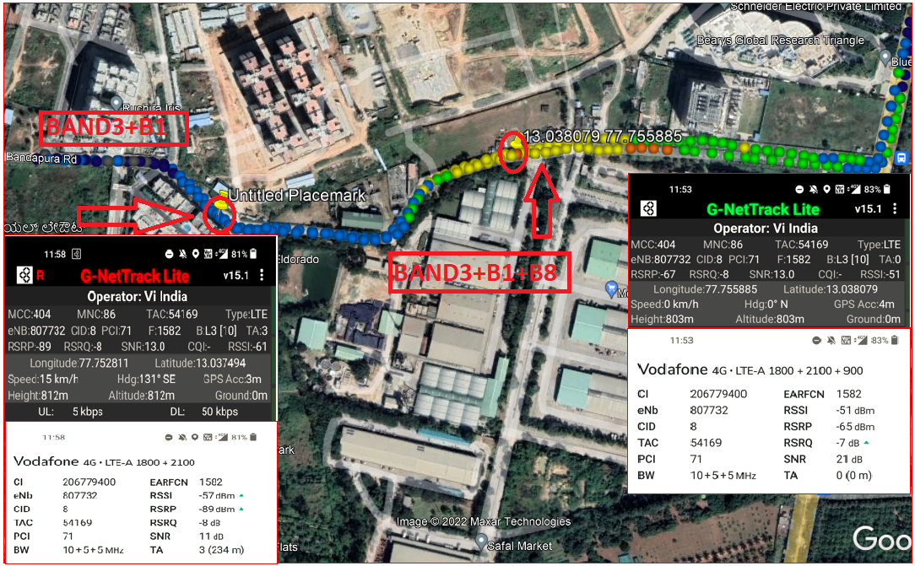
HO from 3CA (B3+B1+B8) cell to another 2CA(B3+B1) cell for
Vi operator
Route>>safal market >>Bandapura raod

Slide 11
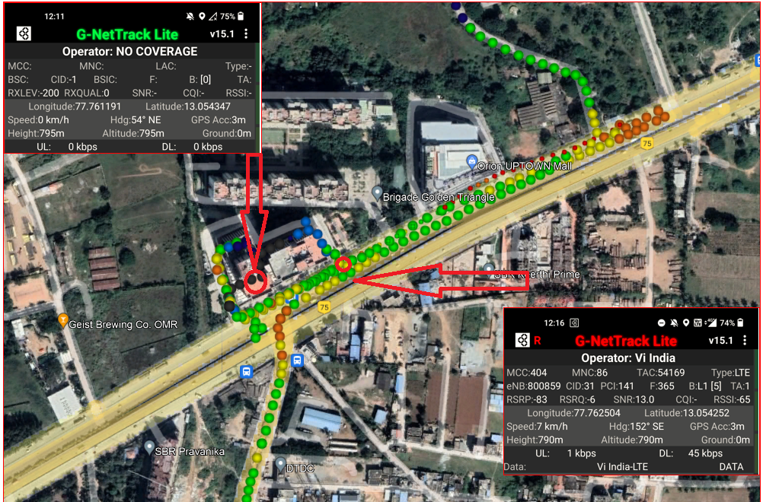
Vi Operator for OOS to in service route>>brigade signature tower base ment >>exit gate

Slide 12
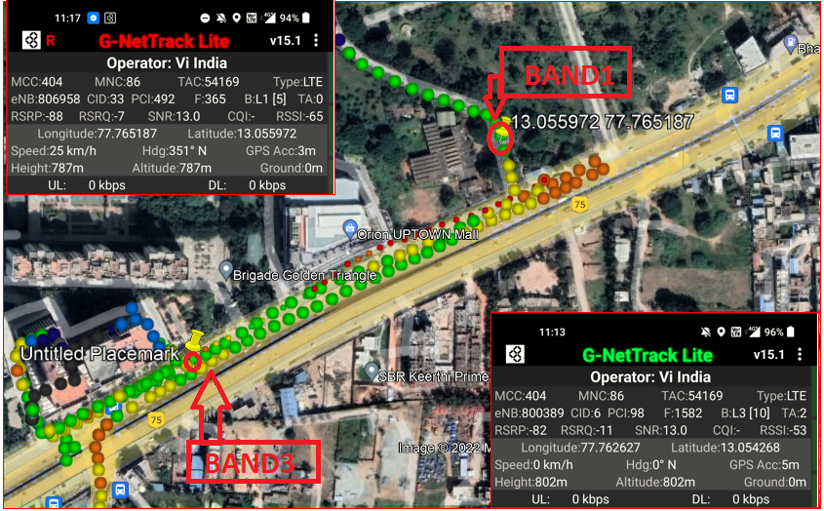
Band HO from B3 to B1 during ongoing MO call for Vi operator
Route>>brigade signature tower>>orion uptown mall>>Huskur road

Slide 13
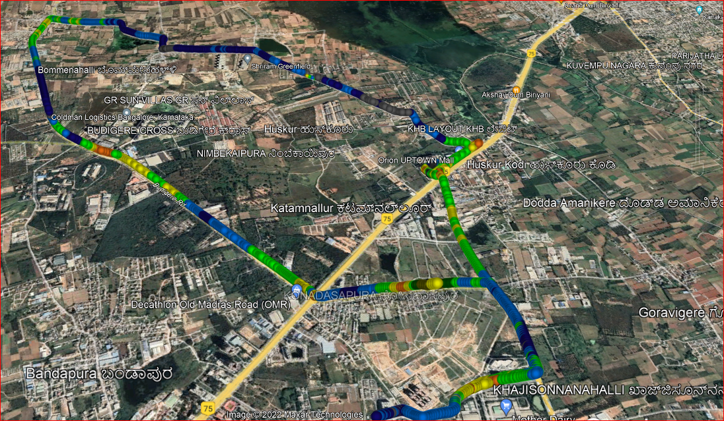
Mix Coverage & Different band Route for long call for Vi operator
Started from kattamanallur>>Huskur>>nimbekapura road>bommenahalli>>budigiri cross>>budigiri road>>sufal market>>brigade signature tower.

Slide 14
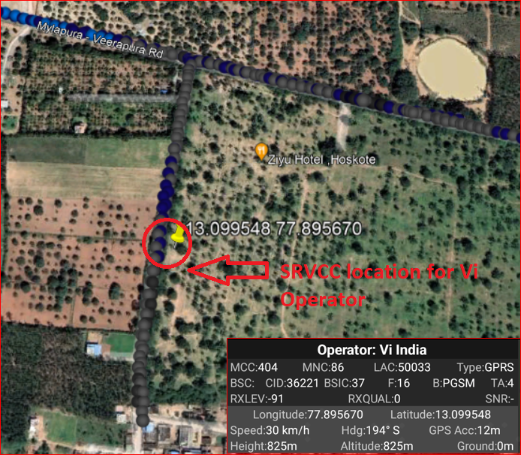
SRVCC Vi 4G Operator to Vi 2G RAT during ongoing MO call
Mylapura-Veerapura road to Chikkanallala

Slide 15
Services Supported by Airtel VoLTE Operator
Features/Services | Description | Support(Yes/NO) | Location
Bands of Operator | Band-1,3,8, Band-40 | Yes | Bengaluru
Bandwidth of Bands | Band-1: 2100 MHz(FDD) | yes
 | Band-3: 1800 MHz(FDD) | Yes
 | Band-8: 900 MHz(FDD) | Yes
 | Band-40: 2300 MHz(TDD) | Yes
EARFCN for All Bands | Band-1:240 | Yes
 | Band-3:1301 | Yes
 | Band-8:3646 | Yes
 | Band-40:39125 | Yes
Band Handover | Band 1,3,8->Band 40-> & Vice-versa | YES
Infra | Ericsson
Reselection(L<-->W) | In Idle Mode | NO
Redirection(L-->W) | In Dedicated Mode | NO
PS Handover(L-->>W) | In Dedicated Mode | NO
CSFB(L-->W) | Circuit Switch Fall back | NO
Inter frequency Reselection | FDD to TDD & TDD to FDD | YES
Inter frequency Redirection | FDD to TDD & TDD to FDD | YES
Volte | Voice Over LTE | YES
SMS |  | YES
MMS |  | NO

Slide 16
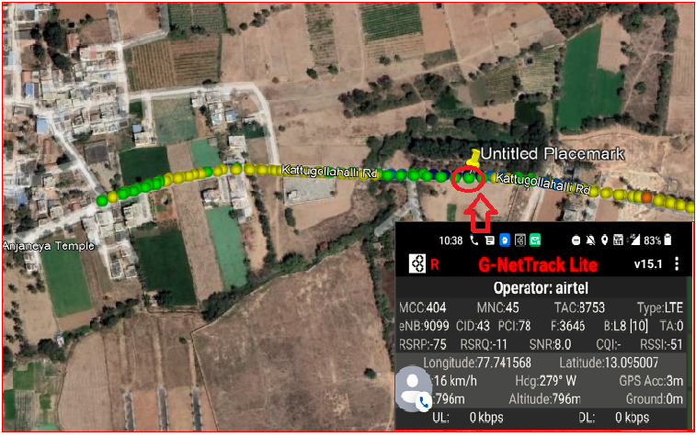
Airtel 4G VoLTE Good Coverage Area Band8
Route >> Budigere Road >> Patalmma Temple

Slide 17
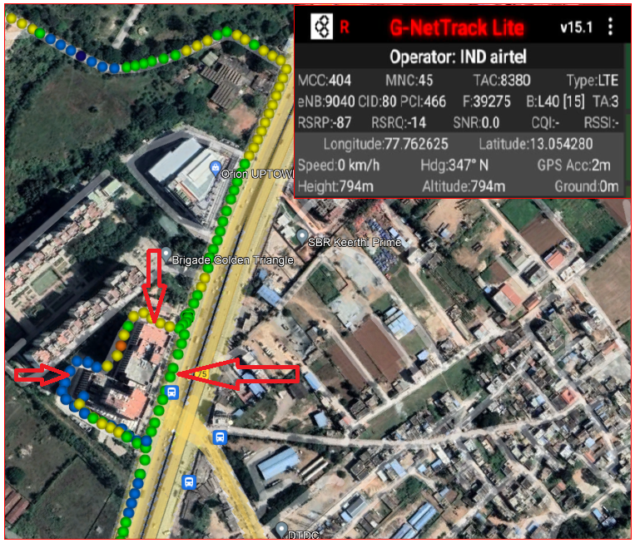
Airtel 4G VoLTE Mix Coverage Area
Route >> kattamanallur>>brigade signature tower

Slide 18
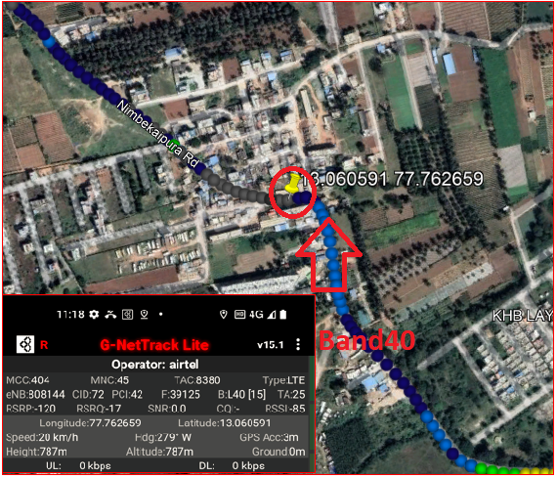
Airtel 4G Volte operator Weak Coverage Area Band 40
Route >> orion uptown mall>>Nimbekaipura road>>jodi huskuru.

Slide 19
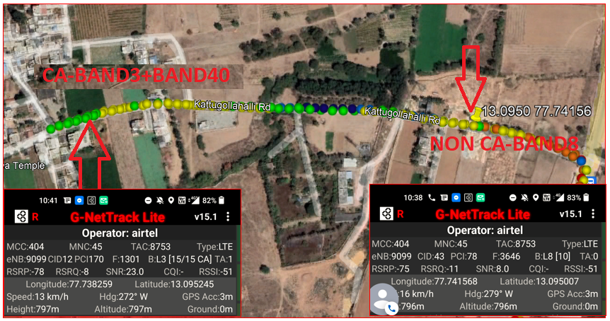
Airtel 4G Volte operator CA (B3+B40) to Non CA B3
Route >>Kattugollahalli road >>patalamma temple >>mandur road

Slide 20
Airtel 4G Volte Operator Non CA B8 to CA (B3 + B40) Handover
Route >> mandur road >>pattalamma temple >>kattugollahalli road.

Slide 21
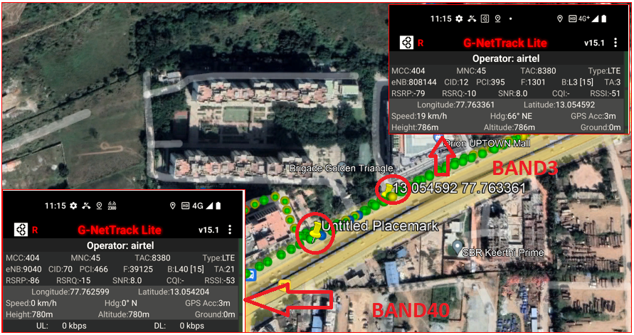
Airtel 4G Volte Operator Band Handover (B3 – B40) during ongoing call
Route >>Brigade signature tower >>orion uptown mall

Slide 22
Airtel 4G Volte Operator Band Handover (B40 – B3) during ongoing call
Route >>Brigade signature tower >>orion uptown mall

Slide 23
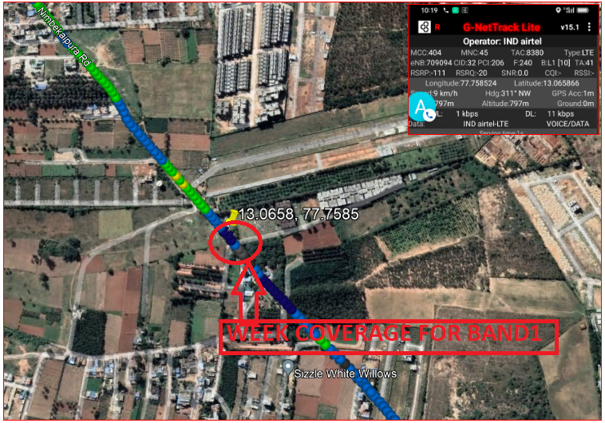
Airtel 4G Volte operator Weak Coverage Area Band 1
Route >> orion uptown mall>>Nimbekaipura road>>farm greenery pvt.

Slide 24
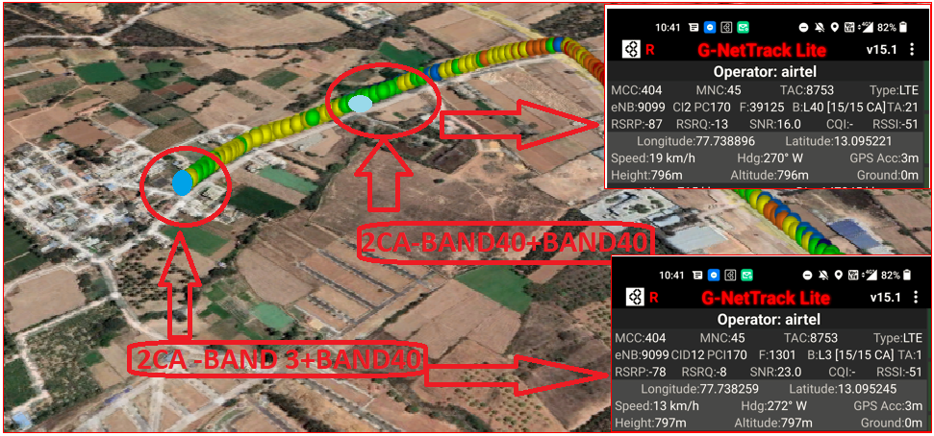
Airtel 4G Volte operator CA to CA Handover(B3+B40) to (B40+B40)
Route >>Kodigehalli>>kattugollahalli road>>Patalamma Temple.

Slide 25
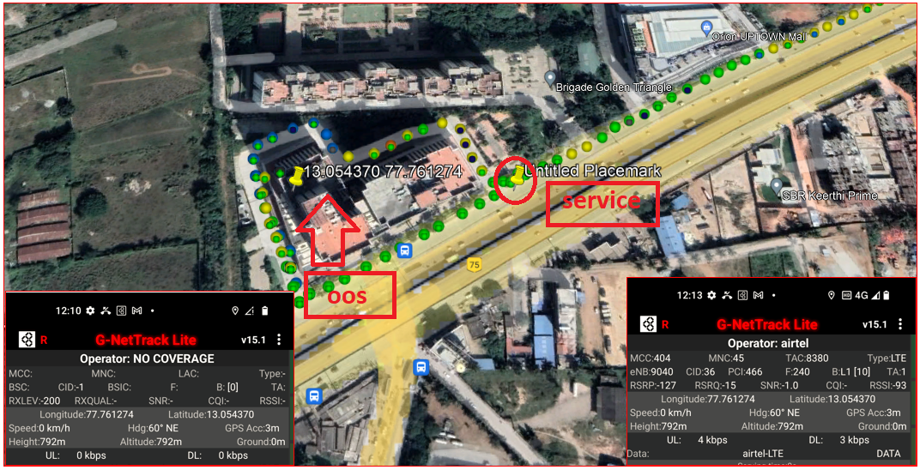
Airtel 4G VoLTE OOS to IN Service
Route >>brigade signature tower base ment >> brigade signature exit gate

Slide 26
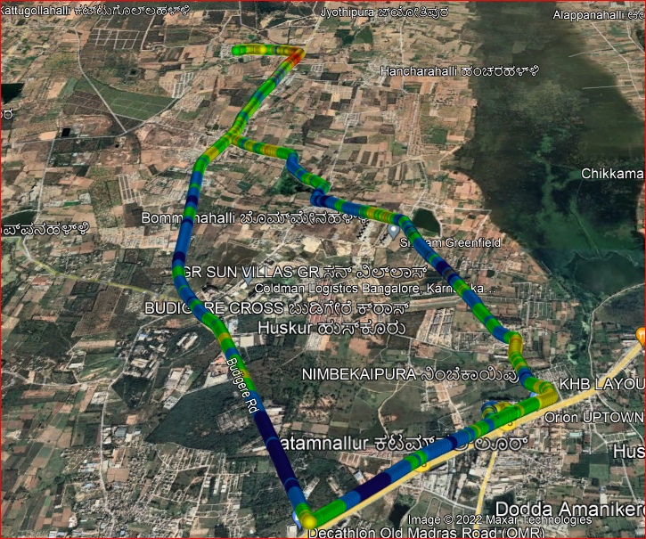
Airtel 4G VOLTE Long Call Drive Route
Route >> Brigade signature towers>>Shriram Green field>>lagumenahalli>>mandur>>kodigehalli>>budigire cross>>kattamanallur.

Slide 27
Services Supported by JIO Operator
Features/Services | Description | Support(Yes/NO) | Location
Bands of Operator | Band-3, Band-5, Band-40 | Yes | Bangalore
Bandwidth of Bands | Band-3: 1800 MHz(FDD) | yes
 | Band-5: 850 MHz(FDD) | Yes
 | Band-40: 2300 MHz(TDD) | Yes
EARFCN for All Bands | Band-3: 1451 | Yes
 | Band-5: 2515 | Yes
 | Band-40: 38948,38750 | Yes
Band Handover | Band 3->Band 5->Band 40-> & Vice-versa | YES
Infra | Samsung & Mavenir
Reselection(L<-->W) | In Idle Mode | NO
Redirection(L-->W) | In Dedicated Mode | NO
PS Handover(L-->>W) | In Dedicated Mode | NO
CSFB(L-->W) | Circuit Switch Fall back | NO
Inter frequency Reselection | FDD to TDD & TDD to FDD | YES
Inter frequency Redirection | FDD to TDD & TDD to FDD | YES
Volte | Voice Over LTE | YES
SMS |  | YES
MMS |  | NO

Slide 28
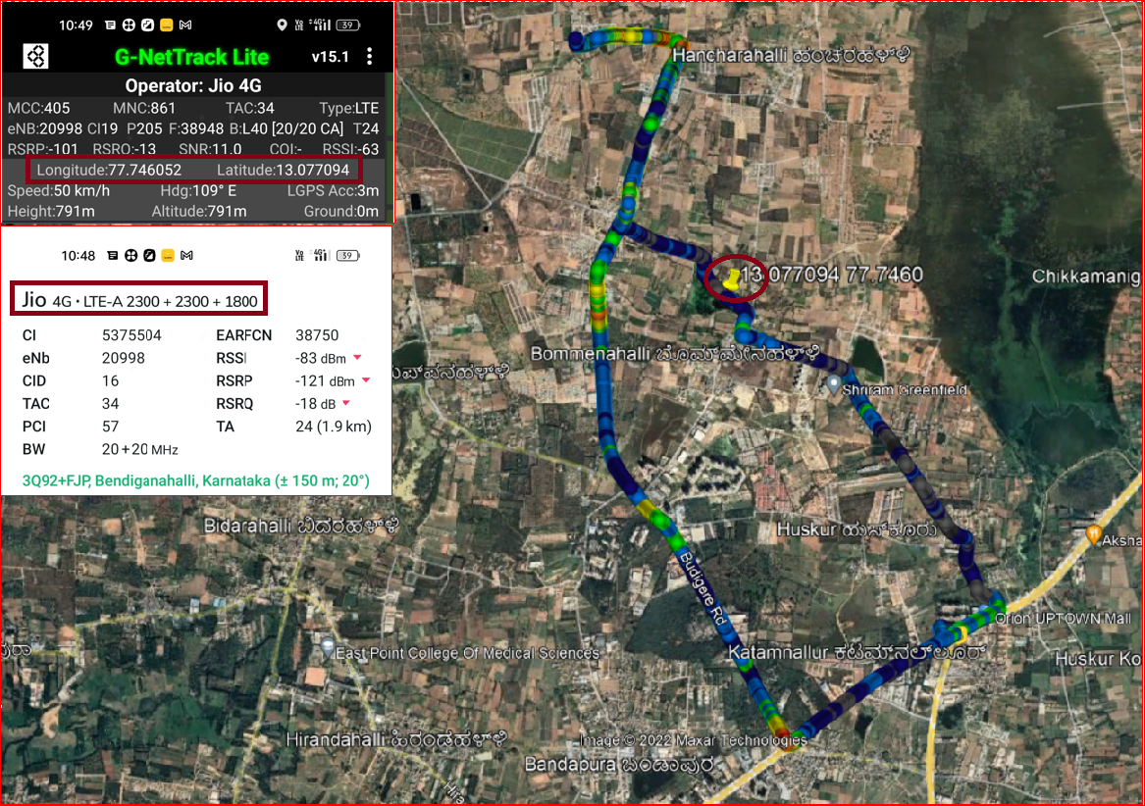
JIO Operator 3CA location
Route >> Lagumenahalli>>Raghuvanahalli Hoskothe Road

Slide 29
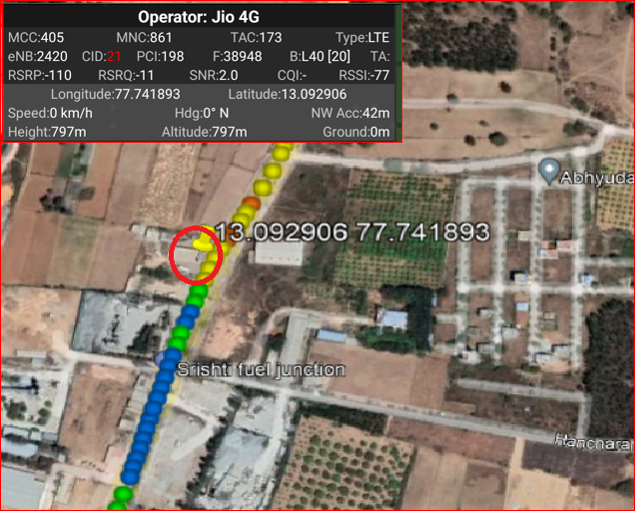
JIO Operator Mix Coverage
Route >> Mandur >> Kodigehalli >> Jyothipura

Slide 30
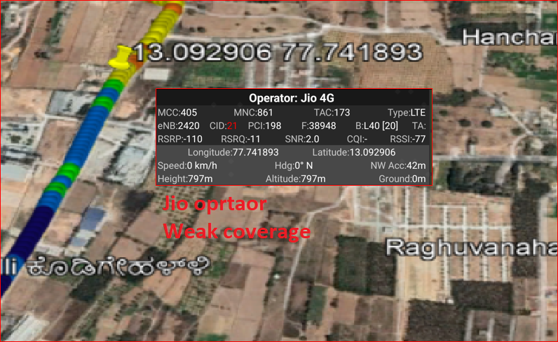
JIO Operator Weak coverage Band 40
Route >> jyothipura >>Abhiyudya star city >> Sristi fuel junction

Slide 31
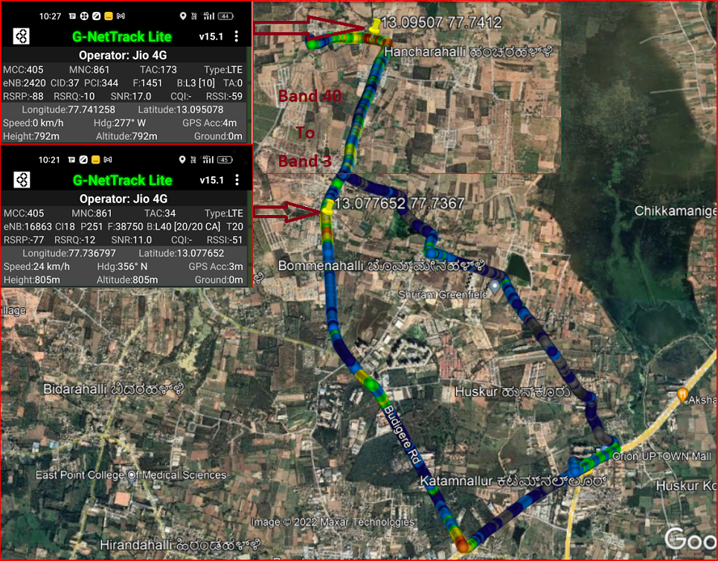
JIO Operator Band Ho from Band 40 to Band 3
Route >> Near Mandur Gram Panchayat>> Kottugollahalli Road

Slide 32
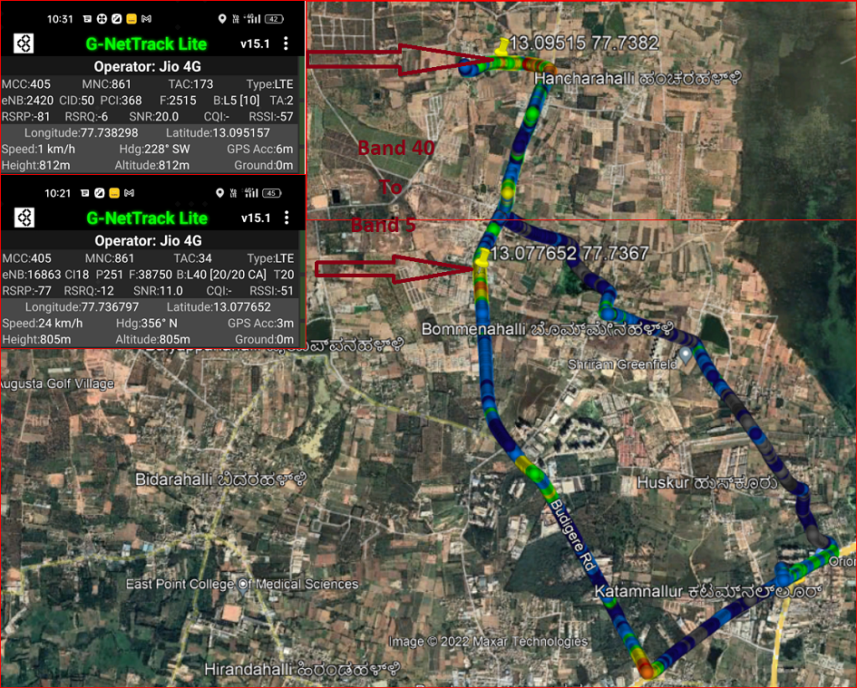
JIO Operator Band HO from Band 3 to band 5
Route >> Mandur>>Kattugollahalli road

Slide 33
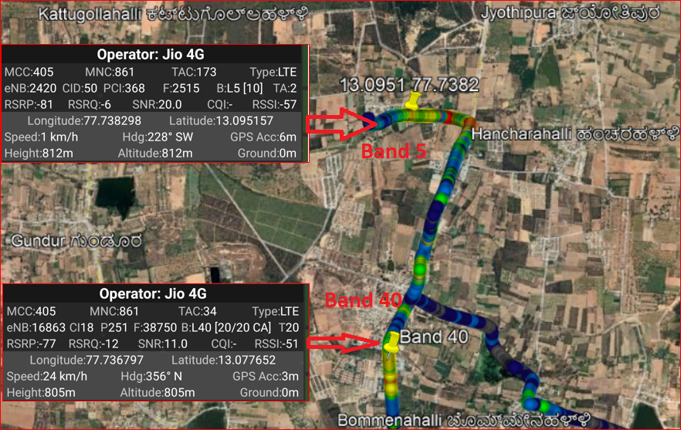
JIO Operator Band HO from Band 5 to Band 40
Route >> Budigere road

Slide 34
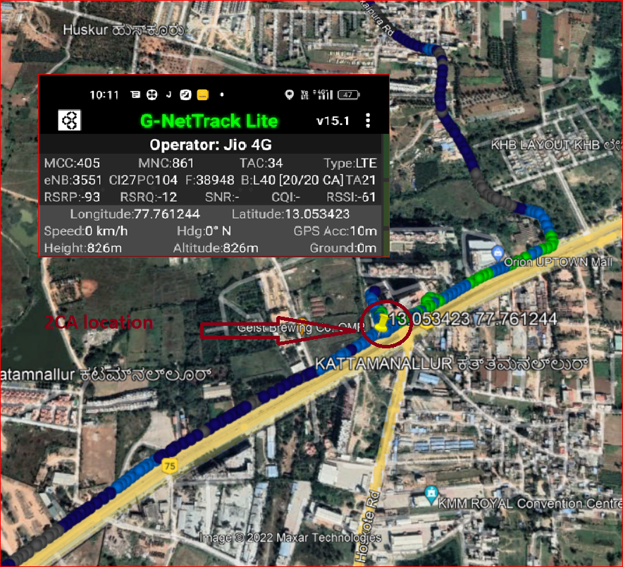
JIO Operator 2CA Location
Route >> Kattamanallur>>Orion mall

Slide 35
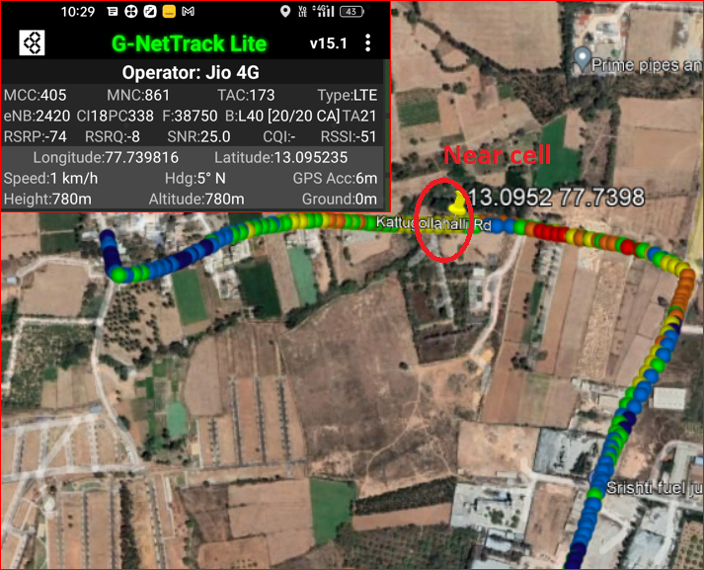
JIO Near cell
Location >> Kattugollahalli road

Slide 36
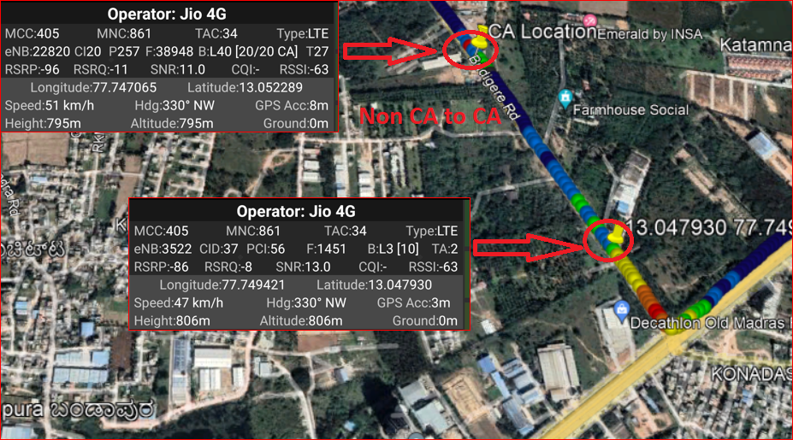
JIO Operator: Non CA cell to CA cell : B3 to B(40+40)
Route >> Budigere road

Slide 37
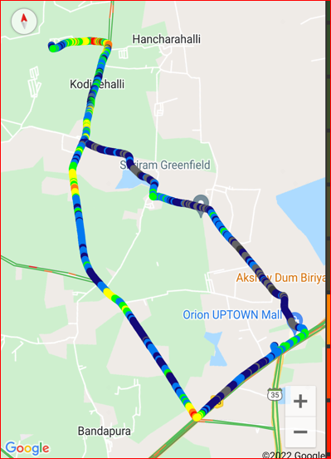
JIO Long call
Route>>Started at Kattamanllur to Kattugollahalli road

Slide 38
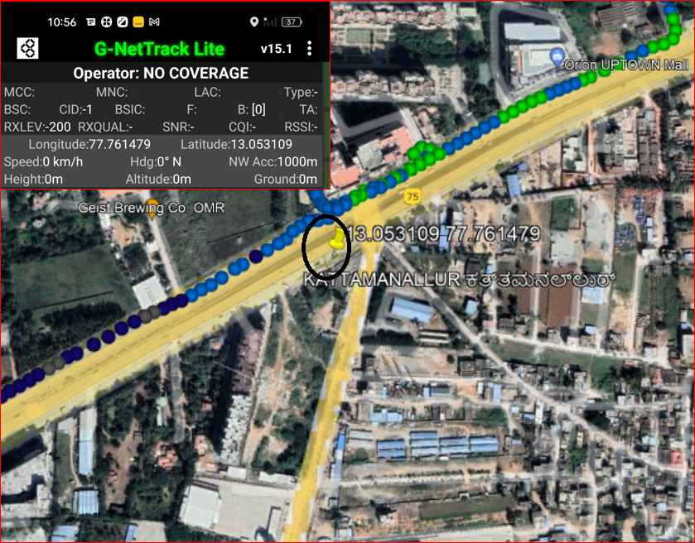
Out Of Service Location for JIO operator
Route >> Brigade signature tower (Basaement) Near Kattamnallur gate

