Slide 1
MARQUIS TECHNOLOGIES
Drive Route FOR Airtel 5g NSA Technology

Slide 2
Drive Route Airtel 5G for NSA Technology
Operator | Band | A-EARFCN | PCI
Airtel | n78 | 636576 | 185
 |  |  | 263
 |  |  | 345
 | n1 | 433230 | 453
Note :-
CA, VoWiFi and During Call NR to LTE handover still not implemented
Mixed :-Mobility: RSRP : -75dbm to -95dbm
Cell Edge :-Stationary: RSRP : -95dbm to -115dbm
Near Cell :-Stationary: RSRP: -60dbm to -75dbm

Slide 3
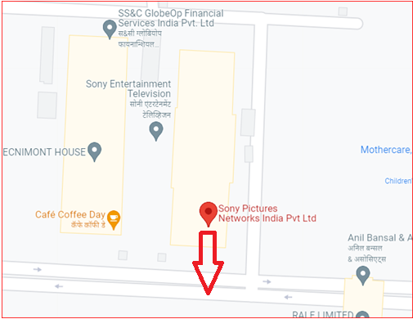

Airtel Band n78(Near Cell):- Sony Pictures Networks India Pvt Ltd, Malad West
Operator: Airtel
Band:- n78 PCI: 185
E-ARFCN : 636576
RSRP: -60dBm to -75dBm
NC:1

Slide 4
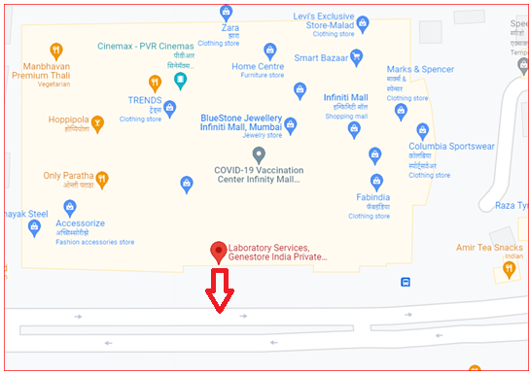

Airtel Band n78(Mixed Cell):- Laboratory Services , Malad west
Operator: Airtel
Band :- n78 PCI:263
E-ARFCN : 636576
RSRP: -76dBm to -90dBm
NC:1

Slide 5
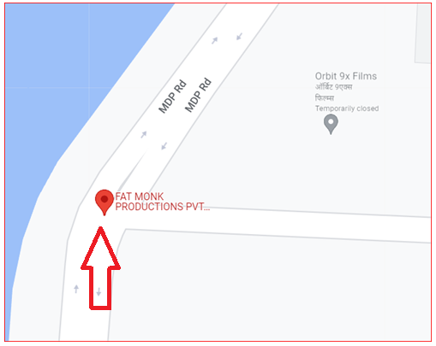

Airtel Band n78(Edge Cell):- MDP Road, Malad West
Operator: Airtel
Band :- n78 PCI:345
E-ARFCN : 636576
RSRP:-91dBm to -110dBm
NC:1

Slide 6
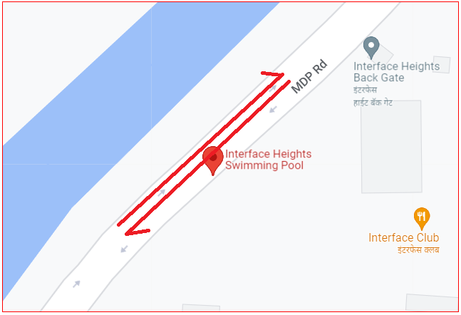
Airtel (NR to OOS & OOS to NR):- Near Interface Height, Malad West
Operator: Airtel
5G to OOS
MDP Road

Slide 7
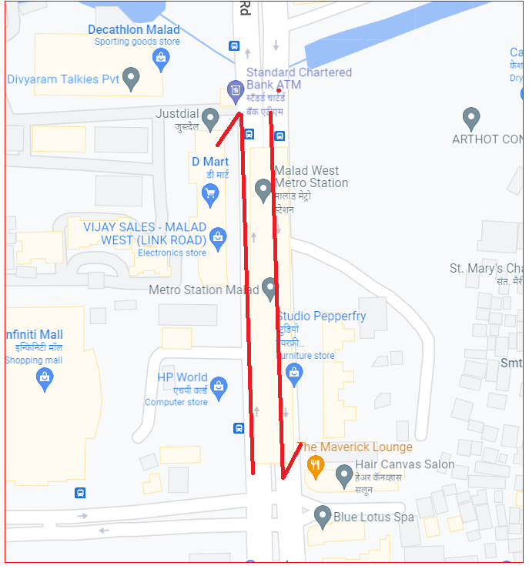
Airtel Intra Band Reselection Info :- Band n78
Operator: Airtel
Band :- n78
EARFCN:- 636576
From :- HP World
To :- Crystal Palace

Slide 8
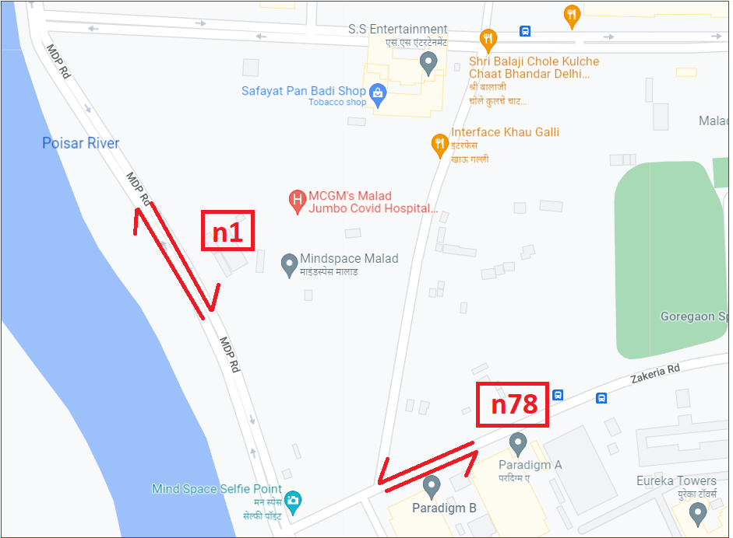
Airtel Inter Band Reselection Info :- Band n1 to n78
Operator: Airtel
Band :- n1 to n78
EARFCN n1 :- 433230
PCI:- 453
EARFCN n78 :- 636576
PCI:- 185 From :- MDP Road
To :- Zakeria Road

Slide 9
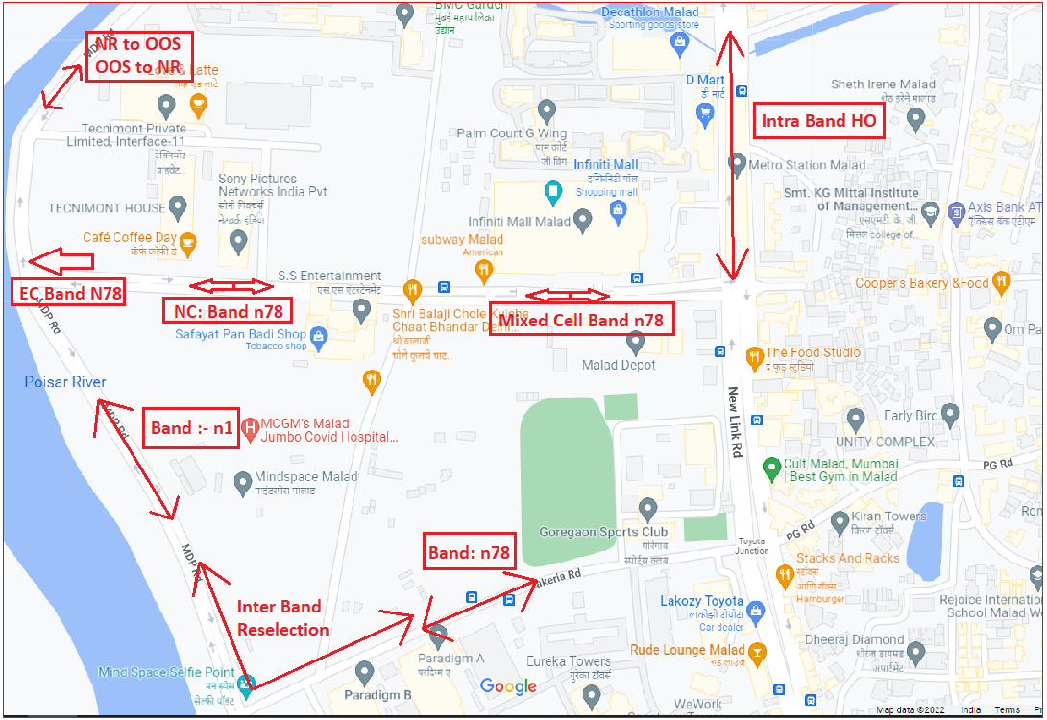
Airtel Band Info for 5G NSA Technology Summary of Test Location:-

Slide 10
Thank You

