Slide 1
MARQUIS TECHNOLOGIES
Drive Route

Slide 2
Rourkela/India
Operator Details:
S. No. | Operator |  | Supported Bands | Supported Features by Network
1 | Major | Airtel | LTE&5G BAND 3/8/40,5GBand N78 | 2G/4G/5G/VoLTE/VoWiFi
2 |  | JIO | LTE&5G Band 3/5/40,5G Band N78/N28 | VoWiFi/VoLTE/4G/5G
3 |  | VI | LTE BAND 3 | VoWiFi/VoLTE/4G/2G
4 | Minor | BSNL | B1/B28 | 4G/3G/2G

Slide 3
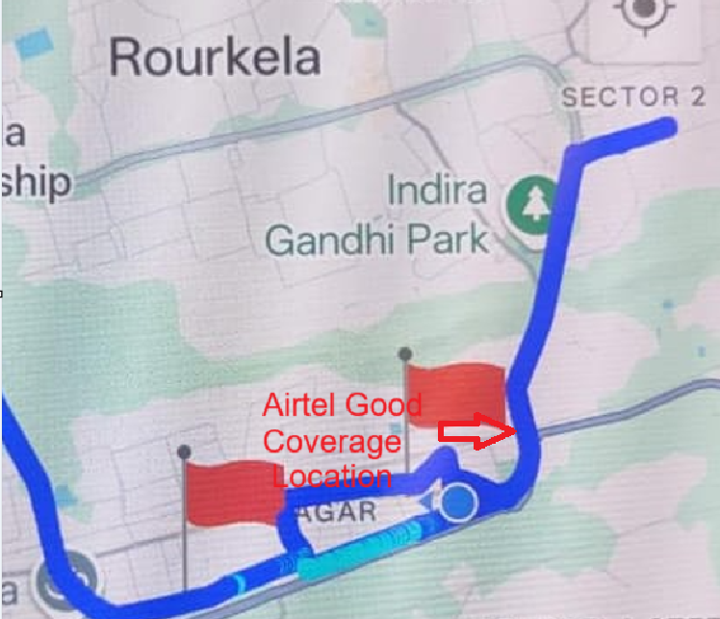
5G Near Cell,Airtel
Lat/Long – 22.22404,84.863697
Specification –Railway Station Road Rourkela

Slide 4
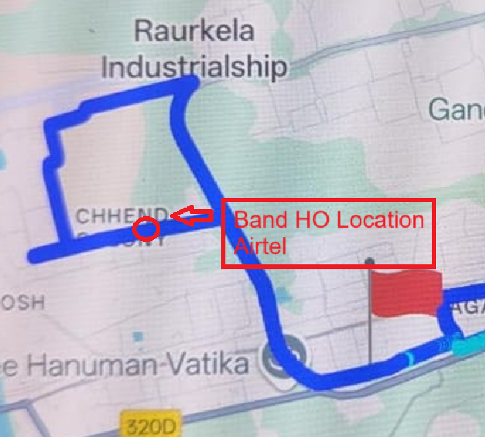
Band Handover ,Airtel
Lat/Long 22.22142, 84.84477 Location – Airport Road Rourkela

Slide 5
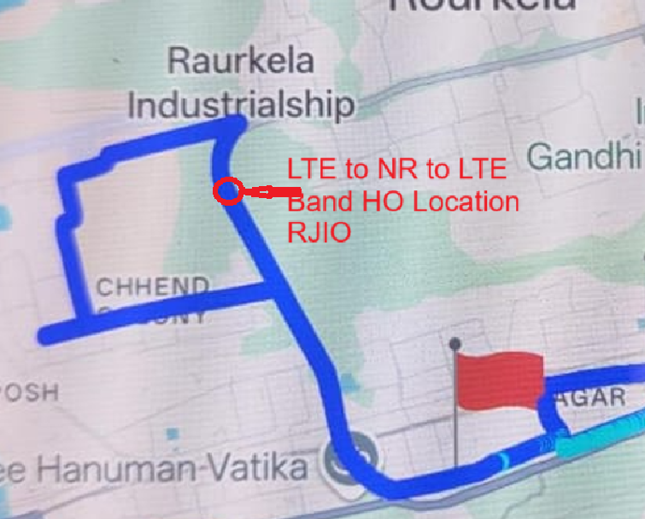
NR to LTE Handover ,JIO
Lat/Long : 22.22142,84.84477
Location : Ring Road Rourkela

Slide 6
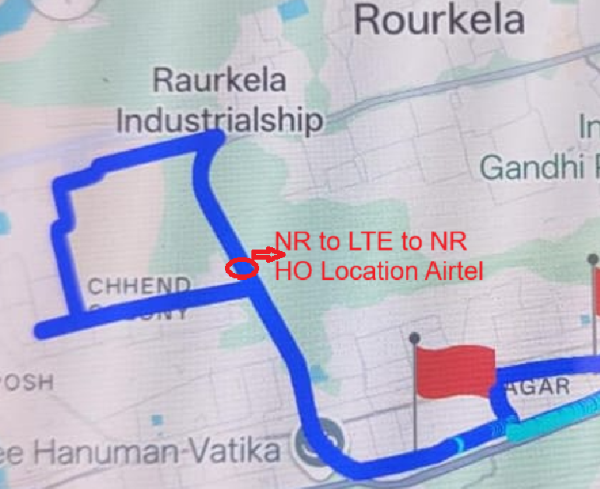
NR To LTE Handover, Airtel
Lat/Long : 22.22142, 84.84477
Location : Gopabandhu Nagar Rourkela

Slide 7
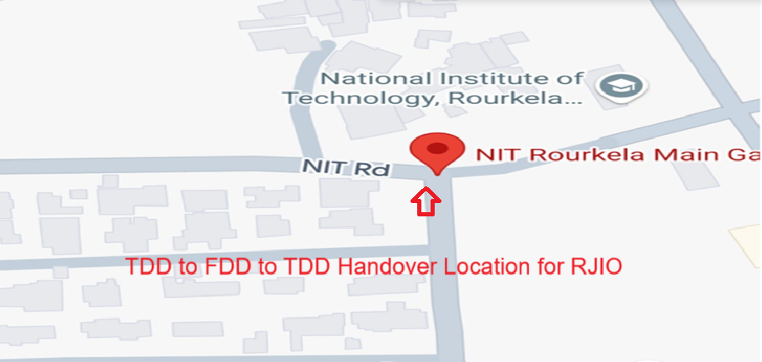
TDD to FDD & FDD to TDD Handover,Jio
Lat/Long: 22.249703, 84.894038
Location:Government NIT , Rourkela

Slide 8
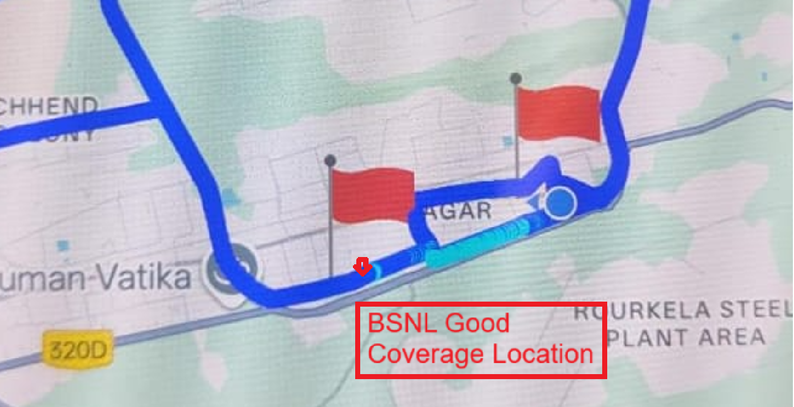
BSNL B28 Good coverage location Lat/Long – 22.22142,84.84477
Location - BSNL Exchange Rourkela
,

Slide 9
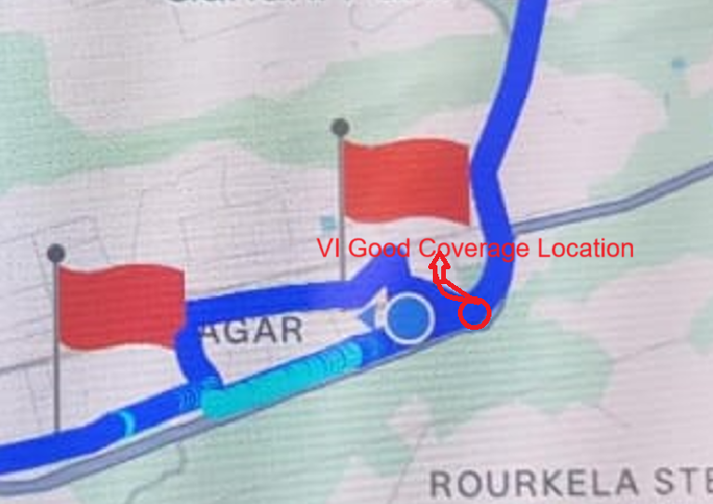
VI Good coverage location Lat/Long – 22.22142, 84.84477
Location –Dev Behera, Rourkela
,

Slide 10
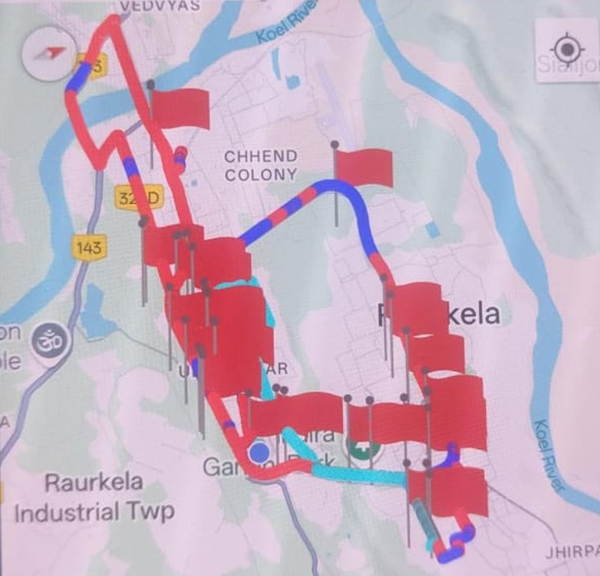
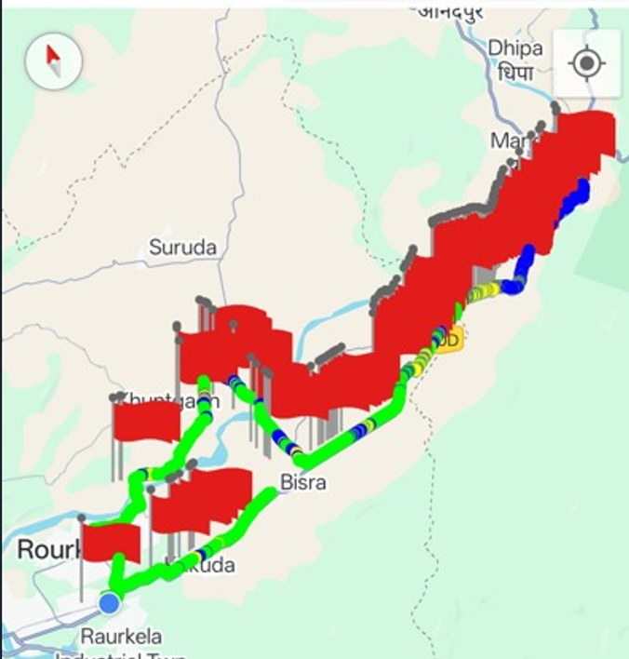
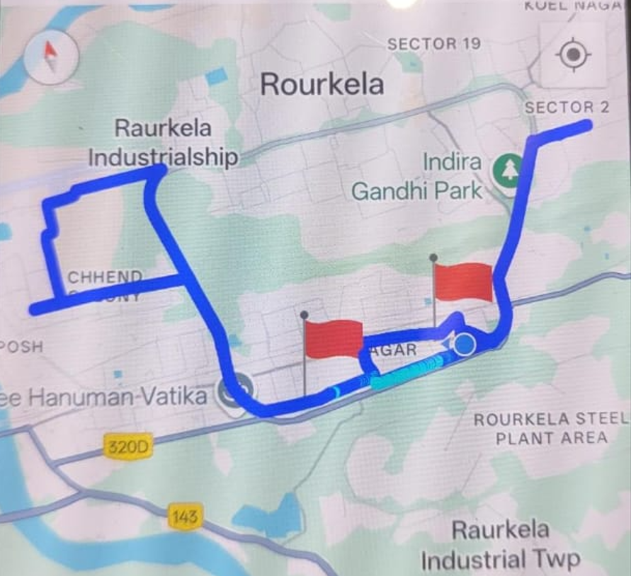
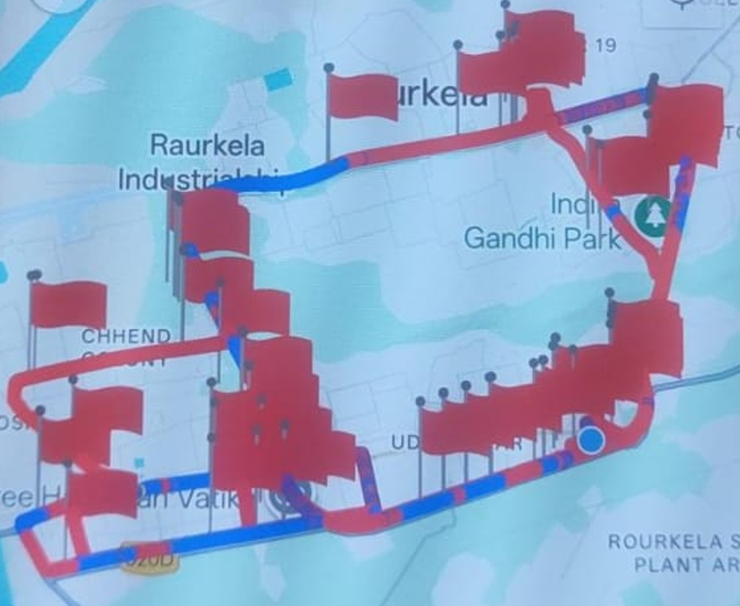
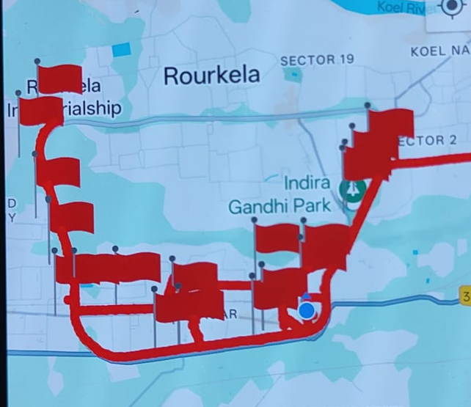
DRIVE ROUTE

Slide 11
THANK YOU
MARQUIS TECHNOLOGIES
www.marquistech.com

