Slide 1
MARQUIS TECHNOLOGIES
MILAN, ITALY

Slide 2
Milan/ITALY
Operator Details:
S. No. | Operator |  | Supported Bands | Supported Features by Network
1 | Major | TIM | N78/L20, L3, PGSM | VoWiFi/VoLTE/5G NSA/4G/2G
2 |  | Vodafone | N48/L28, L3,PGSM | VoLTE/5G NSA/4G/2G
3 |  | Windtre | N48/L7, L7,U8,PGSM | VoWiFi/VoLTE/5G NSA/4G/3G/2G
4 |  | Fastweb | N48/L7, L7,U8,PGSM | VoLTE/5G NSA/4G/3G/2G

Slide 3
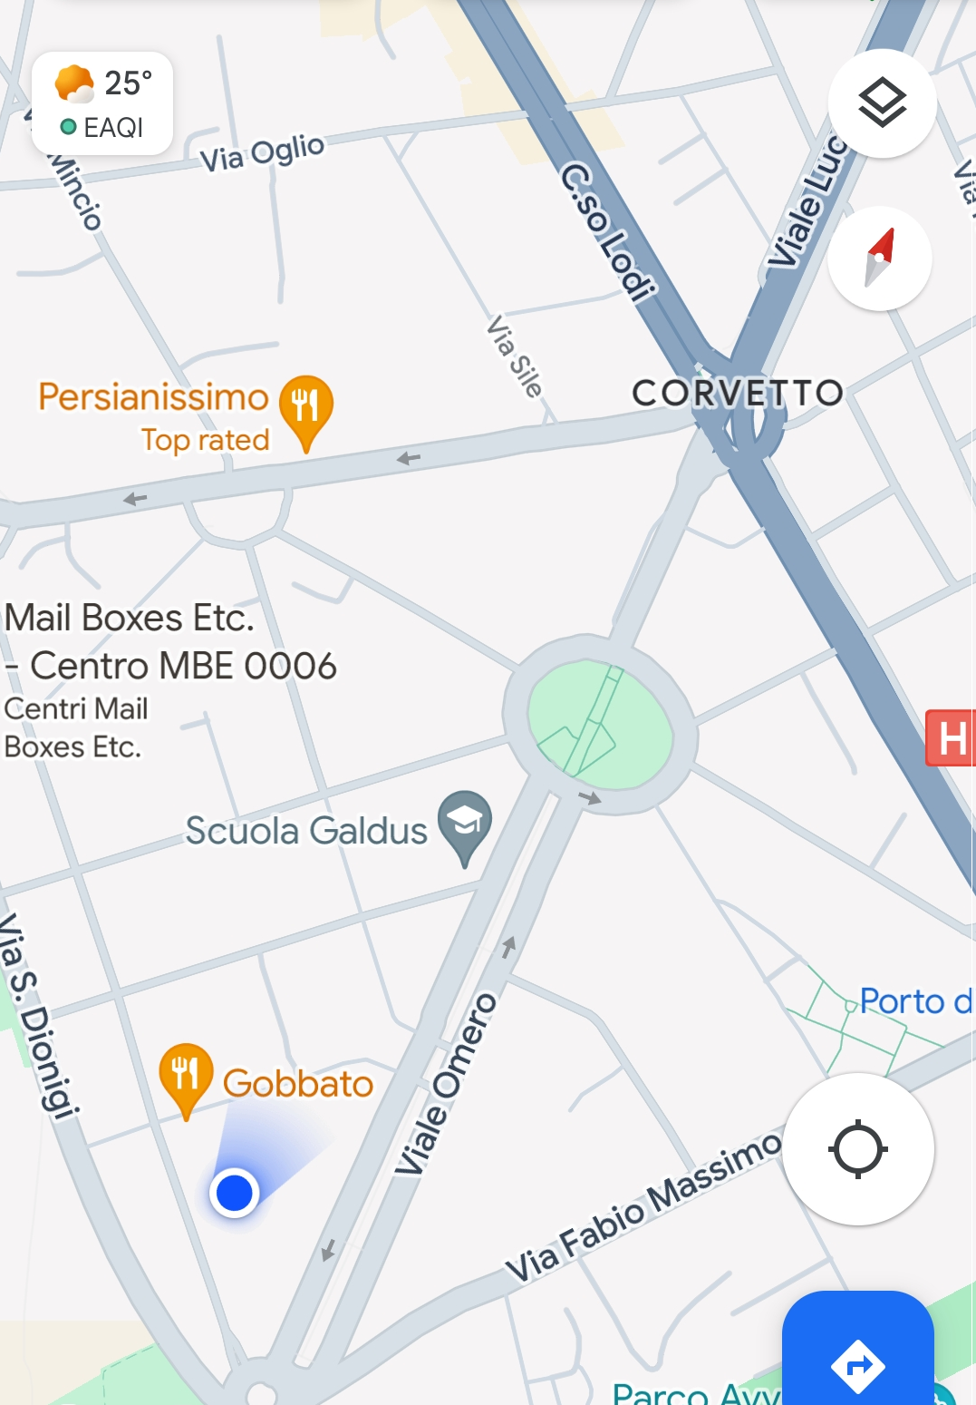
5G NSA, TIM (Milan)
Lat/Long : 45.433194 /9.2230500
Location : Viale Omero, Corvetto, Milan
Specification : TIM 5G NSA stationary network
Good Throughput
TIM 5G NSA stationary network

Slide 4
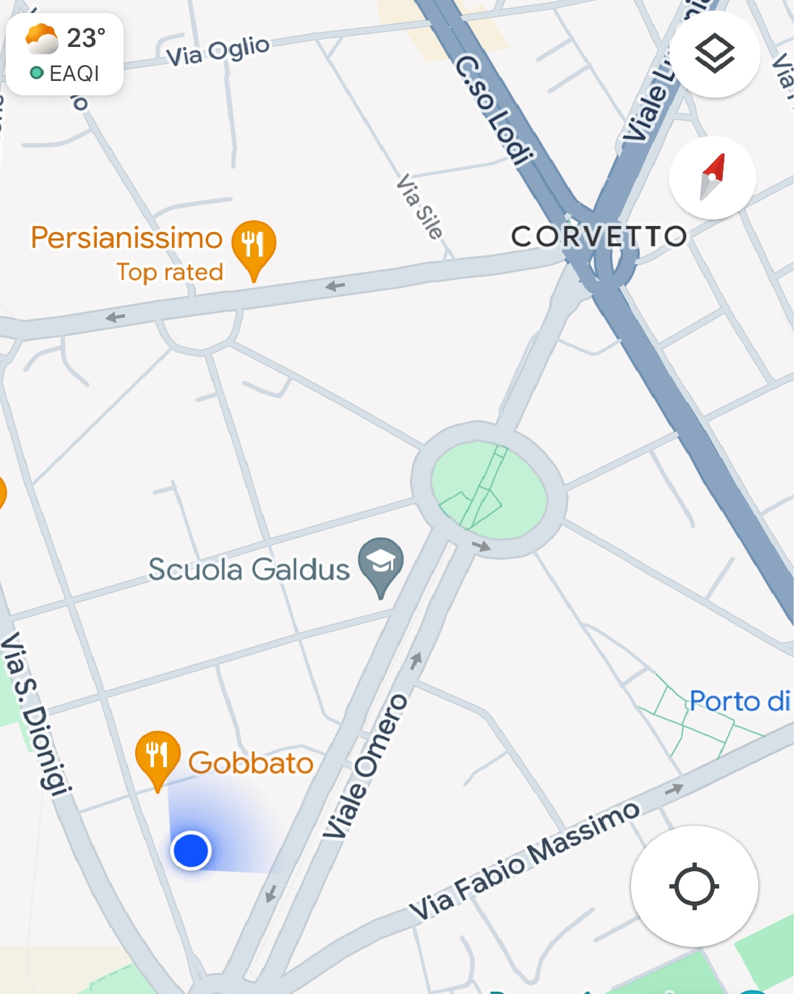
5G NSA , Vodafone (Milan)
Lat/Long : 45.433095 /9.2230983
Location : Viale Omero, Corvetto, Milan
Specification : Vodafone 5G NSA stationary network
Good Throughput
Vodafone 5G NSA stationary network

Slide 5
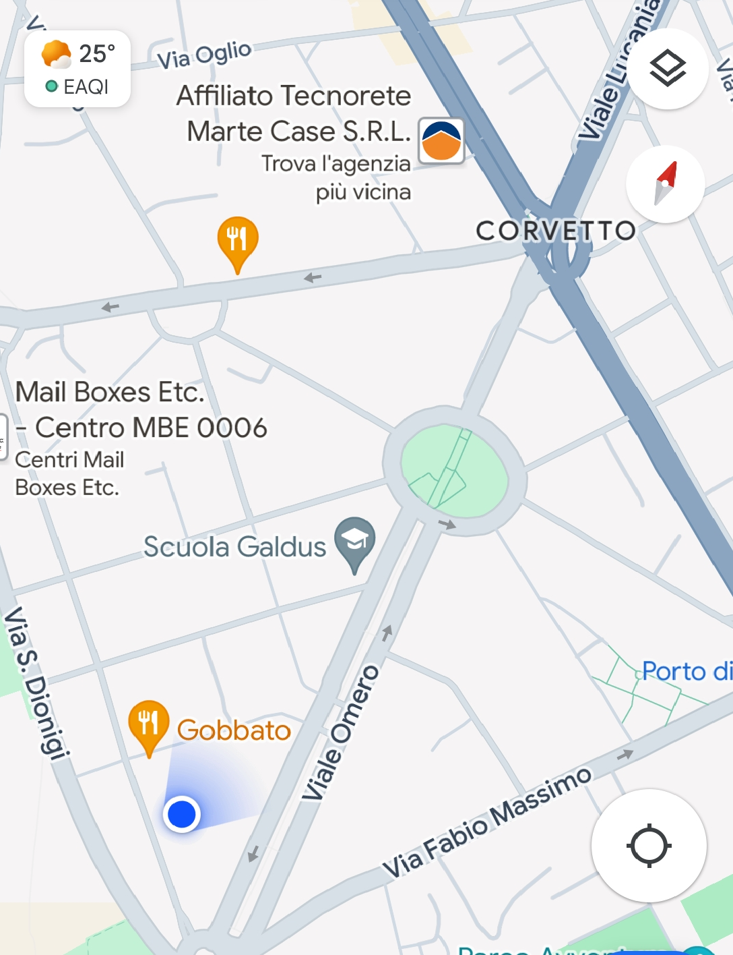
5G NSA, Windtre (Milan)
Lat/Long : 45.433118 /9.2227916
Location : Viale Omero, Corvetto, Milan
Specification : Windtre 5G NSA stationary network
Good Throughput
Windtre 5G NSA stationary network

Slide 6
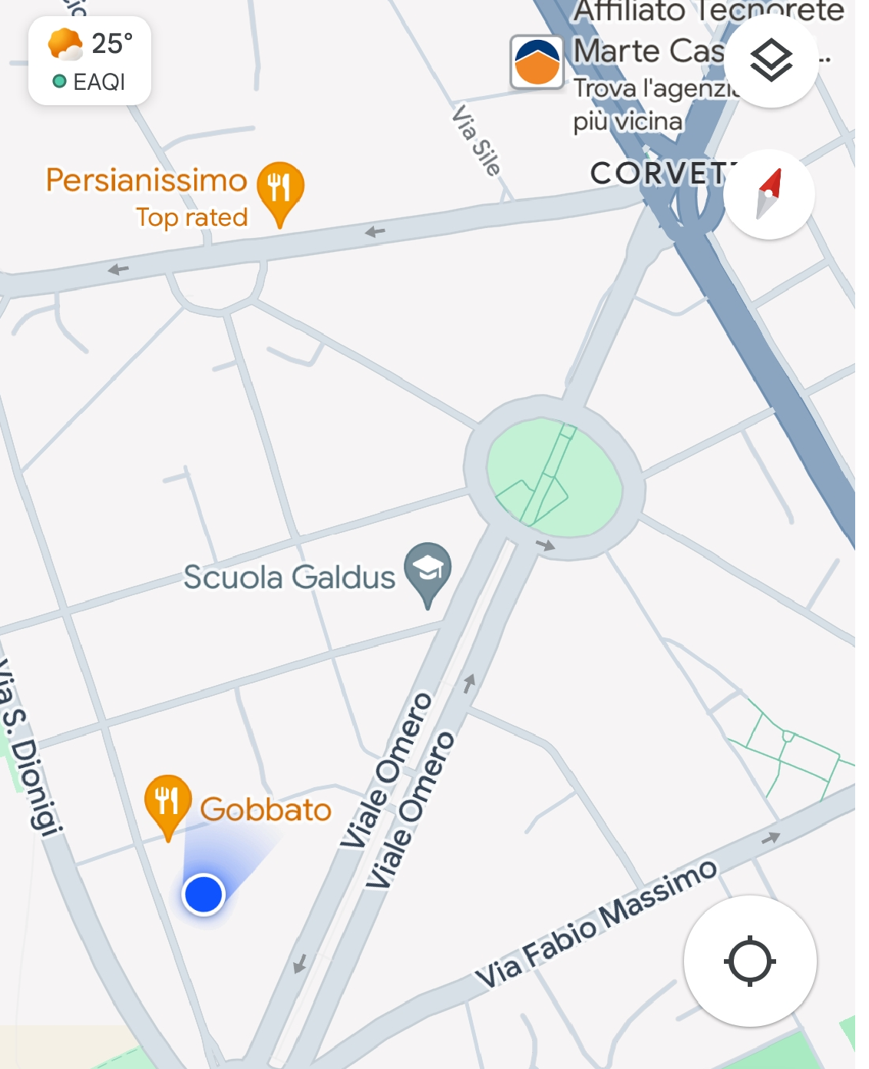
5G NSA, Fastweb (Milan)
Lat/Long : 45.433273 /9.2227833
Location : Viale Omero, Corvetto, Milan
Specification : Fastweb 5G NSA stationary network
Good Throughput
Fastweb 5G NSA stationary network

Slide 7
THANK YOU
MARQUIS TECHNOLOGIES
www.marquistech.com

