Slide 1

MARQUIS TECHNOLOGIES
DRIVE ROUTE : Bratislava, SLOVAKIA
Telekom
O2
ORANGE
Notes:
CONFIDENTIAL

Slide 2
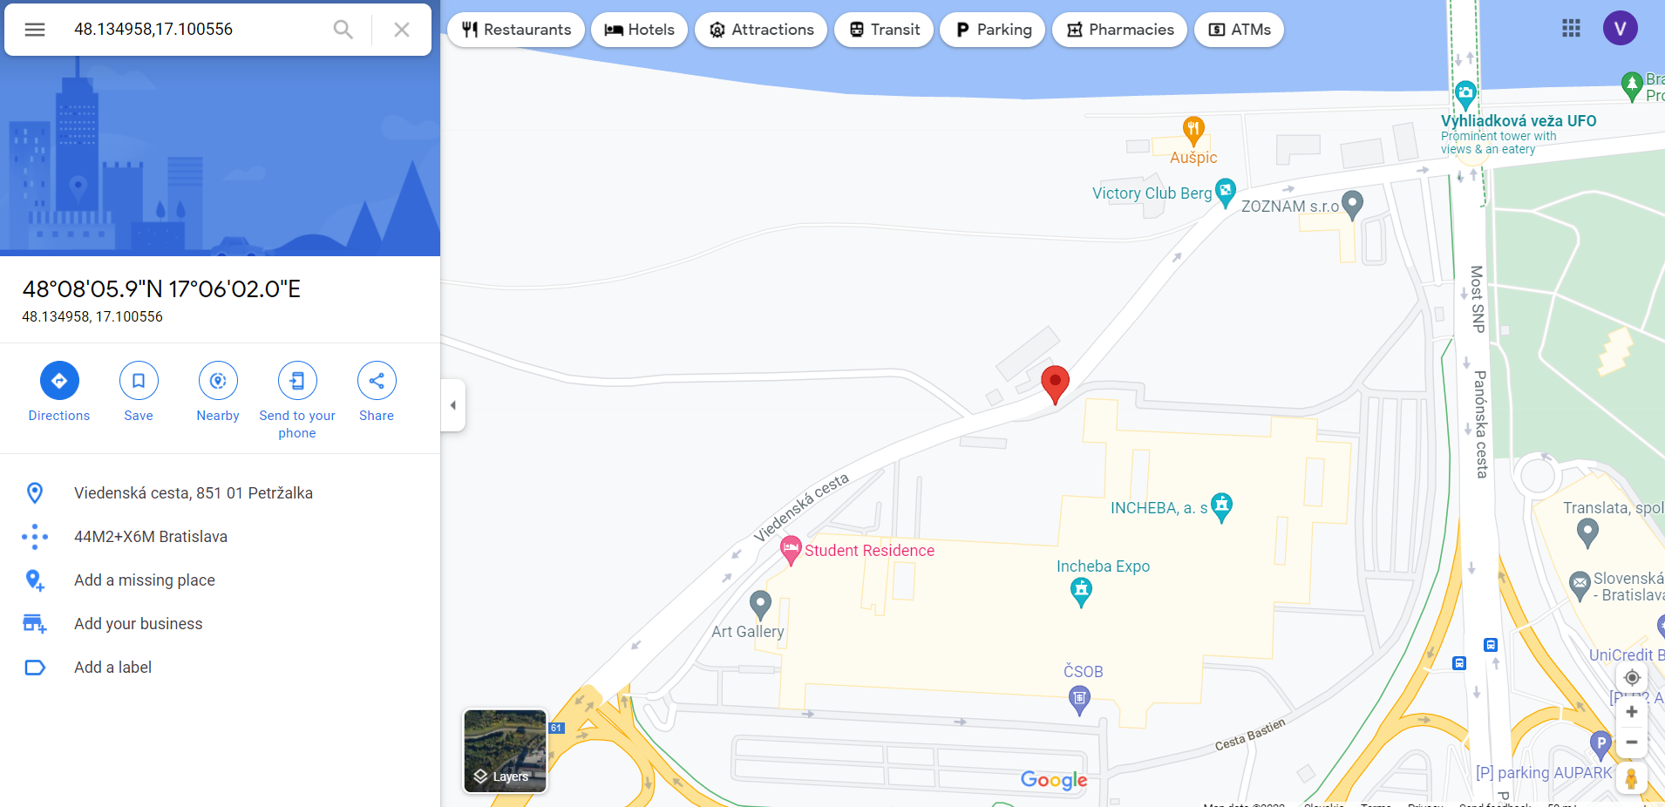

5G Location for Telekom Operator: Bratislava, Slovakia

Slide 3
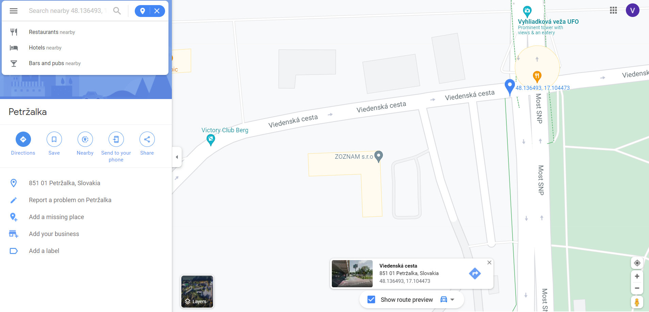
4G Telekom Location: Bratislava, Slovakia

Slide 4
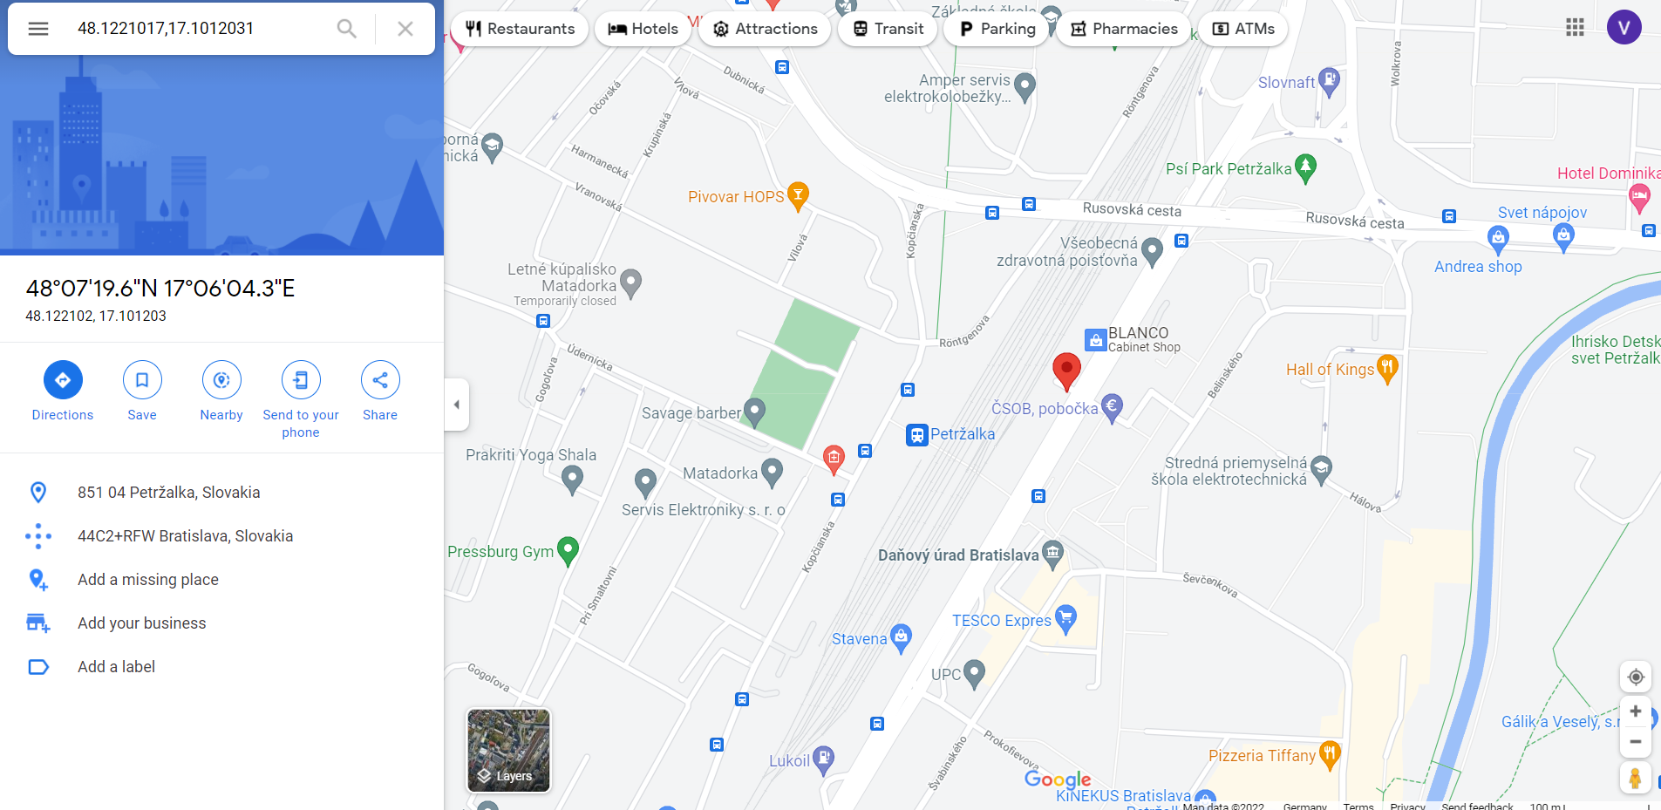
5G O2 Operator location: Bratislava, Slovakia

Slide 5
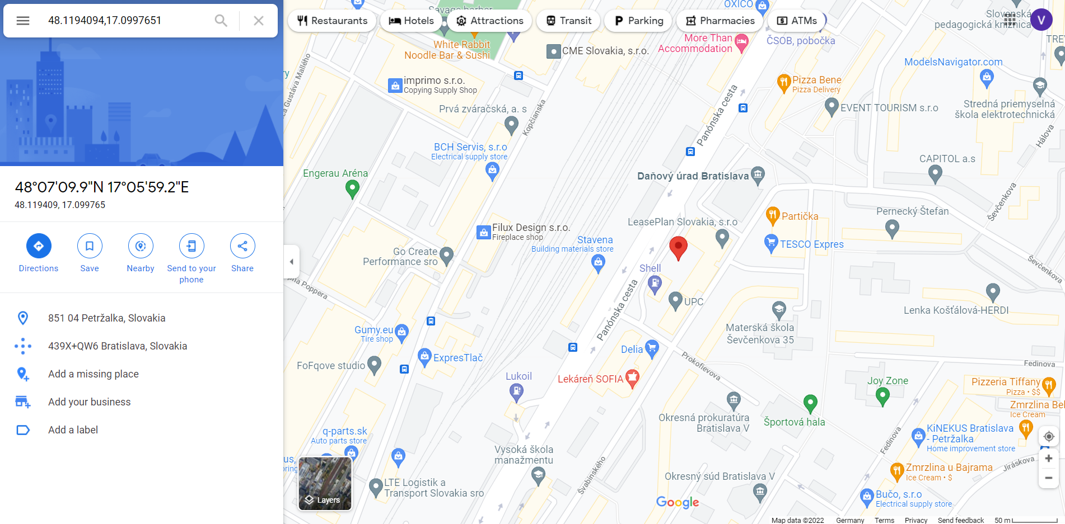

Slide 6
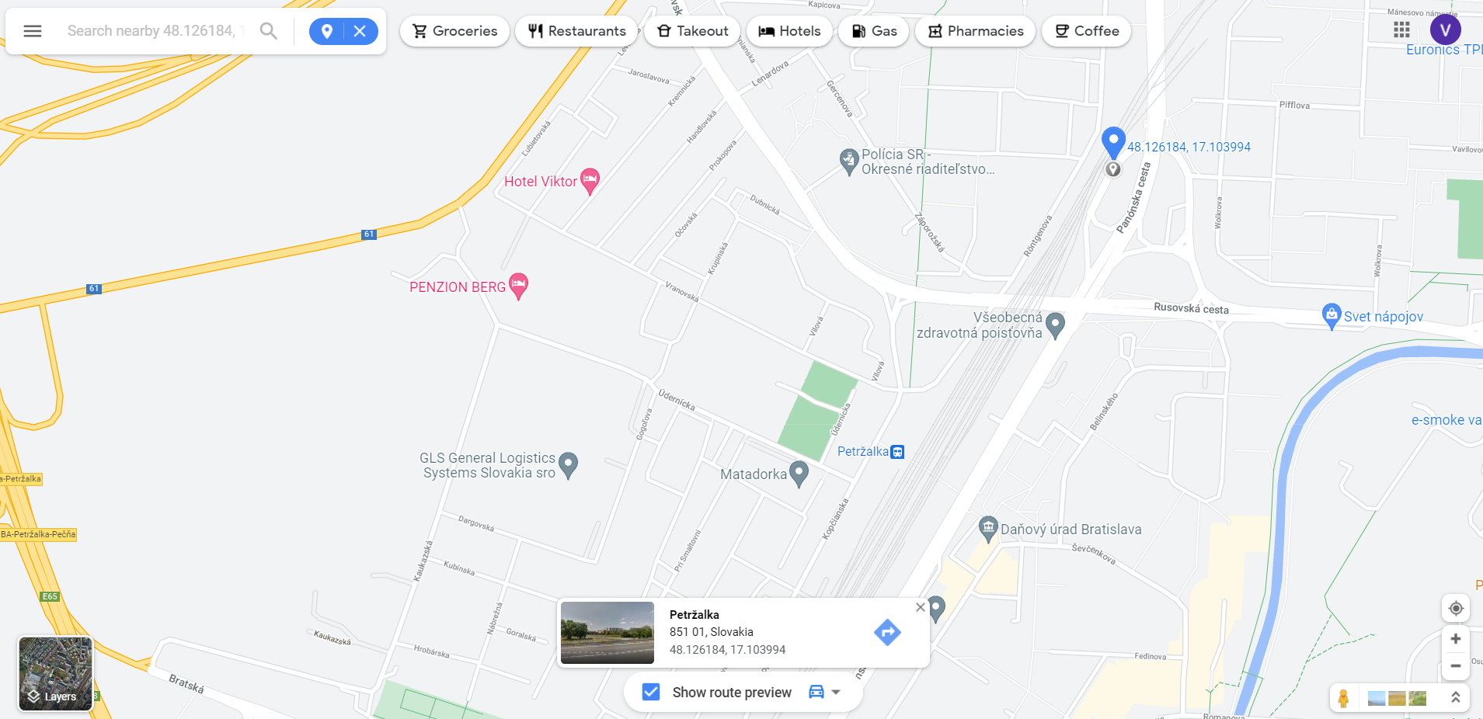
O2 operator 4g location: Bratislava, Slovakia

Slide 7
Orange operator 4g location: Bratislava, Slovakia

Slide 8
Thank You

