Slide 1

MARQUIS TECHNOLOGIES
DRIVE ROUTE : ROME, ITALY
VODAFONE OPERATOR
TIM OPERATOR
WINDTRE OPERATOR
VERY OPERATOR
Notes:
CONFIDENTIAL

Slide 2
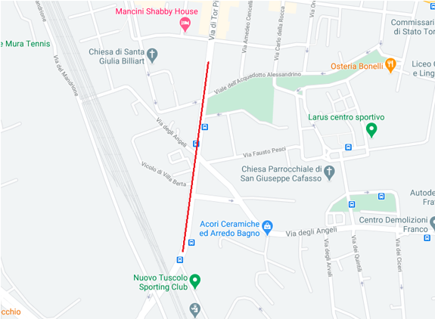
5G NR Location for vodafone Operator (Good coverage)Band-n78, Bandwidth -90MHz Location- Quartiere VIII Tuscolano, Rome, Italy

Slide 3
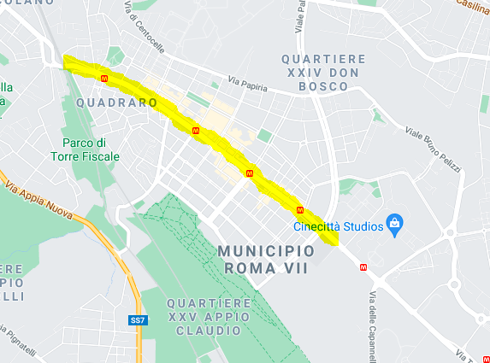
VODAFONE 5G NR handover location: Via dell'Acqua Felice, 6-50, 00178 Roma RM

Slide 4
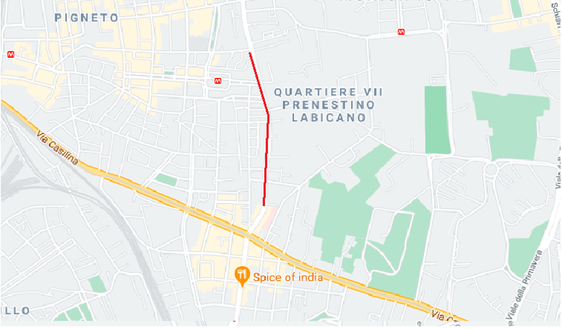
5G NR Location for TIM Operator (Good Coverage) Band-n78, Bandwidth-80MHz Location- Quartiere VII Prenestino Labicano,Rome ,Italy

Slide 5
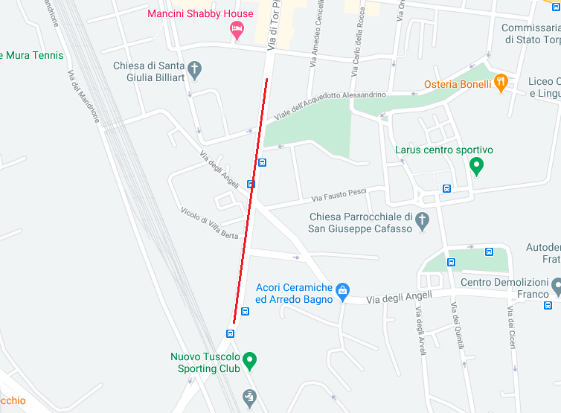
TIM 5G NR handover location: Quartiere VIII Tuscolano, Rome, Metropolitan City of Rome

Slide 6
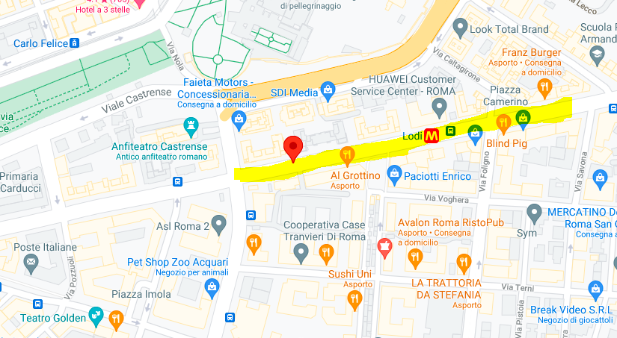

Slide 7
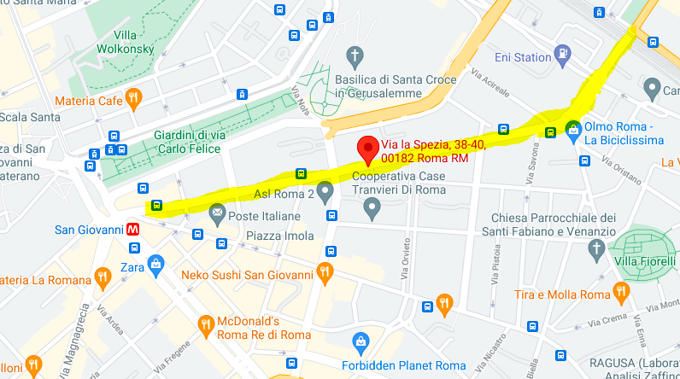

Slide 8
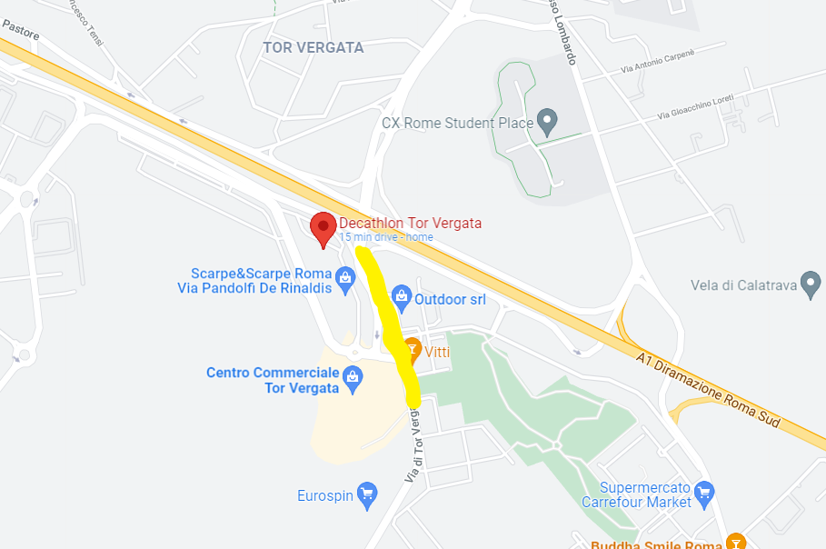
SRVCC : WINDTRE , VERY Operator

Slide 9
Thank You

