Slide 1
MARQUIS TECHNOLOGIES
Drive Route – Bogotá (Colombia)

Slide 2
Testing Place – Mexico City (Mexico)
Country | Colombia
Continent | South America (LATAM)
City | Bogotá
Time Zone | GMT-5
International Dialing Code | +57

Slide 3
RSRP Criteria
Near Cell :-Stationary: RSRP : -55dbm to -85dbm
Cell Edge :-Stationary: RSRP : -95dbm to -110dbm
Mixed :-Mobility: RSRP : -55dbm to -120dbm

Slide 4
Operator Information
MCC | MNC | Operator | Bands (MHz)
732 | 101 | Claro (VoLTE commercial available) 4G/3G/2G .VoWiFi | LTE-2600MHz, UMTS- 850/1900 MHz, GSM-850/1900MHz
732 | 102/123 | Movistar VoLTE commercial available) 4G/3G/2G .VoWiFi | LTE- 1700/2100 MHz, UMTS-850/1900 MHz, GSM-850/1900MHz
732 | 103 | Tigo (VoLTE commercially available) 4G/3G. VoWiFi not commercially available. | LTE-1700/2100 MHz, UMTS- 850/1900 MHz , GSM-850/1900MHz

Slide 5
Claro Operator
Drive Route – Bogota-Sopo-La Calera (Colombia)

Slide 6
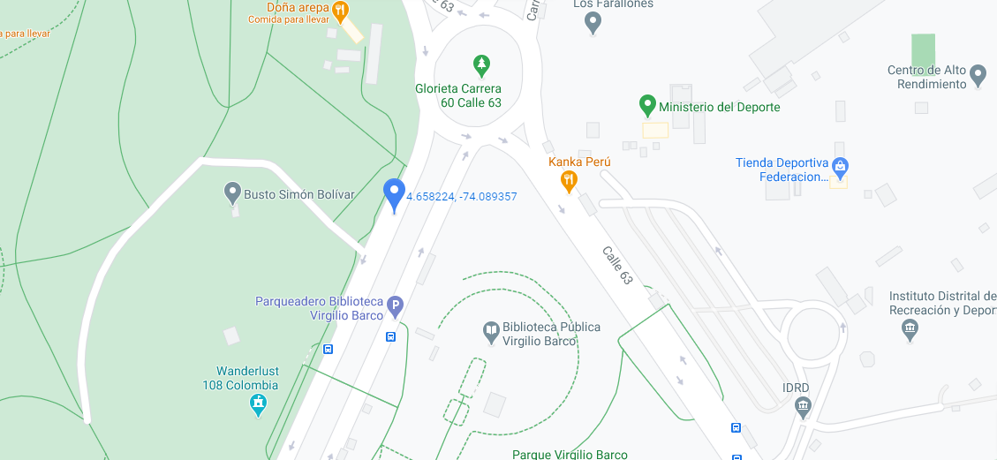
CA Cell Calle 63 Carrera 60, Bogota Operator: Claro
Claro-Slide : 1

Slide 7
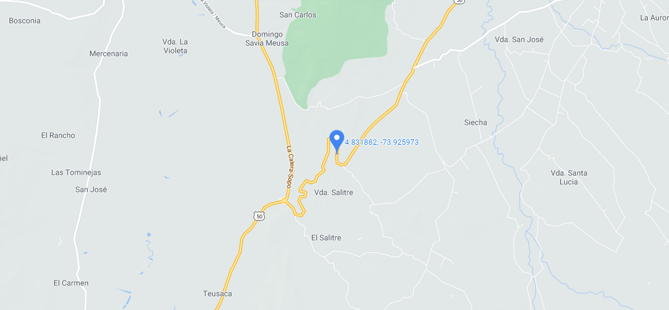
IRAT to 3G Location Point 1 (Move from La Calera town to Guasca town) Operator: Claro
Claro-Slide: 2

Slide 8
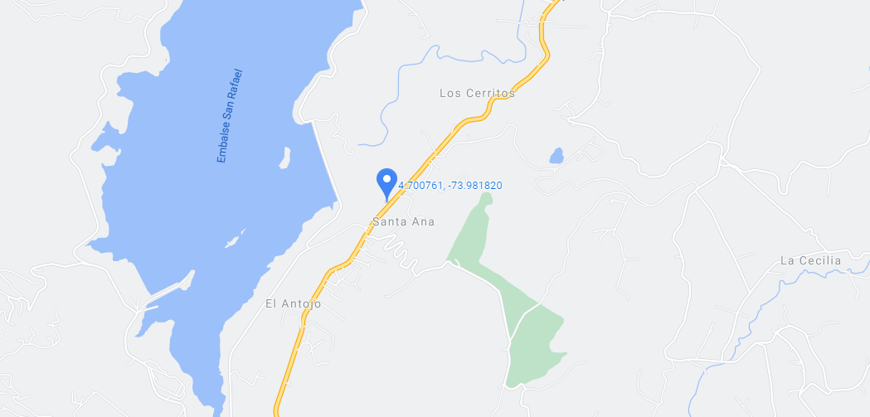
IRAT to 3G Location Point 2 (Move from La Calera town to Sopo town) Operator: Claro
Claro-Slide: 3

Slide 9
SRVCC to 3G Point 1 (Move from La Calera town to Guasca town) Operator: Claro
Claro-Slide: 4

Slide 10
SRVCC to 3G Point 2 (Move from La Calera town to Sopo town) Operator: Claro
Claro-Slide: 5

Slide 11
Movistar Operator
Drive Route – Bogota – Tenjo
(Colombia)

Slide 12
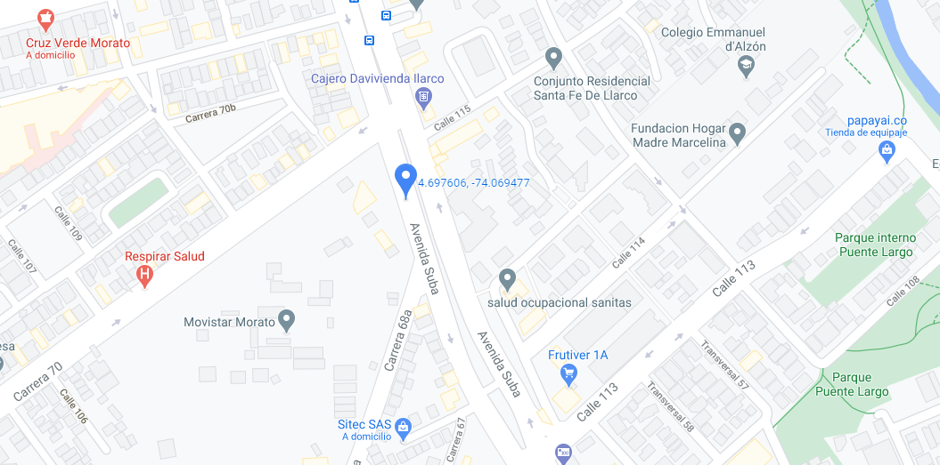
CA Location Movistar Colombia Headquarters, AV Suba Calle 114. Bogota. Operator: Movistar
Movistar-Slide-1

Slide 13
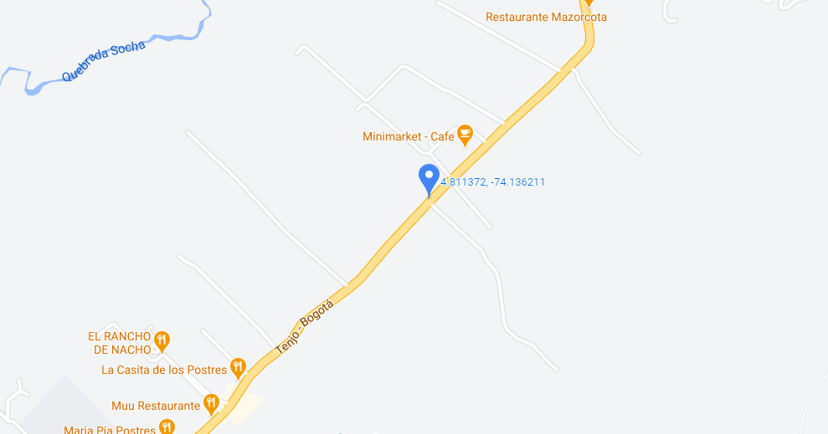
IRAT to 3G Location Move from Bogota city from Tenjo town. Operator: Movistar
Movistar-Slide :2

Slide 14
SRVCC to 3G Move from Bogota city from Tenjo town. Operator: Movistar
Movistar-Slide :3

Slide 15
Tigo Operator
Drive Route – Bogota
(Colombia)

Slide 16
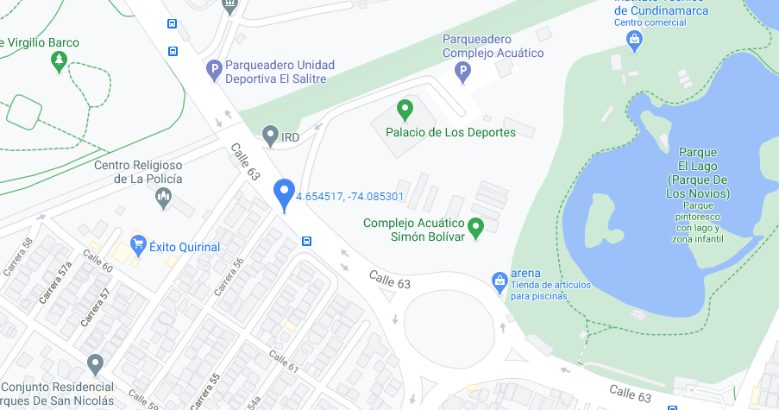
CA Location Calle 63 Carrera 56 Bogota Operator: Tigo
Tigo-Slide:1

Slide 17
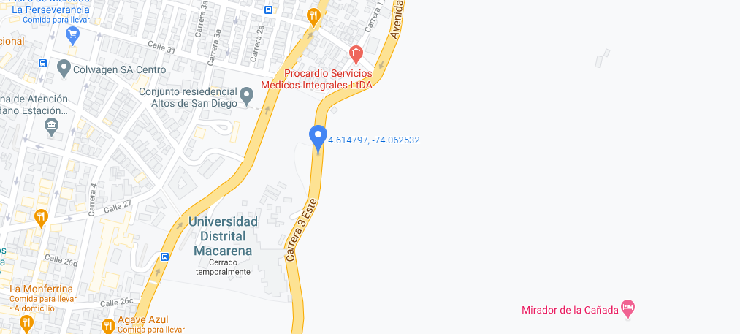
IRAT to 3G Location Move from Monserrate to Rosales in Circunvalar Via. Bogota Operator: Tigo
Tigo-Slide:2

Slide 18
SRVCC Location Move from Monserrate to Rosales in Circunvalar Via. Bogota Operator: Tigo
Tigo-Slide:3

Slide 19
THANK YOU
MARQUIS TECHNOLOGIES
www.marquistech.com

