Slide 1
MARQUIS TECHNOLOGIES
Drive Route – São Paulo(Brazil)

Slide 2
Testing Place – Mexico City (Mexico)
Country | Brazil
Continent | South America(LATAM)
City | São Paulo
Time Zone | UTC/GMT-3
International Dialing Code | +55

Slide 3
RSRP Criteria
Near Cell :-Stationary: RSRP : -55dbm to -85dbm
Cell Edge :-Stationary: RSRP : -95dbm to -110dbm
Mixed :-Mobility: RSRP : -55dbm to -120dbm

Slide 4
Operator Information
MCC | MNC | Operator | Bands (MHz)
724 | 06, 10, 11, 23 | Vivo VoLTE and VoWIFI commercially available 4G/3G/2G | LTE: B3(1800), B7(2600), B28(700) UMTS: B5(850), B1(2100) GSM: 850(PCS)
334 | 30 | Claro VoLTE commercially available VoWIFI not commercially available 4G/3G/2G | LTE: B3(1800), B7(2600), B28(700) UMTS: B5(850), B1(2100) GSM: 1800(PCS)
334 | 40/50 | TIM VoLTE commercially available VoWiFi not commercially available. 4G/3G/2G | LTE: B3(1800), B7(2600), B28(700) UMTS: B5(850), B1(2100) GSM: 1800(PCS)

Slide 5
Vivo Operator
Drive Route – São Paulo(Brazil)

Slide 6
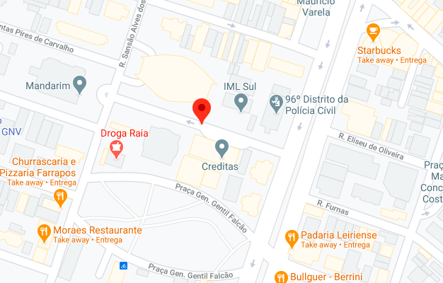
CA Cell Rua Irmã Gabriela, Cidade Monções, São Paulo Operator: Vivo
Vivo-Slide: 1

Slide 7
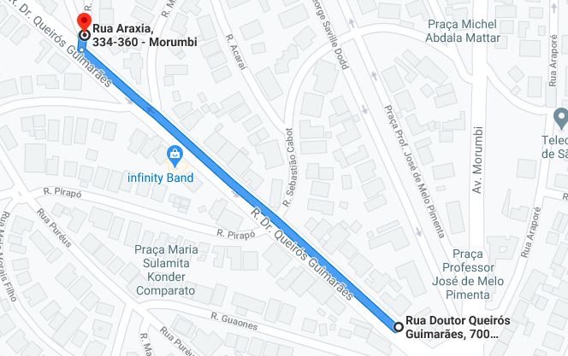
IRAT to 3G Location (From Rua Doutor Queirós Guimarães, 700 to Rua Doutor Queirós Guimarães, 334) Operator: Vivo
Vivo-Slide: 2

Slide 8
SRVCC to 3G (From Rua Doutor Queirós Guimarães, 700 to Rua Doutor Queirós Guimarães, 334)
Vivo-Slide: 3

Slide 9
Claro Operator
Drive Route – São Paulo(Brazil)

Slide 10
CA Location Rua Irmã Gabriela, Cidade Monções, São Paulo Operator: Claro
Claro-Slide-1

Slide 11
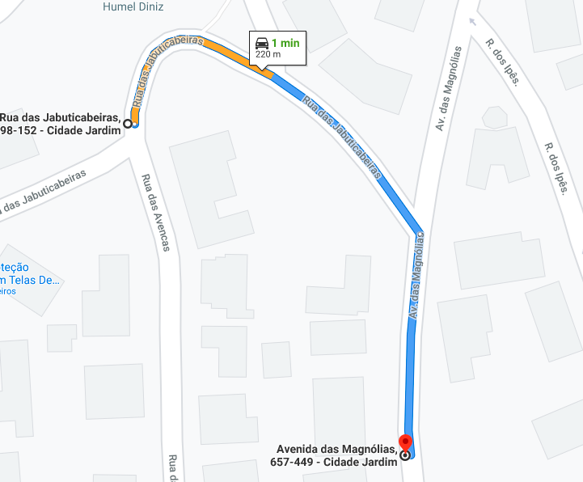
IRAT to 3G Location From Rua das Jabuticabeiras 98 to Avenida das Magnólias 585 Operator: Claro
Claro-Slide :2

Slide 12
SRVCC to 3G From Rua das Jabuticabeiras 98 to Avenida das Magnólias 585 Operator: Claro
Claro-Slide: 3

Slide 13
TIM Operator
Drive Route – São Paulo(Brazil)

Slide 14
CA Location Rua Irmã Gabriela, Cidade Monções, São Paulo Operator: TIM
TIM-Slide : 1

Slide 15
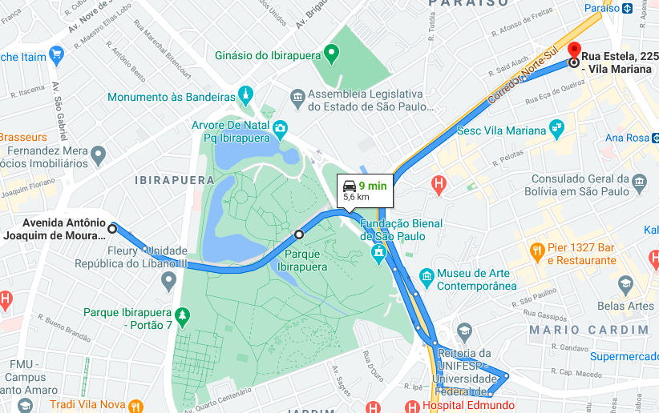
IRAT Location From Av. Antônio Joaquim de Moura Andrade 425, go thru the Túnel Ayrton Senna. Park on the last stop before the tunnel exit > Rua Estela 225 Operator: TIM
TIM-Slide : 2

Slide 16
SRVCC Location From Av. Antônio Joaquim de Moura Andrade 425, go thru the Túnel Ayrton Senna. Park on the last stop before the tunnel exit > Rua Estela 225 Operator: TIM
TIM-Slide: 3

Slide 17
THANK YOU
MARQUIS TECHNOLOGIES
www.marquistech.com

