Slide 1
MARQUIS TECHNOLOGIES
Drive Route – Belgrade (Serbia)

Slide 2
Travel to Cairo (Egypt)
Country | Serbia
Continent | Europe
City | Belgrade
Duration of travel from Bulgaria | Approx. 5 Hrs. by car
Time Zone | GMT +1
International Dialing Code | +381
VISA | Not Required
VISA Duration | Not Required
VISA Fees | Not Required
VISA Requirements | Not Required
Yellow Fever Vaccination Certificate | Not Required

Slide 3
Operator Information
MCC | MNC | Operator | Bands (MHz)
220 | 02 | VIP mobile | GSM 900 / 1800 / UMTS 2100
220 | 01 | Telenor | GSM 900 / 1800 / UMTS 2100
220 | 03 | MTS telecom | GSM 900 / 1800 / UMTS 2100

Slide 4
USSD Codes for operators
No. | Operator | Balance Check Code | Customer Care | Voice Mail No.
1 | VIP | * 128 # | Call 128 for Prepaid | 7777
2 | Telenor | *121# | Call 121 for Prepaid | 912
3 | MTS | *797# | Call 1234 for Prepaid | 1234

Slide 5
Manual APN Settings
Attached is a sheet which has Manual APN Settings for all operators in Belgrade (Serbia)

Slide 6
RSRP Criteria
Near Cell :-Stationary: RSRP : -55dbm to -85dbm
Cell Edge :-Stationary: RSRP : -95dbm to -110dbm
Mixed :-Mobility: RSRP : -55dbm to -120dbm

Slide 7
Services Supported by Operators
Operator | Features/Services | Supports(Yes/No)
VIP mobile | Reselection | Yes
 | Redirection | Yes
 | MMS | Yes
 | CSFB | Yes(3G)
 | VoLTE | YES
 | PS Handover | Yes
Telenor | Reselection | Yes
 | Redirection | Yes
 | MMS | Yes
 | CSFB | Yes(3G)
 | VoLTE | YES
 | PS Handover | Yes
MTS | Reselection | Yes
 | Redirection | Yes
 | MMS | Yes
 | CSFB | Yes(3G)
 | VoLTE | YES
 | PS Handover | Yes

Slide 8
Additional Information
Where to Get SIM cards?
Ušće Mall and
What Documents Required to Purchase SIM?
Passport ID.
Best Recharge Option for 8 days Testing?
Recharges are available in all confectionery shop.
Best Hotel to Stay
Belgrade city hotel
Driver Details for Mobility?

Slide 9
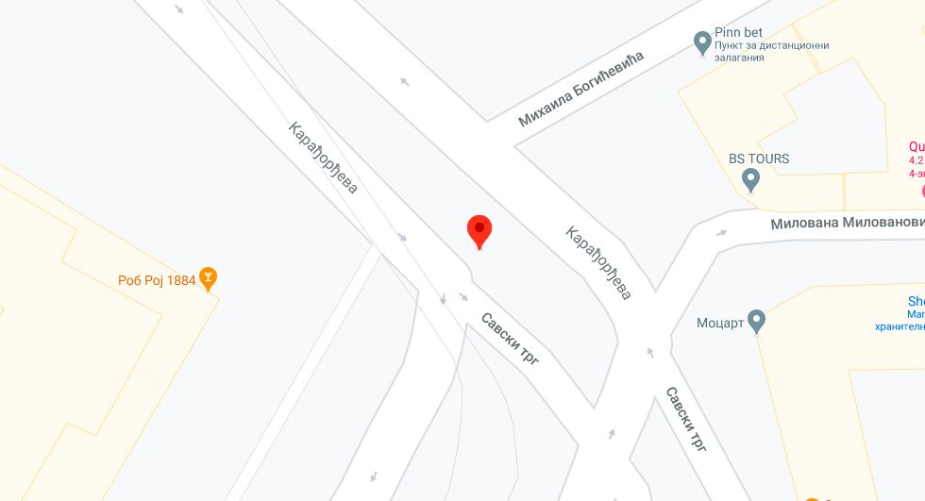
Near Cell Location of Telenor and VIP mobile Location :Near Belgrade city hotel Lat: 44°48'32.7 Long: EN 20°27'24.2

Slide 10
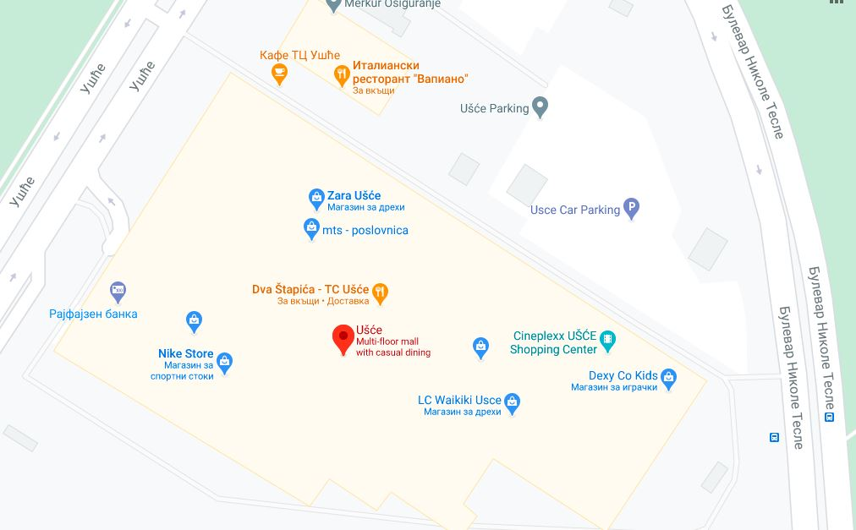
Edge Cell Location of MTS, Telenor and Vip Location : UŠĆE Shopping Center car parking Lat: 44°48'57.4"N Long: 20°26'14.5"E

Slide 11
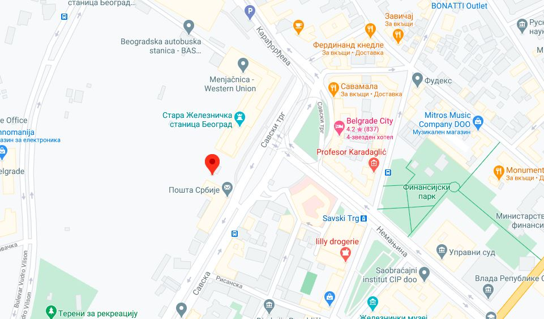
Edge Cell Location of MTS Location : Serbian poste Lat: 44°48'27.7"N Long: 20°27'17.9"E

Slide 12
Top Most Popular Android Apps used in belgrade
Facebook
Facebook Messenger
WhatsApp Messenger
Donesi
IUleci
Glovo
Linked in
Waze - GPS
Viber
Tik Tok

Slide 13
Local EM number used in Serbia
Police | 112
Traffic Police | 112
Tourist Police | 112
Ambulance | 112
Fire Bridge | 112

Slide 14
THANK YOU
MARQUIS TECHNOLOGIES
www.marquistech.com

