Slide 1
MARQUIS TECHNOLOGIES
Drive Route

Slide 2
Agartala/India
Operator Details:
S. No. | Operator |  | Supported Bands | Supported Features by Network
1 | Major | Airtel | LTE FDD B1/B3/B8 & TDD B40/N78 | VoWiFi/VoLTE/4G/2G/5G
2 |  | JIO | LTE FDD B3/B5 & TDD B40/N78/N28 | VoWiFi/VoLTE/4G/5G
3 |  | VI | LTE FDD B3/B8 & TDD B41/N78 | VoWiFi/VoLTE/4G/3G/2G/5G
4 | Minor | BSNL | LTE FDD B1 | VOLTE/4G/3G/2G

Slide 3
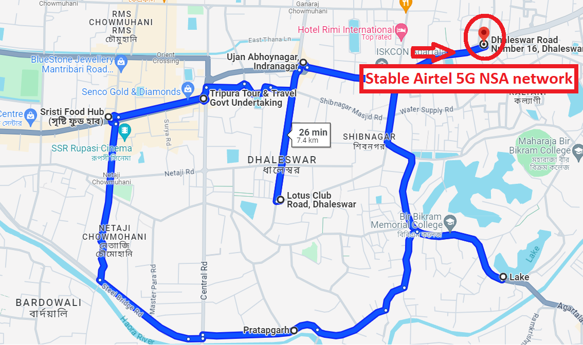
5G Near Cell,Airtel
Lat/Long 23.832302, 91.294648
Specification –Stable Airtel 5G NSA network
Good Throughput

Slide 4
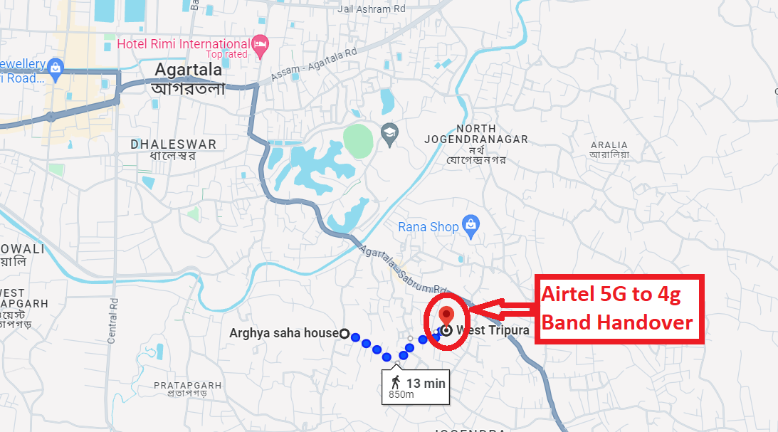
NR to LTE Handover ,Airtel
Lat/Long 23.817708, 91.302248 Specification –Band Handover ,Weak coverage

Slide 5
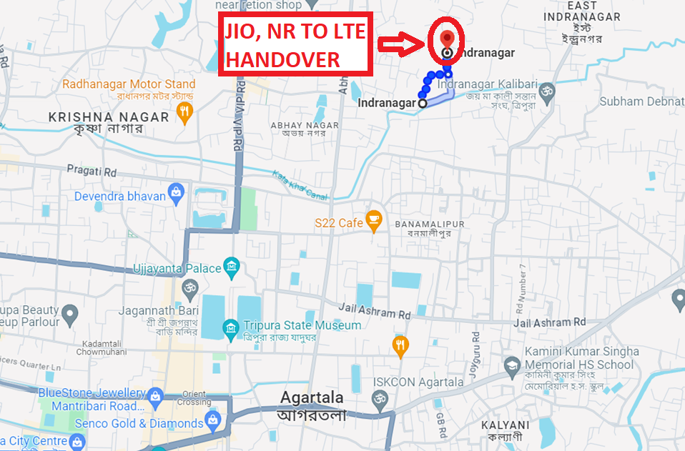
NR to LTE Handover ,JIO
Lat/Long 23.847555, 91.293605
Specification –Band Handover

Slide 6
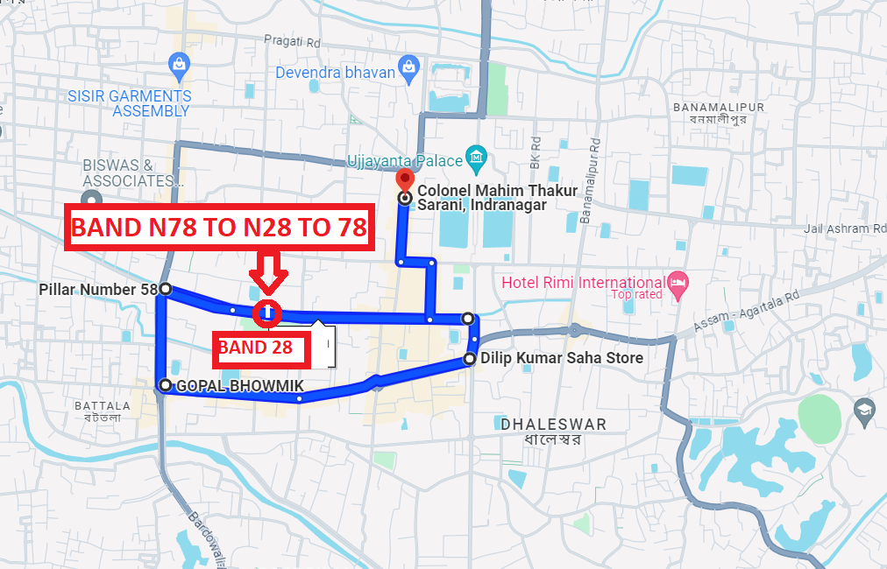
Inter-freq HO on NR ,JIO (n78-n28-n78)
Lat, Long -23.832026, 91.274523 Location -TRIPURA INTER OFFICE SPORTS

Slide 7
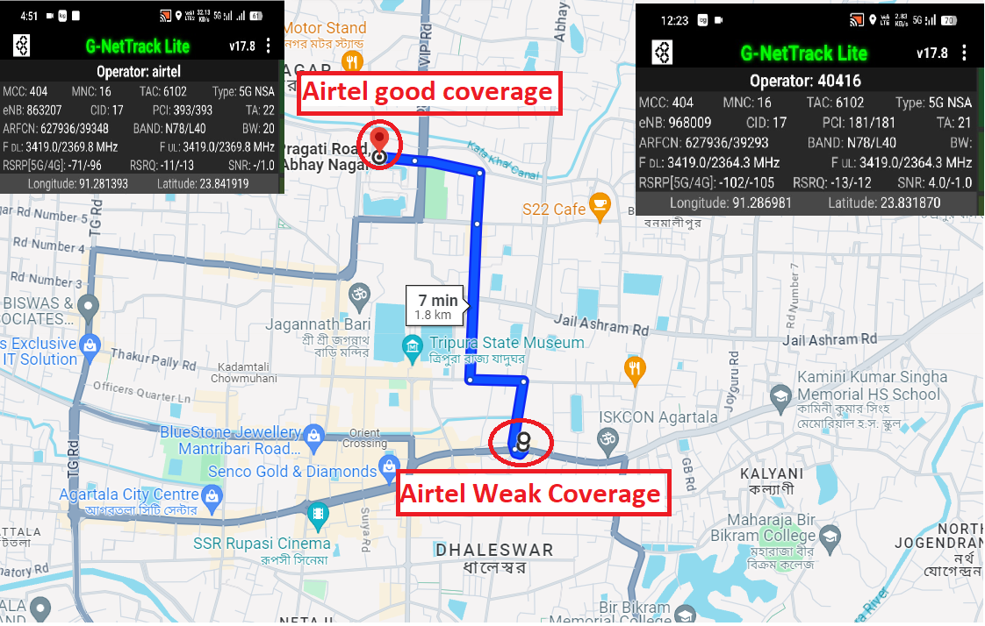
Airtel Weak and good coverage Good coverage Lat, Long -23.832026, 91.281393 Weak coverage Lat, Long -23.831870, 91.286981

Slide 8
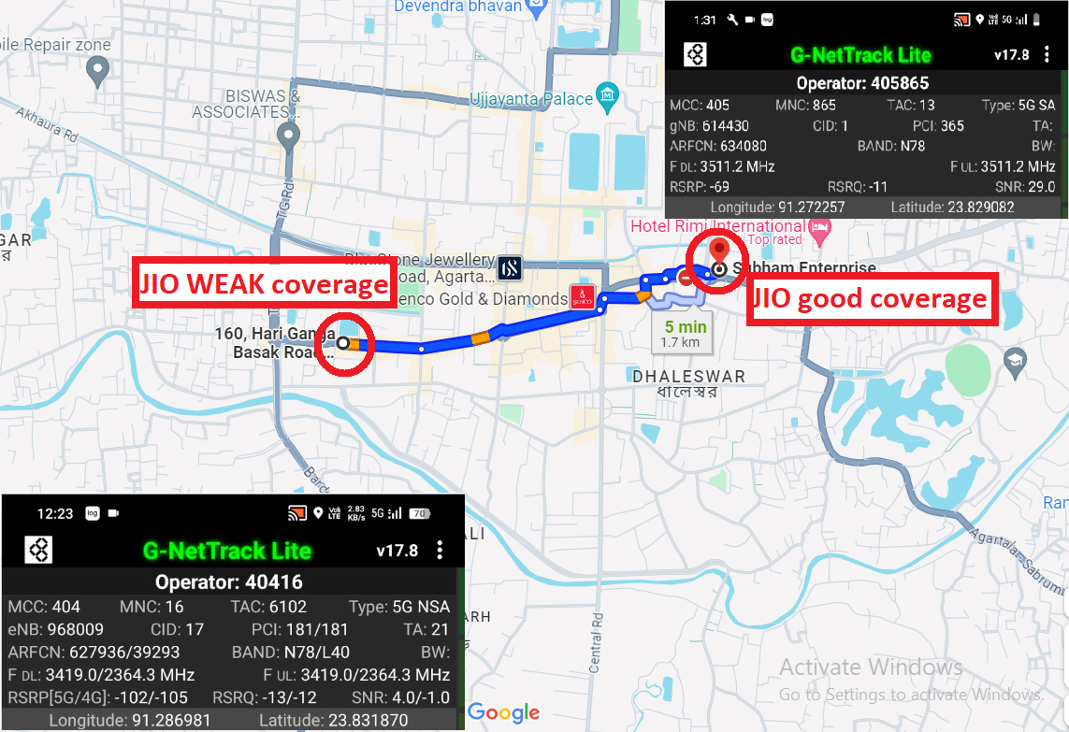
JIO Weak and good coverage Good coverage Lat, Long -23.829082, 91.272257 Weak coverage Lat, Long -23.831746, 91.287155

Slide 9
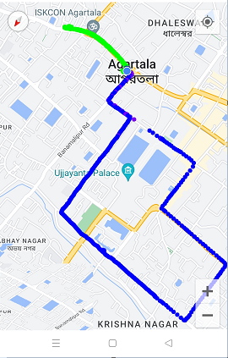
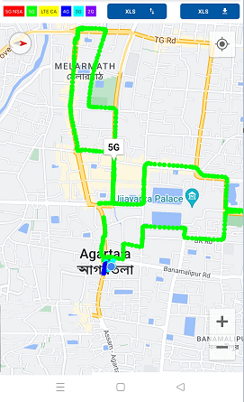
Drive Route

Slide 10
THANK YOU
MARQUIS TECHNOLOGIES
www.marquistech.com

