Slide 1
MARQUIS TECHNOLOGIES
Drive Route & Features tested
In COLONGE ,germany.

Slide 2
Operator Details:
S. No. | Operator |  | Supported Bands | Supported Features by Network
1 | Major | TMO | N78,N28,N1 | VoWiFi/VoLTE/4G/2G/5G

Slide 3
IMPORTANT FEATURES TESTED - TMO OPERATOR
Performance test cases related to data and data for TMO OPERATOR for N78_N28_N1 – SA/NSA .
The testing Area is Subbelrather strasse 14, 50823 colonge
, where the Main antenna has been installed.
Infra-Vendor used is Nokia .
Maximum speed attained was 1400/210 in RSRP< -62.

Slide 4
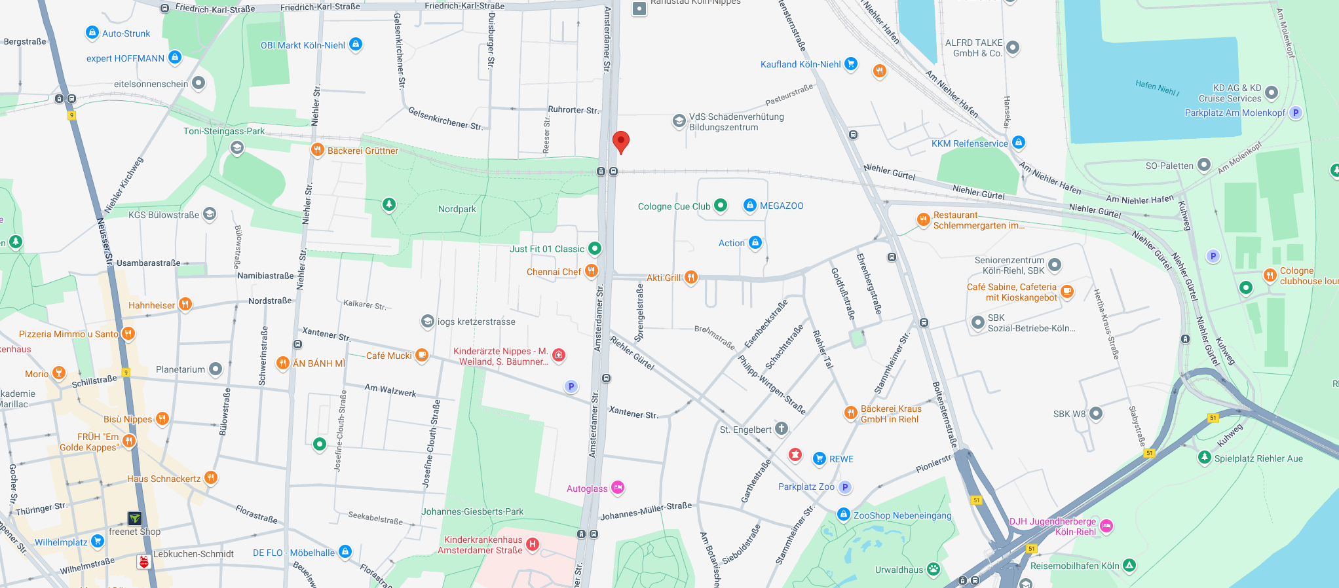
SA Near cell location with features available -
Subbelrather Strasse 14
Notes:
MOBILITY SITES ARE THESE

Slide 5
Information of PCI with supported Bands-
NE Name | Frequency Band | Physical Cell ID
OX201 | N78_N28_N1 | 437,438, 439

Slide 6
Testing Details – TMO Operator
The band combination present at N78+N28+N1 – SA COMBINATION.
We tested Performance Bidirectional, DL,UL,Ping,Speedtest test cases.
We tested kobuk sdx85 cpe and our main focus was on performance test cases.

Slide 7
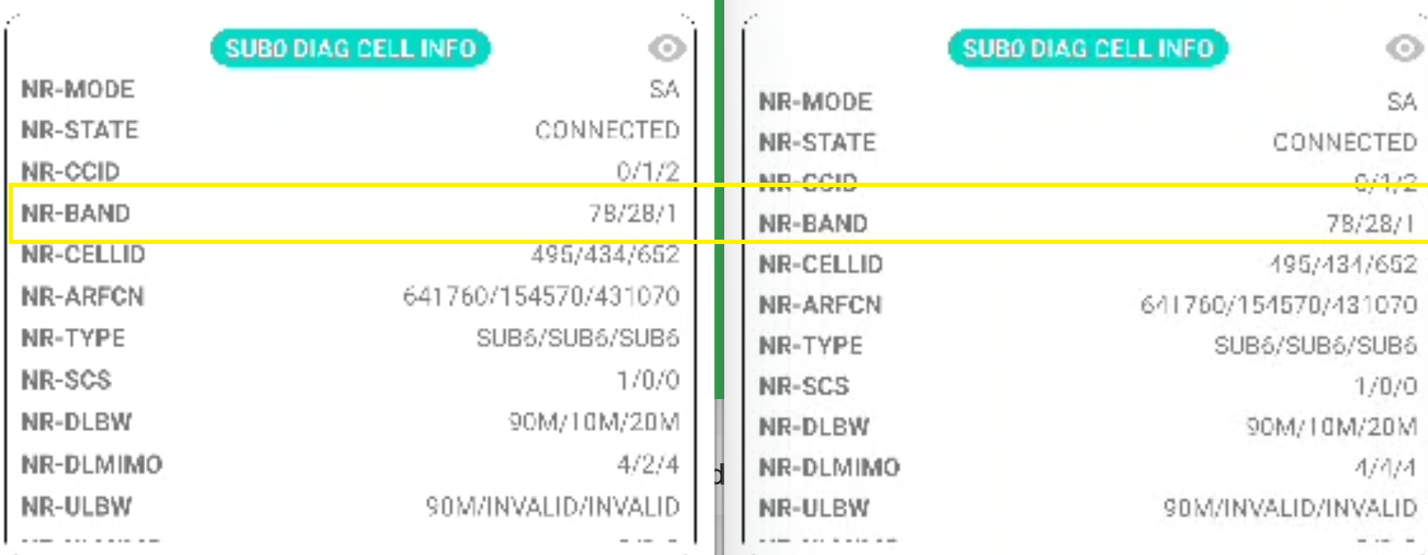
Band Details during Testing_N78+N28+N1

Slide 8
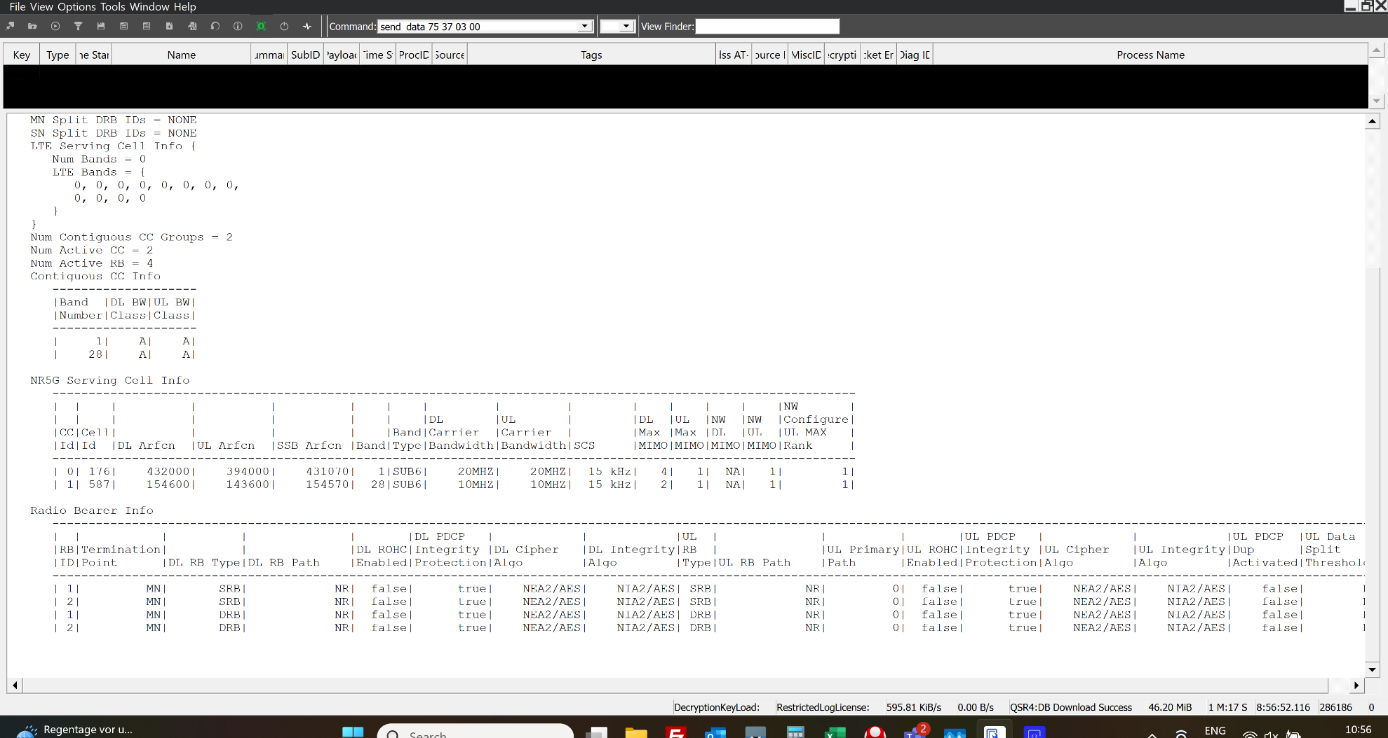
Band Details during Testing_N1+N28 for F+F ULCA

Slide 9
THANK YOU
MARQUIS TECHNOLOGIES
www.marquistech.com

