Slide 1
MARQUIS TECHNOLOGIES
5G Drive Route of RIYADH(Saudi Arabia)

Slide 2
Operator Information
MCC | MNC | Operator | Bands (MHz)
420 | 03 | MOBILY | GSM 900, W-CDMA 900/2100, LTE B1/B3/B20/B41, NR- B41
420 | 04 | ZAIN | GSM 900, W-CDMA 2100, LTE B1 /B3/B8/B20/B41, NR B3 & B78
420 | 01 | STC | GSM 900, W-CDMA 900/2100, LTEB1/B3/B7/B28/B40, NR B1, B3, B28, B78

Slide 3
Services Supported by Operators
Operator | Features/Services | Supports(Yes/No)
Zain | 5G | Yes
 | VoLTE | Yes
 | VoWiFi | Yes
 | Reselection | Yes
 | Redirection | Yes
 | MMS | Yes
 | CSFB | Yes
 | PS Handover | Yes
STC | 5G | Yes
 | VoLTE | Yes
 | VoWiFi | Yes
 | Reselection | Yes
 | Redirection | Yes
 | MMS | Yes
 | CSFB | Yes
 | PS Handover | Yes
MOBILY | 5G | Yes
 | VoLTE | Yes
 | VoWiFi | Yes
 | Reselection | Yes
 | Redirection | Yes
 | MMS | Yes
 | CSFB | Yes
 | PS Handover | Yes

Slide 4
RSRP Criteria
Near Cell :-Stationary: RSRP : -55dbM to -75dbm
Cell Edge :-Stationary: RSRP : -90dbM to -105dbM
Mixed :-Mobility: RSRP : -55dbM to -120dbM

Slide 5
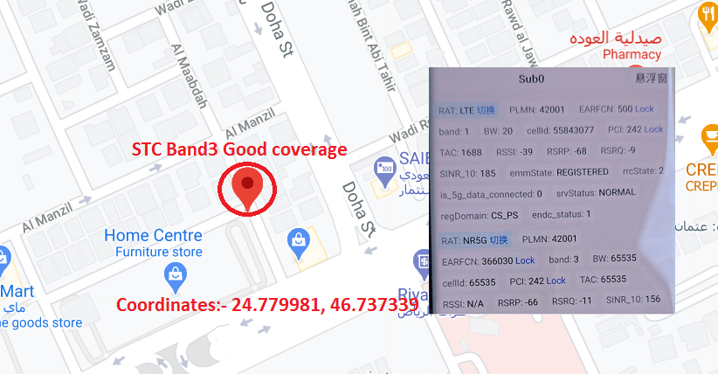
STC 5G Band-3 Good Coverage : Near Home Center Furniture Store, Al Maabdah, Riyadh 11564.

Slide 6
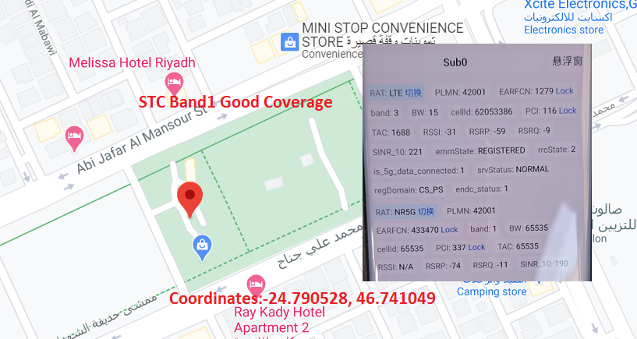
STC 5G Band-1 Good Coverage : Ash Shuhada, Ghirnatah, Riyadh 13241, Saudi Arabia.

Slide 7
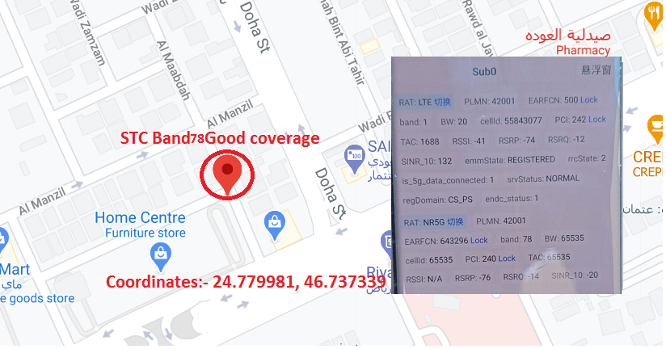
STC 5G Band-78 Good Coverage : Near Home Center Furniture Store, Al Maabdah, Riyadh 11564.

Slide 8
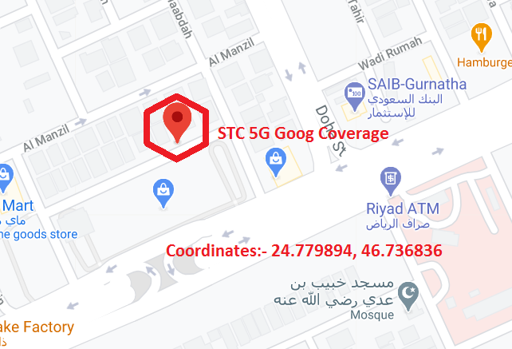
STC 5G Band-78 Good Coverage : 3474 111 Street - Gharnatah, Riyadh 13241.

Slide 9
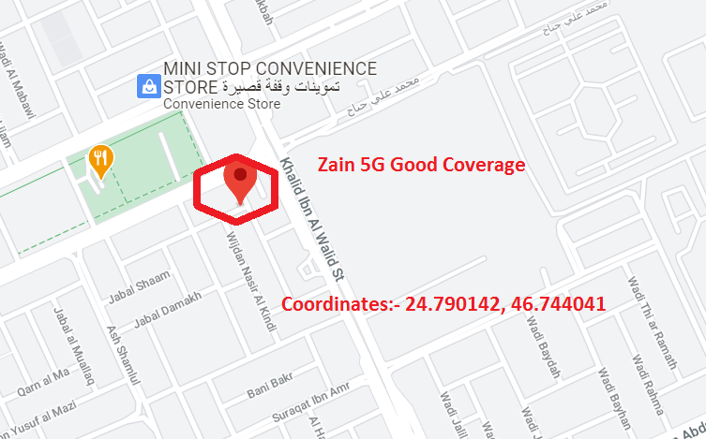
Zain 5G Band-41 Good Coverage : 7576 Omar Waleed Al Dhaher Street, Riyadh 13241.

Slide 10
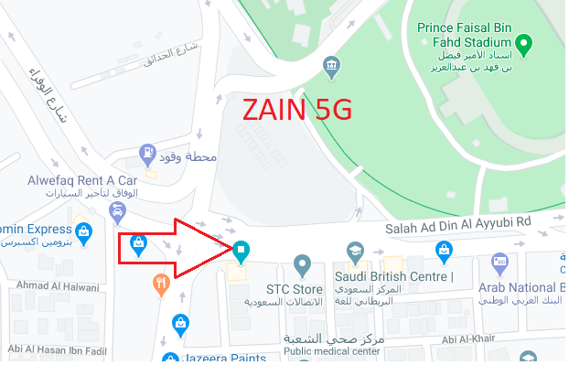
Zain 5G Band3 Good coverage: 2341 Salah Ad Din Al Ayyubi Rd, Al Malaz, Riyadh 12841.
Operator: ZAIN (B3 )
PCI: 152
RSRP: -65dBm to -80dBm
Lat:24.660429
Long:46.736718

Slide 11
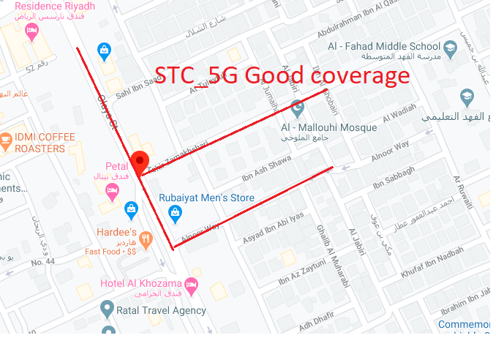
For STC Near Cell : Olaya St, As Sulimaniyah, Riyadh 12222
Operator: STC (B3)
PCI: 191
RSRP: -55dBm to -75dBm
Lat: 24.694091
Long: 46.685543

Slide 12
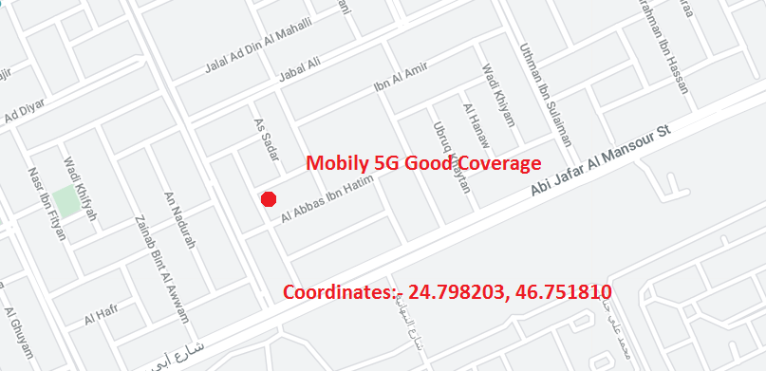
Mobily 5G Band-78 Good Coverage : Park Hyatt Jeddah – Marina, Club and Spa Resort, Riyadh:-

Slide 13
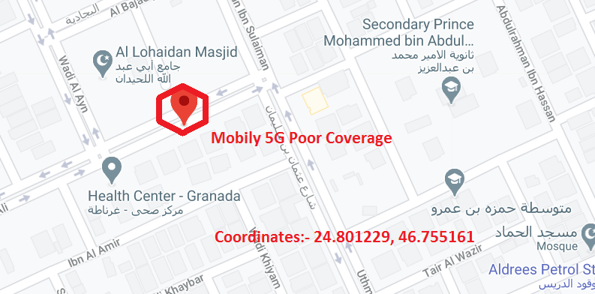
Mobily 5G Band-78 Poor Coverage : Jabal Ali Street- Gharnatah, Riyadh 13242.

Slide 14
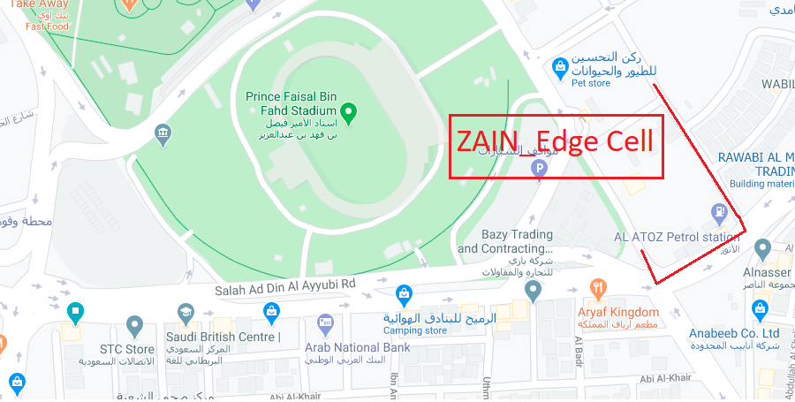
ZAIN (Edge Cell):-6175 Al Ameen Abdullah Al Ali Al Naeem Street, Al Malaz
Operator: ZAIN(B3)
RSRP: -85 dbM to -95dbM
Lat: 24.662423
Long: 46.742651

Slide 15
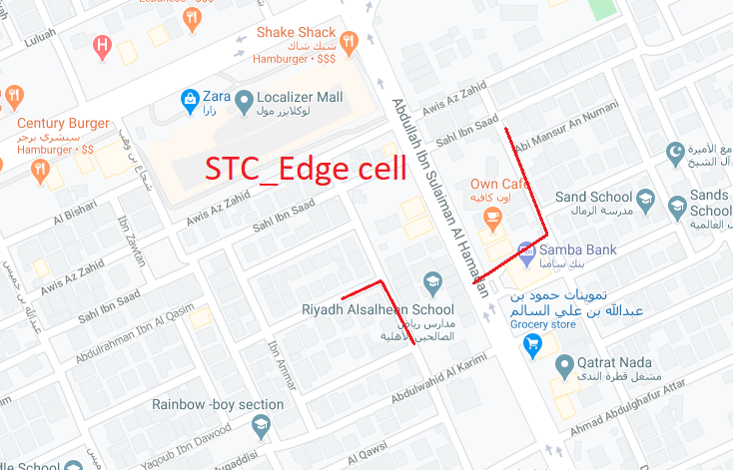
STC (Edge Cell):-7967-7987 Ibn Al Hafidh,As Sulimaniyah, Riyadh 12222
Operator: STC (B3)
RSRP: -85 dbM to -95dbM
Lat: 24.697493
Long: 46.693063

Slide 16
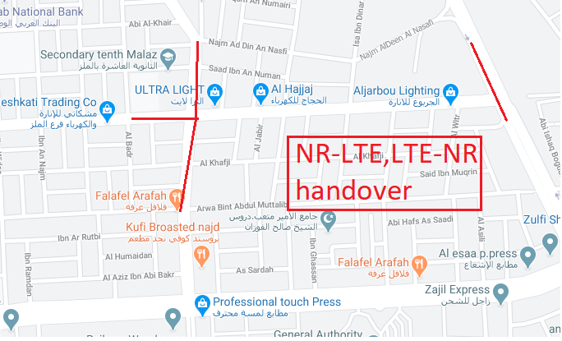
NR-LTE & LTE NR Handover (5G > 4G > 4G>5G Handover Area:: For ZAIN) (3845 Prince Abdul Muhsin Bin Abdulaziz Rd, Al Malaz, Riyadh 12842)

Slide 17
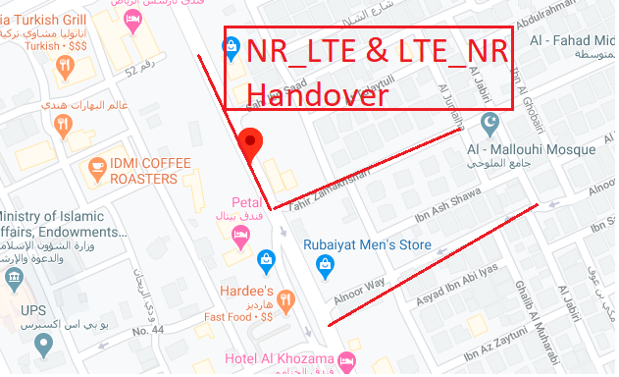
NR-LTE & LTE NR Handover (5G > 4G > 4G>5G Handover Area:: For STC) (Olaya St, As Sulimaniyah, Riyadh 12222)

Slide 18
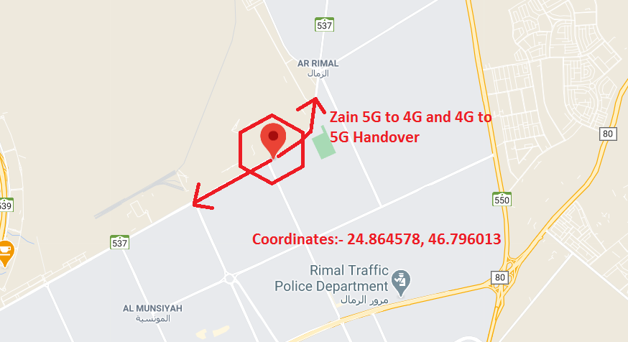
NR-LTE to LTE and LTE to NR-LTE:- 2156, Wadi Qadeem Street – Al Remal, Riyadh 13266(Zain Operator)

Slide 19
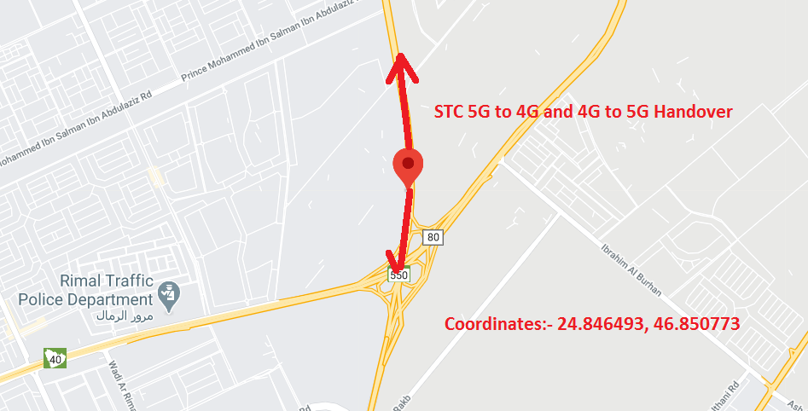
NR-LTE to LTE and LTE to NR-LTE:- 7347, Al Janadriya Road – Al Remal, Riyadh 13264(STC Operator)

Slide 20
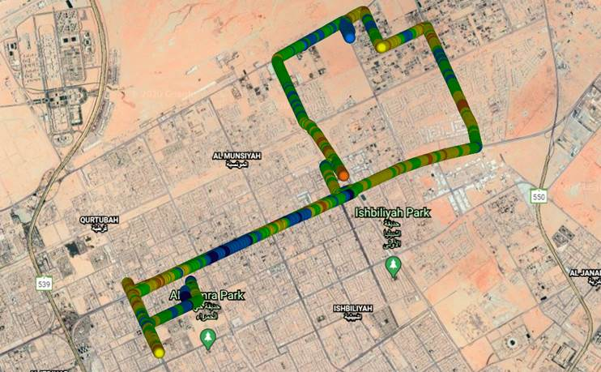
STC/Zain/Mobily- 5G Network Mixed coverage Route:-

Slide 21
THANK YOU
MARQUIS TECHNOLOGIES
www.marquistech.com

