Slide 1
MARQUIS TECHNOLOGIES
Drive Routes - Johannesburg/South Africa

Slide 2
Johannesburg (South Africa)
Country | South Africa
Continent | Africa
City | Johannesburg
Time Zone | GMT +2 Hour
International Dialing Code | +27

Slide 3
Operators in South Africa
MCC | MNC | Operator | Bands (MHz)
655 | 10 | MTN | GSM: 900, 1800 WCDMA: B1, B8 LTE: B1/3/7/8/20/28， B38/41 5G NR: Band 78, Band1
655 | 01 | Vodacom | GSM: 900, 1800 WCDMA: B1, B8 LTE: B1/3/8, B38 5G NR: Band 78
655 | 02 | Telkom | GSM: 900（roaming in Vodacom）, 1800 WCDMA: B1, B8 LTE: B1/3, B40
655 | 05 | Cell C | GSM: 900, 1800 WCDMA: B1, B8 LTE: B1/3

Slide 4
Operators and Related Information
MTN- Supports 5G(NSA), VoLTE, VoWifi, LTE, WCDMA and 2G
Vodacom- Supports 5G(NSA), VoLTE, VoWifi, LTE, WCDMA and 2G
Telkom- Supports VoLTE, VoWifi, LTE, WCDMA and 2G
Cell C- Supports VoWifi, LTE, WCDMA and 2G

Slide 5
USSD codes for balance check
MTN balance check: *136#
Vodacom balance check: *135#
Telkom balance check: *188#
Cell C balance check: *101#, *147#

Slide 6
RSRP Criteria
Near Cell :-Stationary: RSRP : -55dbm to -85dbm
Cell Edge :-Stationary: RSRP : -95dbm to -110dbm
Mixed :-Mobility: RSRP : -55dbm to -120dbm

Slide 7
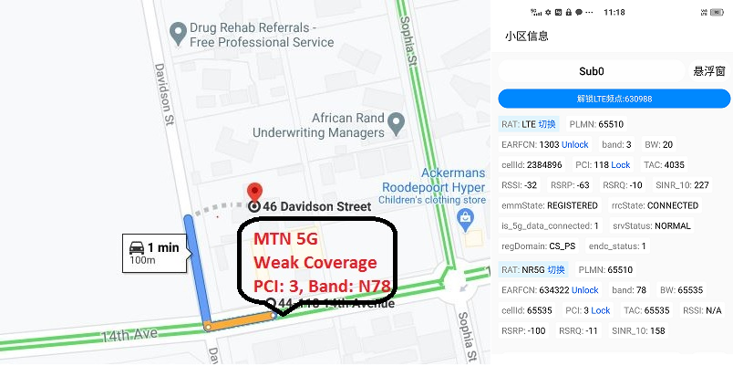
5G Spot for MTN operator:

Slide 8
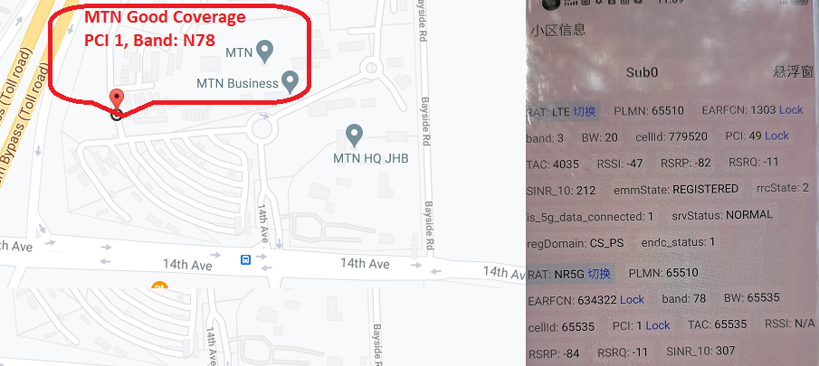
5G Spot for MTN operator:

Slide 9
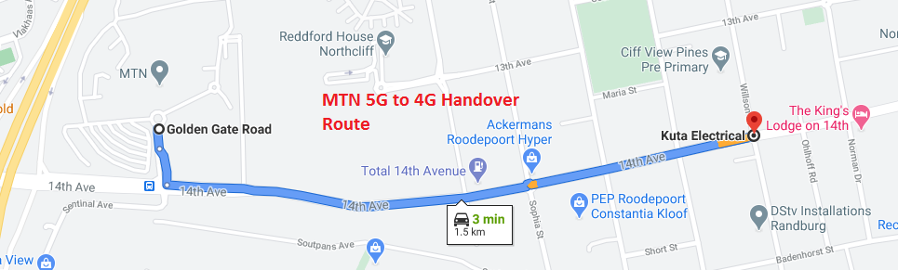
MTN 5G to 4G Handover Route:

Slide 10
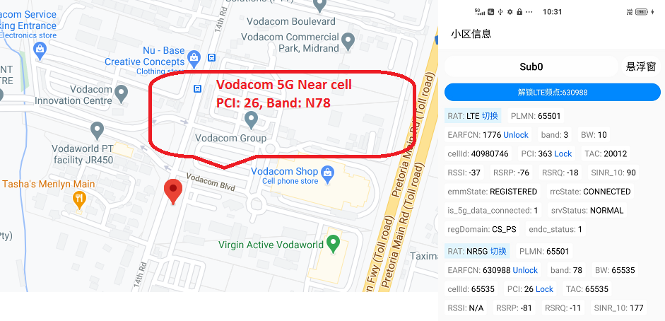
5G Spot for Vodacom operator:

Slide 11
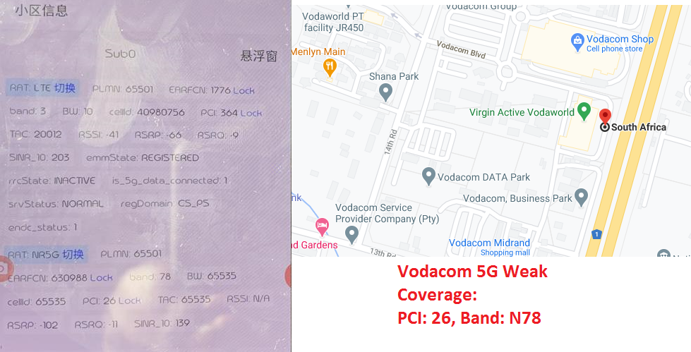
5G Spot for Vodacom operator:

Slide 12
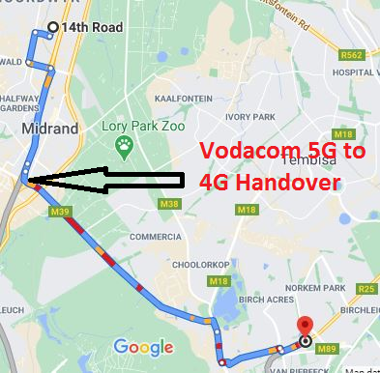
Vodacom 5G to 4G Handover point:

Slide 13
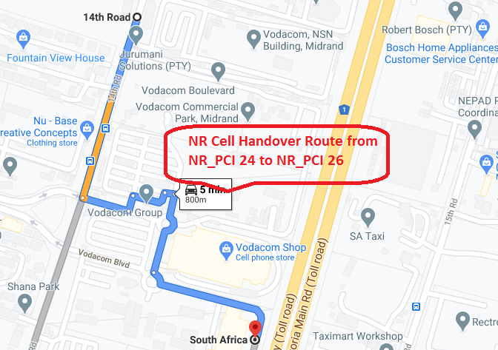
Vodacom NR Cell Handover Route:

Slide 14
Thank You

