Slide 1
MARQUISTECH
NR 5G Test location- Seoul, south korea

Slide 2
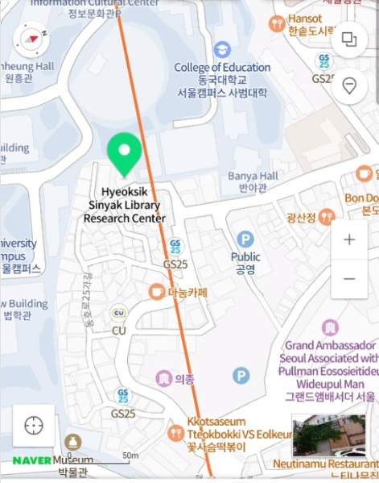
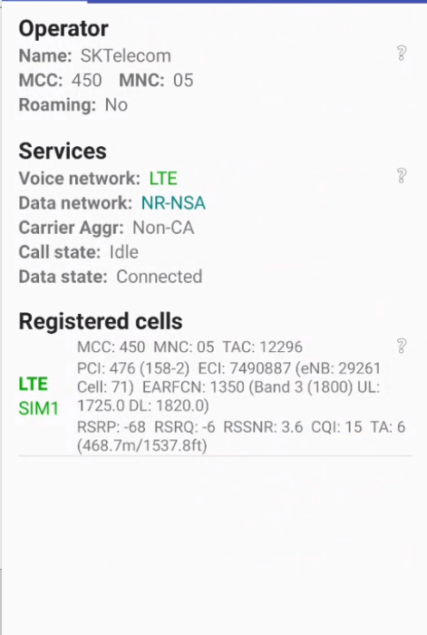
5G NR Location (Good Coverage)
SKT Location (NR-RSRP -60dBm ~ -75dBm)
Dongho ro, 25ga-gil, Jung-gu

Slide 3
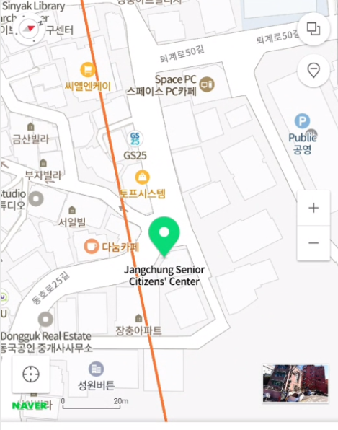
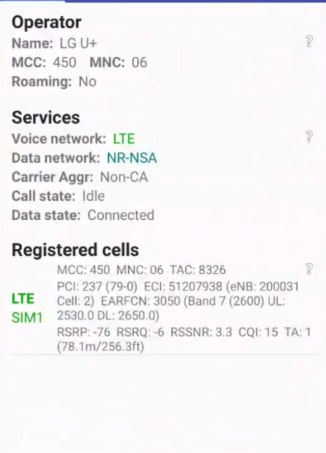
5G NR Location (Good Coverage)
LG U+ Location (NR-RSRP -60dBm ~ -75dBm)
Location- 38, Dongho ro, 25ga-gil, Jung-gu

Slide 4
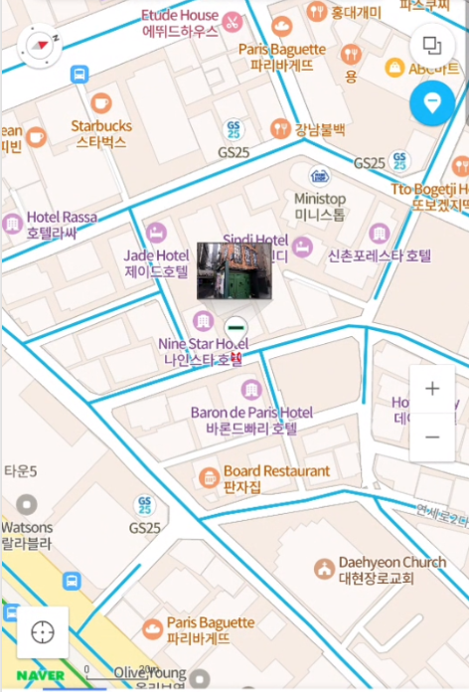
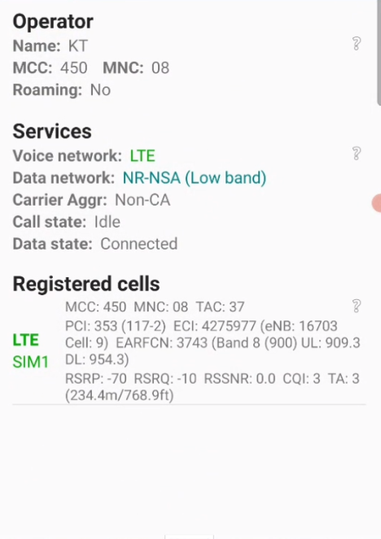
5G NR Location (Good Coverage)
KT Location (NR-RSRP -60dBm ~ -75dBm)
Location- 38, Sinchon, Yonsei- ro, Seodaemun-gu

Slide 5
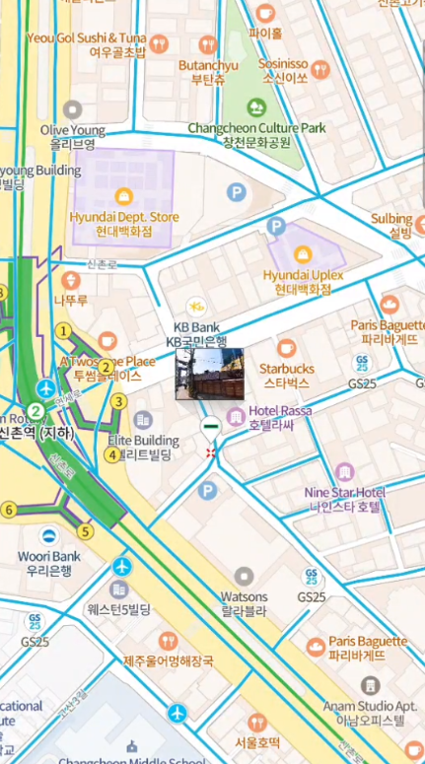
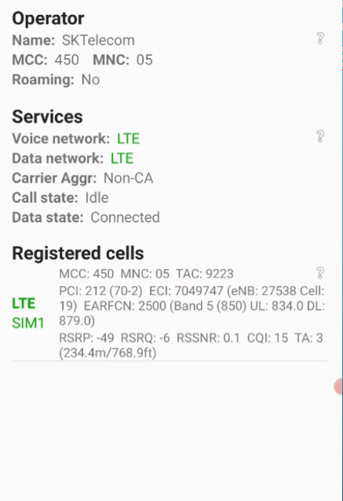
4G NR Location (Good Coverage)
SKT Location (NR-RSRP -60dBm ~ -75dBm)
Location- 38, Sinchon, Yonsei- ro, Seodaemun-gu

Slide 6
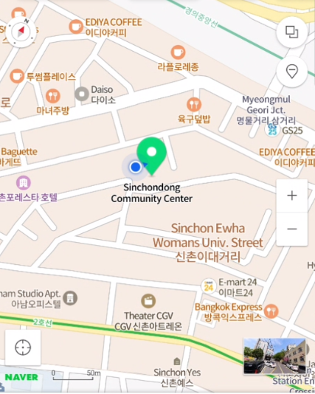
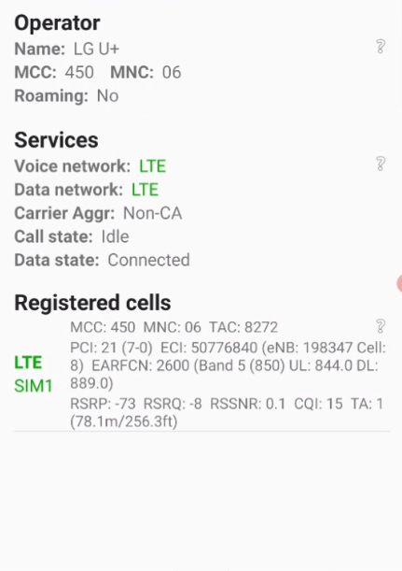
4G NR Location (Good Coverage)
LG U+ Location (NR-RSRP -60dBm ~ -75dBm)
Location- Changcheon dong, Yonsei- ro, Seodaemun-gu, Seoul

Slide 7
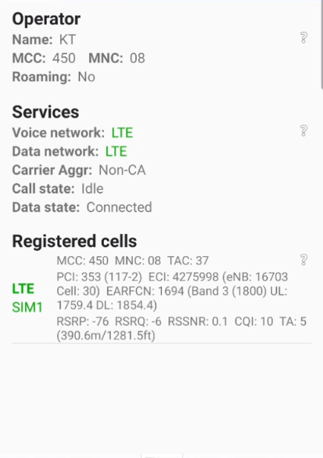
4G NR Location (Good Coverage)
KT Location (NR-RSRP -60dBm ~ -75dBm)
Location- Changcheon dong, Yonsei- ro, Seodaemun-gu, Seoul

Slide 8
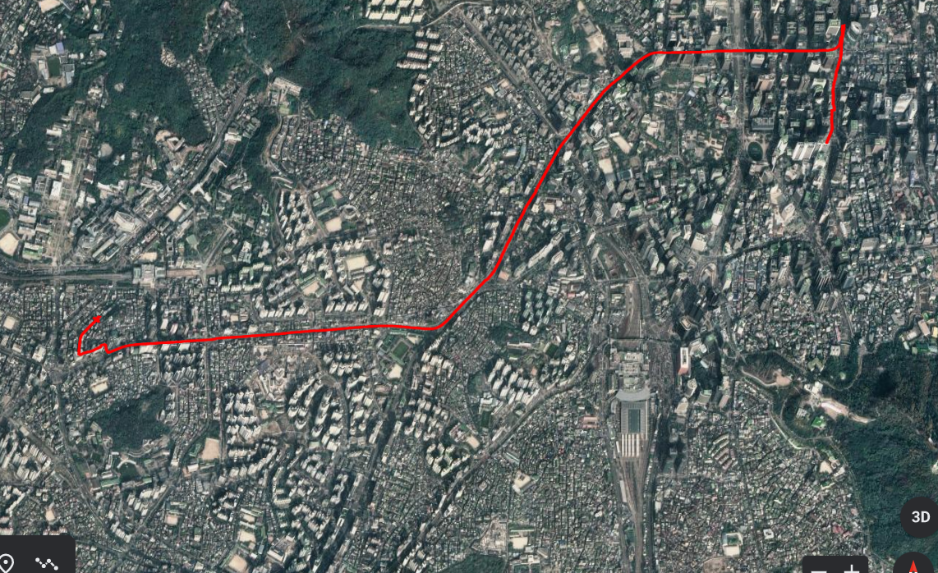
5G NR Browsing for Kt
Location- Sinchon to dondaemun route

Slide 9
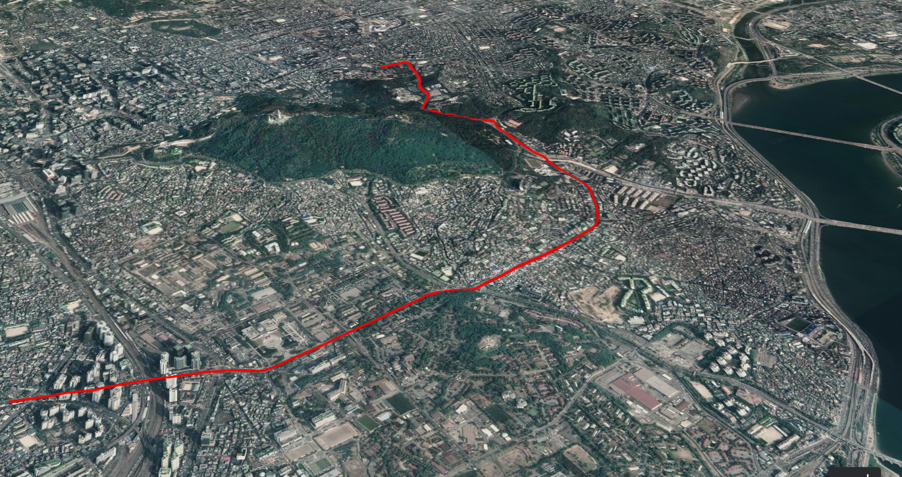
LTE handover for kt location- near namsan tunnel

Slide 10
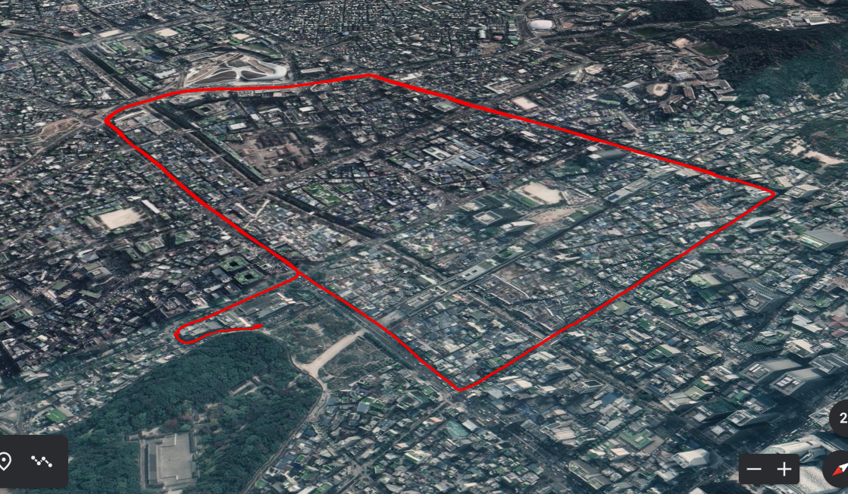
LG U+ browsing location- chungmuro to dongdaemun

Slide 11
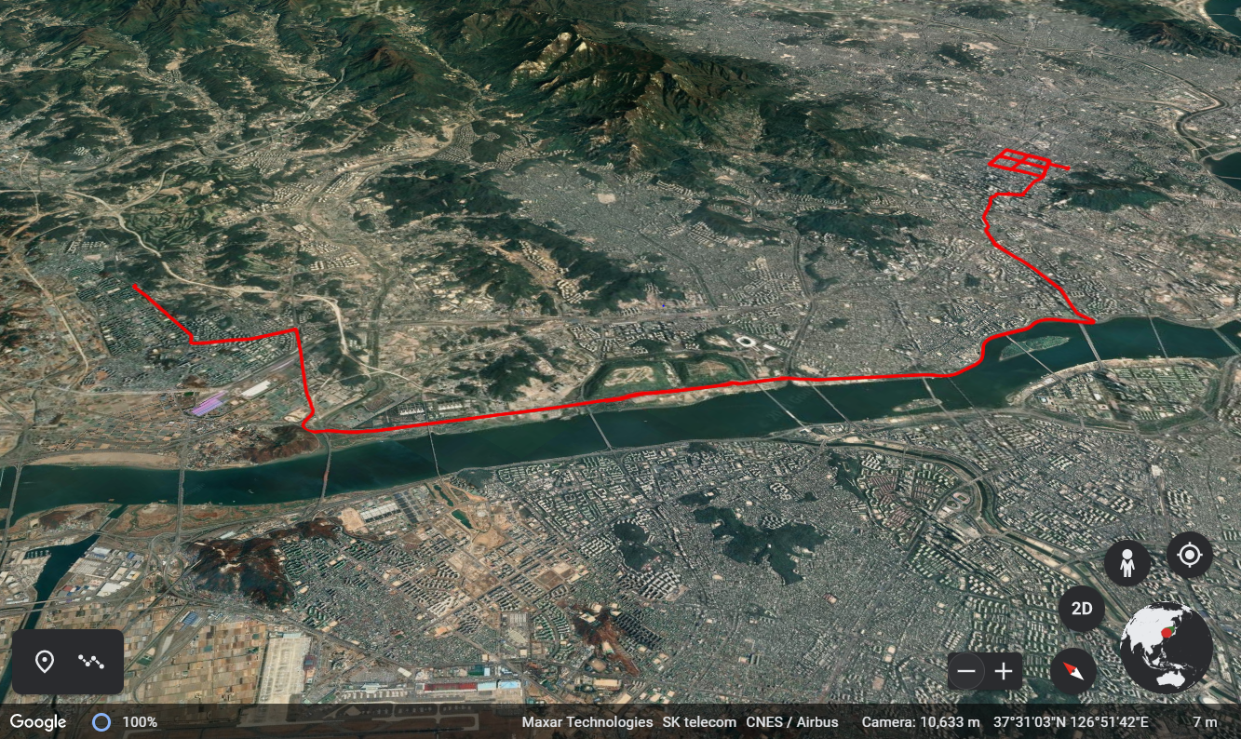
LG U+ LTE handover location- near han river highway

Slide 12
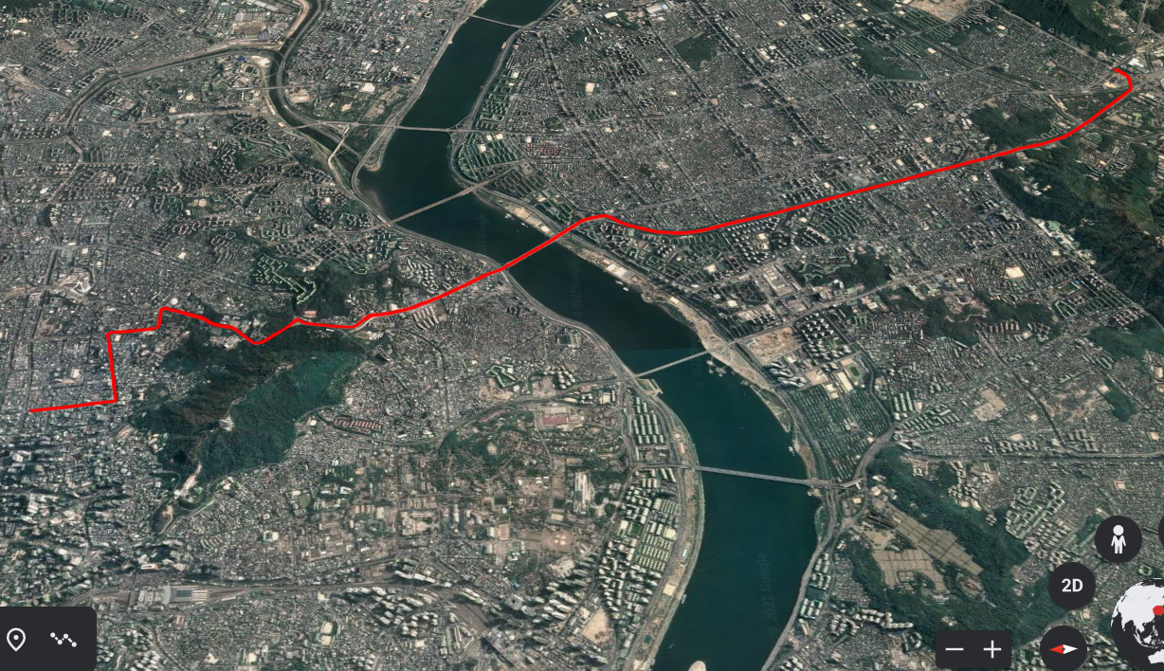
Skt lte handover
Location- near bampo bridge

Slide 13
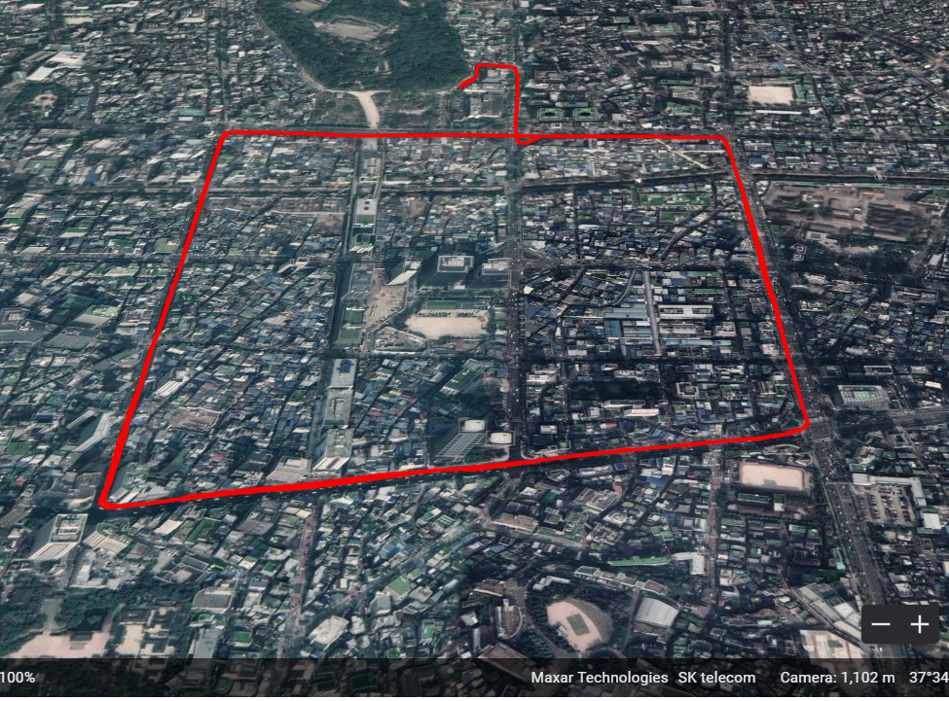
Skt browsing location- chungmur0 to dongdaemun

Slide 14
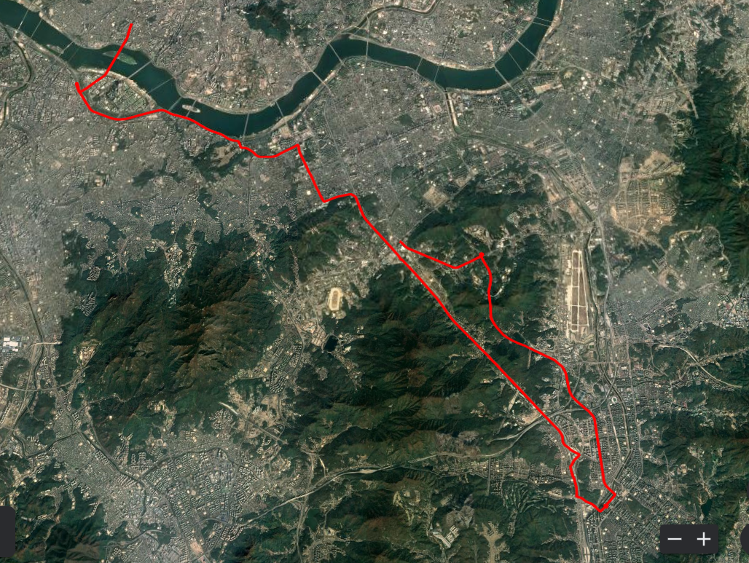
Mo Volte call for skt, kt and lg u+ location- bundang to seoul route

Slide 15
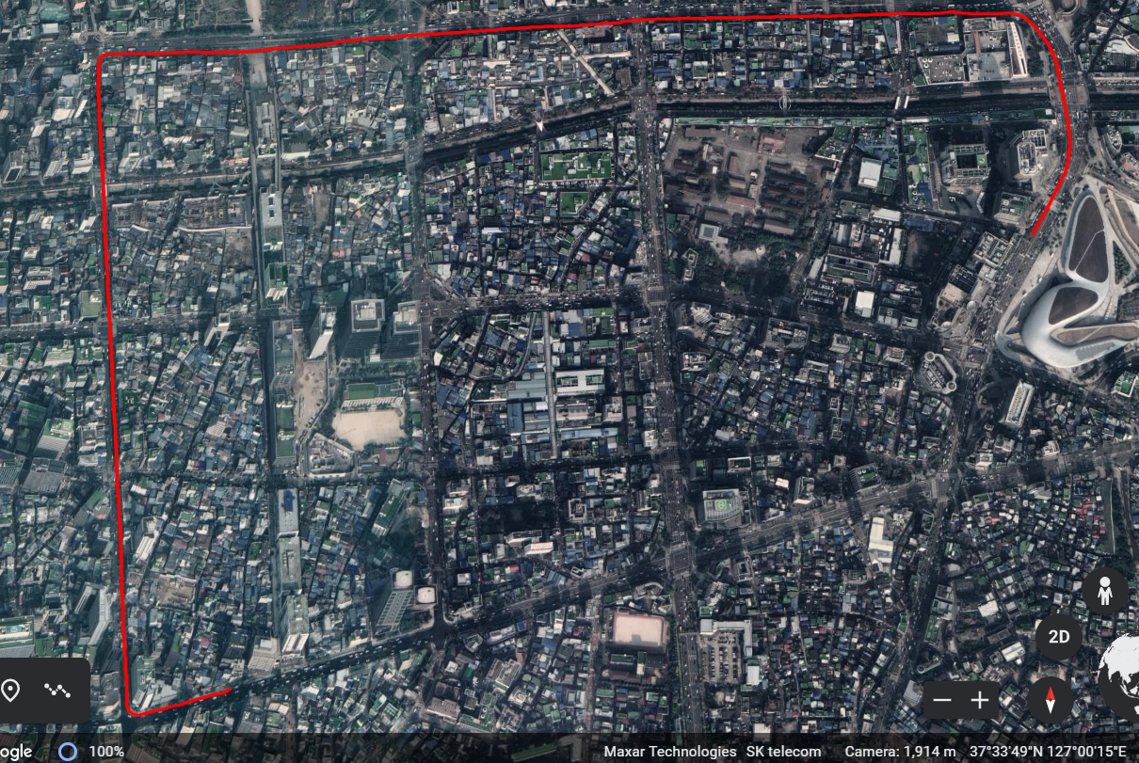
MO non volte call for skt location- dongdaemun to myeongdong

Slide 16
Thank you
pundalik D. walke

